Slide 1


Slide 3
Write the numbers in words.
1) 26
2) 15
3) 89
4) 34

Slide 4
Write the numbers in words.
1) 26
2) 15
3) 89
4) 34
twenty-six
fifteen
eighty-nine
thirty-four

Slide 6
Write the number in digits and words.
Four hundred and twenty-five
425

Slide 7


Write the number in numerals and words.
215
The number is two hundred and fifty.
The number is two hundred and fifteen.
Who is right?

Slide 9
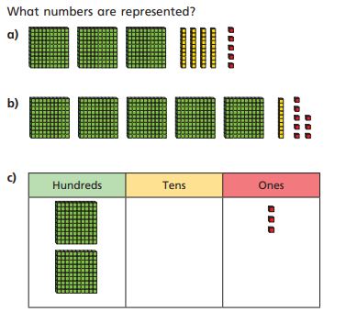

Slide 10
345
518
203

Slide 11
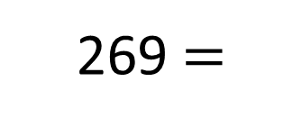
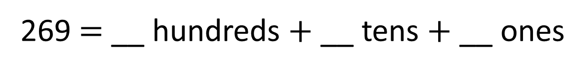


Complete the sentences.
2
6
9
269 $=$ __ hundreds $+$ __ tens $+$ __ ones
$$+$$
$$+$$
269 $=$
200
60
9

Slide 12

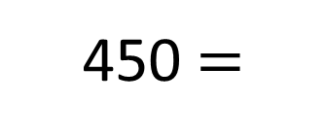

Complete the sentences.
4
5
0
450 $=$ __ hundreds $+$ __ tens $+$ __ ones
$$+$$
450 $=$
400
50

Slide 14
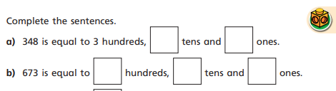
** teacher to fill in with class**
**children to say sentences out loud.**

Slide 15

** teacher to fill in with class**
**children to say sentences out loud.**

Slide 16
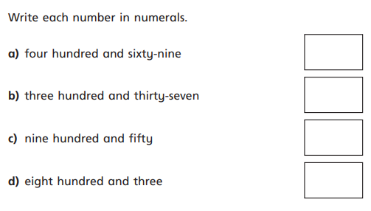
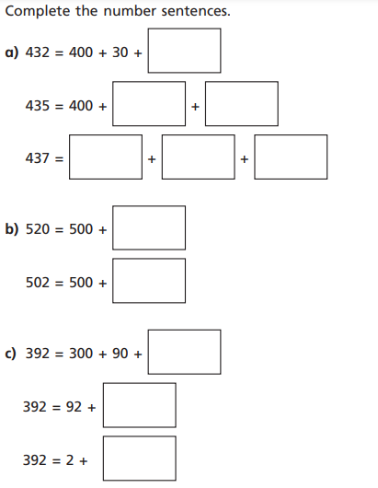
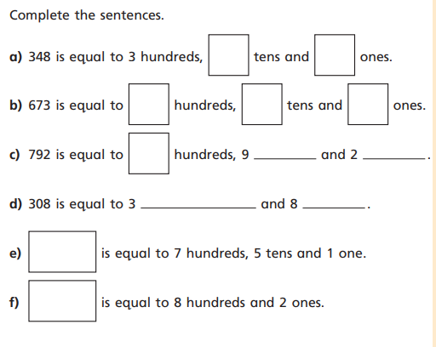
Task

