Slide 1


Slide 3
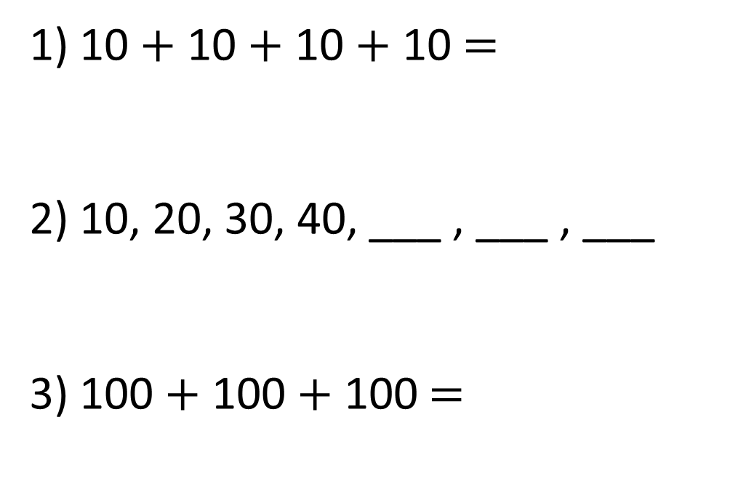
1) 10 $+$ 10 $+$ 10 $+$ 10 $=$
2) 10, 20, 30, 40, ___ , ___ , ___
3) 100 $+$ 100 $+$ 100 $=$

Slide 4
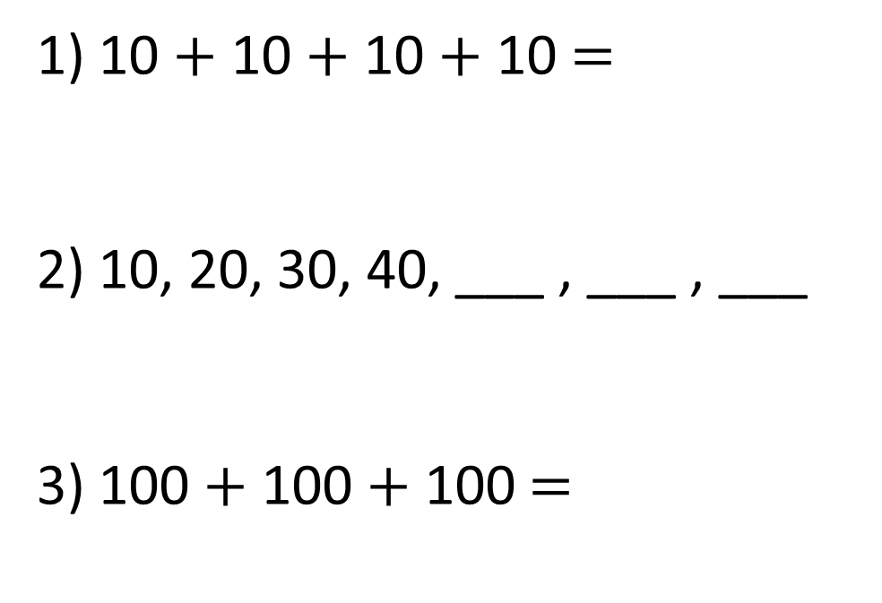
1) 10 $+$ 10 $+$ 10 $+$ 10 $=$
2) 10, 20, 30, 40, ___ , ___ , ___
3) 100 $+$ 100 $+$ 100 $=$
40
50
60
70
300

Slide 6



How many sweets are there altogether?
3
6
4
There are 364 sweets.

Slide 7
How many sweets are there altogether?
6
0
5
There are 605 sweets.

Slide 8
Have a go at questions 1 – 3 on the worksheet

Slide 9
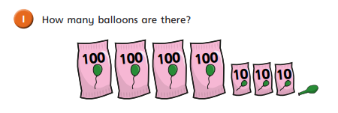
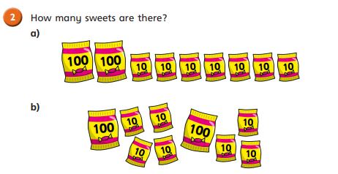


Slide 10
There are 431 balloons
There are 270 sweets
There are 270 sweets
Same number of sweets, but laid out differently.

Slide 11
What number has been made?
2
5
8

Slide 12
What number has been made?
3
4
7

Slide 13
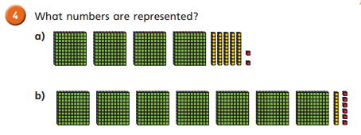

Slide 14
442
716

Slide 15
What number has been made?
2
2
1
12
8

Slide 16
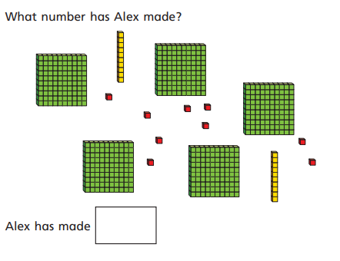
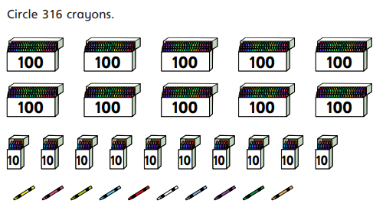
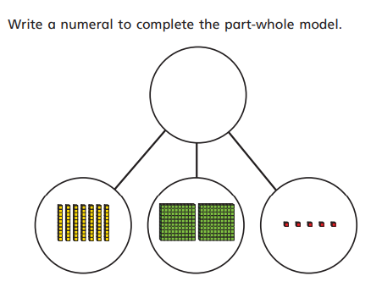
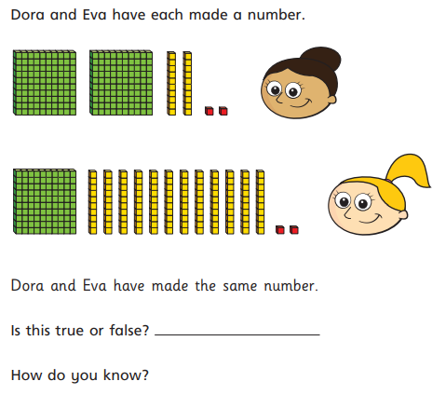
Task

