Slide 1
Monday 14th September 2020
LO: to use and understand grammatical terminology
C: nouns, verbs and adjectives

Slide 2

Watch: https://www.youtube.com/watch?v=JeognSU6wfU

Slide 3
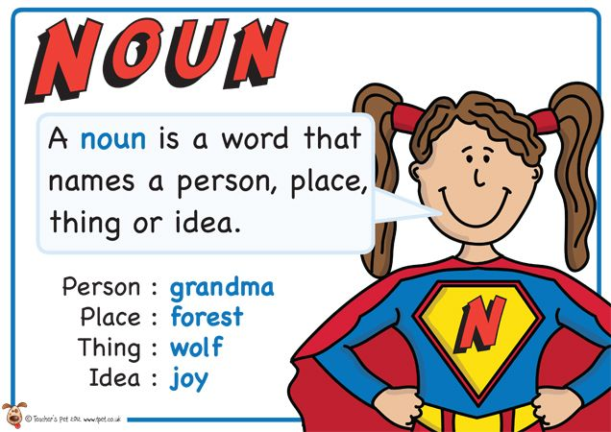

Slide 4
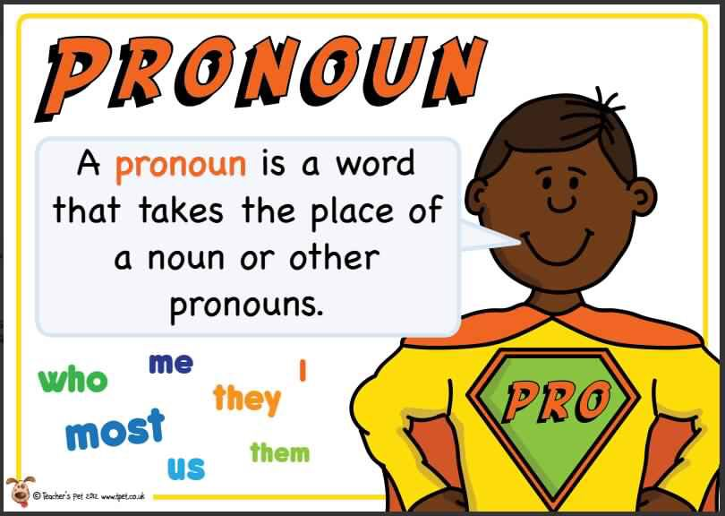

Slide 5
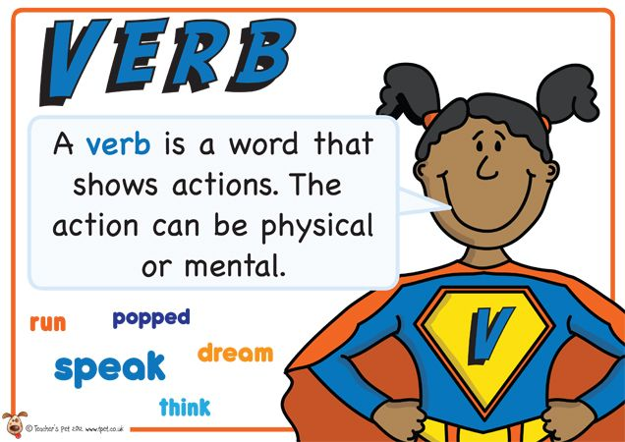

Slide 6
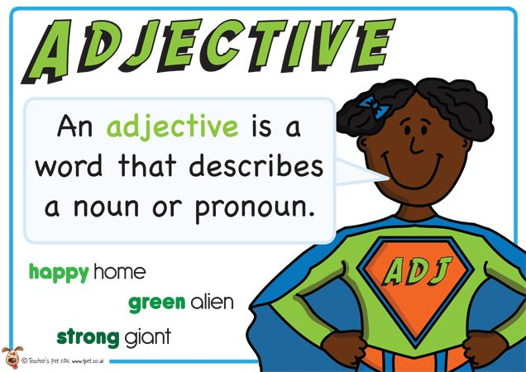

Slide 7

Complete the: Spelling Sounds diagnostic.

Slide 8
Activity 1 – Get Those Nouns Moving
Think of as many related verbs for the nouns below.
See if you can come up with verbs that no one else has.
For example: car
cruised, rushed, dashed, drove
Try these ones: snake, volcano, wind, cat, river, kite
Can you think of your own nouns?

Slide 9
Activity 2 – Create a Mood
Can you add adjectives to create a certain mood?
For example:
The clever girl sat on the antique chair and stared at the valuable painting.
The cruel girl sat on the broken chair and stared at the ruined painting.
Funny: The ______girl sat on the ______chair and stared at the _____painting.
Frightening: The ______girl sat on the ______chair and stared at the _____painting.
Heroic: The ______girl sat on the ______chair and stared at the _____painting.
Threatening: The ______girl sat on the ______chair and stared at the _____painting.
Calm: The ______girl sat on the ______chair and stared at the _____painting.
Excited: The ______girl sat on the ______chair and stared at the _____painting.
Gloomy: The ______girl sat on the ______chair and stared at the _____painting.

Slide 10
Tuesday 15th September 2020
LO: to write sentences that include conjunctions
C:

Slide 11
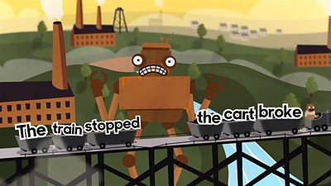
Watch: https://www.bbc.co.uk/bitesize/topics/zwwp8mn/articles/z9wvqhv https://www.bbc.co.uk/bitesize/topics/zwwp8mn/articles/zqk37p3

Slide 12
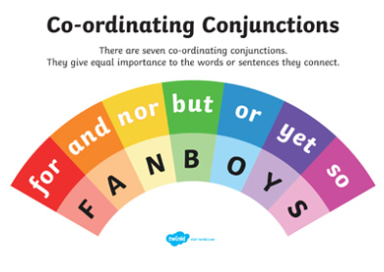

Slide 13
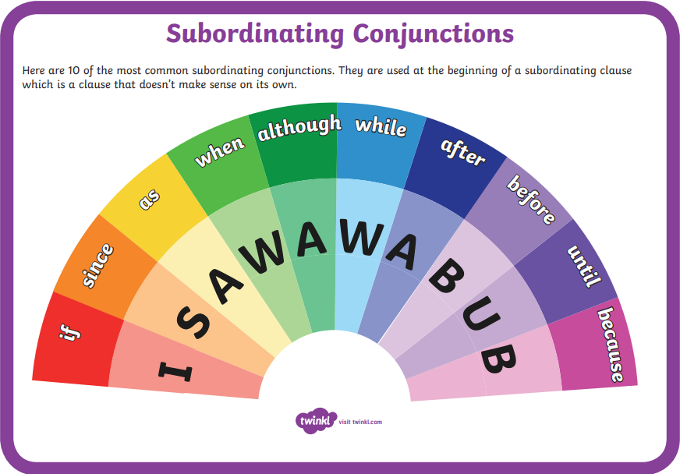

Slide 14
Complete the: Word Classes diagnostic.

Slide 15
Activity: Subordinating Conjunctions Noughts and Crosses
In pairs.
Take it in turns to choose a conjunction from the grid below and create a sentence using that subordinating conjunction to describe the picture on the next slide in some way.
The first person to achieve a diagonal, horizontal or vertical row of correctly structured sentences wins.
Write your sentences in the grid and stick in your books.
You could magpie you partner’s sentences in a different colour if they are good!
Challenge: can you think of one sentence that contains all the three words in any of the rows?
Your sentence has to make sense and describe the picture in some way.

Slide 16
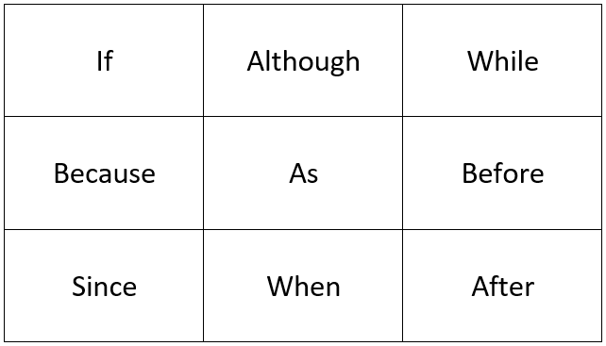

Slide 17
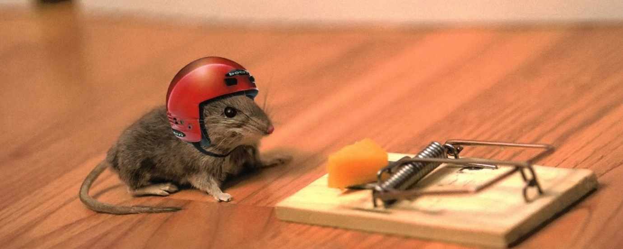

Slide 18
Wednesday 16th September 2020
LO: to understand texts
C: The Heart and the Bottle

Slide 19

Watch: https://www.youtube.com/watch?v=UsT3Oz26nFE
What is the story about?
Can you retell the events of the story?
Let’s look back at the illustrations and see if they can help us!

Slide 20
Activity: answer these questions
Pages 1-4:
1. What is the girl much like? What do you think this means?
2. Who might the man watching the girl be?
3. Why do you think the man has a walking stick?
4. List 2 things the man in the picture is wearing.
Pages 5-10
5. What does the girl think the stars might be made of?
6. What does the girl take delight in?
Page 15
7. In the sentence, “and that seemed to fix things…,” why has the author used the word seemed? What is this word telling you?
8. Do you think a bottle necklace is a safe place for your heart? Why or why not?
Page 30
9. Why do you think the ‘chair wasn’t so empty anymore’?

Slide 21
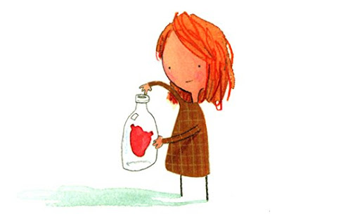
Red Pen Challenge:
Did the girl really put her heart in a bottle?
What has happened in this book and what do you think it is trying to say?

Slide 22
Thursday 17th September 2020
LO: to use a range of descriptive phrases
C: The Heart and the Bottle

Slide 23
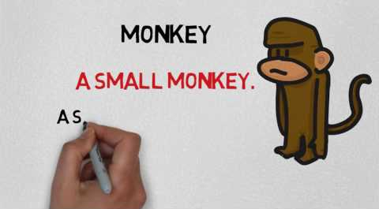
Watch: https://www.youtube.com/watch?v=4fCk8ye4jio https://www.youtube.com/watch?v=8GGWLr11Bio

Slide 24

Watch: https://www.youtube.com/watch?v=B8MnOXgX0Kk

Slide 25
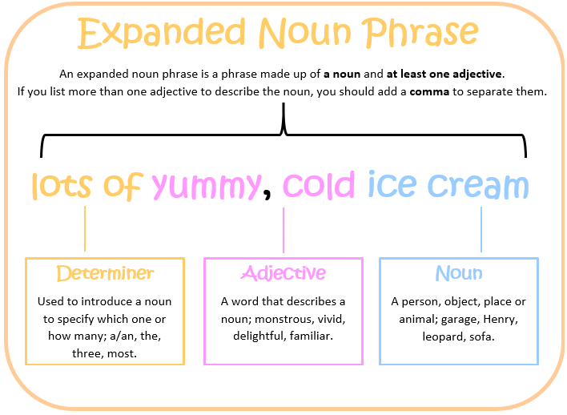

Slide 26
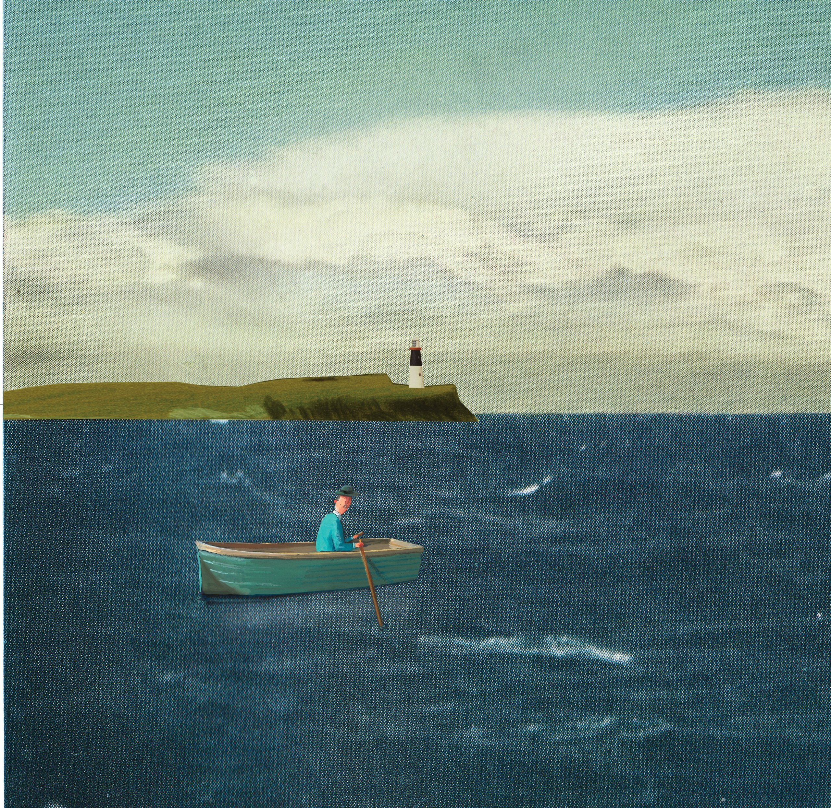
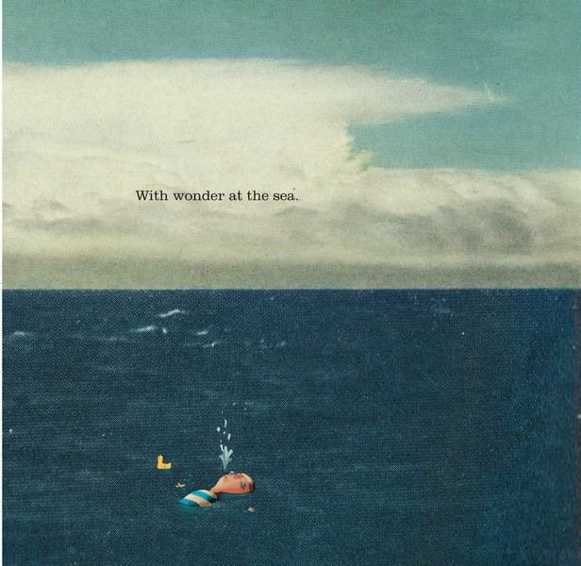
What expanded noun phrases could we use to describe this scene?

Slide 27
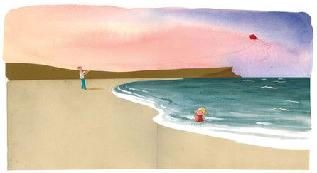
Activity: stick the illustration into your books and annotate it with expanded noun phrases which describe the scene.

Slide 28
Friday 18th September 2020
LO: to use fronted adverbials
C: The Heart and the Bottle

Slide 29
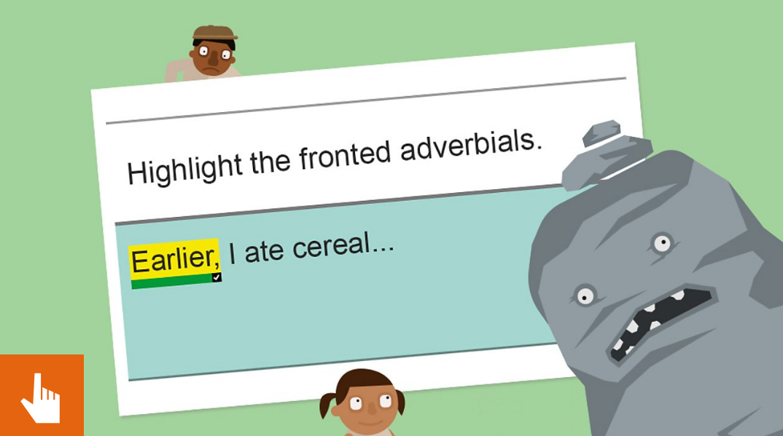
Watch: https://www.bbc.co.uk/bitesize/topics/zwwp8mn/articles/zp937p3

Slide 30

What do you notice about these sentences from the book?
Feeling unsure, the girl thought the best thing was to put her heart in a safe place.
Although in truth, nothing was the same.

Slide 31
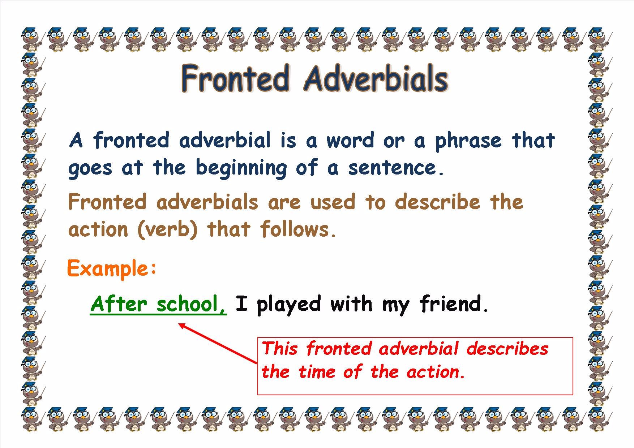

Slide 32
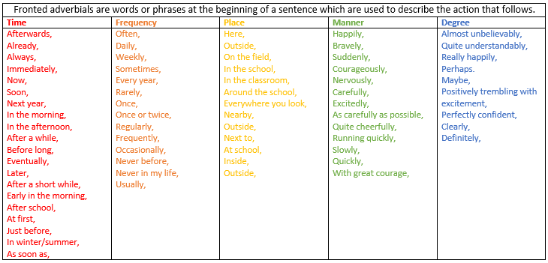

Think of sentences with fronted adverbials linked to the story.

Slide 33
Activity: in your books, write down some sentences with fronted adverbials linked to the story.

