Slide 1
Maths
This week, please post your Maths every day on Showbie.

Slide 2
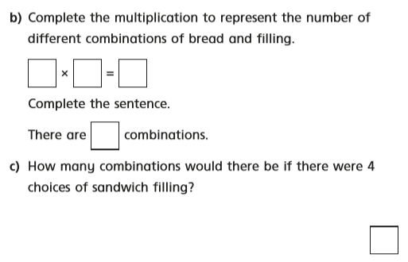
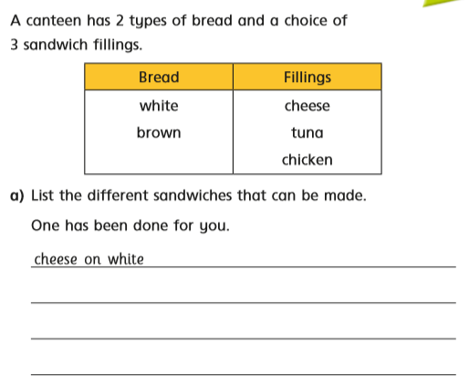
Monday

Slide 3
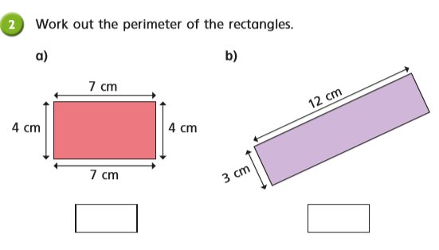
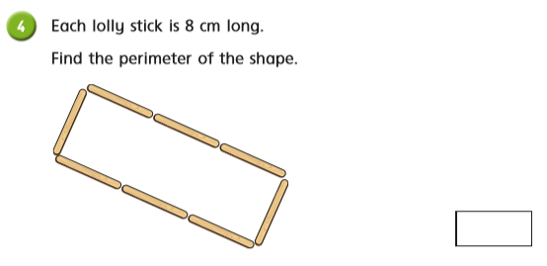
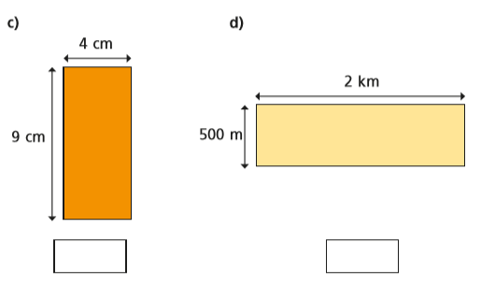
Tuesday

Slide 4
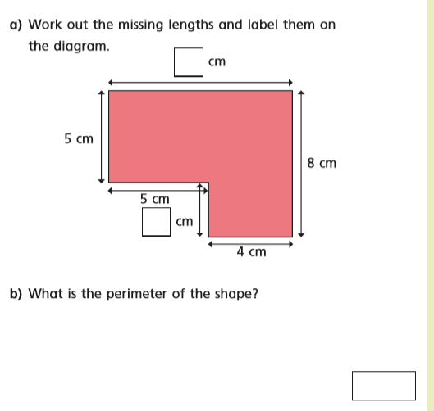
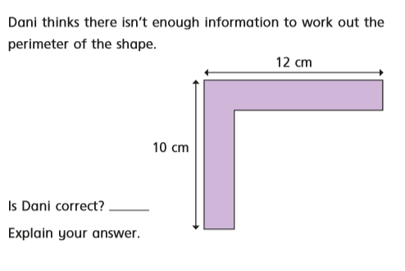
Wednesday

Slide 5
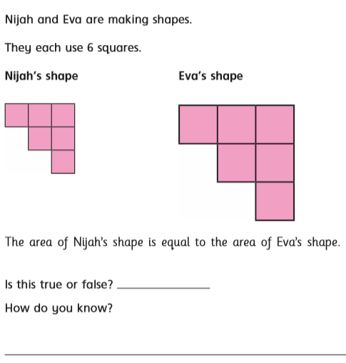
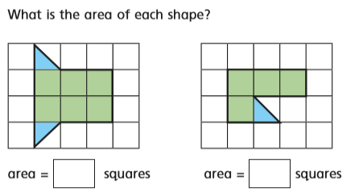
Thursday

Slide 6
Friday
Please complete the family challenge on White Rose.
Answers do not need to be posted on Showbie and you will find the answers on the White Rose website.

