Slide 1


Slide 2
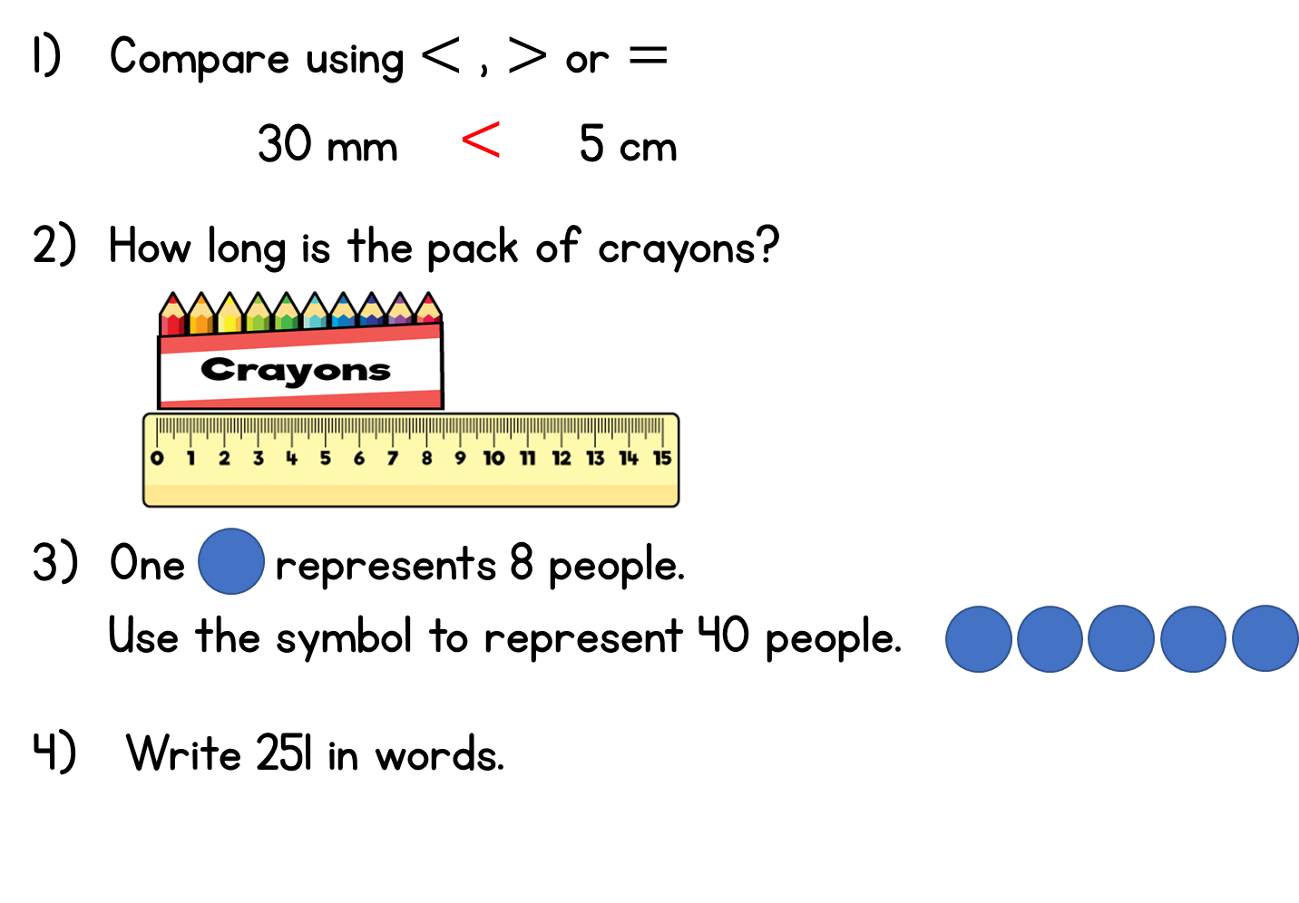
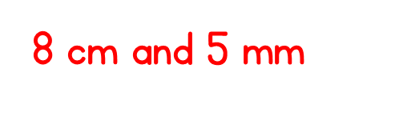


$$<$$

Slide 4
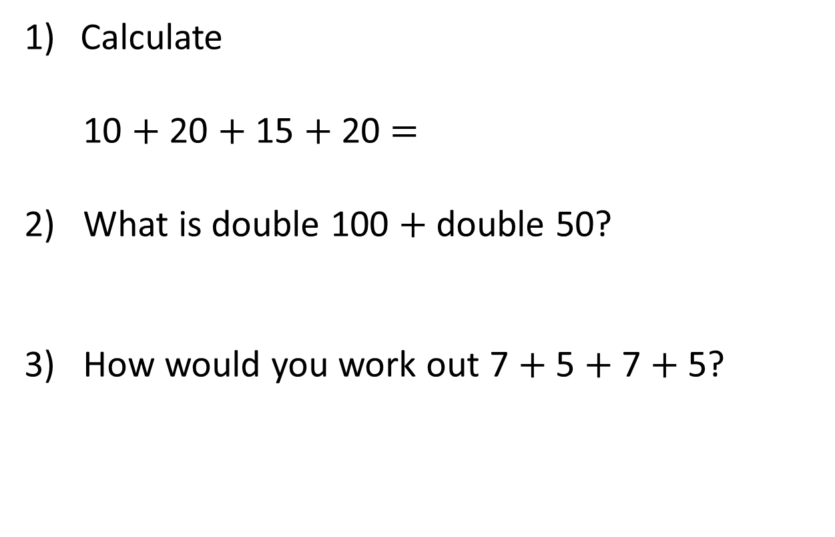
Calculate
10 $+$ 20 $+$ 15 $+$ 20 $=$
2) What is double 100 $+$ double 50?
3) How would you work out 7 $+$ 5 $+$ 7 $+$ 5?

Slide 5
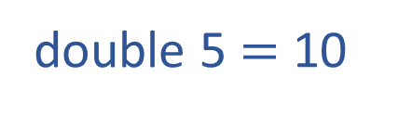
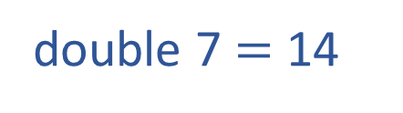
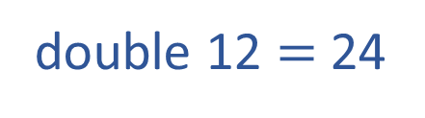
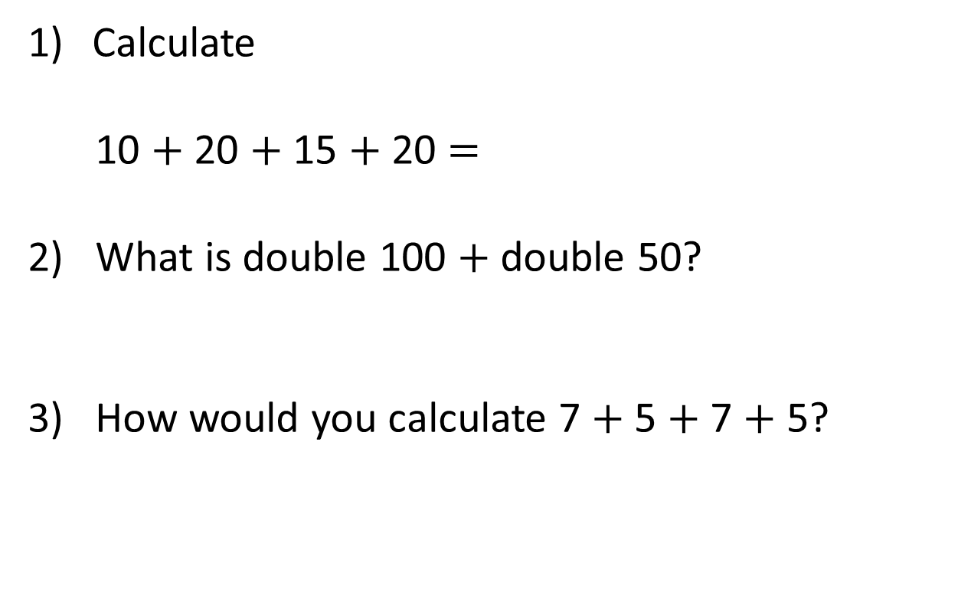
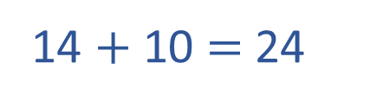
Calculate
10 $+$ 20 $+$ 15 $+$ 20 $=$
2) What is double 100 $+$ double 50?
3) How would you calculate 7 $+$ 5 $+$ 7 $+$ 5?
65
300
double 7 $=$ 14
12
12
double 5 $=$ 10
double 12 $=$ 24
14 $+$ 10 $=$ 24

Slide 7
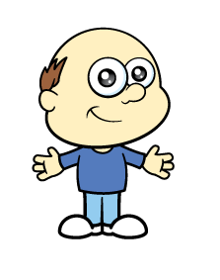

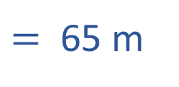
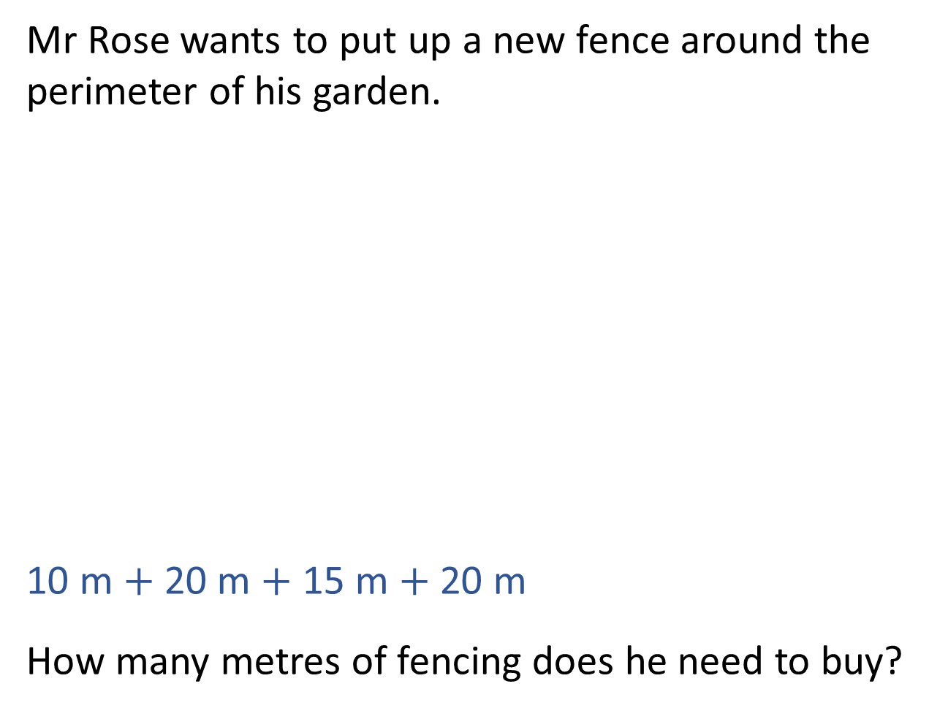
Mr Rose wants to put up a new fence around the perimeter of his garden.
10 m $+$ 20 m $+$ 15 m $+$ 20 m
How many metres of fencing does he need to buy?
10 m
20 m
20 m
15 m
$=$ 65 m
Mr Rose will need to buy 65 metres of fencing.
Song: https://www.youtube.com/watch?v=n5ULJ_kcFzI

Slide 8
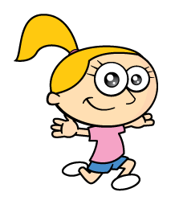
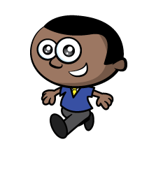

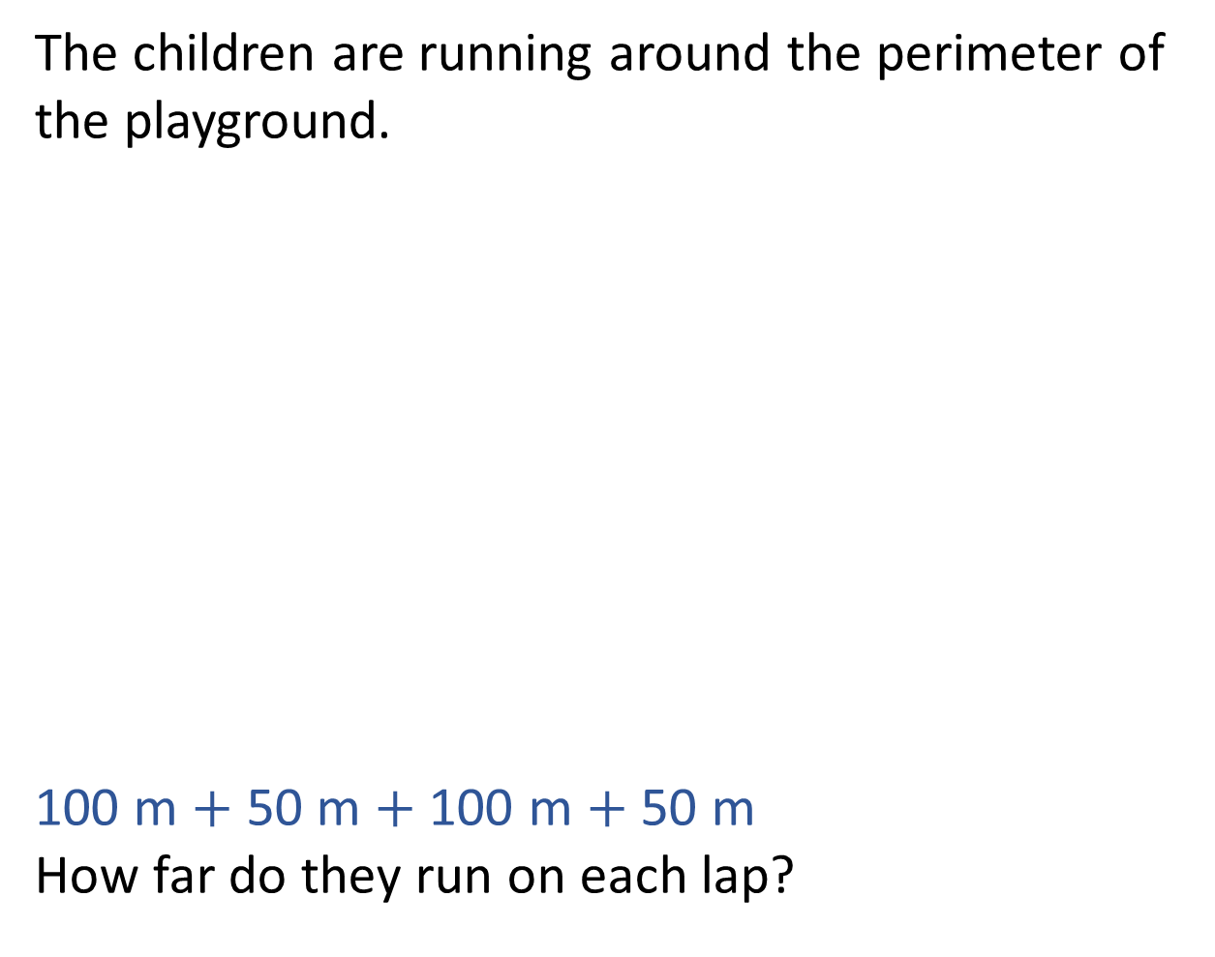
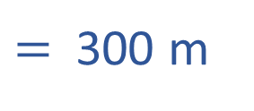
The children are running around the perimeter of the playground.
100 m $+$ 50 m $+$ 100 m $+$ 50 m
How far do they run on each lap?
100 m
50 m
50 m
100 m
$=$ 300 m
Each lap is 300 metres.

Slide 9
What is the perimeter of the rectangle?
1 cm
1 cm
24 cm

Slide 10

What is the perimeter of these shapes?
1 cm
1 cm
12 cm
14 cm
14 cm
Have a think

Slide 11

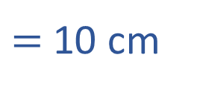

Annie has a 3 cm by 2 cm rectangular tile.
What is the perimeter of Annie’s tile?
1 cm
1 cm
3 cm $+$ 2 cm $+$ 3 cm $+$ 2 cm
$=$ 10 cm

Slide 12
Using sticks, can you make a shape that has a perimeter of 20cm?
24cm?
36cm?
Have a think

