Slide 1


Slide 2
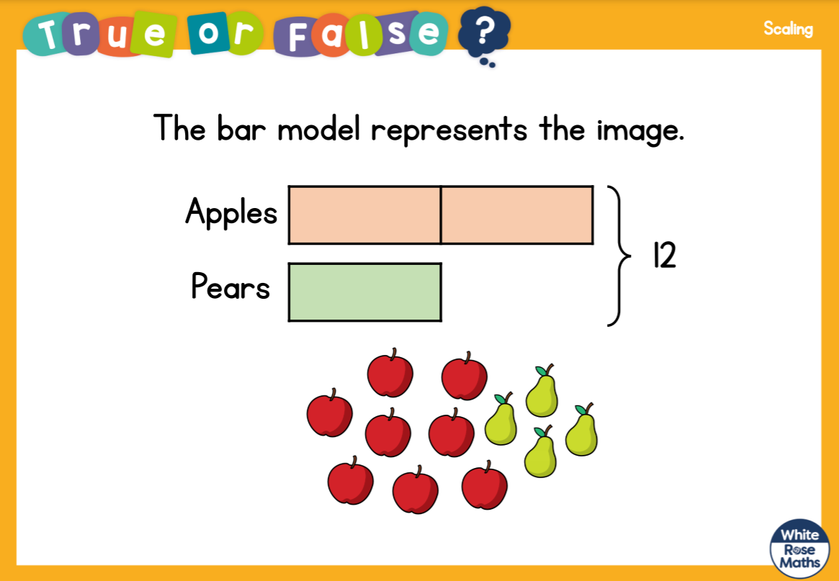

Slide 3
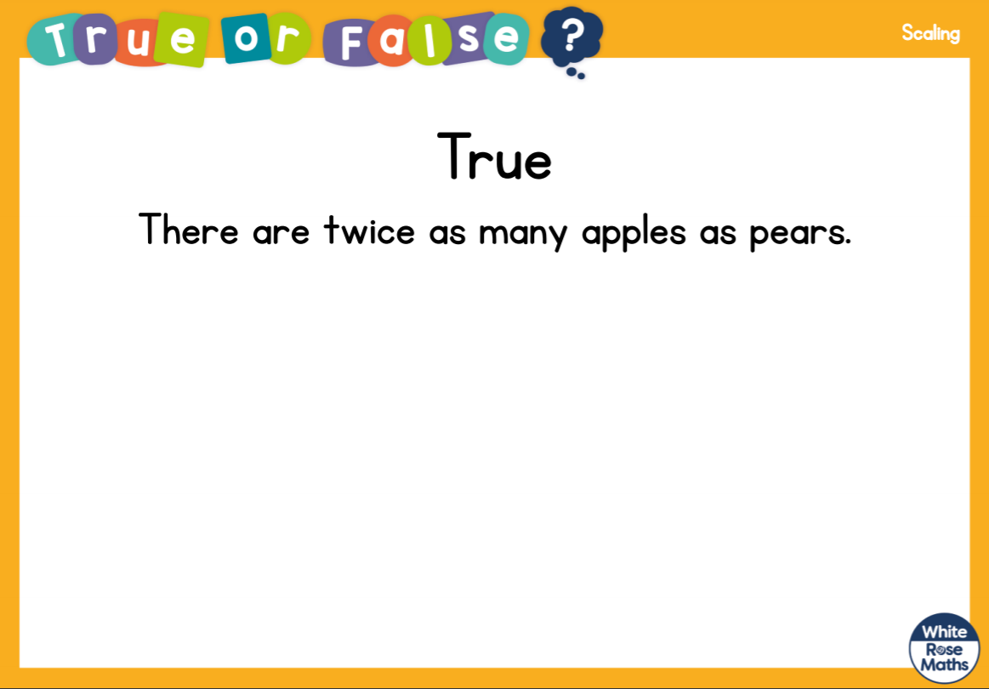

Slide 5

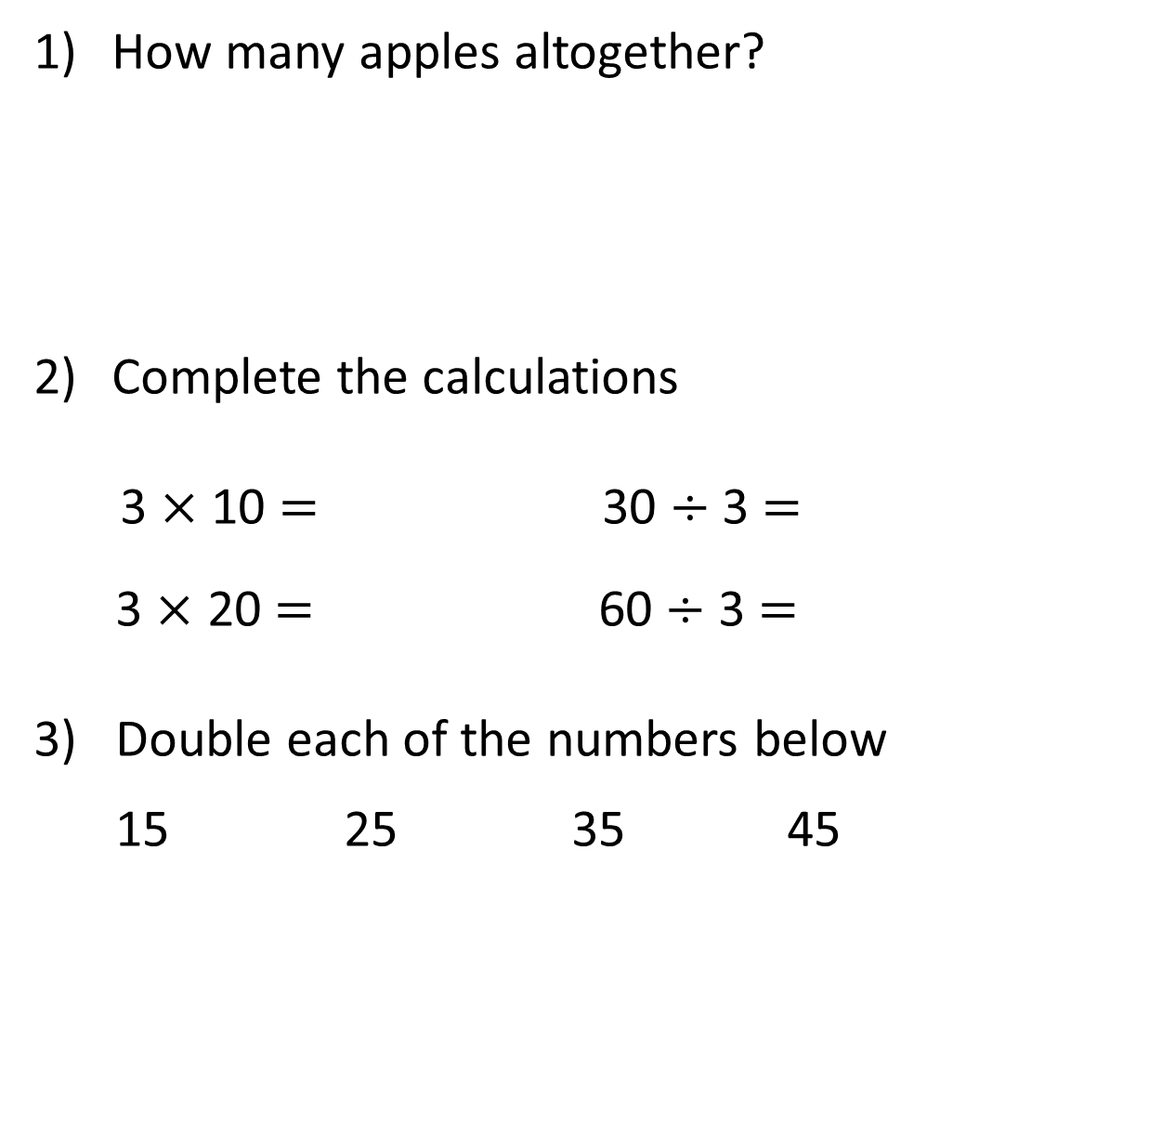
How many apples altogether?
Complete the calculations
3 $×$ 10 $=$ 30 $÷$ 3 $=$
3 $×$ 20 $=$ 60 $÷$ 3 $=$
3) Double each of the numbers below
15 25 35 45

Slide 6
How many apples altogether?
Complete the calculations
3 $×$ 10 $=$ 30 $÷$ 3 $=$
3 $×$ 20 $=$ 60 $÷$ 3 $=$
3) Double each of the numbers below
15 25 35 45
30
30
10
60
20
30
50
70
90

Slide 8
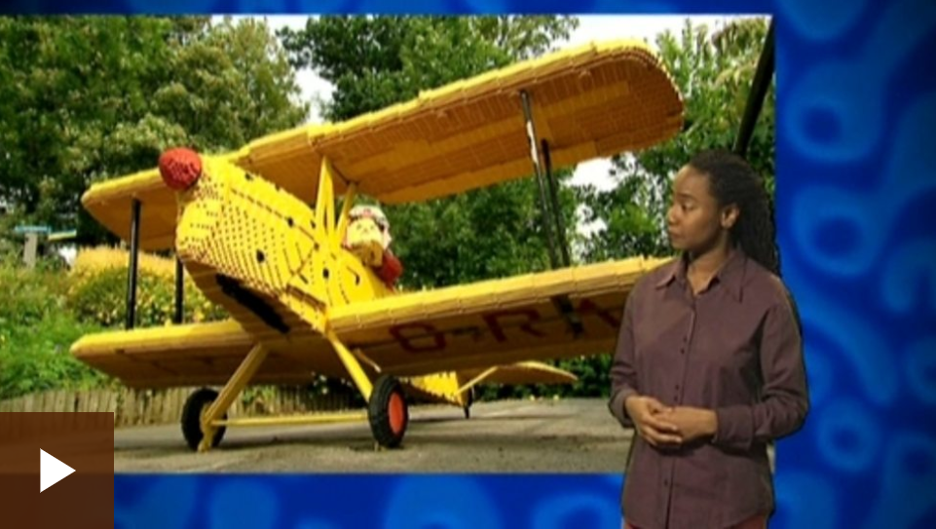
What is scaling?
https://www.bbc.co.uk/bitesize/clips/z8pfgk7

Slide 9
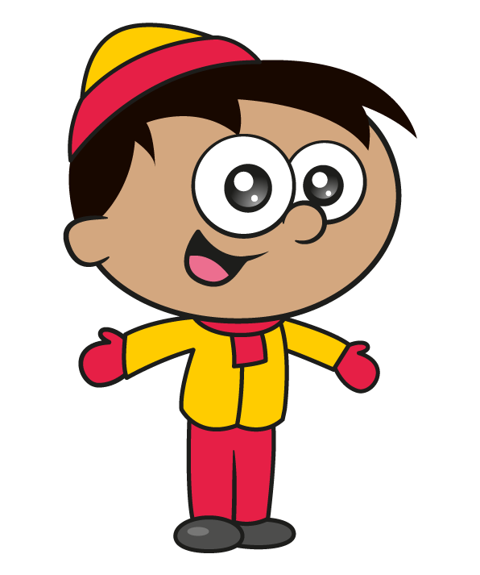

The children are making snowballs.
Do you agree with Eva?
Can you represent this using a bar model or a picture?
I have twice as many snowballs as you!

Slide 10
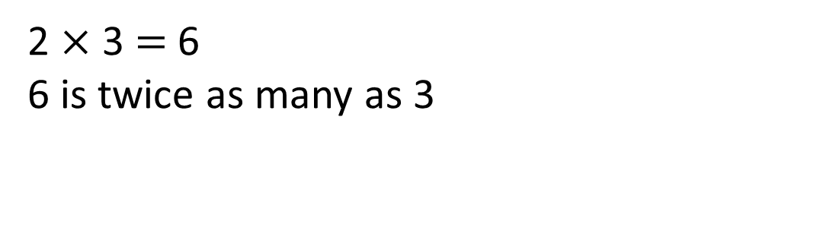
Does Eva have twice as many snowballs as Amir?
Amir has 3 snowballs.
Eva has 6 snowballs.
2 $×$ 3 $=$ 6
6 is twice as many as 3

Slide 11
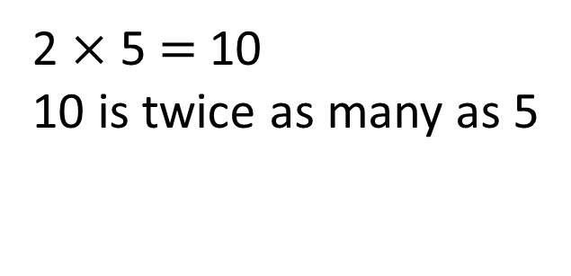
Amir now has 5 snowballs.
If Eva makes twice as many snowballs, how many will she have?
Eva has 10 snowballs.
2 $×$ 5 $=$ 10
10 is twice as many as 5

Slide 12

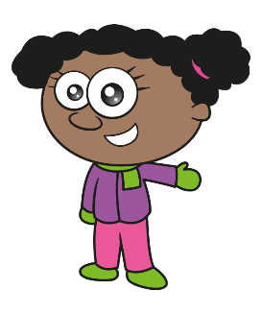
Eva has 10 snowballs
Have a think
I have made three times as many snowballs as you!
How many snowballs has Whitney made?

Slide 13
Eva has 10 snowballs.
Whitney has three times as many snowballs as Eva.
10
10
10
10
Whitney has 30 snowballs.
How many snowballs does Whitney have?

Slide 14
What else can you see from the bar model?
20
Have a think
10
40
10
10
10
Whitney has 20 more snowballs than Eva.
Eva has 20 fewer snowballs than Whitney.
The girls have 40 snowballs altogether.

Slide 15



Here is a bar model to represent how children in Class 3 travel to school.
Use the bar model to complete the sentences.
Have a think
Twice
______ as many children travel by car as by bus.
5 times
_______ as many children walk as travel by bus.

Slide 16
Have a go at questions on the worksheet

