Slide 1

Microsoft
Word

Slide 2
What is Word?
Word is the Microsoft Office word processing program.
You can type, insert images, pictures and diagrams for a variety of needs.

Slide 3
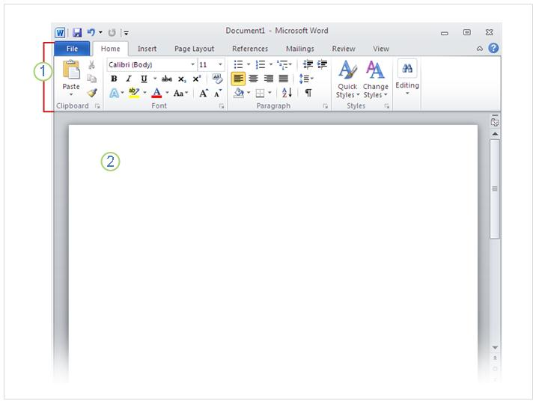
The first time you open Word
The Word ribbon which sits above the document.
A blank document, which looks like a white piece of paper.

Slide 4
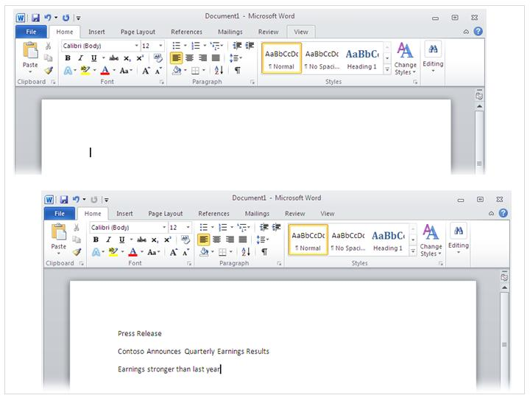

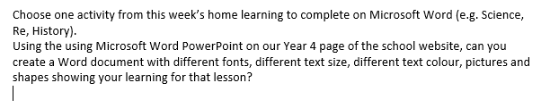
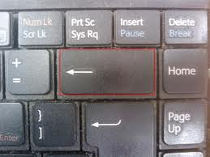
Just start typing…
In the document, look for the cursor, which is a blinking line. This will show you where you can start typing.
If you want to type further down the document, just press the Enter button.
If you make a mistake, press the Backspace key.

Slide 5
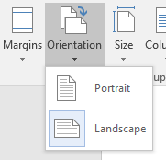
Change the Page Layout
Click on the Layout Tab

Slide 6
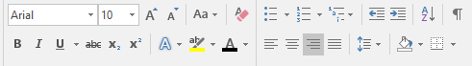
Changing the text
You can use the Home tab to change the text
3
1
2
Click here to change the size of the letters.
2. Click here to change the colour of the text.
3. Click here to change the style of the text.

Slide 7
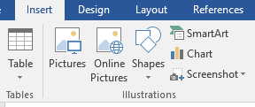
Inserting Pictures from the Internet
Click on the Insert Tab

Slide 8
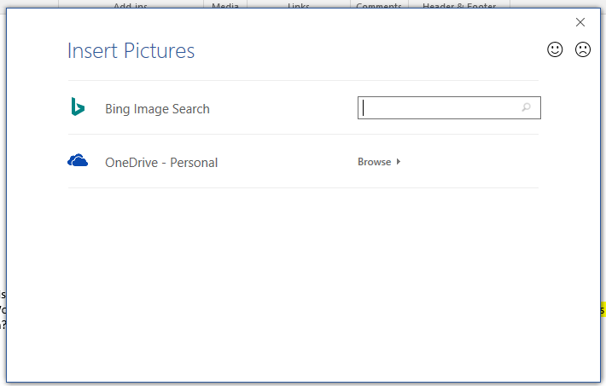
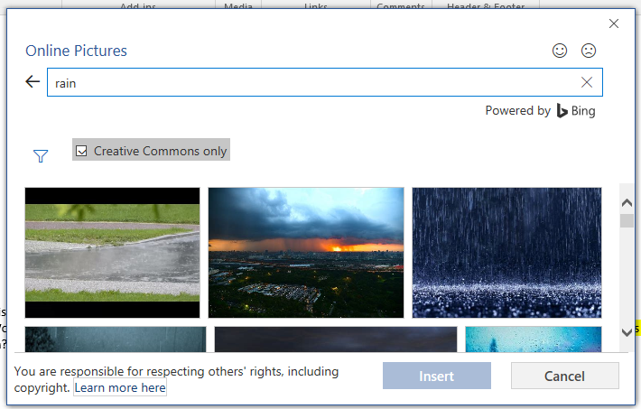
Inserting Pictures from the Internet
Type in your chosen topic and click on the magnifying class.
When you have chosen your image, select it with the mouse and click Insert.

Slide 9
Inserting a Picture from your computer
Click on the Insert Tab.
Find the image you want to insert.
Select the image with the mouse and click Insert.

Slide 10
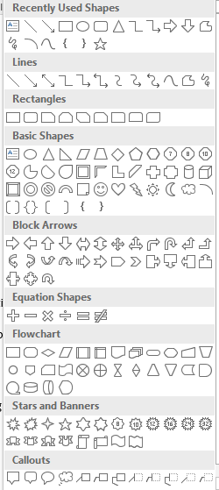
Inserting a Shape
Click on the Insert Tab.
Select the shape you want and then
drag the mouse to make the shape.

Slide 11
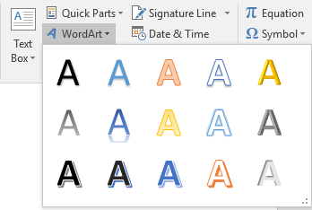
Inserting WordArt
Click on the Insert Tab.
Choose the Word Art you want to use and type in what you want to write.

Slide 12
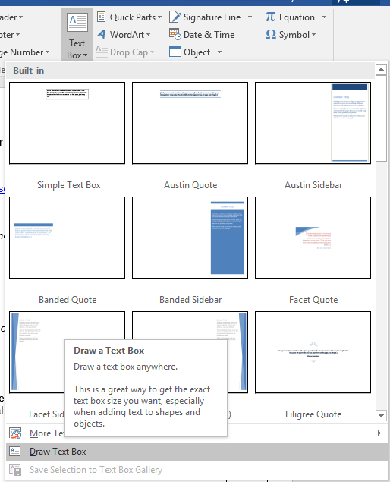
Inserting a Text Box
Click on the Insert Tab.
Select Text Box, Draw Text Box and drag the mouse
to draw the Text Box.

