Slide 1
To develop ideas.
To master techniques
C: Dragons.

Slide 2
Look at the following dragon paintings
What is the mood of the piece?
How have they used their media?
Have they blended or is it blocks of colour?
What does the artist want us to feel?

Slide 3
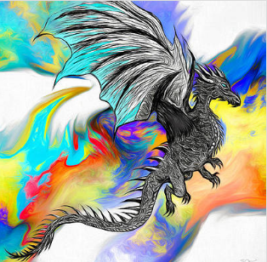

Slide 4
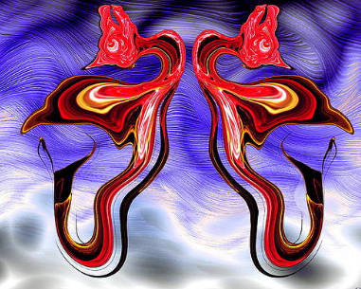

Slide 5
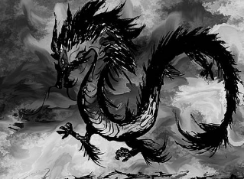

Slide 6
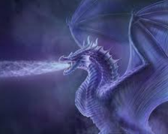

Slide 7
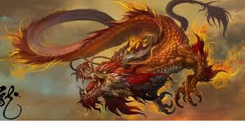

Slide 8
You are going to sketch a dragon today using the critical techniques we used when drawing a butterfly using ‘Austin’s butterfly’.
You need to divide you page into 4.
You will sketch your dragon in the first box.
You then need to critically analyse your sketch – what needs improving? Choose 1 area.
You need to work on what needs improving in your next sketch in your next box.
You need to repeat this process until you have 4 sketches, each showing an improvement from the last.

