Slide 1
Growing strawberries

Slide 2
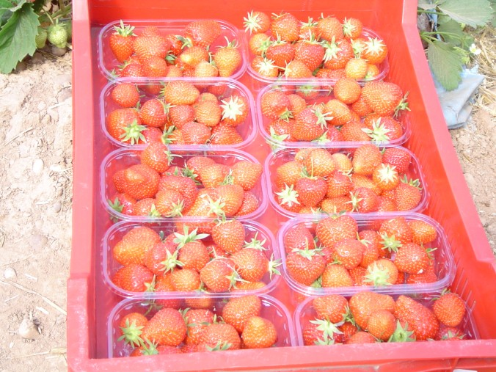
Do you know what these are?
They are strawberries.
How are they grown?

Slide 3
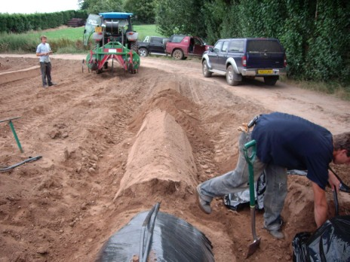
First, the farmer makes soil mounds.
The mounds are called beds.

Slide 4
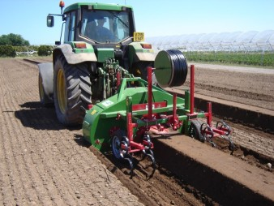
Some farmers use a machine to do this.
The machine is called a bedformer.

Slide 5
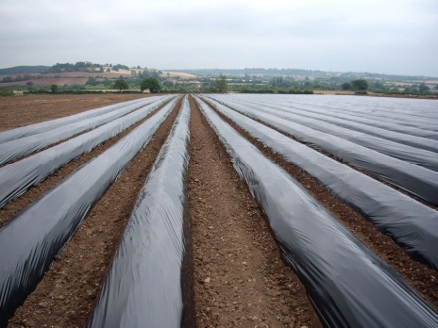
Next, the beds are covered with plastic.

Slide 6
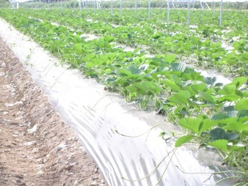
The farmer makes holes in the plastic and plants the strawberry plants.
The plastic keeps the strawberries warm and helps them grow.

Slide 7
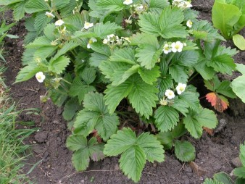
The strawberry plants grow small white flowers.

Slide 8
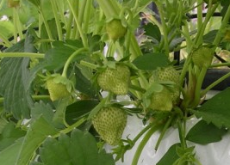
The flowers die and fruit grows in their place.

Slide 9
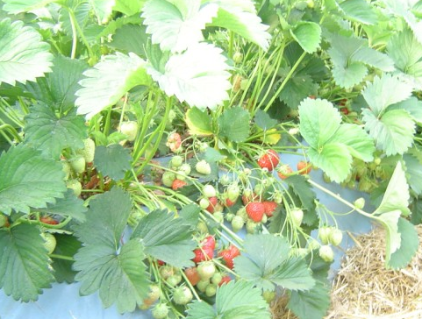
When the strawberries turn red, they are ready to be picked.

Slide 10
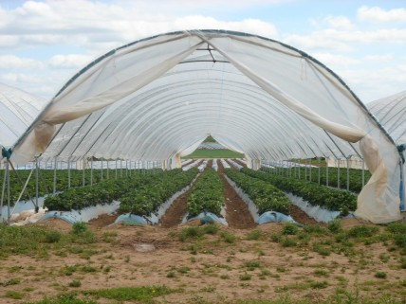
Some farmers grow strawberries in large plastic tunnels.
The tunnels protect the strawberries from bad weather.

Slide 11
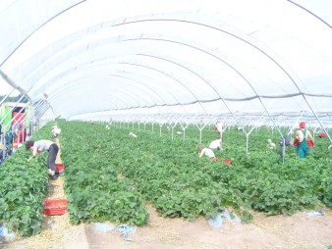
When the strawberries are ready, they are picked by hand.
They have to be picked by hand because they are too soft to be picked by machine.
Can you see the pickers?

Slide 12
When they have been picked, the strawberries are put into punnets.

Slide 13
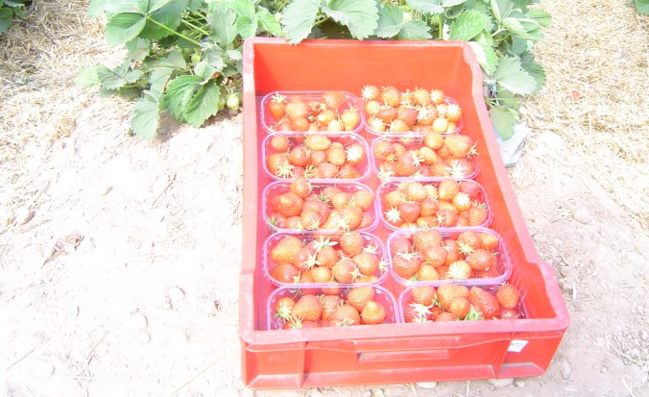
The punnets are put into crates so they can be moved around easily.

Slide 14
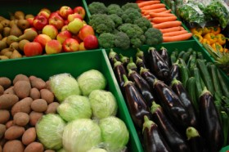
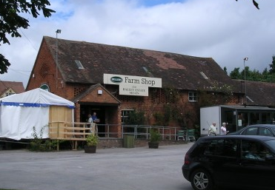
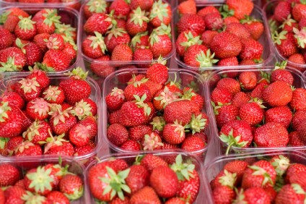
Sometimes the strawberries are sold in a farm shop or on a market.

Slide 15
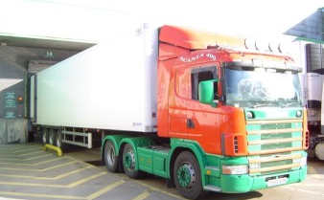
Sometimes strawberries are loaded into a lorry and taken to a supermarket.

