Slide 1
Friday 26th March 2021
L.O: To understand texts- prediction skills
C: Boy

Slide 2
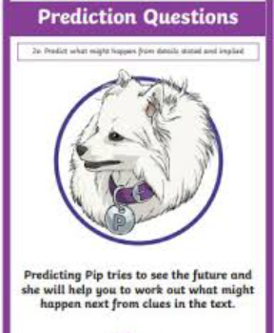
Today we are continuing to explore our new book! We are continuing to explore Roald’s childhood.
We are going to use our Predicting Pip skills to help us understand key events in his life.

Slide 3
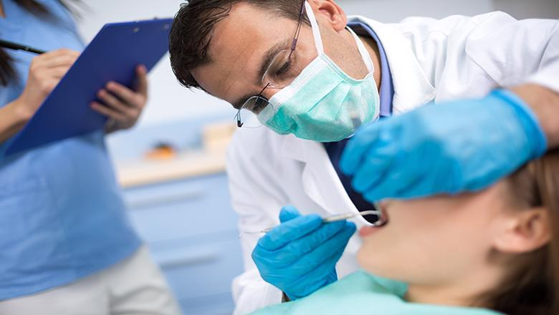
Starter: Thinking time
How does this image make you feel? Do you have positive or negative emotions?

Slide 4
Class Read
Class Read p.78-82
I’m going to read you just the first paragraph.

Slide 5
Our Task
I would like you to write a paragraph predicting what might happen at the doctors.
I will model this for you.

Slide 6
Our task
Paddlers: Follow a writing frame.
Snorkellers: To write your predictive paragraph independently.
Divers: Write your paragraph with consideration to the era. Did they have the medicine and tools we have today?

Slide 7
Class Read
Class Read p.78-82
Let’s read the rest of the section. You can read along with me this time!

Slide 8

Red Pen Challenge:
:
We are going to edit our intros: Book on Book style! Can you spot the ALL/MOST/SOME/ONE structure?

