Slide 1
Monday
LO: To round to the nearest 100.
C: To know and use number.
Watch the 1st part of the video until it asks you to pause then complete the
Work on this PowerPoint.
https://vimeo.com/452198607

Slide 3
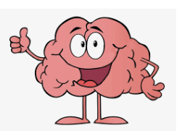
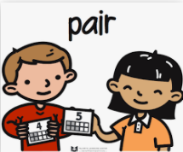
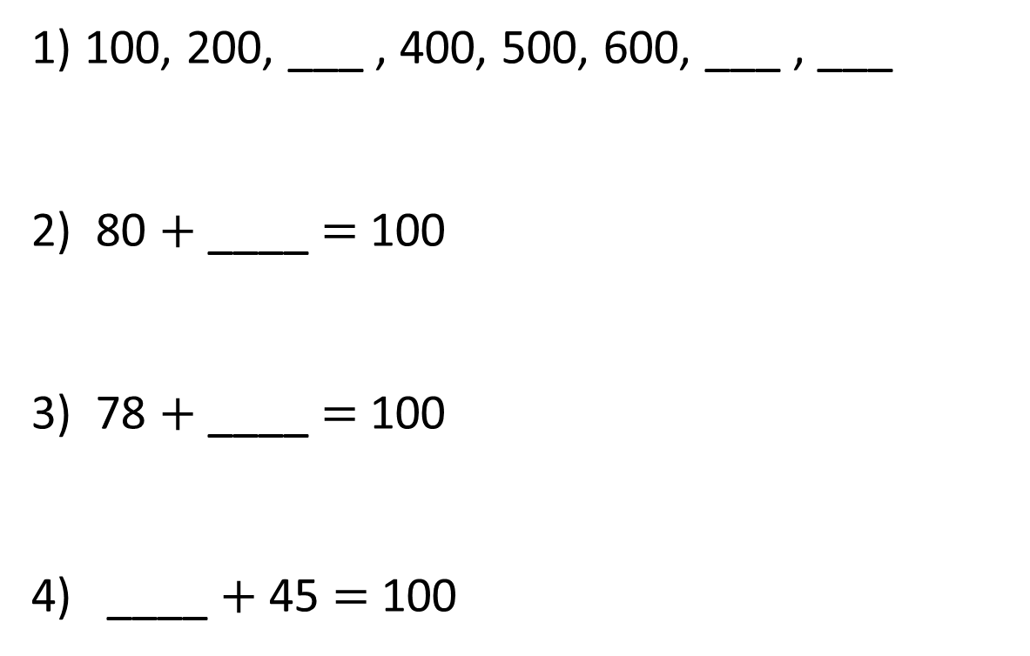
1) 100, 200, ___ , 400, 500, 600, ___ , ___
2) 80 $+$ ____ $=$ 100
3) 78 $+$ ____ $=$ 100
4) ____ $+$ 45 $=$ 100
Let’s warm our brains!

Slide 4
1) 100, 200, ___ , 400, 500, 600, ___ , ___
2) 80 $+$ ____ $=$ 100
3) 78 $+$ ____ $=$ 100
4) ____ $+$ 45 $=$ 100
300
700
800
20
22
55

Slide 6
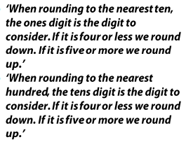


Slide 7

Round to the nearest 10
0
ones
1
one
2
ones
3
ones
4
ones
5
ones
6
ones
7
ones
8
ones
9
ones
Round to the nearest 100
0
tens
1
ten
2
tens
3
tens
4
tens
5
tens
6
tens
7
tens
8
tens
9
tens
482
713
859
Let’s talk through these numbers as a class.

Slide 8
Round 130 to the nearest 100
100
100
110
120
130
140
150
160
170
180
190
200
130 is between 100 and 200.
The previous multiple of 100 is 100.
The next multiple of 100 is 200.

Slide 9
Round 130 to the nearest 100
30
70
100
110
120
130
140
150
160
170
180
190
200
130 is closer to 100 than 200
130 rounded to the nearest 100 is 100

Slide 10
Round 138 to the nearest 100
38
62
100
138
200
138 is closer to 100 than 200
138 rounded to the nearest 100 is 100

Slide 11
Have a go at questions on the work sheet for Monday from our website.

Slide 12
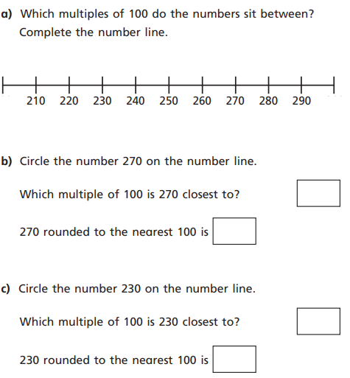
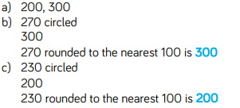
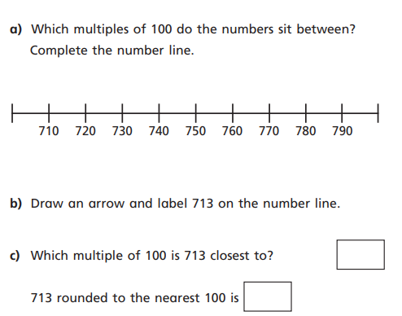
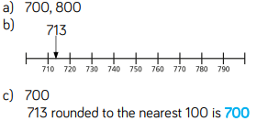
Answers
Talk through answers with an
Adult.

Slide 13
Tuesday
LO: To round to the nearest 100.
C: To know and use number.
Re-watch the 1st part of the video until it asks you to pause then complete the
work on this PowerPoint.
https://vimeo.com/452198607

Slide 15
Let’s recap!
Round to the nearest 10
0
ones
1
one
2
ones
3
ones
4
ones
5
ones
6
ones
7
ones
8
ones
9
ones
Round to the nearest 100
0
tens
1
ten
2
tens
3
tens
4
tens
5
tens
6
tens
7
tens
8
tens
9
tens
521
674
851
Let’s talk through these numbers as a class.

Slide 17
Round these numbers to the nearest 100
549
275
354
206

Slide 18
Answers
549 = 500
275 = 300
354 = 400
206 = 200

Slide 19
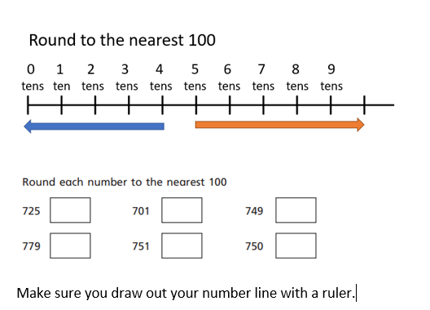
Task

Slide 20
Wednesday
LO: To round to the nearest 100.
C: To know and use number.
Watch the 2nd part of the video until it asks you to pause then complete the
work on this PowerPoint.
https://vimeo.com/452198607

Slide 21
Let’s recap!
Round to the nearest 10
0
ones
1
one
2
ones
3
ones
4
ones
5
ones
6
ones
7
ones
8
ones
9
ones
Round to the nearest 100
0
tens
1
ten
2
tens
3
tens
4
tens
5
tens
6
tens
7
tens
8
tens
9
tens
349
893
751
Let’s talk through these numbers as a class.

Slide 22
Have a go at the sheet for Wednesday from our website.

Slide 23
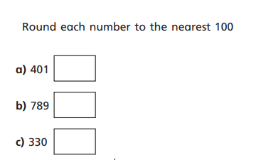

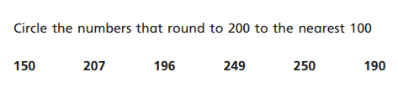

Answers
Talk through answers
with an adult

Slide 24
Friday
LO: To round to the nearest 100.
C: To know and use number.
Watch the 2nd part of the video until it asks you to pause then complete the
work on this PowerPoint.
https://vimeo.com/452198607

Slide 25
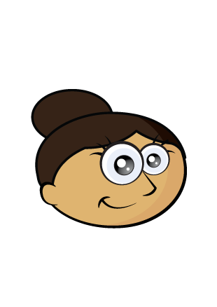
Dora is thinking of a number.
It rounds to 400 to the nearest 100
It rounds to 450 to the nearest 10
What could Dora’s number be?
445
446
447
448
449
450
451
452
453
454

Slide 26
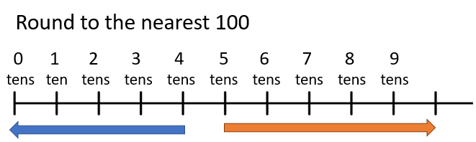
Round these numbers to the nearest 100
44
99
972

Slide 27
Answers
44 = 0
99 = 100
972 = 1000

Slide 28
Now, let’s round these numbers to the nearest 100 then the nearest 10.
462
827

Slide 29
Now, let’s round these numbers to the nearest 100 then the nearest 10.
462 = 460 to the nearest 10 and 500 to the nearest 100.
827 = 830 to the nearest 10 and 800 to the nearest 100.

Slide 30
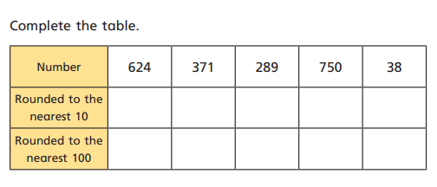
Task
RP: A number with 5 ones will always round up to the next 100.
Always, sometimes never?

