Slide 1
Monday 28th September 2020
LO: to use the main features of a type of writing
C: Harvest

Slide 2
What do you think these are?

Slide 3
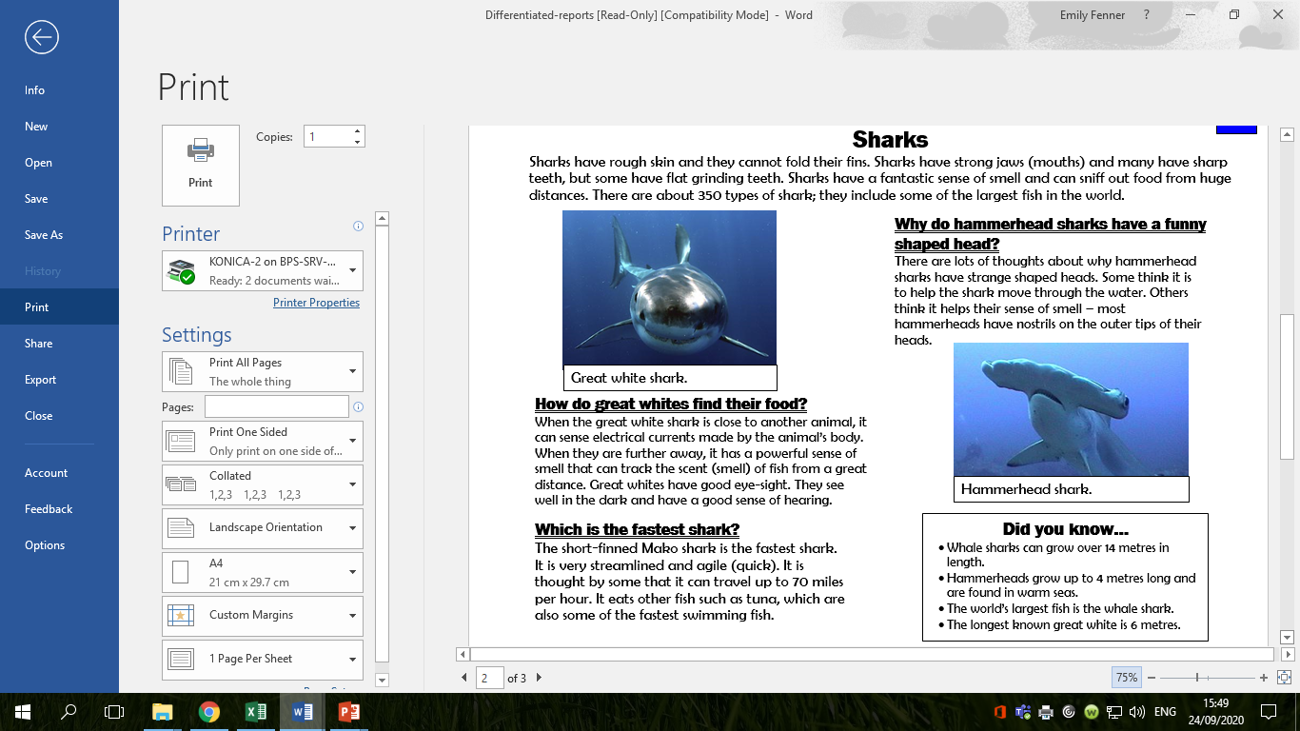

Slide 4
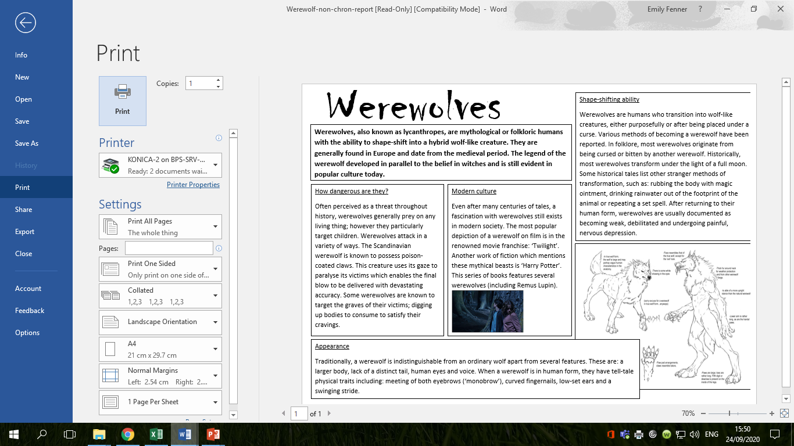

Slide 5
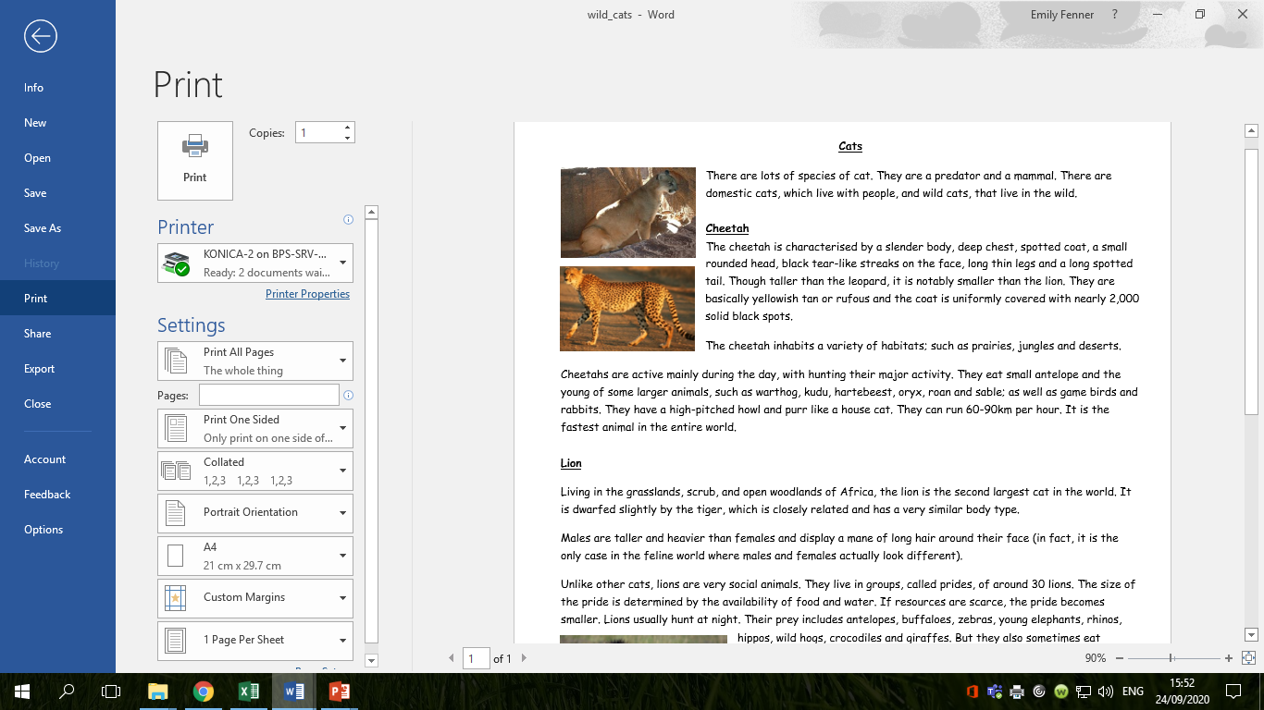

Slide 6
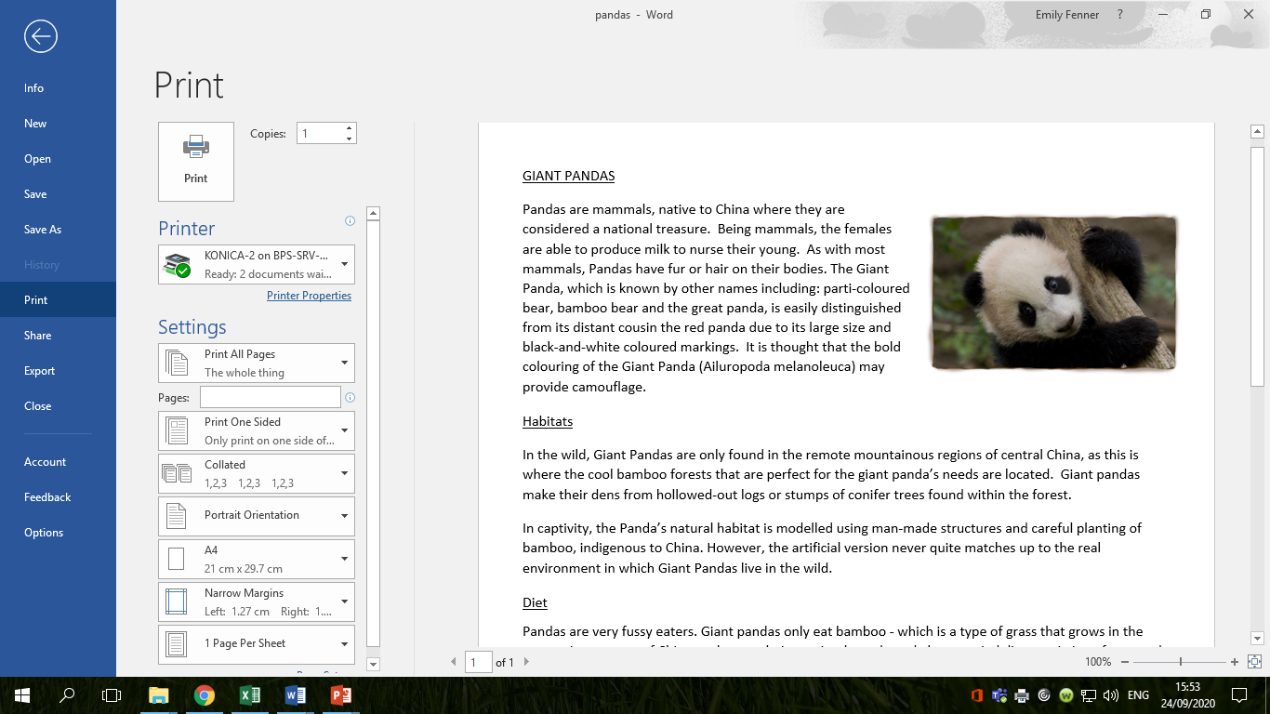

Slide 7


Slide 8

What are the features of non-chronological reports?
Let’s create a class bubble map of our ideas.

Slide 9
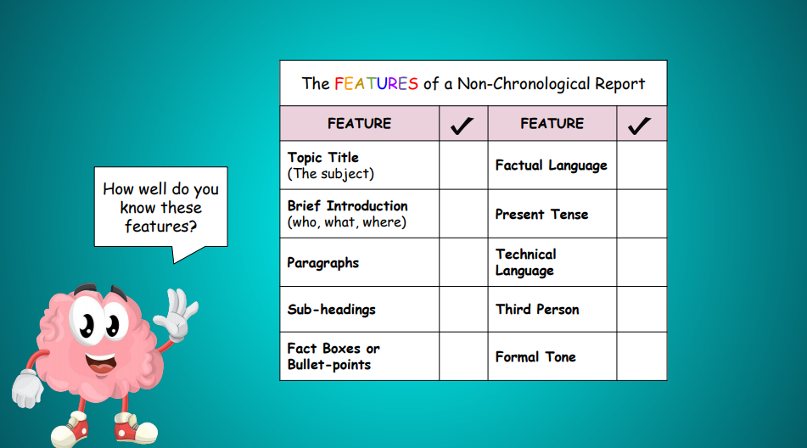
What are the features of non-chronological reports?

Slide 10
Let’s look back at the examples – have they all got the features we’ve identified? Are there any more features we need to add to our bubble map?

Slide 11
Tuesday 29th September 2020
LO: to use organisational devices
C: Harvest

Slide 12
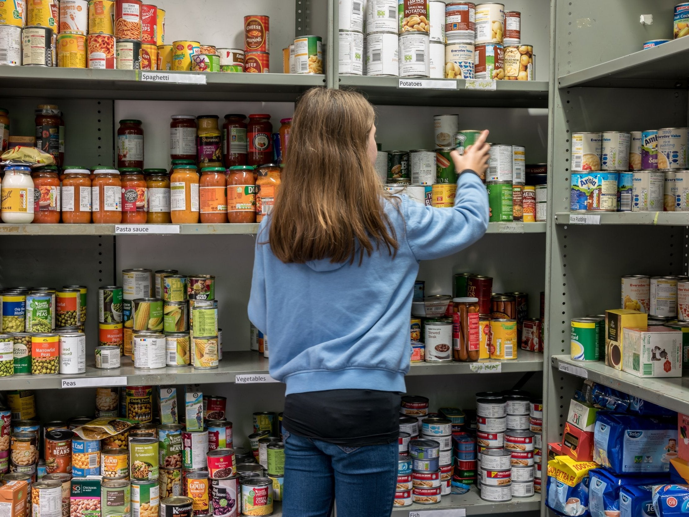
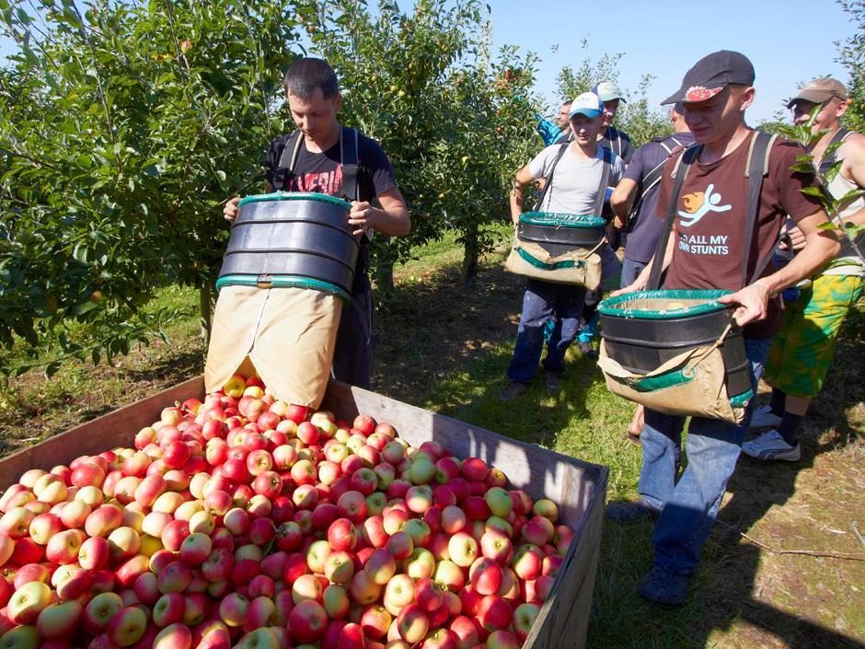
This week, we are going to be writing our own non-chronological reports about food banks or fruit picking during Covid-19.

Slide 13
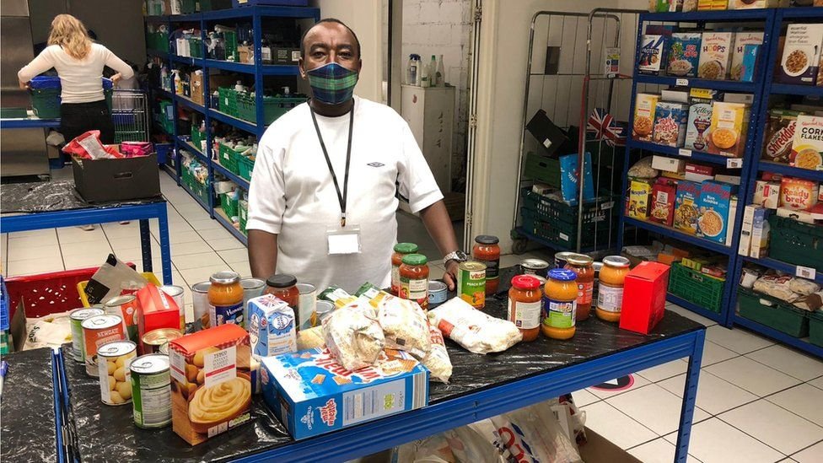
What would you like to find out about the food bank?

Slide 14
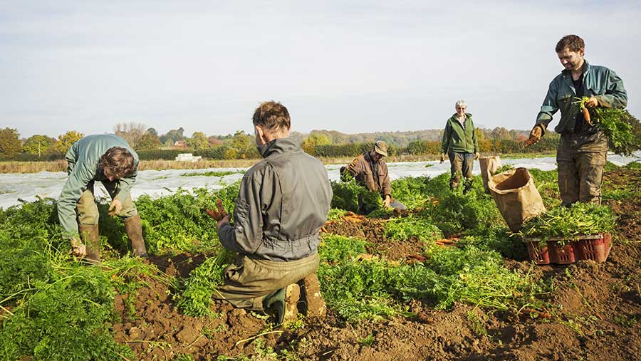
What would you like to find out about fruit picking?

Slide 15
Activity:
Write down 4 questions about either the food bank or fruit picking that you would like to find out the answer to.
Your questions should be written correctly with capital letters and question marks.
Examples:
What food can be donated to the food bank?
Why do people donate food to the food bank?
What happens if the fruit is not picked in time?
How long does it take to pick fruit?

Slide 16
Wednesday 30th September 2020
LO: to plan, write, edit and improve
C: Harvest

Slide 17

Think about your questions from last lesson.
You are going to use the information texts to try to answer some of your questions!
You are going to write down the answers to your questions as notes.
What are notes?

Slide 18
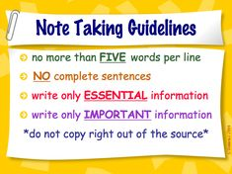
Notes are a brief record of points or ideas written down as an aid to memory.

Slide 19
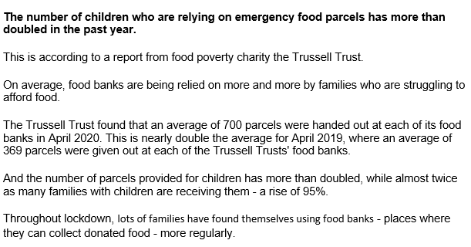
Let’s practise together.

Slide 20
Activity:
Read through the information texts and write down any facts you would like to include in your information text.
Remember, your facts must link to your questions.

Slide 21
Thursday 1st October 2020
LO: to plan, write, edit and improve
C: Harvest

Slide 22
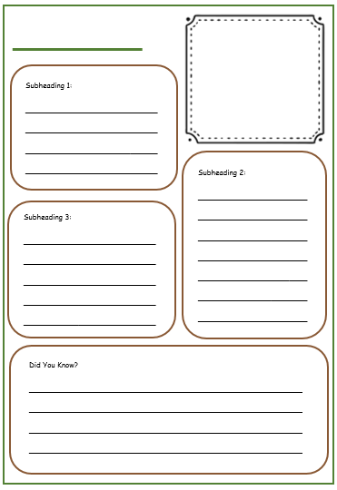
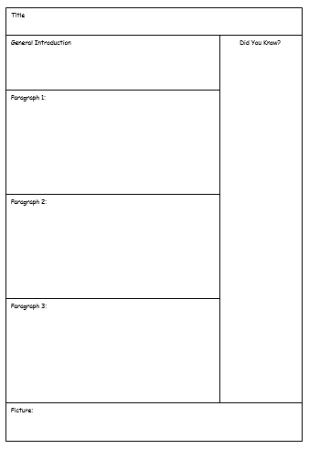
You are going to plan your information text today!
Which planning template would you like to use?

Slide 23
Let’s plan one together.
We need to:
- write in our sub-headings (remembering to use questions marks if it is a question)
- write down the key facts we would like to use
- write down what pictures we will use or draw a quick sketch

Slide 24
Activity:
Complete the planning template for your information text.

Slide 25
Friday 2nd October 2020
LO: to use the main features of a type of writing
C: Harvest

Slide 26
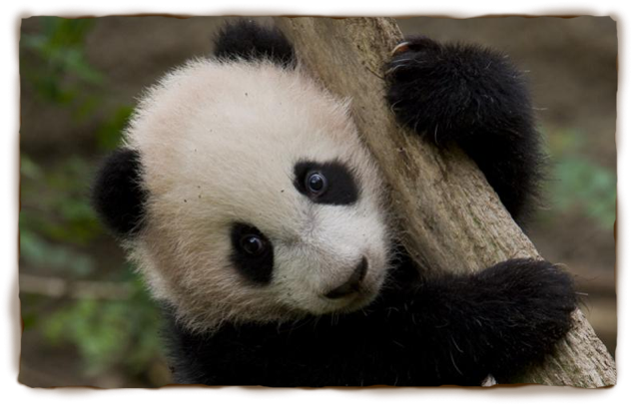
Which feature of non-chronological reports is this?
Pandas are mammals, native to China where they are considered a national treasure. As with most mammals, Pandas have fur or hair on their bodies. The Giant Panda, which is known by other names including: parti-coloured bear, bamboo bear and the great panda, is easily distinguished from its distant cousin the red panda due to its large size and black-and-white coloured markings. It is thought that the bold colouring of the Giant Panda may provide camouflage.

Slide 27
All non-chronological reports will start with an introduction.
What needs to go in an introduction?

Slide 28
The introduction of your non-chronological report what the text is all about.
The attention of the audience is grabbed at this point because it will help them to decide whether they want to continue reading the rest of the text or not.
Introduce the information
Who (who are you writing about?)
What (what is it or what is it used for?)
Where (where is it found?)

Slide 29
Pandas are mammals, native to China where they are considered a national treasure.
As with most mammals, Pandas have fur or hair on their bodies. The Giant Panda, which
is known by other names including: parti-coloured bear, bamboo bear and the great
panda, is easily distinguished from its distant cousin the red panda due to its large size
and black-and-white coloured markings. It is thought that the bold colouring of the
Giant Panda may provide camouflage.
Introduce the information
Who (who are you writing about?)
What (what is it or what is it used for?)
Where (where is it found?)

Slide 30
Let’s write one together.

Slide 31
Activity:
Write the introduction for your non-chronological report.
Remember to punctuate your sentences correctly.
Try to use expanded noun phrases and fronted adverbials if you can!

