Slide 1
Monday 5th October 2020
LO: plan, write, edit and improve.
C: Harvest

Slide 2
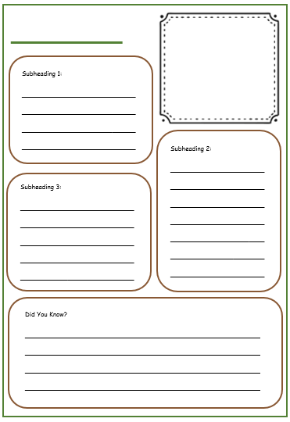
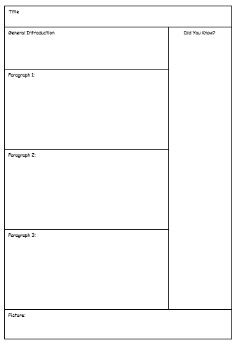
Look back at your plans from last week.
Today you are going to draft your first two paragraphs.
What does ‘draft’ mean?

Slide 3


Slide 4
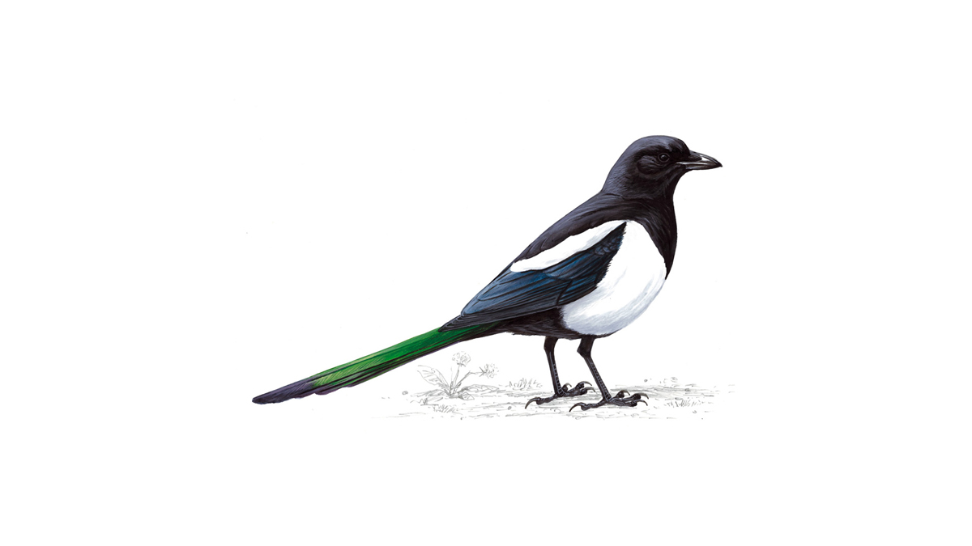

Let’s look at this example together.
If you were the teacher, what would you highlight in pink?
Is there anything you might like to magpie for your own work?
What are charity shops?
A Charity Shop is a special shop that sells new and used items to raise money and awareness for the charity they represent. There are over 11,200 charity shops in the UK raising money for various charities including: The British Heart Foundation, Dogs Trust, Cancer Research and Oxfam. Every year charity shops raise more than £295 million for a range of causes in the UK. This money funds medical research, supporting sick children, homeless people, for animal welfare and many other causes.

Slide 5
What is wrong with this example?
If you were the teacher, what would you highlight in green?
What are charity shops?
there are lots of charity shops neer me. There is a charity called Dogs Trust that looks after dogs. I lik dogs. My favourite dog is a Labrador. I like gowng to charity shops because I like shopping. Shops are fun and they sell lots of fun stuff.

Slide 6
Activity
Use the fact page to help you draft your first two sub-headings.
Remember: a paragraph should have 6-8 sentences in it.
Your facts should link to your sub-headings.
Your facts must also be true.

Slide 7
Tuesday 6th October 2020
LO: plan, write, edit and improve.
C: Harvest

Slide 8
Look back at your plans from last week.
Today you are going to draft your final paragraph and your did you know? fact box.
Who can remember what ‘draft’ means?

Slide 10
Let’s look at this example together.
If you were the teacher, what would you highlight in pink?
Is there anything you might like to magpie for your own work?
How can you help charity shops?
You can help charity shops in lots of different ways. One way is to donate items including bags, books, clothing, games, films, jewellery, music, shoes and toys. Another way is to visit a charity shop and buy something. This way you are supporting their activities and furthering their charitable work. You could also volunteer to help in a charity shop. It’s estimated that over 233,000 people volunteer in charity shops to help to sort and sell the stock.

Slide 11
What is wrong with this example?
If you were the teacher, what would you highlight in green?
How can you help charity shops?
You can giv old things to charity shops for them to sell. I gave my old clothes that didn’t fit me enymore. It felt nice to help over people I was sad thow because i gave away my favourite purple top as it didn’t fit me. there are lots of charity shops all over the UK. There are also lots of diffrent charities too.

Slide 12
Activity
Use the fact page to help you draft your final sub-heading and did you know? fact box.
Remember: a paragraph should have 6-8 sentences in it.
Your facts should link to your sub-headings.
Your facts must also be true.

Slide 13
Wednesday 7th October 2020
LO: plan, write, edit and improve.
C: Harvest

Slide 14
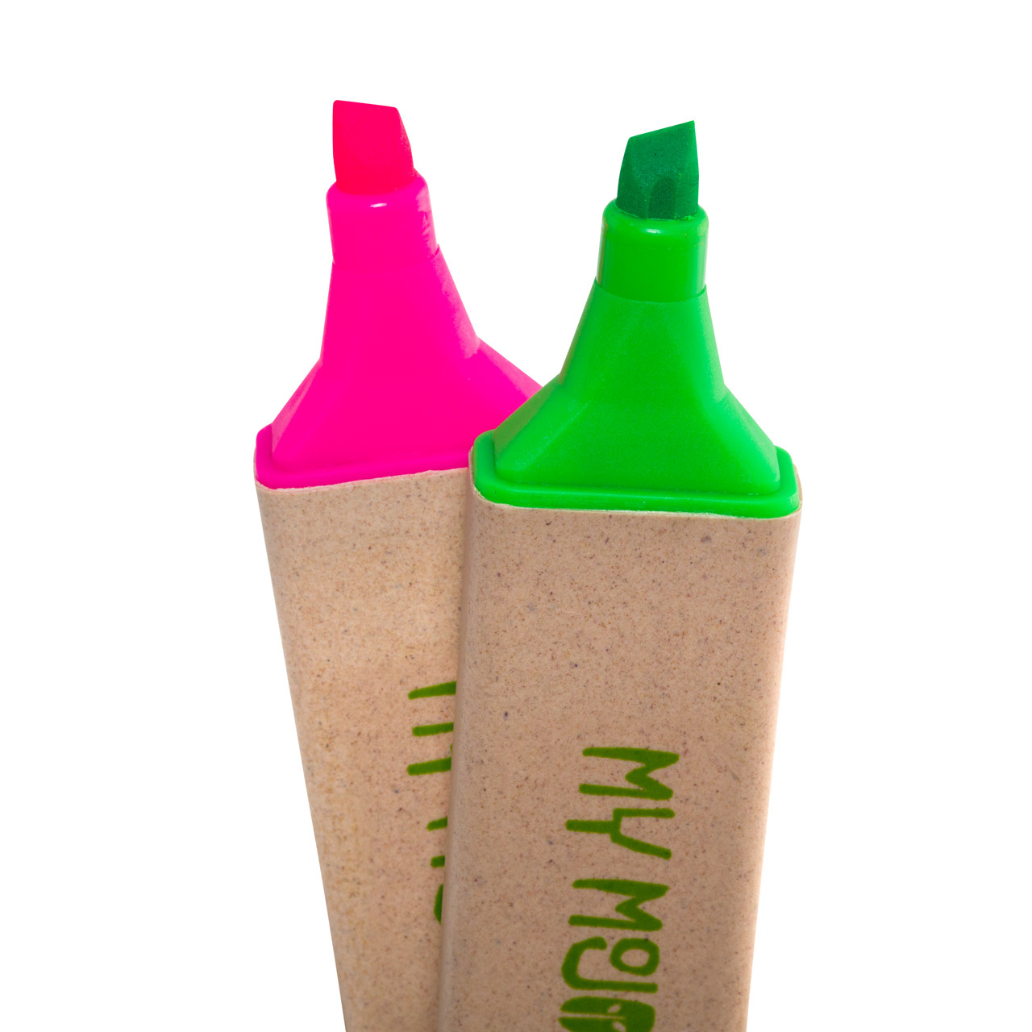
Look back at your marked drafts.
What have you done well?
What do you need to improve?

Slide 15
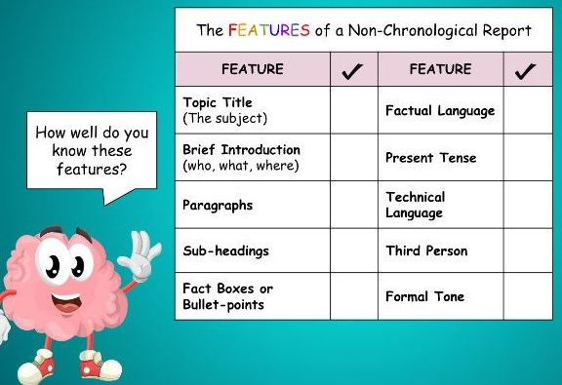
We are going to start writing our final non-chronological report for the Harvest Festival today.
Remember, the best reports will be chosen to go in our Harvest Festival video!
What do you need to include to create an impressive non-chronological report?

Slide 16
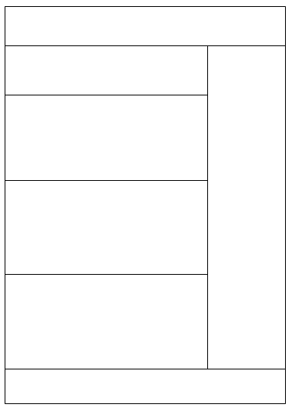
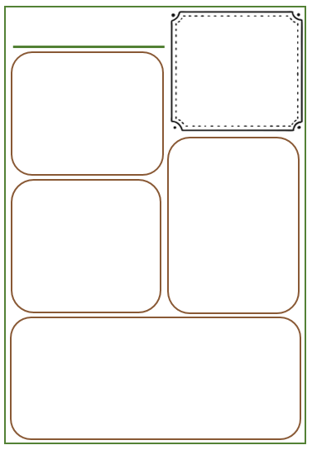

Slide 17

Activity
Using your marked draft to help you, begin to write your final non-chronological report.
Remember to ask an adult for help if you are unsure.

Slide 18
Friday 9th October 2020
LO: plan, write, edit and improve.
C: Harvest

Slide 19
Look back at your marked drafts.
What have you done well?
What do you need to improve?

Slide 20
We are going to finish writing our final non-chronological report for the Harvest Festival today.
Remember, the best reports will be chosen to go in our Harvest Festival video!
What do you need to include to create an impressive non-chronological report?

Slide 21
Activity
Using your marked draft to help you, finish writing your final non-chronological report.
This includes drawing and colouring your picture(s)!
Remember to ask an adult for help if you are unsure.

