Slide 1
LO: To count in 1000’s
C: To know and use number.
Watch this video until it asks you to pause, then answer the questions on the PowerPoints. Continue to watch the video and then answer the questions for Monday on our website.
https://vimeo.com/455437546

Slide 3
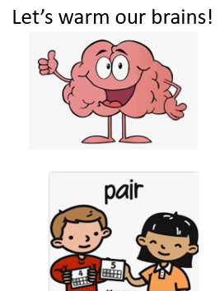
1) Complete the sequence.
100, 200, 300, 400, _____ , _____
2) Write the missing numbers.
800, 700, ____, 500, 400, ____
3) What is 100 more than 800?
4) What is 100 less than 200?

Slide 4
1) Complete the sequence.
100, 200, 300, 400, _____ , _____
2) Write the missing numbers.
800, 700, ____, 500, 400, ____
3) What is 100 more than 800?
4) What is 100 less than 200?
500
600
600
300
900
100

Slide 6

1,000
1,000
1,000
1,000
1,000
1,000
1,000
1,000
1,000
1,000
one thousand
two thousand
three thousand
four thousand
five thousand
six thousand
seven thousand
eight thousand
nine thousand
ten thousand

Slide 7
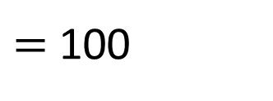
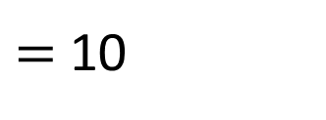
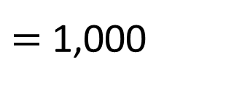
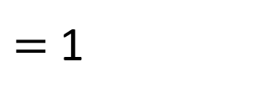
$=$ 1
$=$ 10
$=$ 100
$=$ 1,000

Slide 8
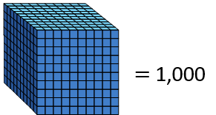




Slide 9
10,000
2,000
9,000
8,000
7,000
6,000
5,000
4,000
1,000
3,000
seven thousand
six thousand
five thousand
four thousand
three thousand
two thousand
one thousand
ten thousand
nine thousand
eight thousand

Slide 10
Have a go at these questions.

Slide 11
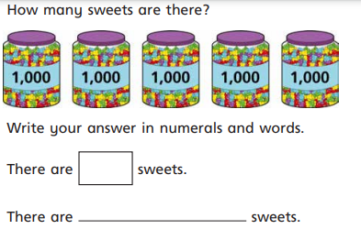
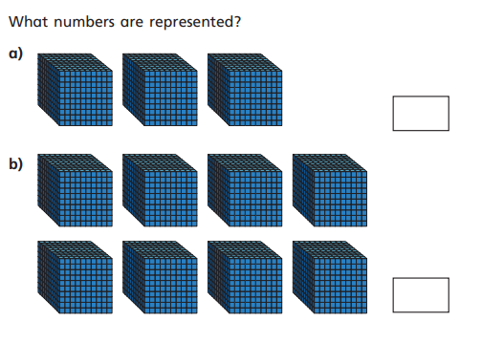

Slide 12
Answers
5000
Five thousand
3000
8000

Slide 13
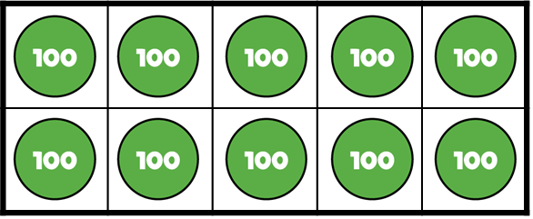
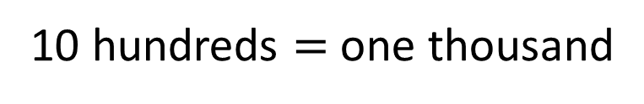
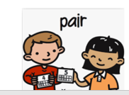
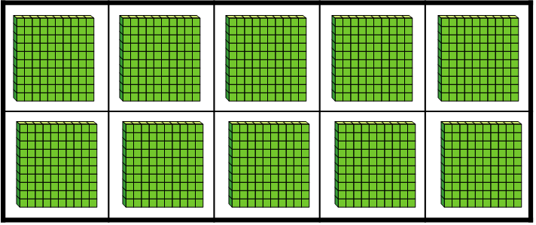
There are 10 hundreds.
10 hundreds $=$ one thousand
What’s the same?
What’s different?

Slide 14



Have a think
Which representations show 4,000?

Slide 15
Have a think
Which representations show 4,000?

Slide 16
Now have a go at Monday’s practice sheet that you can find on our webpage.

Slide 17
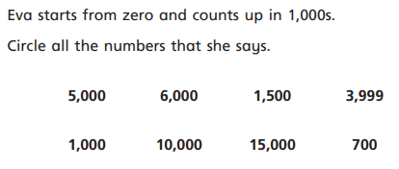
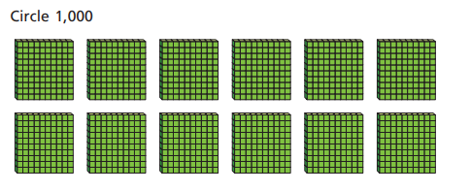
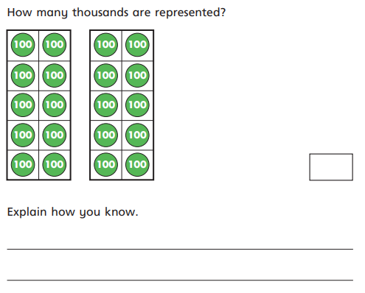
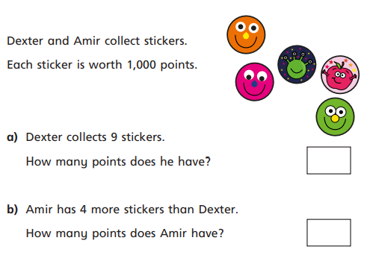
2000
9000
There are 10 lots of 100 in 1000. There are 20 lots of 100 here, so 2000 is represented
13,000

Slide 18
LO: Counting in 1000’s
LO: 1000’S, 100’S 10’S and 1’s.
C: To know and use number.
Watch this video until it asks you to pause, then answer the questions on the PowerPoints. Continue to watch the video and then answer the questions for Monday on our website.
https://vimeo.com/455438217

Slide 20
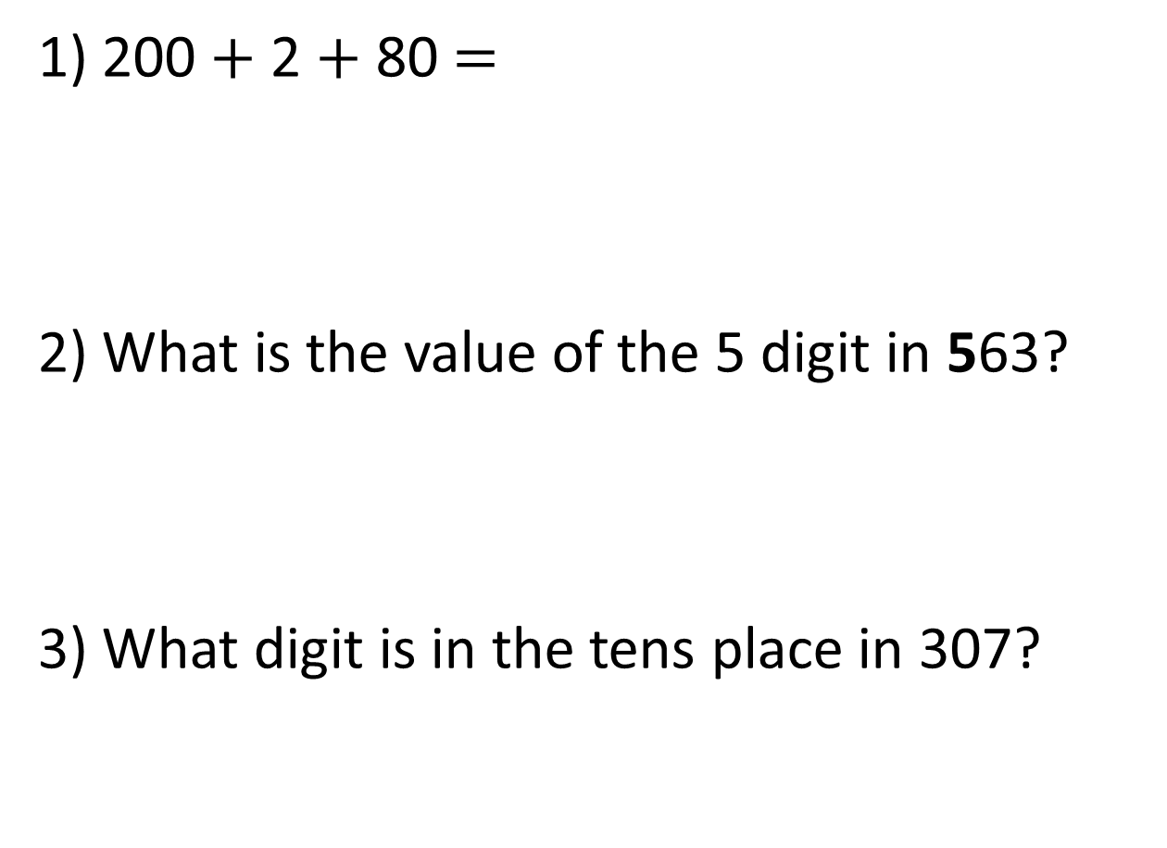
1) 200 $+$ 2 $+$ 80 $=$
2) What is the value of the 5 digit in 563?
3) What digit is in the tens place in 307?

Slide 21
1) 200 $+$ 2 $+$ 80 $=$
2) What is the value of the 5 digit in 563?
3) What digit is in the tens place in 307?
282
500
0

Slide 22
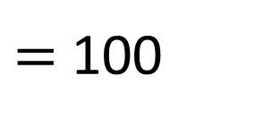
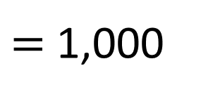
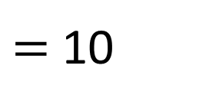
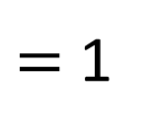
$=$ 1
$=$ 10
$=$ 100
$=$ 1,000

Slide 23
Thousands | Hundreds | Tens | Ones
3,000
200
30
5
3,235

Slide 24
Thousands | Hundreds | Tens | Ones
3,000
0
30
5
3,035

Slide 25


Have a think
Thousands | Hundreds | Tens | Ones
This number is 134

Slide 26
Have a think
Thousands | Hundreds | Tens | Ones
1,000
300
40
0
1,340
This number is 134

Slide 27

5,132
Have a think
What is the value of the 1 digit?
100
Thousands | Hundreds | Tens | Ones

Slide 28
5,132
5,000
What is the value of the 5 digit?
Thousands | Hundreds | Tens | Ones

Slide 29
5,132
Have a think
2
What is the value of the 2 digit?
Thousands | Hundreds | Tens | Ones
What is this number written in words?
Five thousand,
one hundred
and thirty-two

Slide 30
Now try the tasks for Tuesday that you
will find on our website

Slide 31
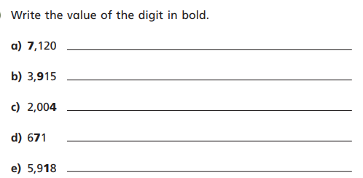
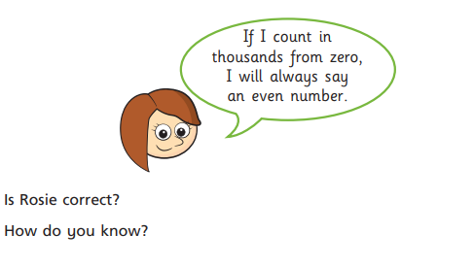
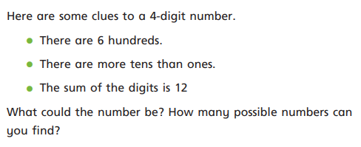
7000
900
4
70
10
Challenge
All multiples of a thousand end in a zero, therefore they are all even numbers as even numbers end in a 2, 4, 6, 8, or 0.
Answers may include:
3621 1650
2631 2640
1641 3630

Slide 32
LO: Partitioning.
C: To know and use number.
Watch this whole video (don’t pause to answer questions) then answer the questions for Wednesday on the website.
https://vimeo.com/455454604

Slide 34
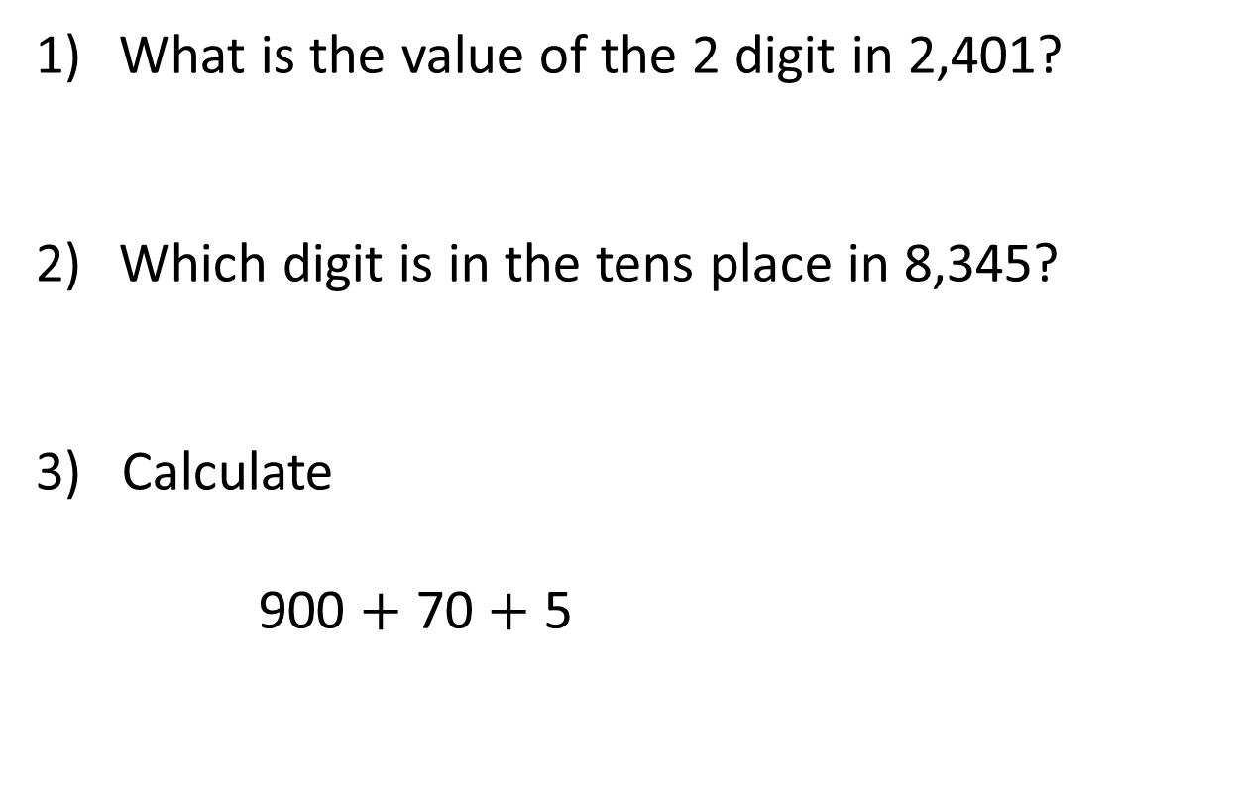
What is the value of the 2 digit in 2,401?
Which digit is in the tens place in 8,345?
3) Calculate
900 $+$ 70 $+$ 5

Slide 35
What is the value of the 2 digit in 2,401?
Which digit is in the tens place in 8,345?
3) Calculate
900 $+$ 70 $+$ 5
2,000
4
975

Slide 37




2,144
4
$$=$$
2,000
$$+$$
100
$$+$$
40
$$+$$
Thousands | Hundreds | Tens | Ones
Let’s look at this as a class.

Slide 38








Thousands | Hundreds | Tens | Ones
6,238
$$=$$
6,000
$$+$$
200
$$+$$
30
$$+$$
8
6,238
$$=$$
8
$$+$$
30
$$+$$
200
$$+$$
6,000

Slide 39




Have a think
Thousands | Hundreds | Tens | Ones
6,038
$$=$$
6,000
$$+$$
0
$$+$$
30
$$+$$
8
6,038
$$=$$
6,000
$$+$$
30
$$+$$
8

Slide 40
















Have a think
Thousands | Hundreds | Tens | Ones
3,412
$$=$$
3,000
$$+$$
400
$$+$$
10
$$+$$
2
3,412
$$=$$
3,000
$$+$$
300
$$+$$
110
$$+$$
2
3,412
$$=$$
3,200
$$+$$
200
$$+$$
10
$$+$$
2
3,412
$$=$$
$$+$$
100
$$+$$
$$+$$

Slide 41
5,692
5,000
2
600
90
5
6
5,692 is equal to thousands, hundreds,
tens and ones
9
2

Slide 42
Have a go at the Wednesday’s questions on our website.

Slide 43
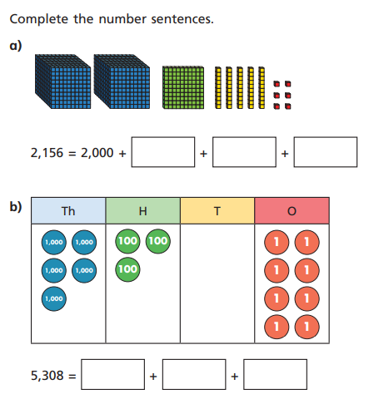
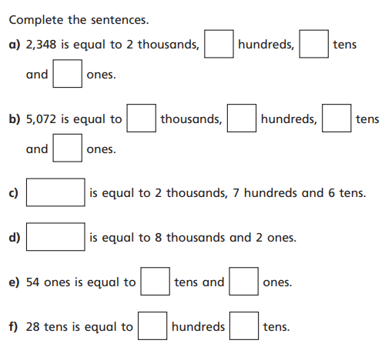
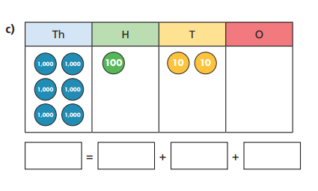

Slide 44
Answers
100
50
6
3
4
8
5
0
7
2
5000
300
8
2760
8002
5
4
2
8
6000
100
20
0

Slide 45
LO: Partitioning.
C: To know and use number.
Watch this whole video again (don’t pause to answer questions) then answer the questions for Thursday on the website.
https://vimeo.com/455454604

Slide 47
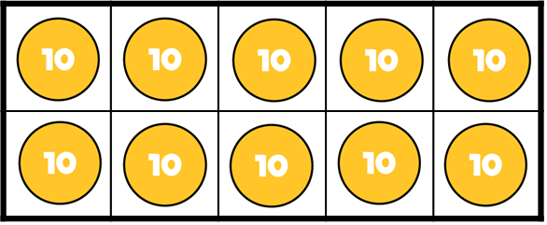


If
$$=$$
Then
$$=$$

Slide 48
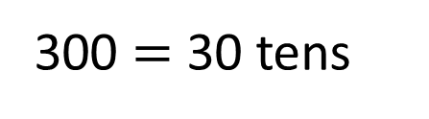
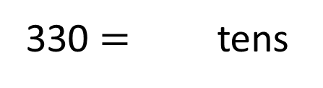
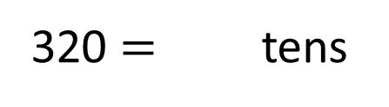
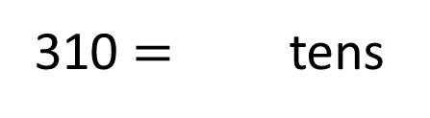
Have a think
If
300 $=$ 30 tens
Then
310 $=$ tens
31
320 $=$ tens
32
330 $=$ tens
33

Slide 49


If
$$=$$
Then
$$=$$
How many hundreds are equal to 4,100?
41

Slide 50
Have a go at Thursday’s questions
on our webpage.

Slide 51
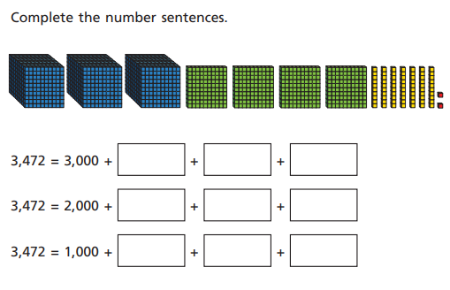
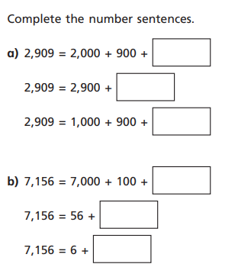
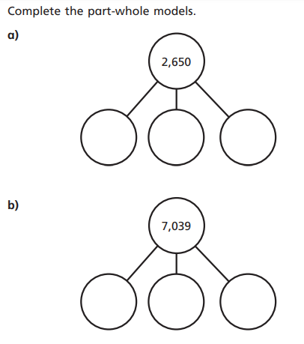
Diving Challenge: Explain why 20 hundreds
is equal to 2000. Use diagrams to help explain
if you can.

Slide 52

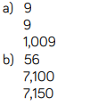

Answers
Diving Challenge: Explain why 20 hundreds
is equal to 2000. Use diagrams to help explain
if you can. I know that there are 10 hundreds in
1000. 10 x 100 = 1000. Therefore, I know there
will be 20 hundreds in 2000. 20 x 100 = 2000.

Slide 53
Friday: Spend some time practising your times tables on TT Rockstars.

