Slide 1
Lesson 3
LO: to construct and interpret food webs
C: Animals including humans

Slide 2
Food Chain Recap – What can you remember?
https://www.bbc.co.uk/bitesize/topics/zbnnb9q/articles/zsphrwx

Slide 3
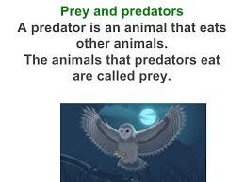
What is a predator? Prey?

Slide 4
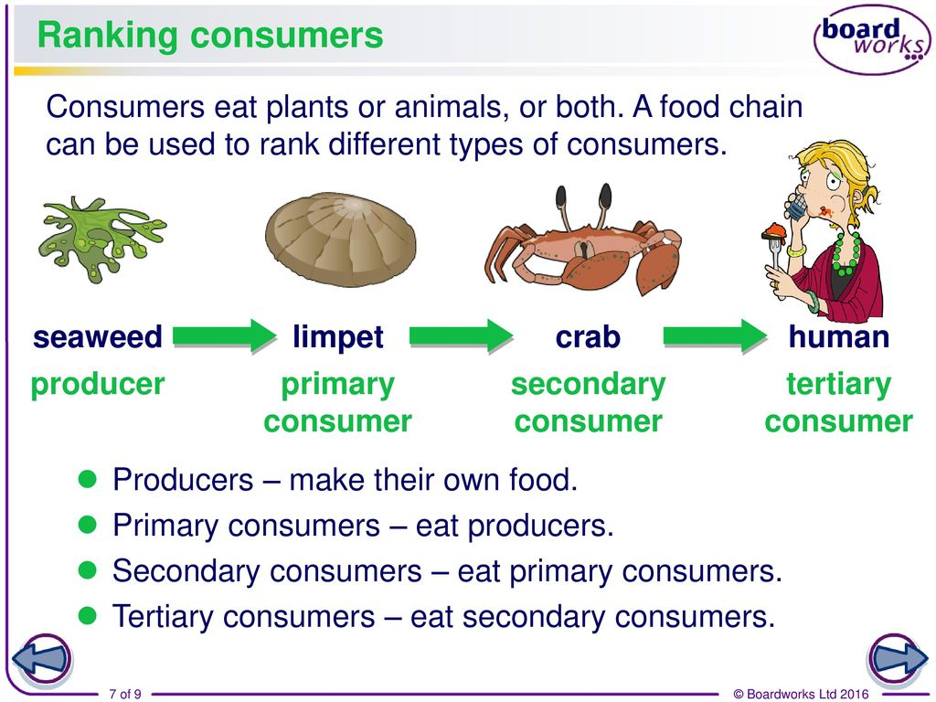
What is a producer? A consumer?

Slide 5
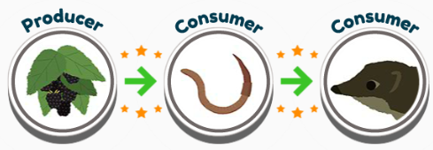
What would happen if there was an increase or decrease in numbers at each level of the food chain?

Slide 6
Some animals prepare for a lack of food at different times of the year – they might store food for the winter, they may hibernate or they migrate (move) to where there is food.
Remember the key role of plants in food chains: green plants form the basis of all food chains, so without them life on earth could not continue.
What would happen if the producer in a food chain dies? How will this affect the rest of the food chain?

Slide 7
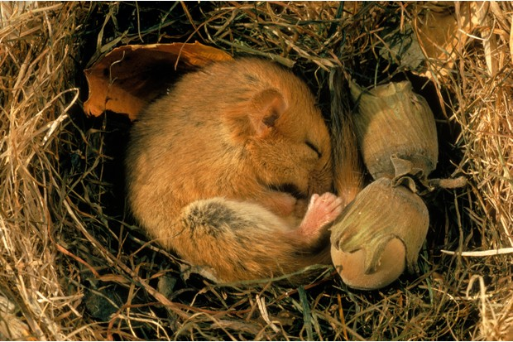
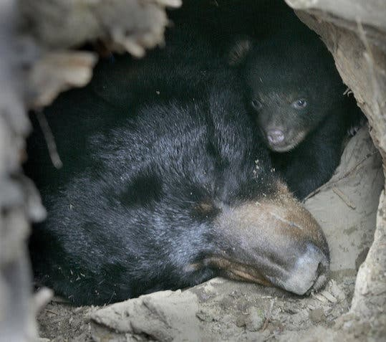
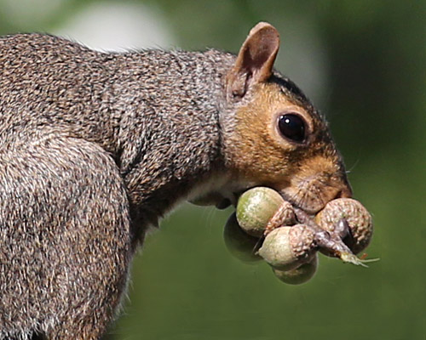
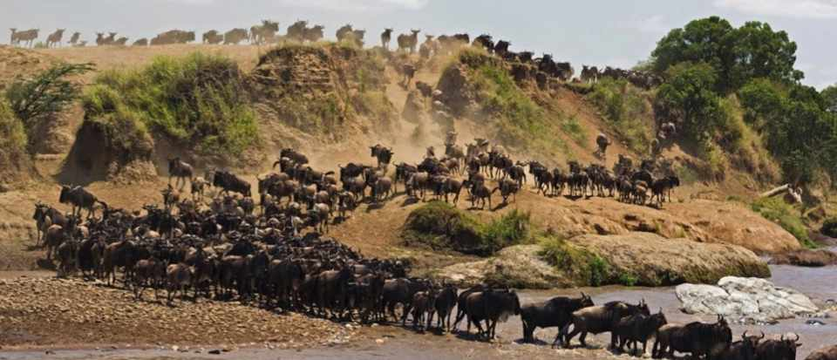
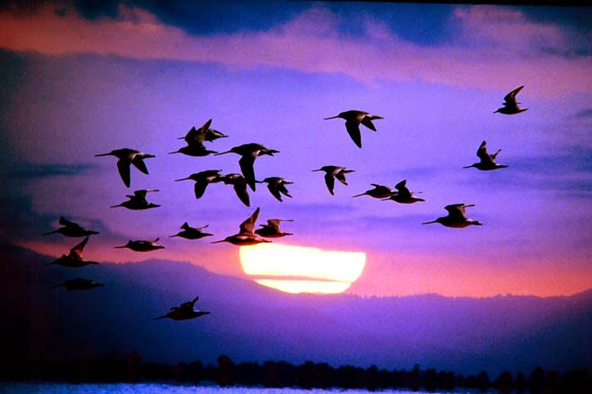

Slide 8
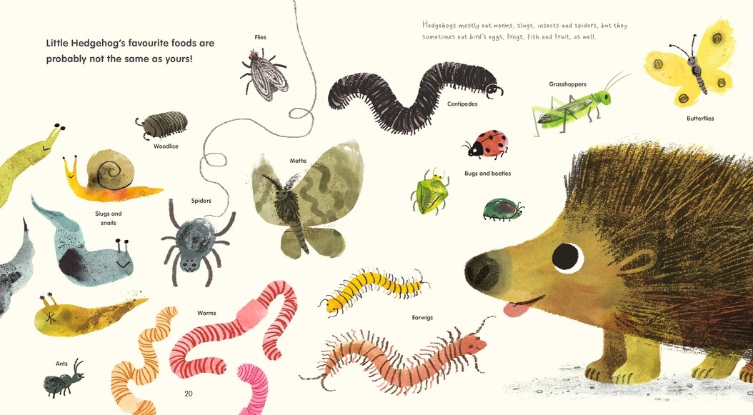
With so many plants and animals sharing the same habitat the feeding relationships are more complex than a simple chain.
Hedgehogs, for example, will eat insects, snails, frogs, toads, snakes, worms, bird eggs, dead animals, mushrooms, grass roots and berries!
Why might a wide and varied diet be a positive thing for the survival of the hedgehogs living in a habitat?

Slide 9
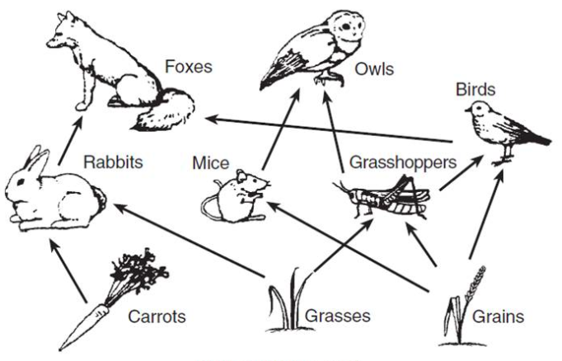
With so much interdependence many food chains become linked and a food web is created.
Interdependence is when two or more living things depend on each other for survival.

Slide 10
Can you identify the food chains which are linked in this food web?

Slide 11
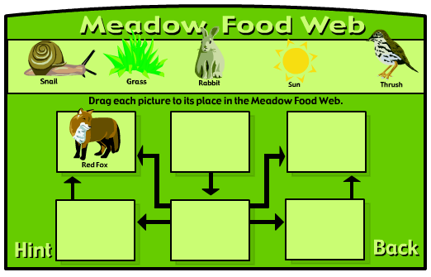
Let’s make our own food webs!
https://www.harcourtschool.com/activity/food/food_menu.html

Slide 12
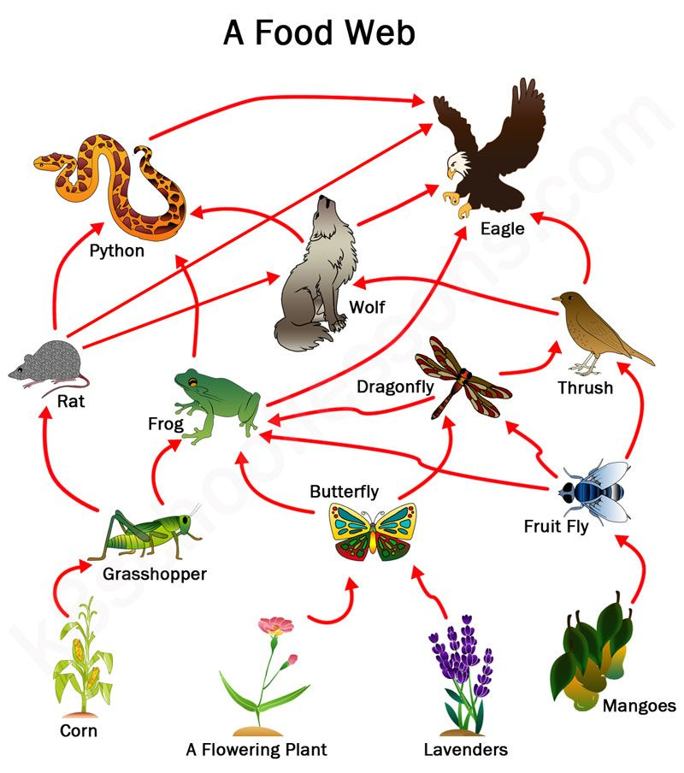
What do you notice about food webs?
Each thread of the food web still starts with a producer but creatures with varied diets may be linked in more than place.

Slide 13
Link to humans
Humans are known as omnivores as they can have a diet consisting of plant matter and animals.
What food chains can we create with humans at the ‘top’?

Slide 14
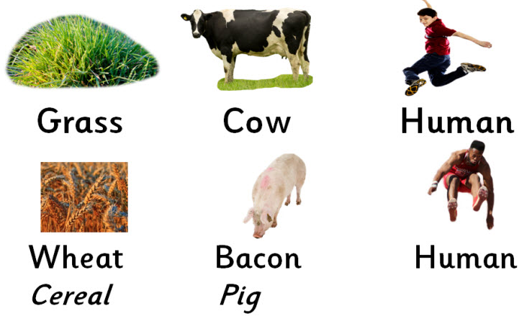
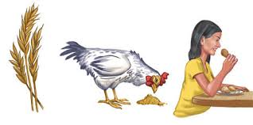
Can you combine these human food chains to create a food web?
Examples:
grass → cow → human
grass → sheep → human
wheat (bread) → human
grass → dragonfly → trout → human
wheat → chicken → human.

Slide 15

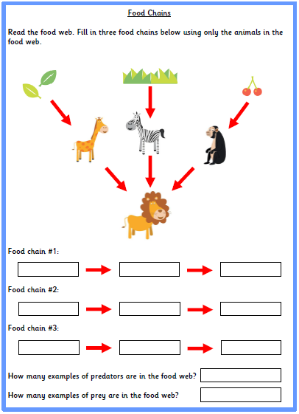
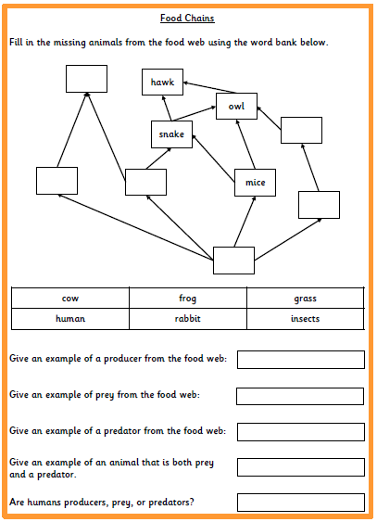
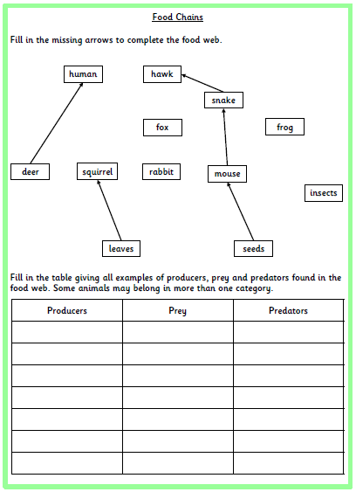
Paddling | Snorkelling | Diving
Look at the food web. Can you identify the individual food chains within the food web? How many predators are in the food web? How many prey are in the food web? Red Pen: can some animals be prey and predator? | Look at the incomplete food web – can you fill in the missing animals using the word bank? Explain/justify your choice. Identify a producer, prey and predator from the food web. Red Pen: what is the difference between a food web and a food chain? | Look at the incomplete food web – can you draw the missing arrows? Explain/justify your choice. Fill in the table of producers, prey and predators, remembering that some animals may belong in more than one category. Red Pen: no plant life concept cartoon (see next slide)

Slide 16


