Slide 1
LO. To build an overview of world history.
Context: Roman invasion

Slide 2
Topic enquiry question
‘What did the Romans ever do for me?’

Slide 3
How would you feel if someone suddenly came into your house and told you that you had to leave?

Slide 4

Invader Settler
What do these words mean?

Slide 5
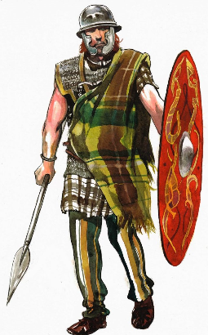
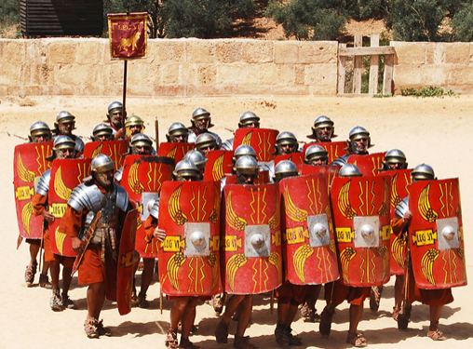
The Romans invaded Britain the were the invaders.
The settlers there were the Celts.

Slide 6
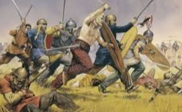
Who occupied Britain?
Around 2,000 years ago, Britain was ruled by tribes of people called the Celts. But this was about to change. For around a century, the Roman army had been building an Empire across Europe. Now it was coming for Britain!

Slide 7
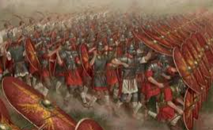
In AD43, the full might of the Roman army landed on the beaches in Kent. Over the next year it battled inland, storming through hillforts and chopping down anyone who stood in their way.

Slide 8
https://www.bbc.co.uk/bitesize/articles/z9j4kqt
Watch this video.
How do you think the Celts felt?

Slide 9
Task
Write a diary entry using emotive language to describe how the Celts may have felt when they were invaded by the Romans.

