Slide 1
Friday 20th November 2020
LO: to understand how beliefs are conveyed
C: Christianity

Slide 2
What Christmas carols can you think of?
Why do we sing these carols at Christmas time?
Do you have a favourite Christmas carol? Why?

Slide 3
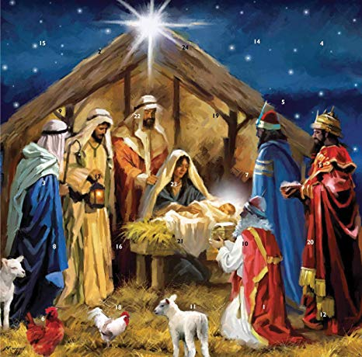
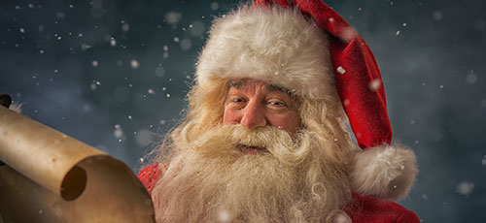
Watch out!
Christmas carols and Christmas songs are not the same!
Christmas carols are religious in nature, while Christmas songs are not.

Slide 4
Look at the lyrics of this Christmas Carol
Can you see any mention of the religious symbols we have looked at?
What does the carol make you imagine?
How does it help you to picture the birth of Jesus?
Do you have any questions about the carol?
Do you understand the words used in the carol?
Does it make you wonder anything?

Slide 5
O Holy Night
O holy night! The stars are brightly shining,
It is the night of the dear Saviour's birth.
Long lay the world in sin and error pining.
Till He appeared and the Spirit felt its worth.
A thrill of hope the weary world rejoices,
For yonder breaks a new and glorious morn.
Fall on your knees! Oh, hear the angel voices!
O night divine, the night when Christ was born;
O night, O holy night, O night divine!
O night, O holy night, O night divine!
Led by the light of faith serenely beaming,
With glowing hearts by His cradle we stand.
O'er the world a star is sweetly gleaming,
Now come the wise men from out of the Orient land.
The King of kings lay thus lowly manger;
In all our trials born to be our friends.
He knows our need, our weakness is no stranger,
Behold your King! Before him lowly bend!

Slide 6

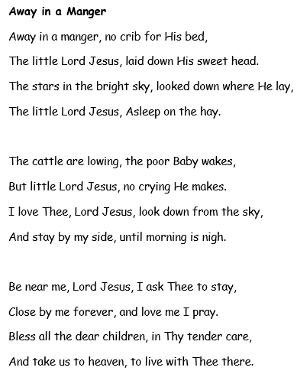
Paddling | Snorkelling | Diving
Draw a picture of what the carol makes you think of. Red Pen: Which is your favourite Christmas carol? Why? | Draw a picture of what the carol makes you think of and label it with quotes from the carol. Red Pen: If you were to write a Christmas carol, what would you write about? Why? | Annotate the carol with questions, what it makes you think of, any symbols you can find and what they may mean. Red Pen: Why do you think Christmas carols are important to Christians?

