Slide 1
Monday 16th November 2020
LO: to write with purpose.
C: Roman God Biographies

Slide 2

Have you heard of this word before?
Do you know what this word means?

Slide 3


Slide 4
A biography is about someone else’s life.
It is about a real person but written by someone else. The author must know a lot about the person and research the person, so that they can write a lot about them.
A biography highlights the key events that have happened in their life, sometimes talking about their childhood.
It can be written about someone who is dead or alive.
A biography describes key facts about a person, such as, where, when and how they live (or have lived if the person is no longer alive).
It provides details that show events in a person’s life.
A biography might talk about a person’s achievements, things that have happened to them, and their likes and dislikes.

Slide 5
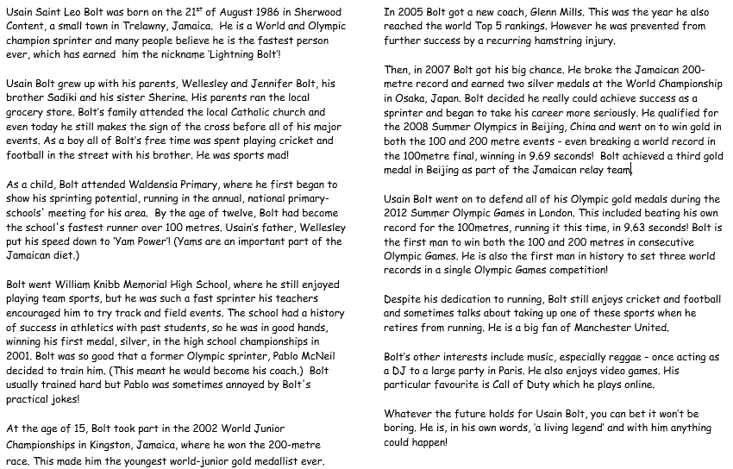
What are the features of biographies?

Slide 6
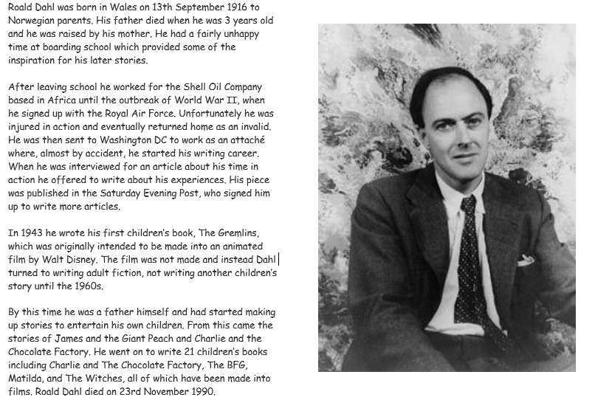
Does it have all of the features we have identified?
Are there any more features we need to add to our list?

Slide 7
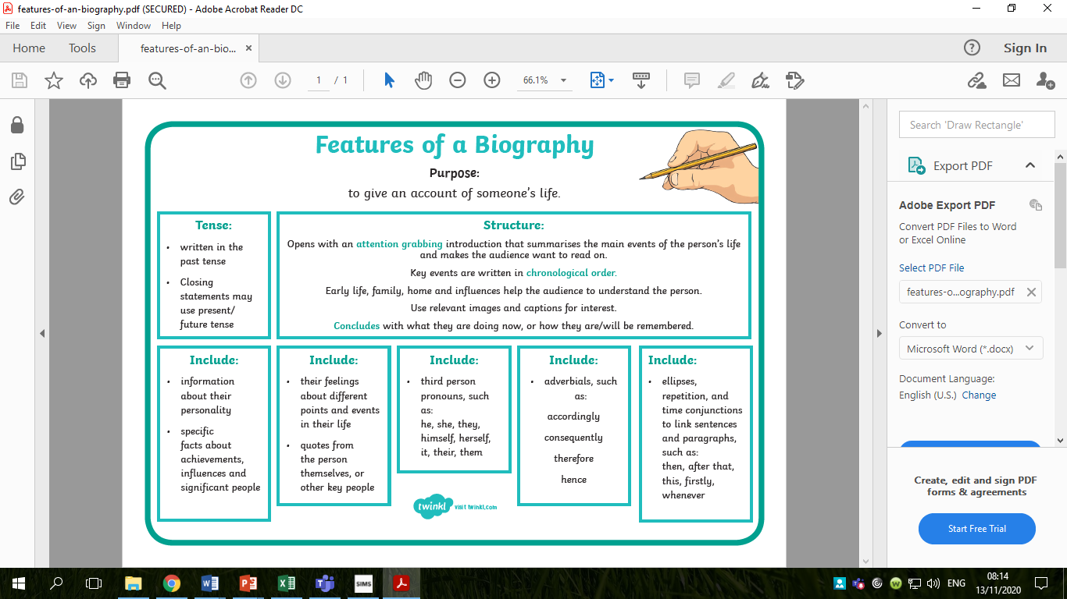

Slide 8
You are going to be writing your own biography about your Roman God this week!
What sub-headings might you use for our Roman God biographies?
What might you write about?

Slide 9
You could write about your God’s:
Childhood
Adulthood
Achievements
Early life
Later life
Successes
Hobbies and interests

Slide 10
Activity:
Create a bubble map for each of your chosen sub-headings showing what you will write in each one.
Red Pen Challenge: using the fronted adverbials word mat, annotate your bubble maps with different sentence starters you could use in your writing this week.

Slide 11
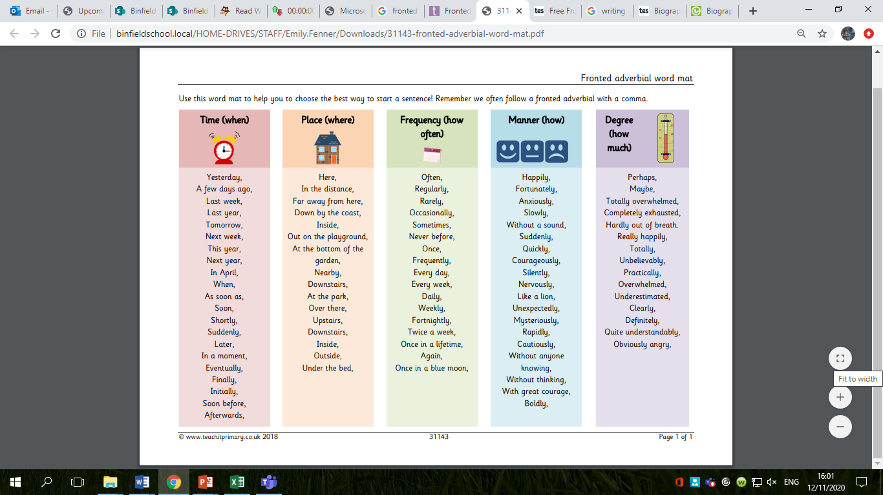

Slide 12
Tuesday 17th November 2020
LO: To organise writing appropriately
To use paragraphs.
To punctuate accurately.
C: Roman God Biographies

Slide 13
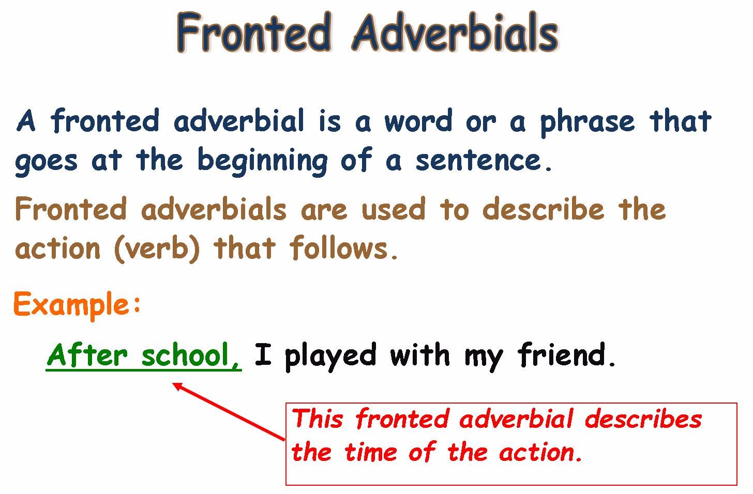
Fronted Adverbials
https://www.bbc.co.uk/bitesize/topics/zwwp8mn/articles/zp937p3#:~:text=A%20fronted%20adverbial%20is%20when,today'%20is%20a%20fronted%20adverbial

Slide 14
Using the fronted adverbials word mat, create some sentences about your Roman God.
Think about where the comma should go.

Slide 15

Early Life
Eddie, the God of Education, was born in 450 BC, in the growing, bustling city of Rome. He grew up with his parents, Venus and Neptune, his brother, Billy, and his sister, Lily. As a child, Eddie spent his days playing in his garden with his siblings and his pet monkey. He loved to practise his spellings with his ivory letters.
When he was old enough, Eddie went to school. His parents had to pay for him, so he worked hard and always tried his best. At school, he learned Literature, Maths and History. His favourite subject was Literature, because he loved to write. Although Eddie was the brightest child in school, he didn’t have many friends.
By the age of 12, Eddie had learned everything his teachers could teach him. Because Eddie enjoyed school so much, he stayed on, and helped the other children in his class. Slowly, but surely, Eddie began to make friends, as the children realised what a kind and caring God he was.

Slide 16
What are you going to include in your first paragraph?

Slide 17
Using the fronted adverbials word mat, create some sentences you could use in your writing today.
Make sure you are using conjunctions too!

Slide 18
Activity:
Write the first paragraph of your biography.
Remember to use:
- conjunctions
- correct punctuation
- fronted adverbials
Red Pen Challenge: use different sentence starters to make your writing more interesting.

Slide 20
Wednesday 18th November 2020
LO: To organise writing appropriately
To use paragraphs.
To punctuate accurately.
C: Roman God Biographies

Slide 21

Starter:
Spend 10 minutes looking back at your work from yesterday.
Use a red pen to make any corrections.

Slide 22
Fronted Adverbials Recap

Slide 23
Adulthood
When Eddie grew up, he realised that his purpose in life was to help others to learn. While his brother became a Roman soldier, Eddie stayed at home reading book after book. Eventually, he became the headteacher at his local school. Because he believed in fairness and equality, Eddie lowered the price of attending school, so that poor children could learn too. As word spread of Eddie’s kindness, the school population grew. Eddie was well-known in the now crowded, over-populated city of Rome, and children would travel for miles to learn from him.
When he was 20, Eddie met his beautiful wife, Solar. They married, and had two children called Star and Moon. While they weren’t as clever as Eddie, they did try hard to learn in school.
When Eddie retired, he moved to the countryside. Occasionally, he would return to his old school, so he could see how well they were learning. Everyone looked forward to Eddie’s visits, because he always taught them something new.

Slide 24
What are you going to include in your second paragraph?

Slide 25
Using the fronted adverbials word mat, create some sentences you could use in your writing today.
Make sure you are using conjunctions too!

Slide 26
Activity:
Write the second paragraph of your biography.
Remember to use:
- conjunctions
- correct punctuation
- fronted adverbials
Red Pen Challenge: use different sentence starters to make your writing more interesting.

Slide 28
Thursday 19th November 2020
LO: To organise writing appropriately
To use paragraphs.
To punctuate accurately.
C: Roman God Biographies

Slide 29
Starter:
Spend 10 minutes looking back at your work from yesterday.
Use a red pen to make your corrections.

Slide 30
Fronted Adverbials Recap

Slide 31
Achievements
Eddie’s greatest achievement was helping thousands of Roman children to learn in a variety of different ways. He made learning accessible for children of all backgrounds, because he was fair and just. Because of Eddie, an immeasurable number of poor Roman children received an education. These children might otherwise have been forced to work in horrible conditions at a young age.
Eddie didn’t just teach children, he taught adults how to teach! Now, there are hundreds of teachers around the Roman Empire helping children to learn. Without Eddie’s help, the people of the Empire would have remained uneducated, and the rule of the Romans would have looked incredibly different.
Eddie used his knowledge as power, and helped the Roman Emperors to create unbeatable battle plans. If it hadn’t been for Eddie, the Roman Empire would not have been able to spread so far across the globe.

Slide 32
What are you going to include in your third paragraph?

Slide 33
Using the fronted adverbials word mat, create some sentences you could use in your writing today.
Make sure you are using conjunctions too!

Slide 34
Activity:
Write the third paragraph of your biography.
Remember to use:
- conjunctions
- correct punctuation
- fronted adverbials
Red Pen Challenge: use different sentence starters to make your writing more interesting.

