Slide 1
PSHCE

Slide 2
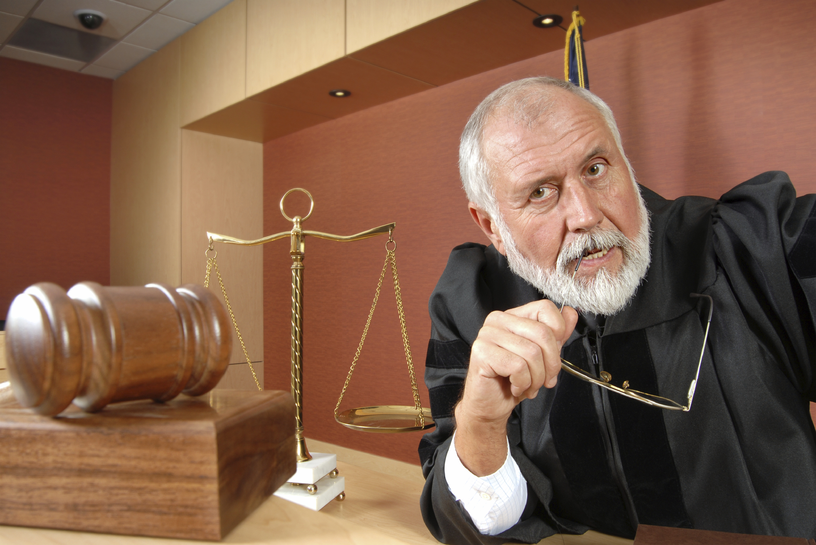

Slide 3
What would this man’s job be?
How might he make his decisions?

Slide 4
This man is a judge.
He has to decide what consequence a person has after his team of jurors decides someone guilty of a crime.

Slide 5
Make a poster based on what he may have to consider about when thinking of a reasonable consequence.
Think about:
Has the person committed a crime before?
What did they do?
Did the person mean to do it?
Are they sorry?

