Slide 1
Mon
LO: To compare 4 digit numbers.
C: To know and use number.
Watch this video, without pausing where it asks you to, then answer the
questions for Monday that you will find on our webpage.
https://vimeo.com/457429670

Slide 3
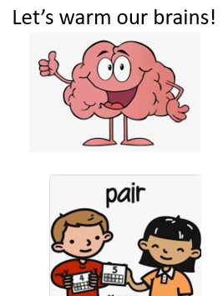
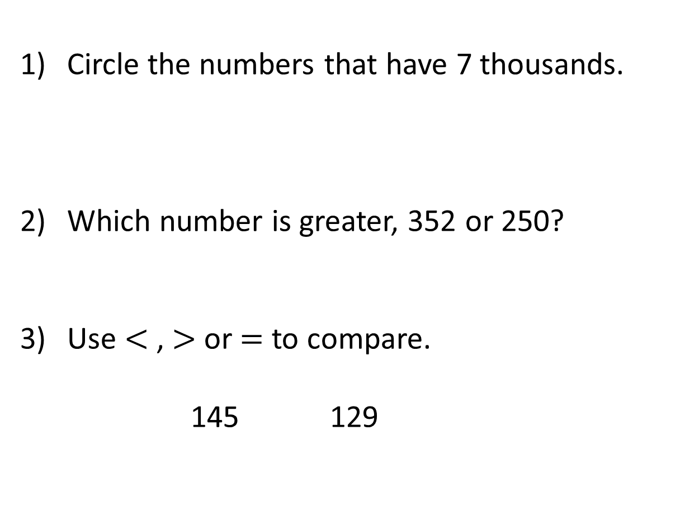
Circle the numbers that have 7 thousands.
Which number is greater, 352 or 250?
Use $<$ , $>$ or $=$ to compare.
145 129
7,893 792 4,827 7,023

Slide 4

Circle the numbers that have 7 thousands.
Which number is greater, 352 or 250?
Use $<$ , $>$ or $=$ to compare.
145 129
7,893 792 4,827 7,023
352
$$>$$

Slide 6
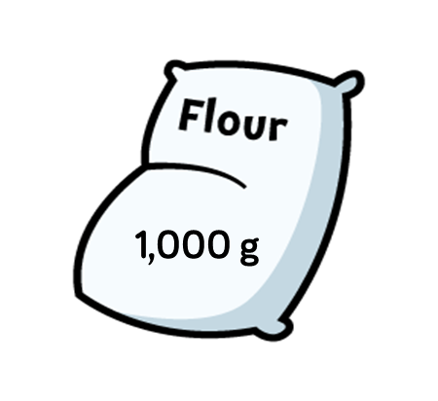

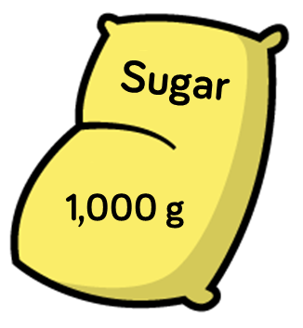
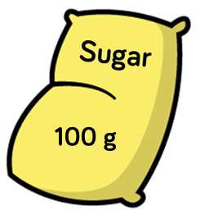
Is there more flour or more sugar?

Slide 7


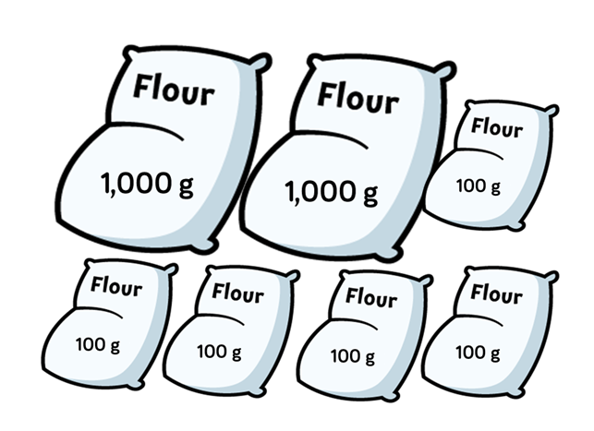
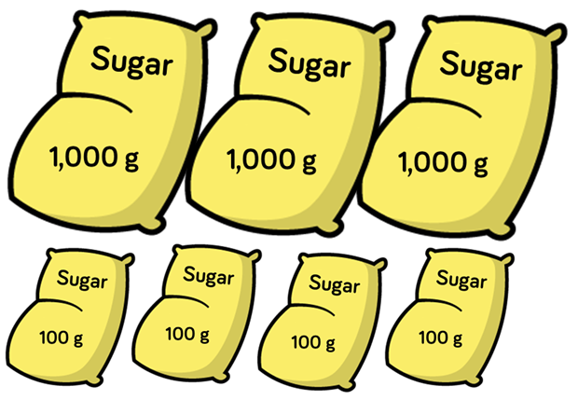
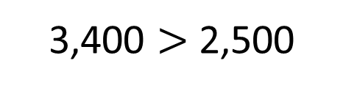
Th | H | T | O
Th | H | T | O
2
5
0
0
3
4
0
0
There is more sugar than flour.
3,400 is greater than 2,500
3,400 $>$ 2,500

Slide 8
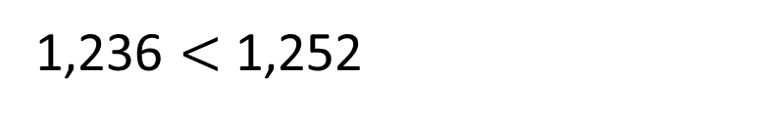
Thousands | Hundreds | Tens | Ones
2
2
1,236 $<$1,252
5
1,236 is less than 1,252
1
Thousands | Hundreds | Tens | Ones
1
2
3
6

Slide 9
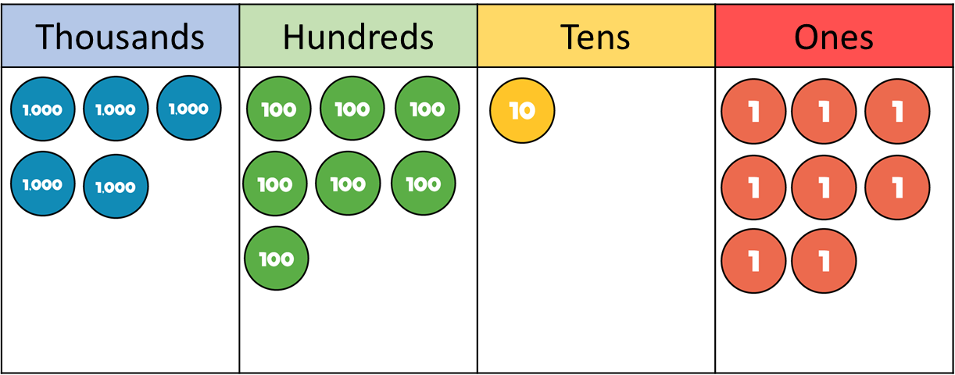
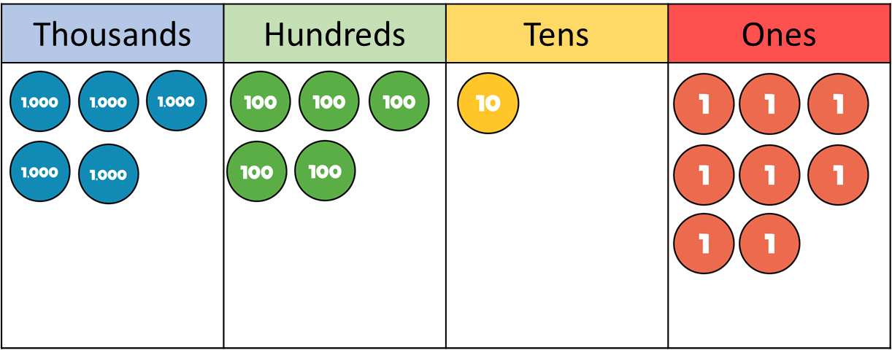
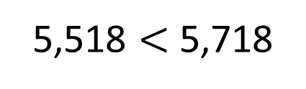
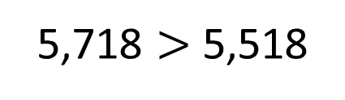
5,718 is greater than 5,518
5,518 is less than 5,718
5
7
1
8
5,518 $<$ 5,718
5,718 $>$ 5,518
5
5
1
8

Slide 10




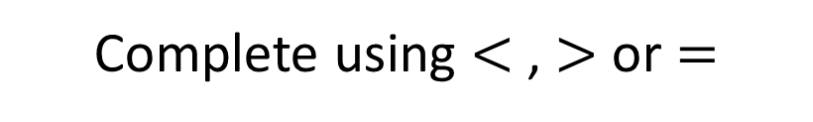
Complete using $<$, $>$ or $=$
Have a think
4
8
2
0
$$>$$
4
8
0
2
4
2
2
0
$$<$$
4
8
0
2
4
8
0
2
$$>$$
4
8
8

Slide 11
Now it’s your turn to have a go…

Slide 12
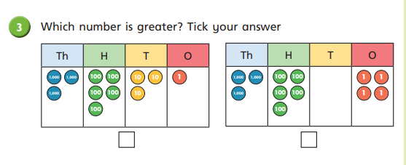
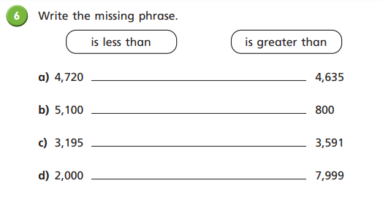
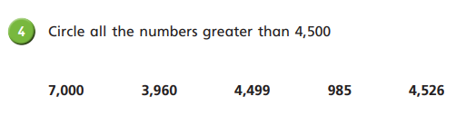
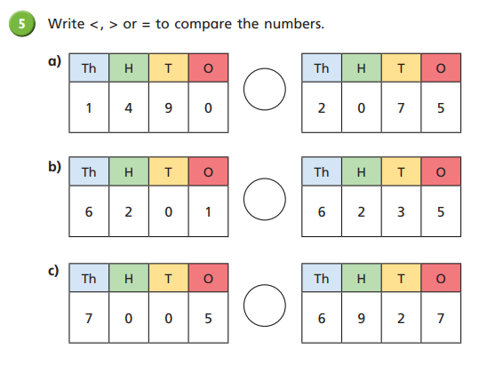
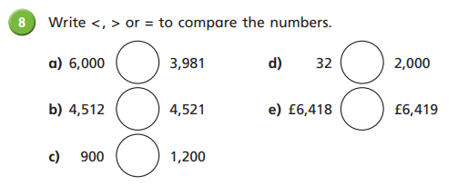

Slide 13

Answers
is greater than
is greater than
is less than
is less than
7,000, 4,526
a) > b) < c) < d) < e) <
a) < b) < c) >

Slide 14
Tues
LO: To compare 4 digit numbers.
LO: To order numbers.
C: To know and use number.
Watch this video, without pausing where it asks you to, then answer the
questions for Tuesday that you will find on our webpage.
https://vimeo.com/457785786

Slide 16
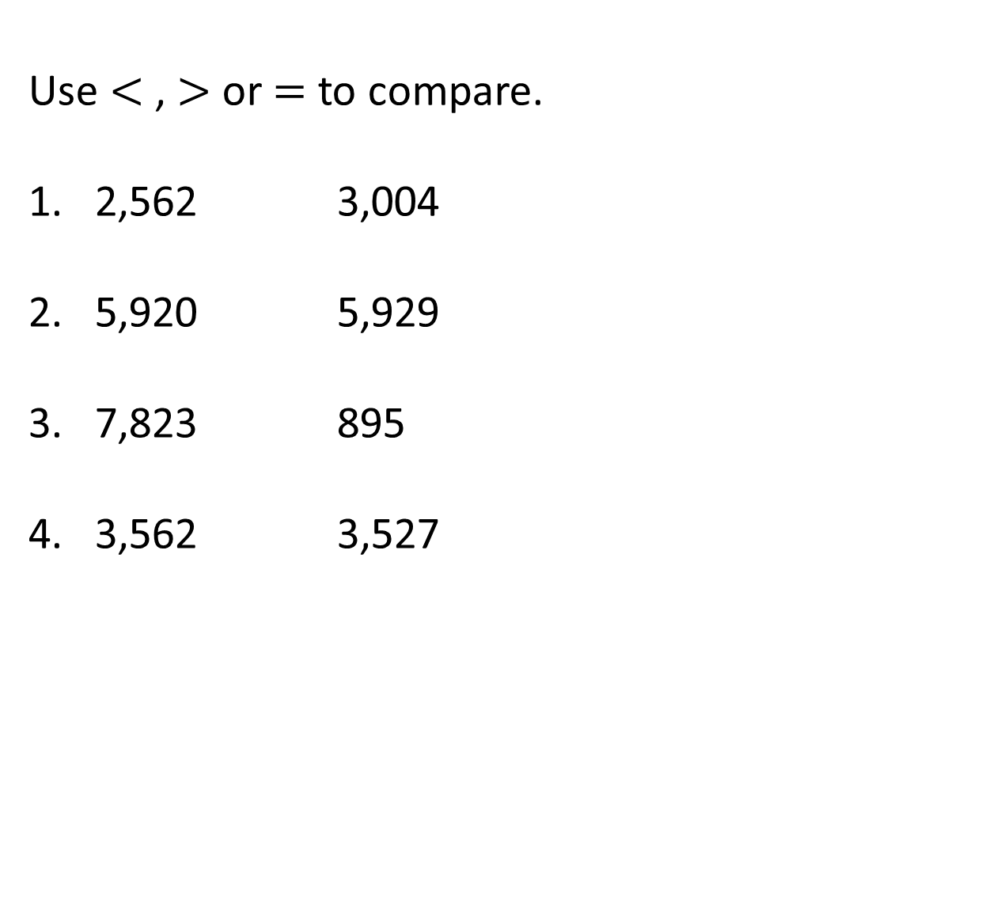
Use $<$ , $>$ or $=$ to compare.
2,562 3,004
2. 5,920 5,929
3. 7,823 895
4. 3,562 3,527

Slide 17



Use $<$ , $>$ or $=$ to compare.
2,562 3,004
2. 5,920 5,929
3. 7,823 895
4. 3,562 3,527
$$<$$
$$<$$
$$>$$
$$>$$

Slide 19



I have done 3,589 steps.
Annie
I have done 3,600 steps.
Mo
I have done 2,942 steps.
Ron
Who has done the most steps?

Slide 20


Annie 3,569
3,600 is the largest number.
Mo 3,600
Mo has done the most steps.
Ron 2,942
Who has done the most steps?
2,942
3,569
3,600

Slide 21
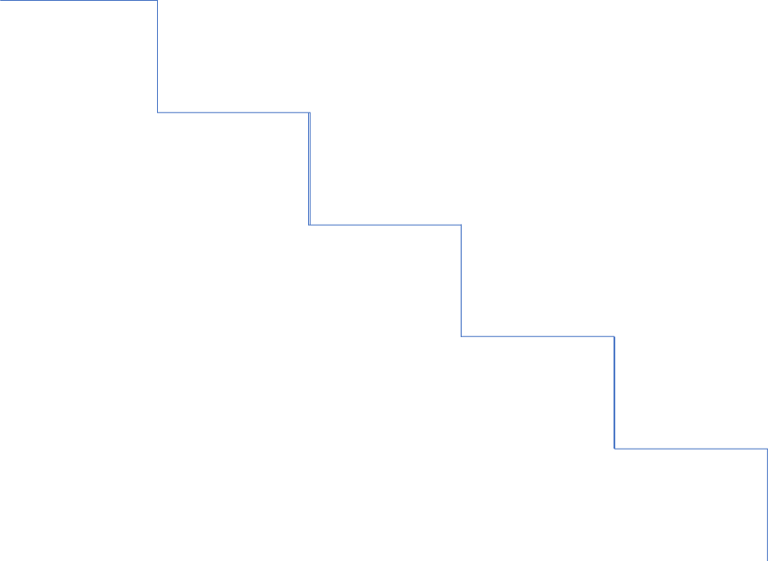
Order the numbers in ascending order.
7,382 850 7,391
ascending
descending
smallest to greatest
greatest to smallest
least to most
most to least

Slide 22
Order the numbers in ascending order.
7,382 850 7,391
Thousands | Hundreds | Tens | Ones
7
3
8
2
8
5
0
7
3
9
1
850
7,382
7,391

Slide 23
Now it’s your turn…

Slide 24
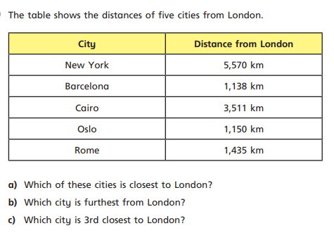
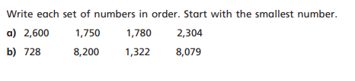
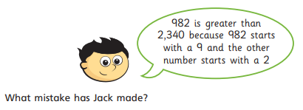
Diving challenge

Slide 25
Answers
1,750 1,780 2,304 2,600
b) 728 1,322 8,079 8,200
a) Barcelona b) New York c) Rome
Diving challenge
An answer referring to 9 hundreds is
smaller than 2 thousands.

Slide 26
Wed
LO: To round to the nearest 1000.
C: C: To know and use number.
Watch this video, without pausing where it asks you to, then answer the
questions for Wednesday that you will find on our webpage.
https://vimeo.com/458106101

Slide 28
Complete the sequence.
2) Round 4,583 to the nearest 10
3) Round 2,391 to the nearest 100
1,000 | 2,000 |  | 4,000 |  |  | 7,000

Slide 29
Complete the sequence.
2) Round 4,583 to the nearest 10
3) Round 2,391 to the nearest 100
1,000 | 2,000 |  | 4,000 |  |  | 7,000
3,000
5,000
6,000
4,580
2,400

Slide 31
Round 2,400 to the nearest 1,000
1,000
2,000
2,100
2,200
2,300
2,400
2,500
2,600
2,700
2,800
2,900
3,000

Slide 32
Round 2,400 to the nearest 1,000
400
600
2,000
2,100
2,200
2,300
2,400
2,500
2,600
2,700
2,800
2,900
3,000
2,400 is closer to 2,000 than 3,000
2,400 rounded to the nearest 1,000 is 2,000

Slide 33
Round 2,478 to the nearest 1,000
478
522
2,000
2,100
2,200
2,300
2,400
2,500
2,600
2,700
2,800
2,900
3,000
2,478 is closer to 2,000 than 3,000
2,478 rounded to the nearest 1,000 is 2,000

Slide 34
Round 5,750 to the nearest 1,000
750
250
5,000
5,100
5,200
5,300
5,400
5,500
5,600
5,700
5,800
5,900
6,000
5,750
5,750 is closer to 6,000 than 5,000
5,750 rounded to the nearest 1,000 is 6,000

Slide 35

Round 5,750 to the nearest 1,000
Thousands | Hundreds | Tens | Ones
5
7
5
0
0
100s
1
100
2
100s
3
100s
4
100s
5
100s
6
100s
7
100s
8
100s
9
100s
5,750 rounded to the nearest 1,000 is 6,000

Slide 36
Now it’s your turn to have a go…

Slide 37
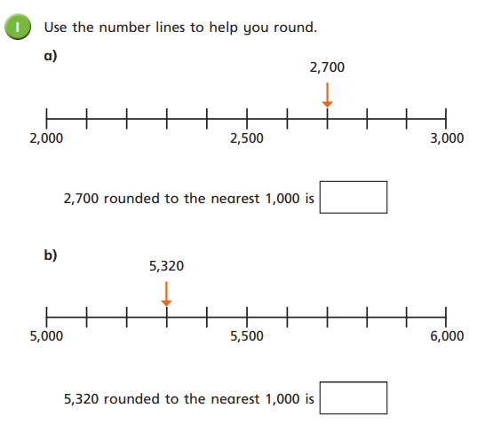
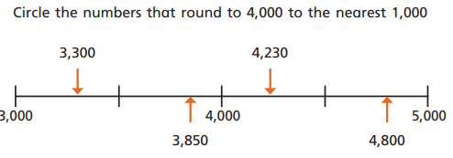
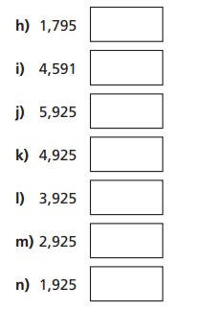
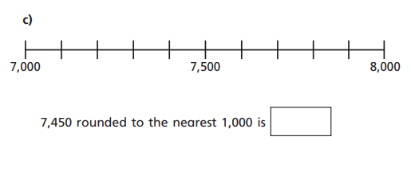
Draw a number line for each on the back
of the sheet.

Slide 38

Answers
3,850 and 4,230
a) 3,000 b) 5,000 c) 7,000

Slide 39
Wed
LO: To round to the nearest 1000.
C: To know and use number.
Re-watch this video, without pausing where it asks you to, then answer the
questions for Thursday that you will find on our webpage.
https://vimeo.com/458106101

Slide 40
6,
5
0
8
Round to the nearest 1,000
Round to the nearest 10
Round to the nearest 100
hundreds digit
ones digit
7,000
tens digit
6,510
6,500
0
1
2
3
4
5
6
7
8
9

Slide 41
8,
9
9
2
Have a think
Round to the nearest 1,000
Round to the nearest 10
Round to the nearest 100
hundreds digit
ones digit
9,000
tens digit
8,990
9,000
0
1
2
3
4
5
6
7
8
9

Slide 42
Now it’s your turn…

Slide 43
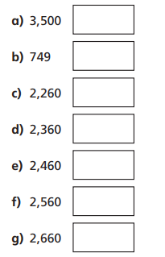
Draw a number line for each one neatly in your books.

Slide 44

Answers

