Slide 1
Monday 19th October 2020
Lo: to use sentences appropriately
C: Robin Hood

Slide 2
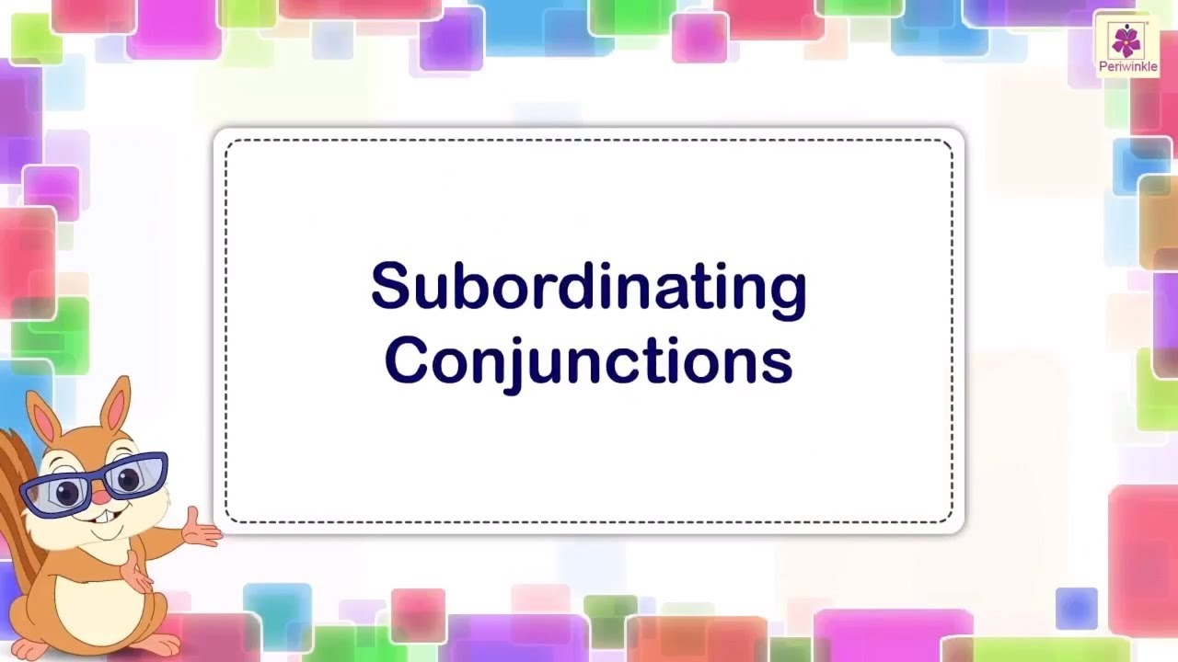
Subordinating Conjunctions
What is a subordinating conjunction?

Slide 3
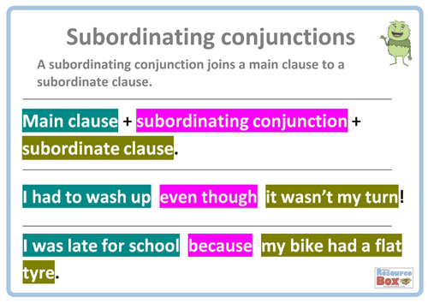
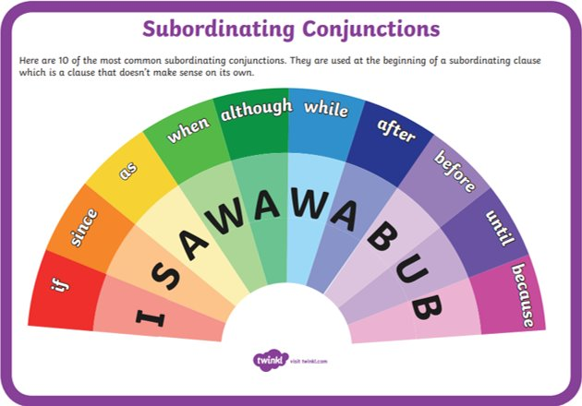

Slide 4
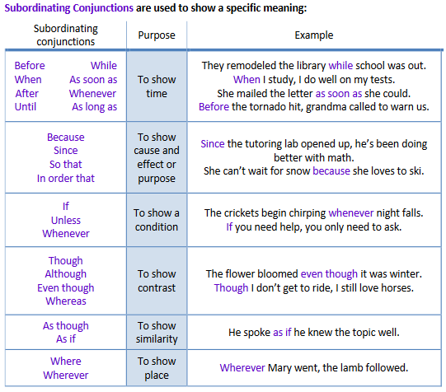

Slide 5
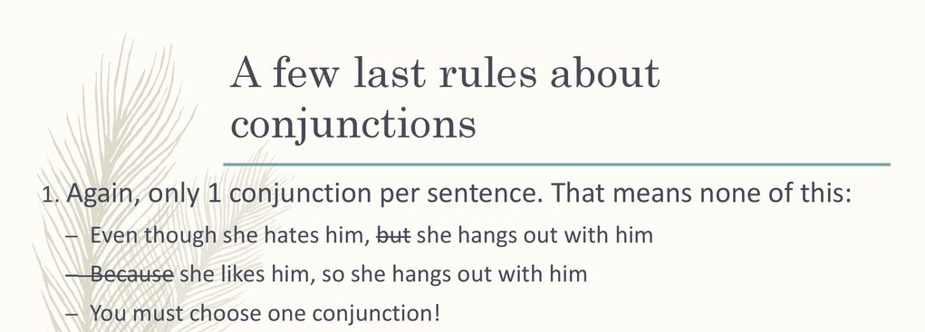
How many conjunctions should be in a sentence?

Slide 6
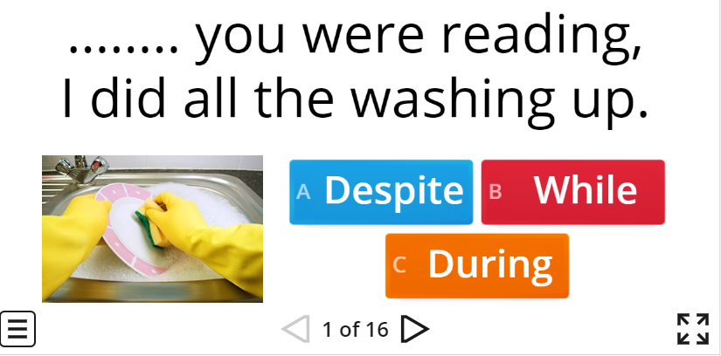
Subordinating Conjunctions Game
https://wordwall.net/resource/516002/conjunctions-level-1-2

Slide 7
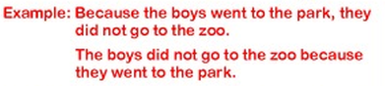
Look at your sentences from Tuesday's lesson.
We are going to expand these sentences using subordinating conjunctions!
Let's do some together.
Challenge: can you start your sentence with a subordinating conjunction?

Slide 8
Activity:
Extend your simple sentences from last Tuesday's lesson using subordinating conjunctions.
Remember to punctuate your sentences correctly with capital letters and full stops.
Check your sentences make sense.
Challenge: can you start your sentence with a subordinating conjunction?
Write it out with the subordinating conjunction in the middle of the sentence and then write it out again with the conjunction at the beginning of the sentence!

Slide 9
Tuesday 20th October 2020
Lo: to use sentences appropriately
C: Robin Hood

Slide 10
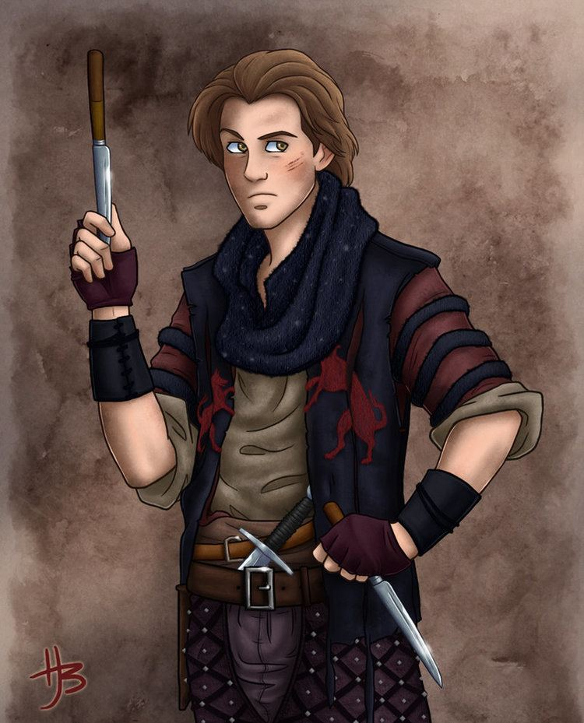
Will Scarlett
Will Scarlett is one of Robin Hood’s merry men!
Look at this picture of Will Scarlett – what expanded noun phrases can you think of to describe him?
Let’s turn our expanded noun phrases into sentences with subordinate conjunctions.

Slide 11
Activity:
1. Work with an adult in the room to red pen your work from yesterday.
2. In pairs: write sentences with subordinate conjunctions and expanded noun phrases which describe Will Scarlett.

Slide 12
Wednesday 21st October 2020
Lo: to use sentences appropriately
C: Robin Hood

Slide 13
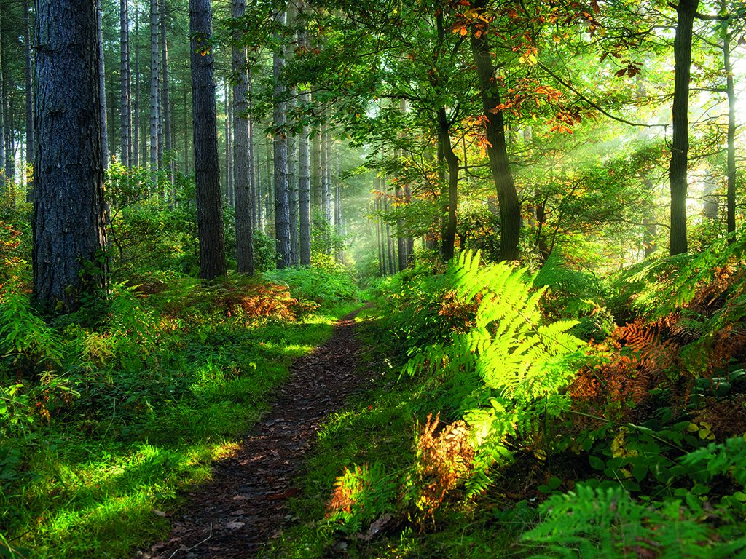
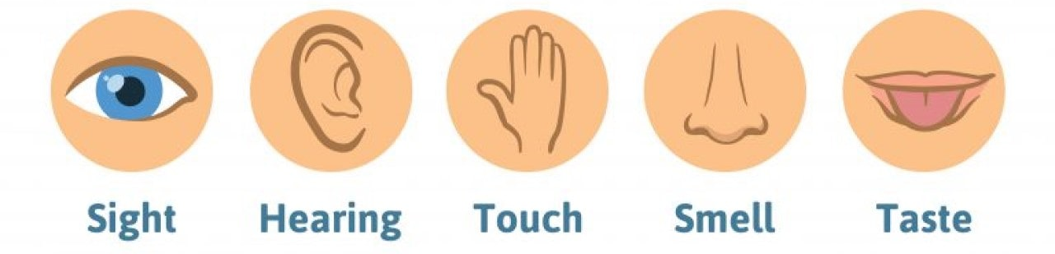
Sherwood Forest
Robin Hood lived in Sherwood Forest.
We are going to pretend the BOLE is Sherwood Forest today!
In your BOLE time: write expanded noun phrases which describe the BOLE.
Use your 5 senses to describe.

Slide 14
Look at the expanded noun phrases you wrote this morning.
We are going to turn these expanded noun phrases into sentences with
co-ordinating and subordinating conjunctions.
What can you remember about conjunctions?

Slide 15
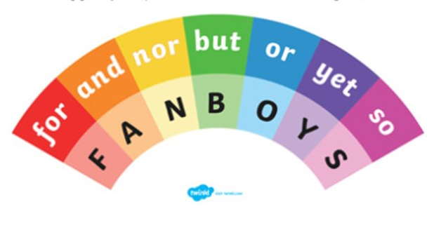

Slide 16
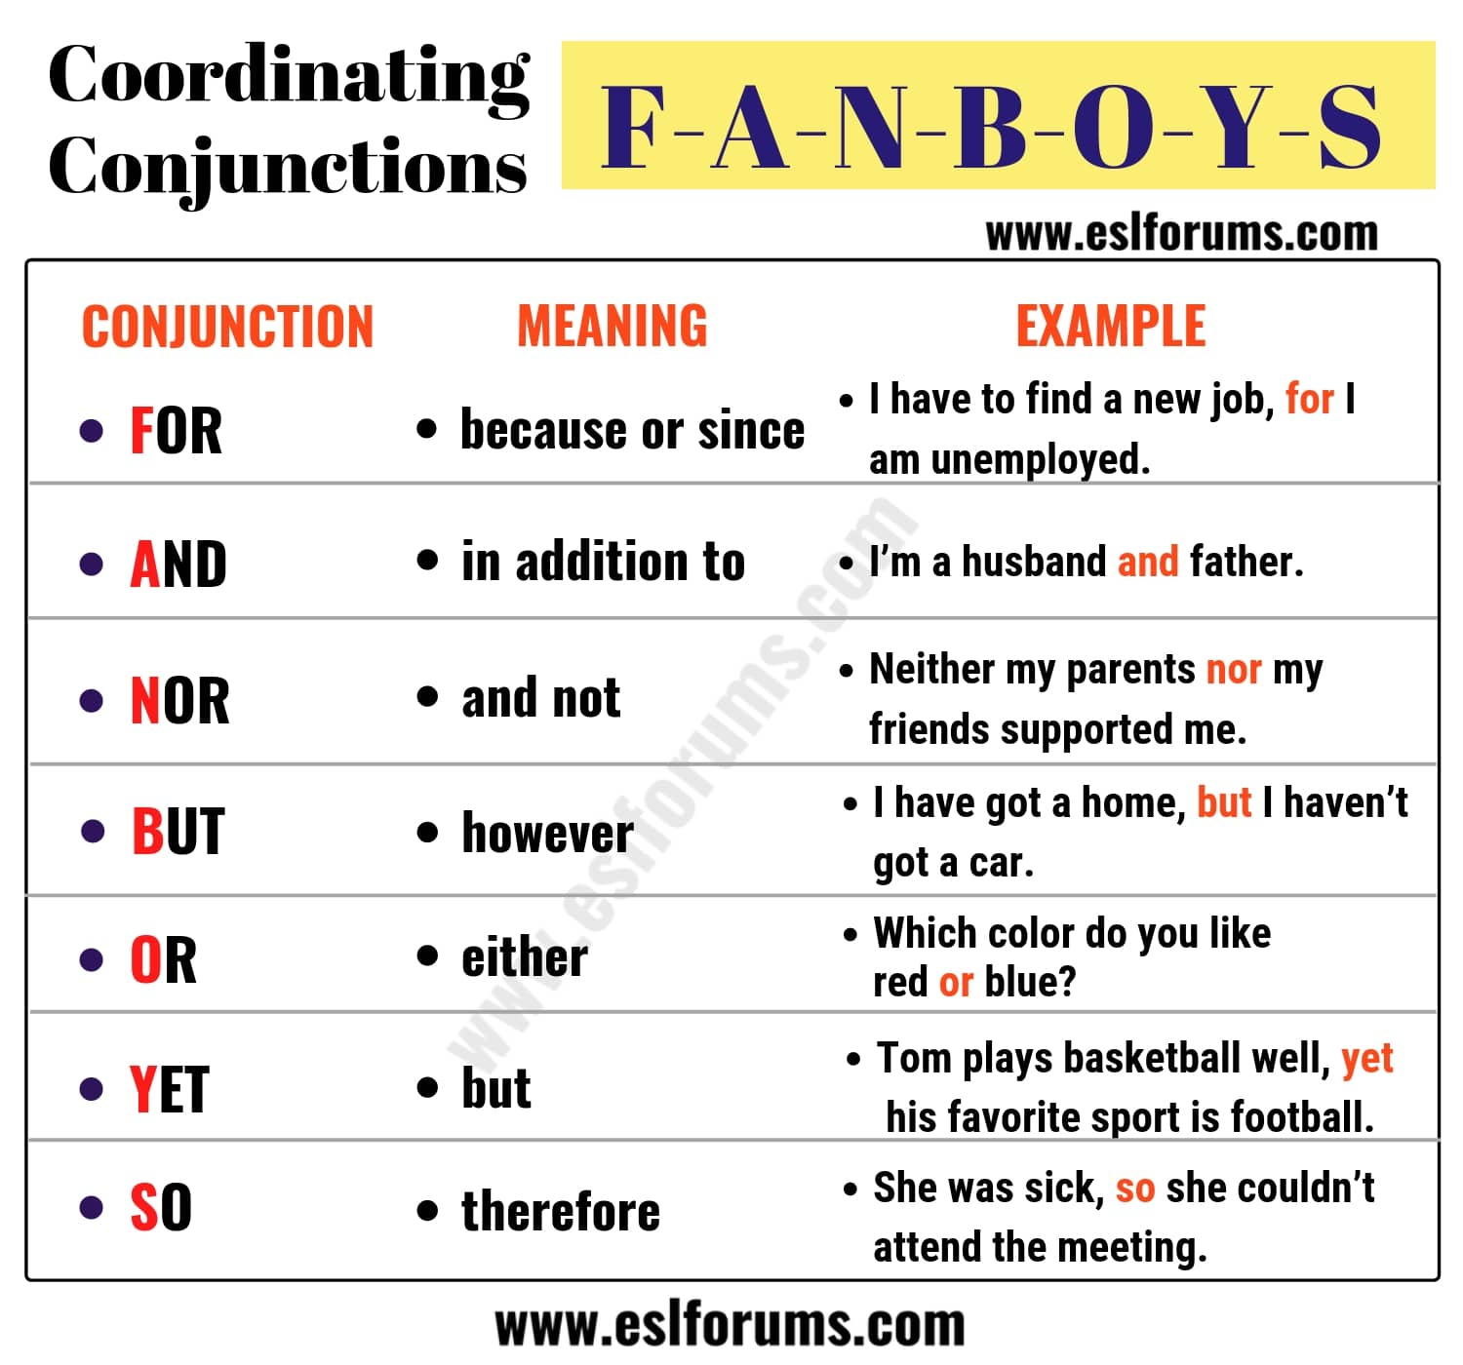

Slide 17
How many conjunctions should be in a sentence?

Slide 18
Let’s write some sentences together.

Slide 19
Activity:
Write sentences about Sherwood Forest (the BOLE) using:
- expanded noun phrases
- co-ordinating conjunctions
- subordinating conjunctions
Red Pen Challenge:
Can you use a different conjunction for each sentence? Try to use a conjunction you haven’t used before!

