Slide 1
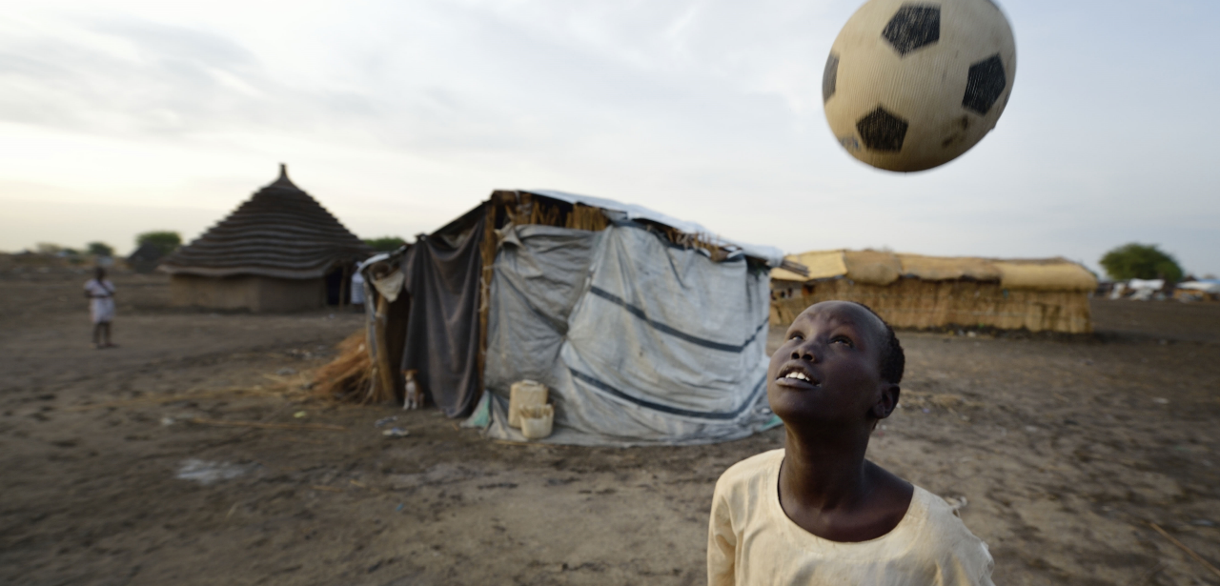

Think about your favourite sport. Why do you enjoy it?
Notes:
Leader: Welcome to our assembly about sport and peace. Think about your favourite sport. Why do you enjoy it?
[Ask children to share a few examples]

Slide 2
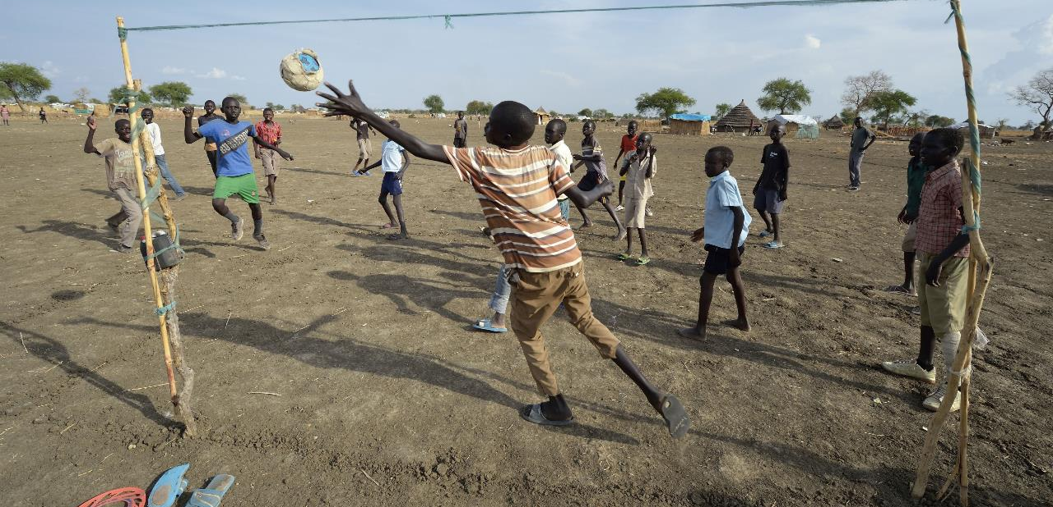

Sport is important for many different reasons.
It brings people together to play.
It teaches us lots of important things
Notes:
Why is sport important?
[Discuss children’s ideas about why sport is important. Start with why sport is important in your school, followed by in your local community and in the wider world]
Sport is important for many different reasons. It brings people together to play. It teaches us lots of important things

Slide 3
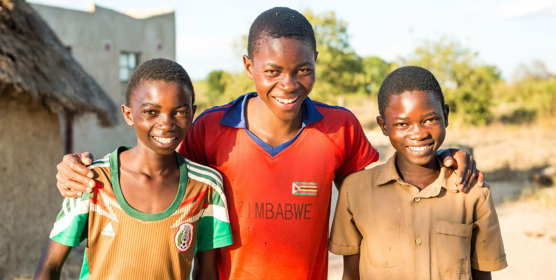


We make new friends and build friendships when we play sport together. We learn to respect each other.
Notes:
Reader 1: We make new friends and build friendships when we play sport together. We learn to respect each other.

Slide 4
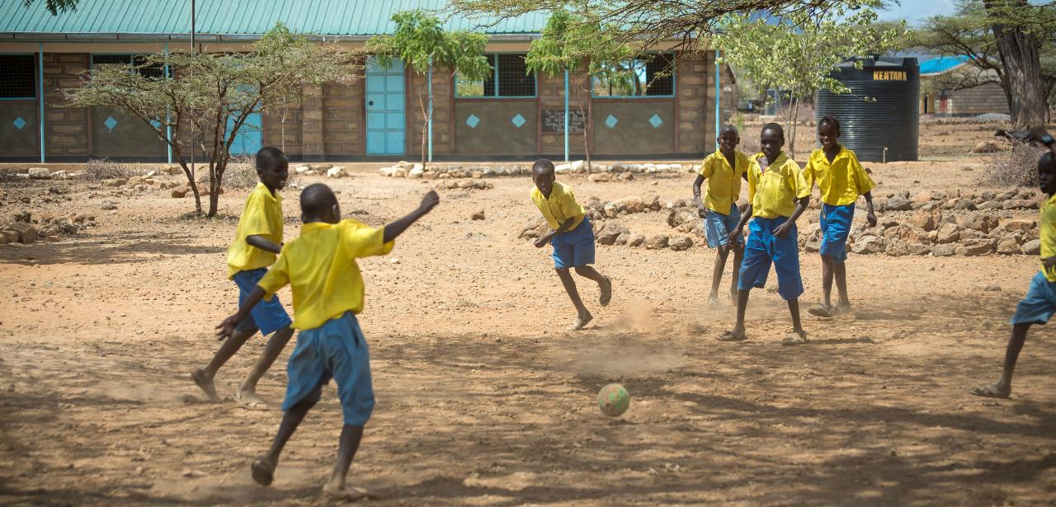


Sport teaches us how to work together.
We call this collaboration.
Notes:
Reader 2: Sport teaches us how to work together. We call this collaboration.

Slide 5
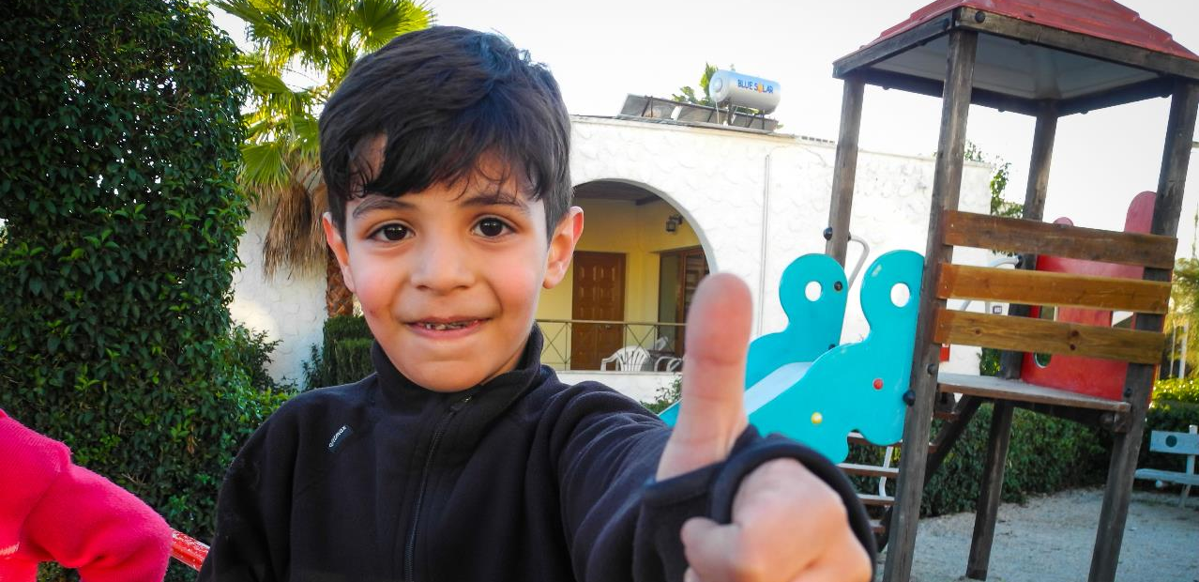


We learn about the importance of honesty and how to play fairly.
Notes:
Reader 3: We learn about the importance of honesty and how to play fairly.

Slide 6
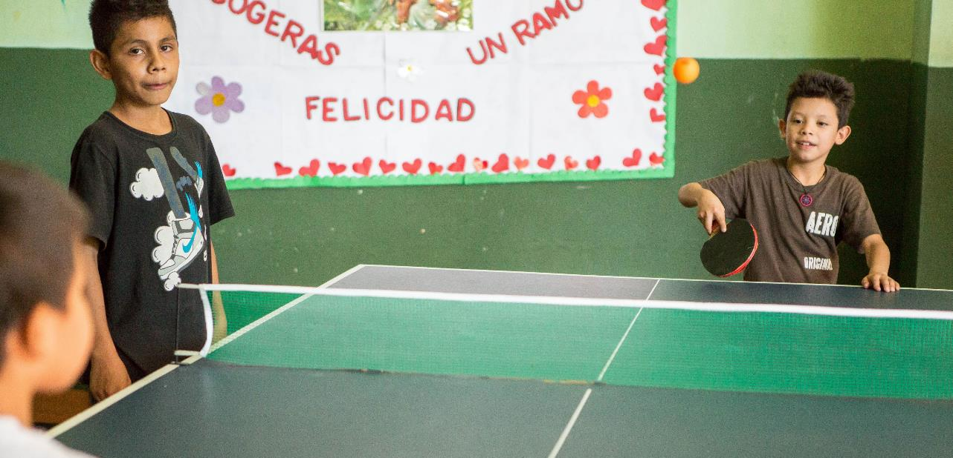

Sport can help to build peace in communities where there is conflict.
Notes:
Reader 4: Sport can help to build peace in communities where there is conflict
[If necessary, clarify what conflict means]

Slide 7
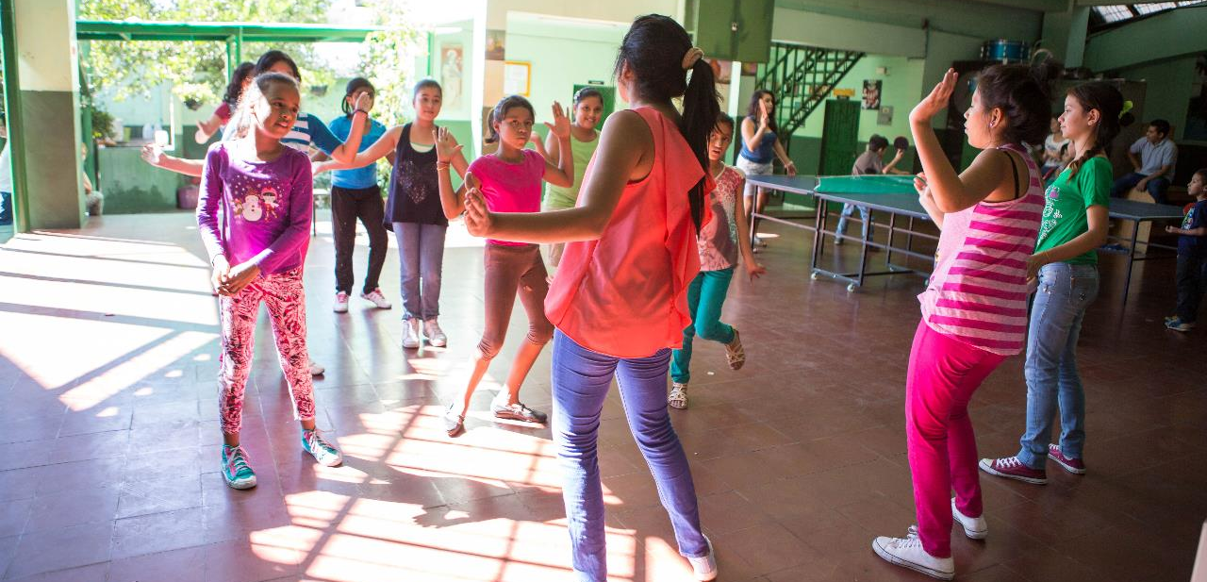
Sport can help people to have FUN!
Notes:
Reader 5: Sport also helps people to have FUN!

Slide 8
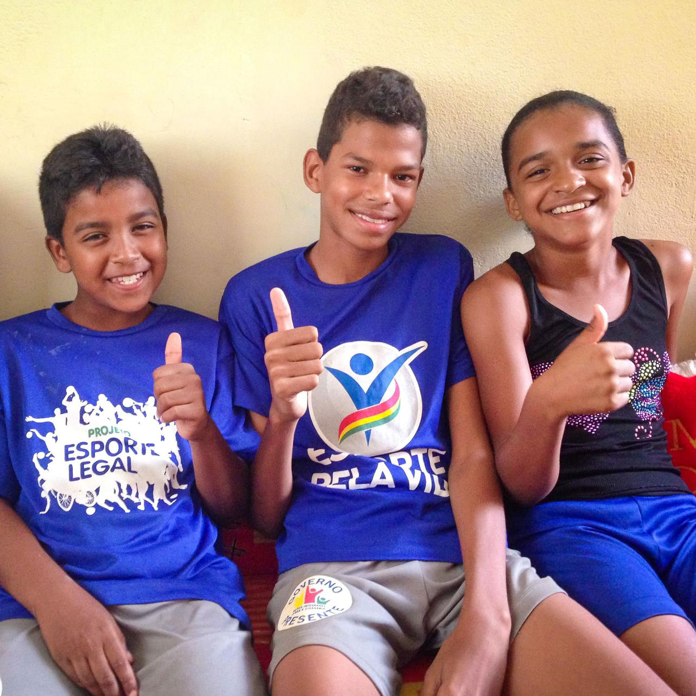
Meet Andreia (on the right), she is 12 years old. Andreia is growing up in North East Brazil, where violence is an everyday problem. Andreia often used to stay at home for her own safety but without other children to play with, she was very bored and frustrated. Thanks to a CAFOD-funded project, she has now joined a football team and has lots of friends to play with. As well as being a lot of fun, the project also taught children about their rights and how to live in harmony in their hometown. Since starting to play football, Andreia is a lot happier. She says: "I am not sad anymore. Now I have a lot of friends and things are better."
Notes:
Meet Andreia (on the right), she is 12 years old. Andreia is growing up in a shanty town in North East Brazil, where violence and gangs are an everyday problem. Andreia often used to stay at home for her own safety. But without other children to play with, she was very bored and frustrated.
Thanks to a CAFOD-funded project, she has now joined a football team and has lots of friends to play with. As well as being a lot of fun, the project also taught children about their rights and how to live in harmony in their hometown.
Since starting to play football, Andreia is a lot happier. She says: "I am not sad anymore. Now I have a lot of friends and things are better."

Slide 9
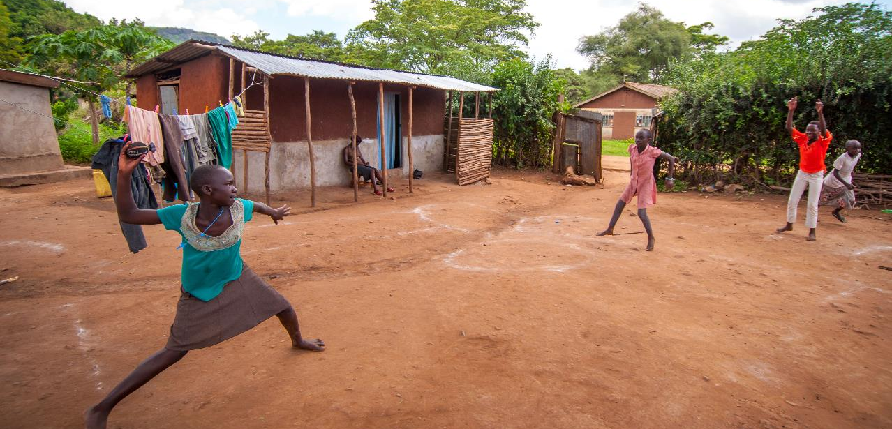
Sport teaches us lots of important things. We call these important things values. Now let’s think about this important question: How can we live out these values in our own lives?
Notes:
Time to Act
Leader: Sport teaches us lots of important things. We call these important things values.
Now lets think about this important question: How can we live out these values in our own lives?
[Encourage children to come up with ways that they can put each value into action in their own lives]

Slide 10
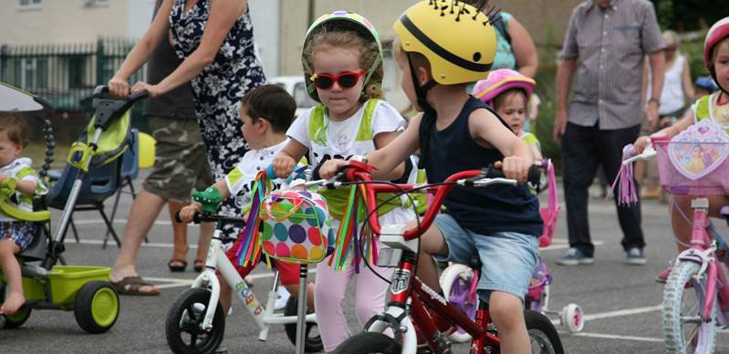
Loving God,
Give strength to people all around the world who are working hard to build peace.
Let us remember to act in friendship with others and show respect.
Help us to work together with our sisters and brothers to build a peaceful and fair world.
Amen

Slide 12
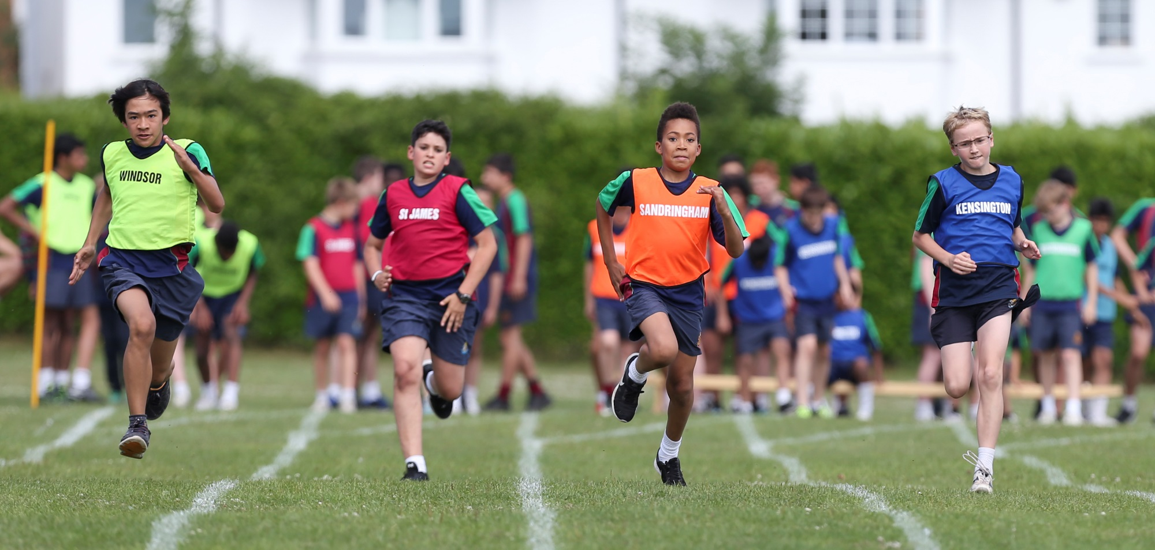
How do you feel about sports day?

Slide 13
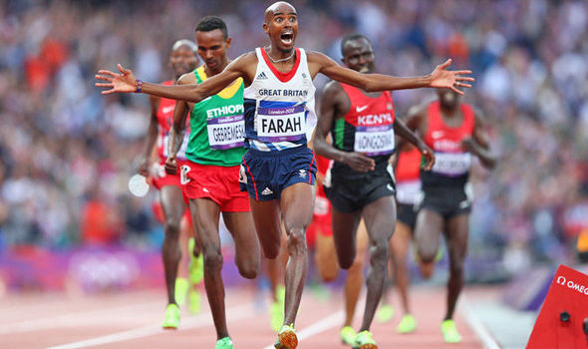
Even professional athletes like Mo Farah experience lots of different emotions before competitions such as the Olympic Games, Commonwealth Games and European Athletics Championships.
Athletes often talk about feeling nervous or excited and worried that they may not do their best after all the training they have done.

Slide 14
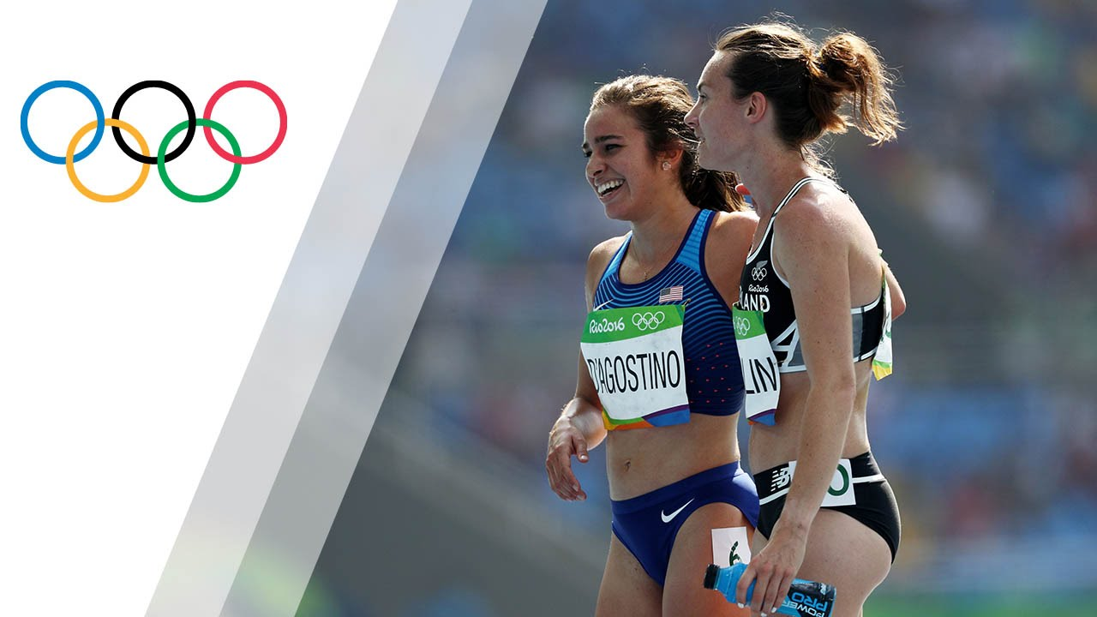
During the 2016 Summer Olympics in Rio, there was an accident while the women’s 5,000 metres event was underway. What happened teaches us that, when competing in a race, it isn’t all about the winning.
Athletes who compete in the Olympics have spent years in training, so they are determined to give the best possible performance. However, on this occasion, two female athletes tripped over one another. Instead of blaming each other, the two athletes helped each other up and encouraged one another to finish the race even though they were both injured and they knew they weren’t going to win.
Watch: ‘The Most Beautiful Moment of Rio 2016’: https://www.youtube.com/watch?v=dCVlRFWOjgE

Slide 15
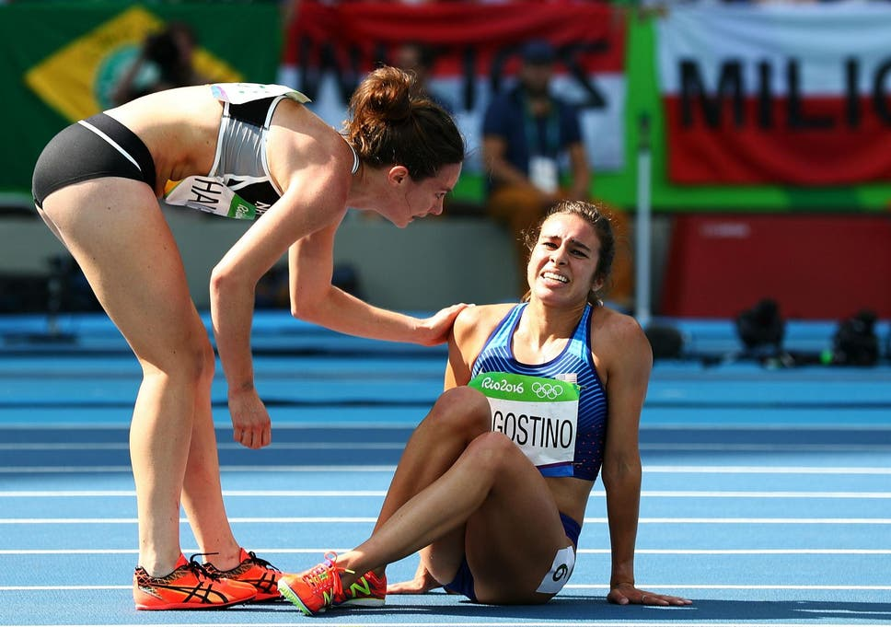
By demonstrating fair play, sportsmanship and compassion for one another during the race, the two athletes ended up being given an Olympic award.
Although both athletes had injured themselves, they both wanted to finish their race well.
Life is sometimes spoken about as a race. We can choose to live our lives well, thinking about other people and helping them. Alternatively, we can decide to live selfish lives that only consider our own needs.

Slide 16
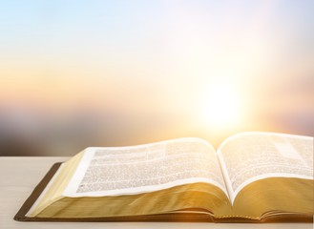
In the New Testament part of the Bible, there is a person called Paul. Paul wrote lots of letters that make up part of the New Testament, which covers the time after Jesus came to Earth. Just before Paul died, he wrote the words, ‘I have fought the good fight, I have finished the race, I have kept the faith.’ (2 Timothy 4.7)
Christians believe that what Paul meant by these words was that he had lived his life in the way that God wanted him to. Paul had travelled around the Roman Empire teaching people about God. The Olympic Games were taking place even when Paul was alive, so people would understand what it meant to run races and cross the finishing line.
Paul’s ‘race’ hadn’t been easy. He had been through some tough times in order to teach people about God. He’d been put in prison, shipwrecked, disliked by many people and sentenced to death. His race to teach people about God had been really difficult and there were many times when he could have been tempted to give up. However, just like the athletes in the YouTube video, Paul carried on with the race so that he could ‘finish well’.

Slide 17
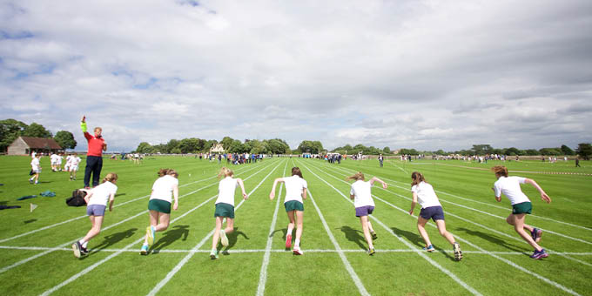
Sports day isn’t just about winning – it’s about taking part and the attitude with which we compete.
Some of us love sport; some of us don’t. However, we can all try our best and we can all help, support and encourage each other as we take part. The two athletes didn’t win an Olympic medal in their event, but they did get a special award for fair play, sportsmanship and the compassion they showed for one another. Having these attitudes during a sports competition is far more important than winning a race.
So, during sports day, let’s be like the two athletes and Paul from the Bible: let’s not give up if we’re not winning. Let’s keep going because the main thing is to finish the race well and feel proud of your achievements.

Slide 18
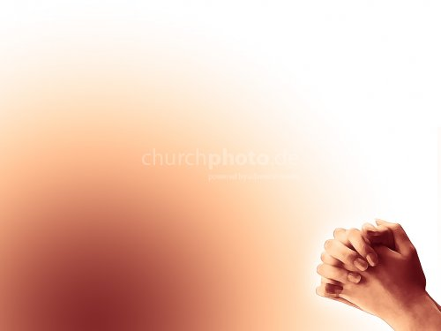
Dear God,
Thank you that we all have different abilities and talents.
Help us to be grateful for what we have.
Help us not to be jealous of others.
Help us to keep trying when we find something difficult.
Help us to encourage others.
Help us to enjoy our sports days!
Amen.

Slide 19
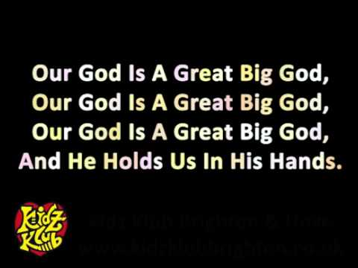
Our God is a great big God:’ https://www.youtube.com/watch?v=eaXPXWBcE3I

