Slide 1
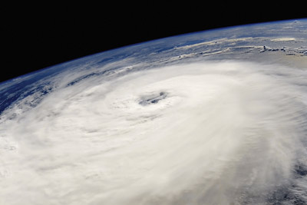
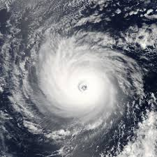
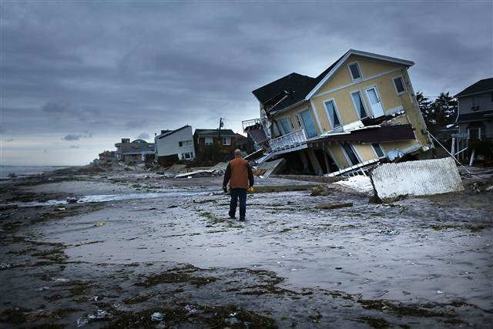
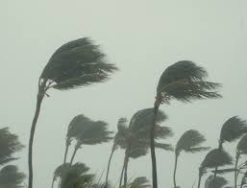
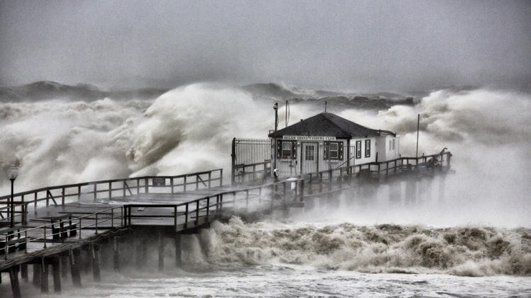
Extreme Weather.
What words come to mind when you look at the images below? Make a list in your books.

Slide 2
How are hurricanes formed?
https://youtu.be/wPDoIrGUrEc

Slide 3
How are hurricanes formed?
Hurricanes are the most violent storms on Earth. People call these storms by other names, such as typhoons or cyclones, depending on where they occur.
The scientific term for all these storms is tropical cyclone.
Only tropical cyclones that form over the Atlantic Ocean or eastern Pacific Ocean are called "hurricanes."

Slide 4
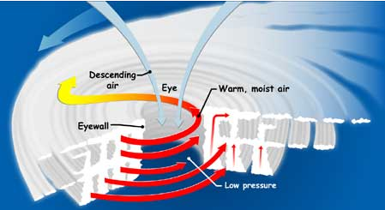
How are hurricanes formed?
Whatever they are called, tropical cyclones all form the same way.
Tropical cyclones are like giant engines that use warm, moist air as fuel. That is why they form only over warm ocean waters near the equator.
The warm, moist air over the ocean rises upward from near the surface, causing an area of lower air pressure below.
Air from surrounding areas with higher air pressure pushes in
to the low pressure area.
Then that "new" air becomes warm and moist and rises, too.
As the warm air continues to rise, the surrounding air swirls in
to take its place.

Slide 5
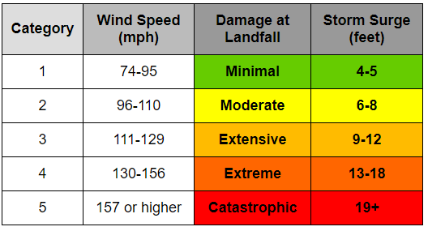
How are hurricanes formed?
As the warmed, moist air rises and cools off, the water in the air forms clouds. The whole system of clouds and wind spins and grows, fed by the ocean's heat and water evaporating from the surface.
When the winds in the rotating storm reach 39 mph, the storm is called a "tropical storm." And when the wind speeds reach 74 mph, the storm is officially a "tropical cyclone," or hurricane.
Tropical cyclones usually weaken when they hit land, because they are no longer being "fed" by the energy from the warm ocean waters. However, they often move far inland, dumping many inches of rain and causing lots of wind damage before they die out completely.

Slide 6
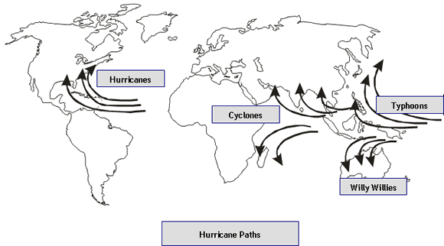
Whirly-Whirly

Slide 7
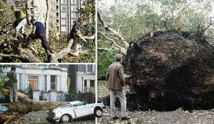
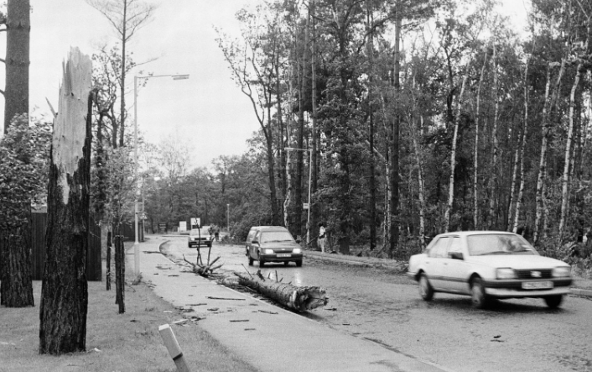
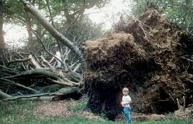
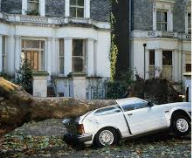
Of course there are times when random hurricanes hit places that they usually wouldn’t.
In 1897 a hurricane hit Britain with winds up to 85mph
https://www.youtube.com/watch?v=eKPQLl5rupg
This picture is Bracknell

