Slide 1


Slide 2
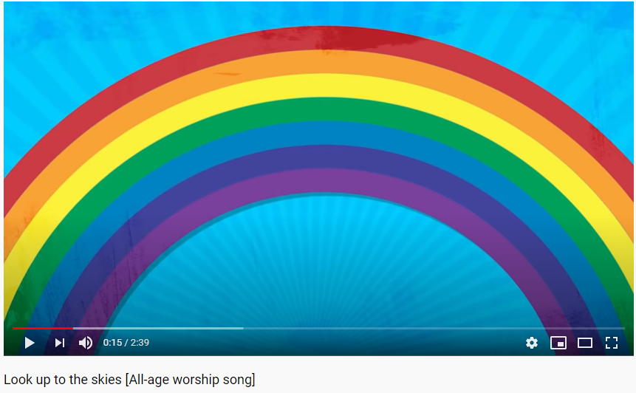
https://www.youtube.com/watch?v=N_v9eLX4BN4&safe=active

Slide 3
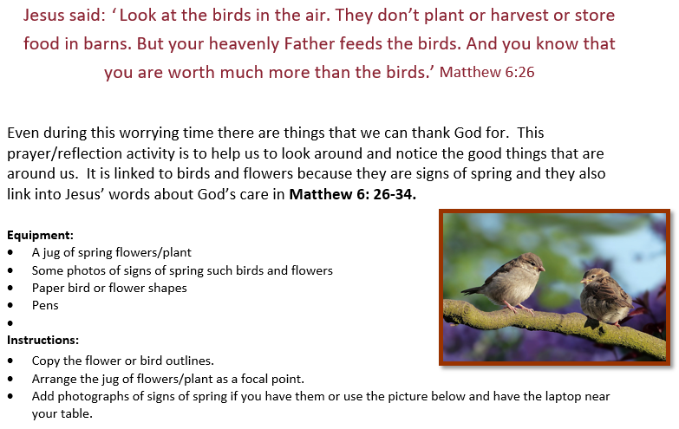

Slide 4


