Slide 1
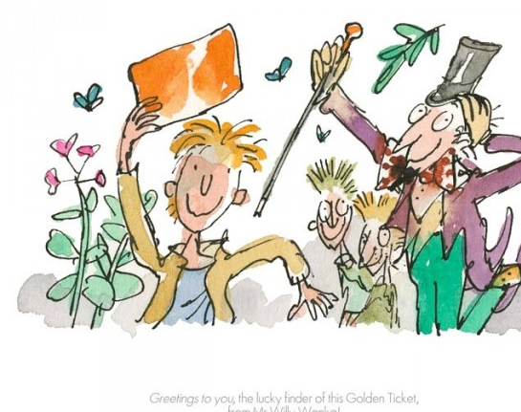
Charlie and the Chocolate Factory Quiz!

Slide 2
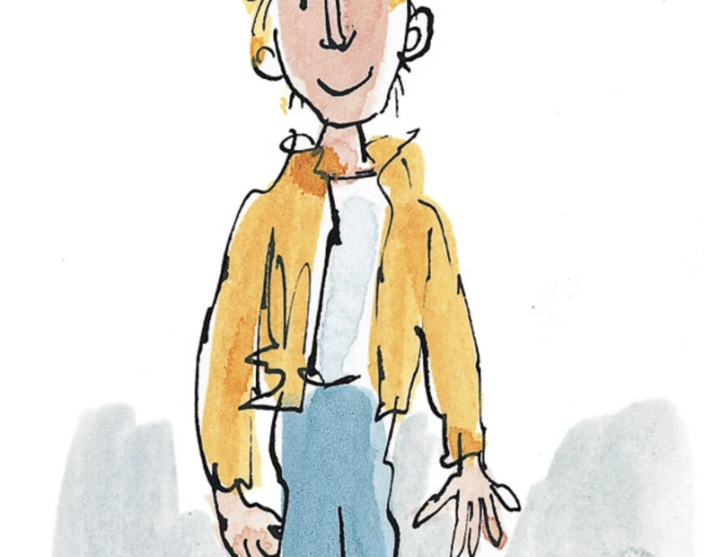
1. Who lives with Charlie?

Slide 3
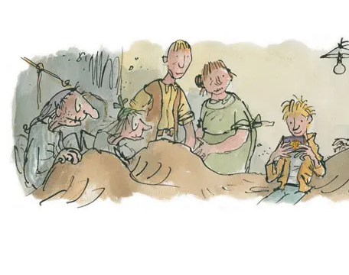
Grandpa Joe, Grandma Josephine, Grandpa George, Grandma Georgina, Mr and Mrs Bucket and Charlie!

Slide 4
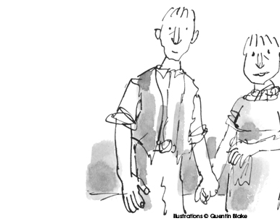
2. What Job did Mr Bucket do?

Slide 5

Toothpaste factory!

Slide 6

3. What sort of things did they eat?

Slide 7


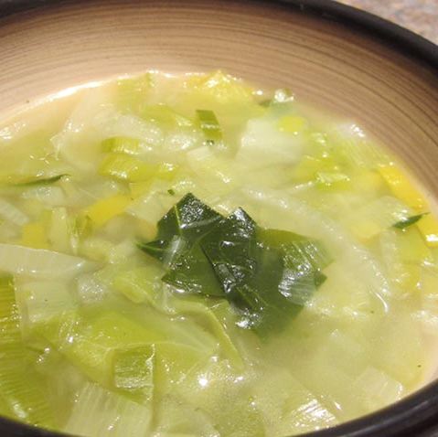
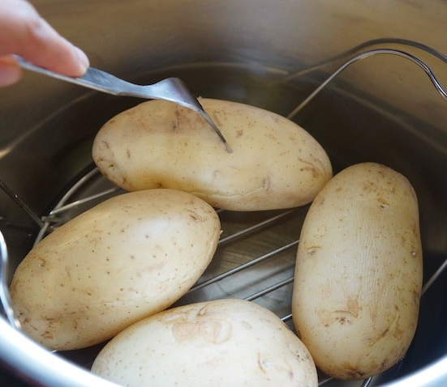

Slide 8
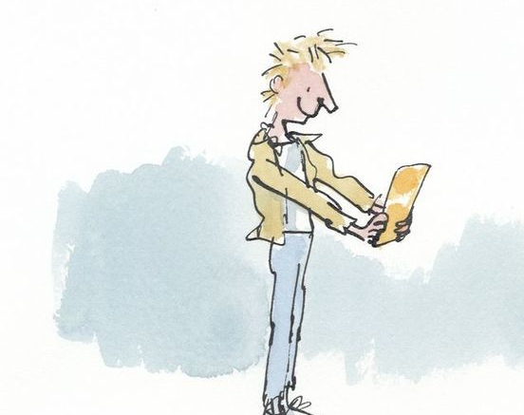
4. What did Charlie really want to eat?

Slide 9
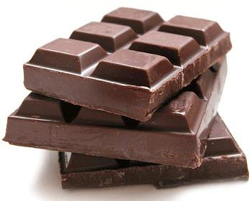
CHOCOLATE!!!!

Slide 10
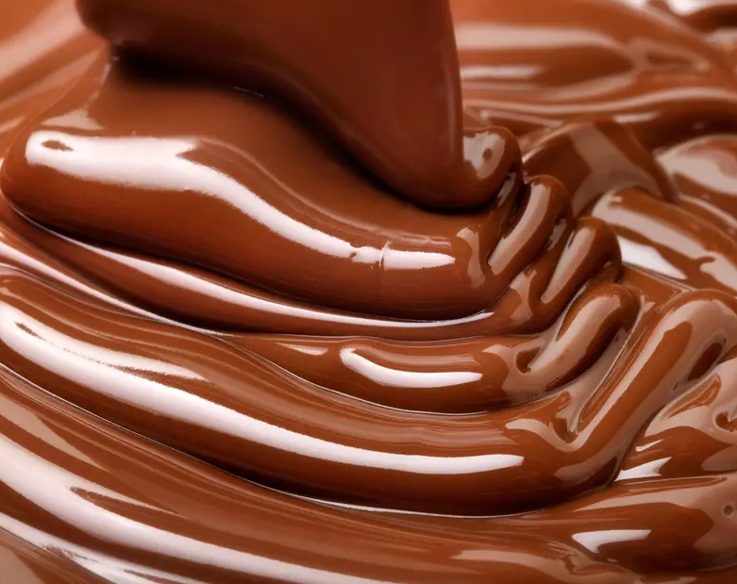
5. When did Charlie get chocolate?

Slide 11

On his birthday!

Slide 12
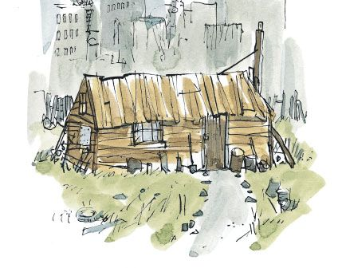
6. What was close to Charlie’s house?

Slide 13
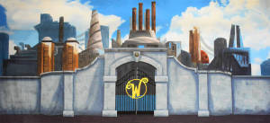
The Chocolate Factory!

