Slide 1
Recognise and find
a quarter

Slide 2
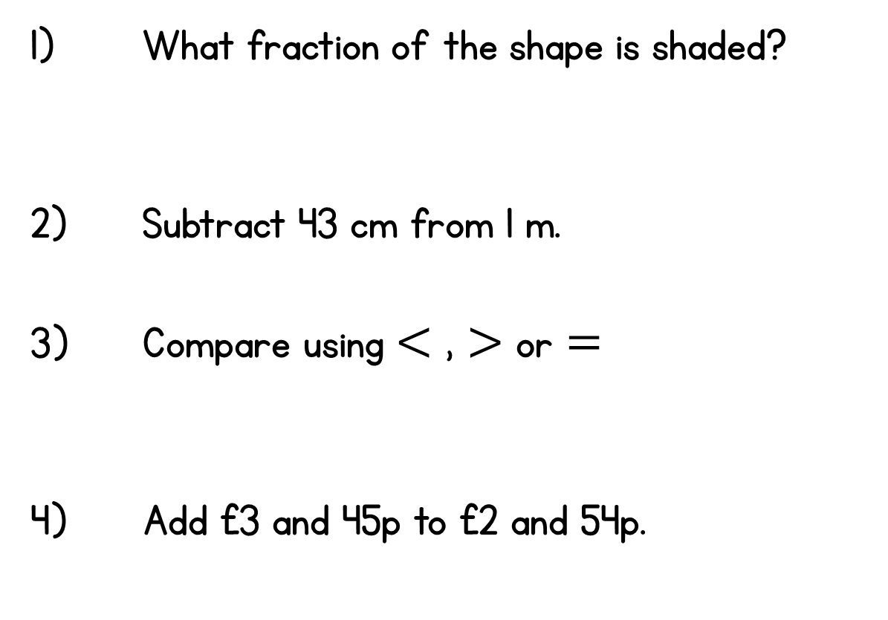
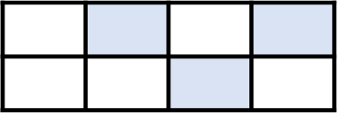
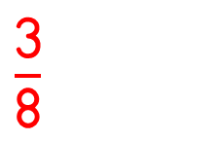
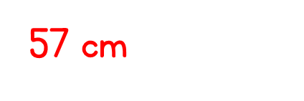


Year 3 | Week 10 | Day 3
35 mm 10 cm

Slide 4

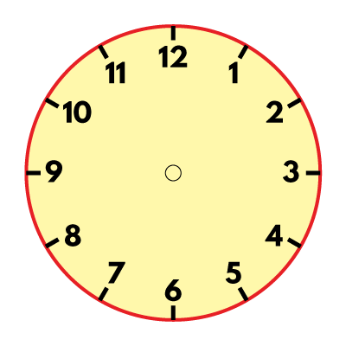
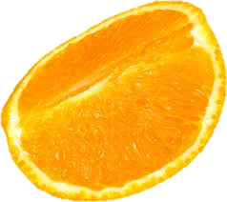


What do you notice?
Have a think
How else could we show one quarter?

Slide 6
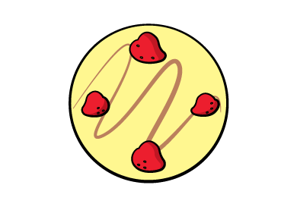
We can recognise a quarter when a shape, measure or quantity has been split into 4 equal parts.
Which cheesecake has been split into 4 equal parts?

Slide 7





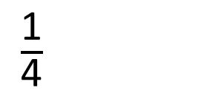
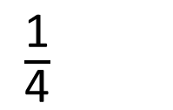
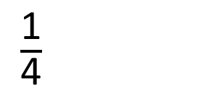
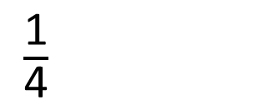
They cut it into 4 equal parts.
They each have one quarter of the whole
cheesecake.
The children are sharing the cheesecake
$\frac{\text{1}}{\text{4}}$
$\frac{\text{1}}{\text{4}}$
$\frac{\text{1}}{\text{4}}$
$\frac{\text{1}}{\text{4}}$

Slide 8
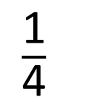
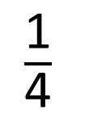
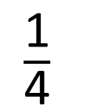
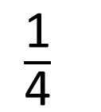
This shape has been divided into 4 equal parts.
Each part is one quarter of the whole shape.
$\frac{\text{1}}{\text{4}}$
$\frac{\text{1}}{\text{4}}$
$\frac{\text{1}}{\text{4}}$
$\frac{\text{1}}{\text{4}}$

Slide 9


Which shapes have one quarter shaded?
v
Have a think

Slide 10
Here is one quarter of a shape.
Can you draw the whole shape?
Is there more than one way to do this?
Have a think

Slide 11

One quarter is half of a half!

Slide 12

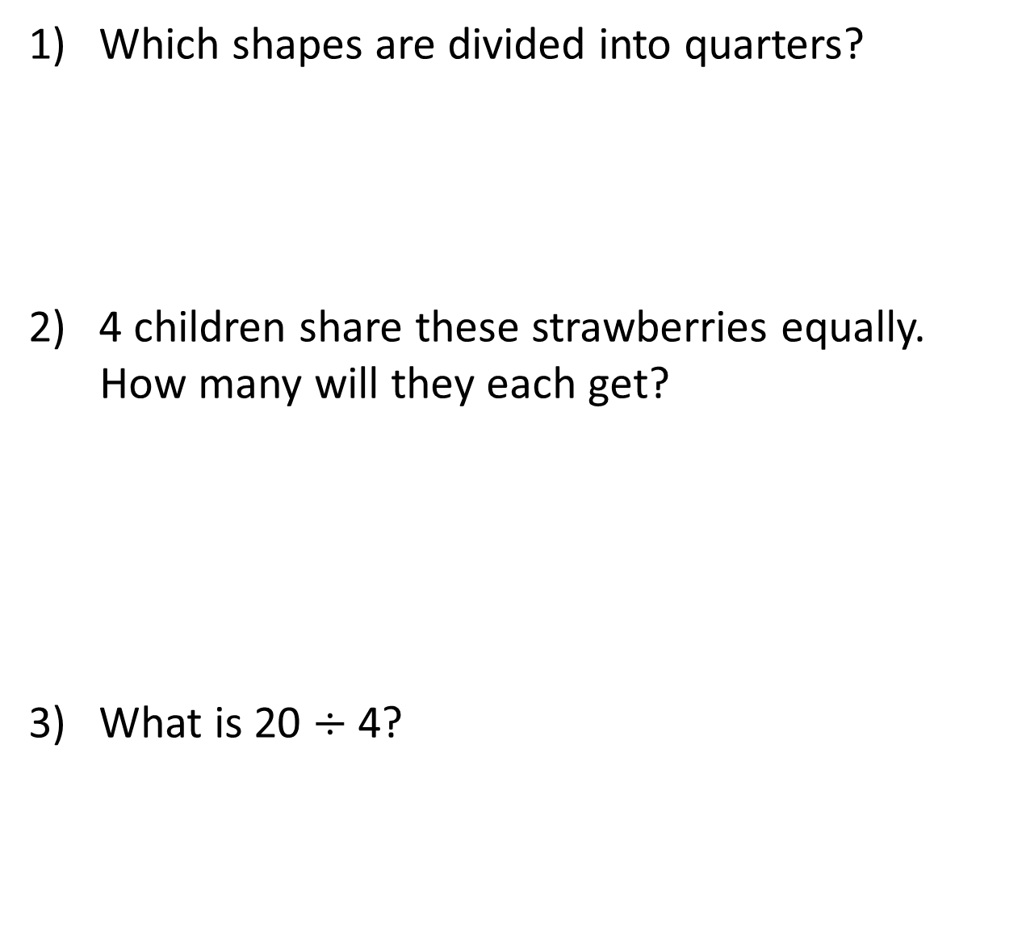
1) Which shapes are divided into quarters?
2) 4 children share these strawberries equally.
How many will they each get?
3) What is 20 $÷$ 4?

Slide 13
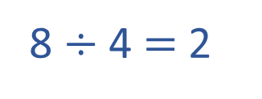
1) Which shapes are divided into quarters?
2) 4 children share these strawberries equally.
How many will they each get?
3) What is 20 $÷$ 4?
8 $÷$ 4 $=$ 2
They will each get 2 strawberries.
5

Slide 14






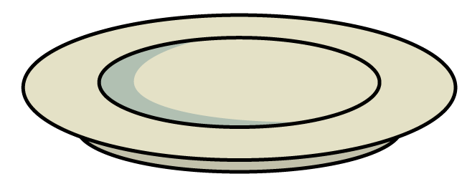
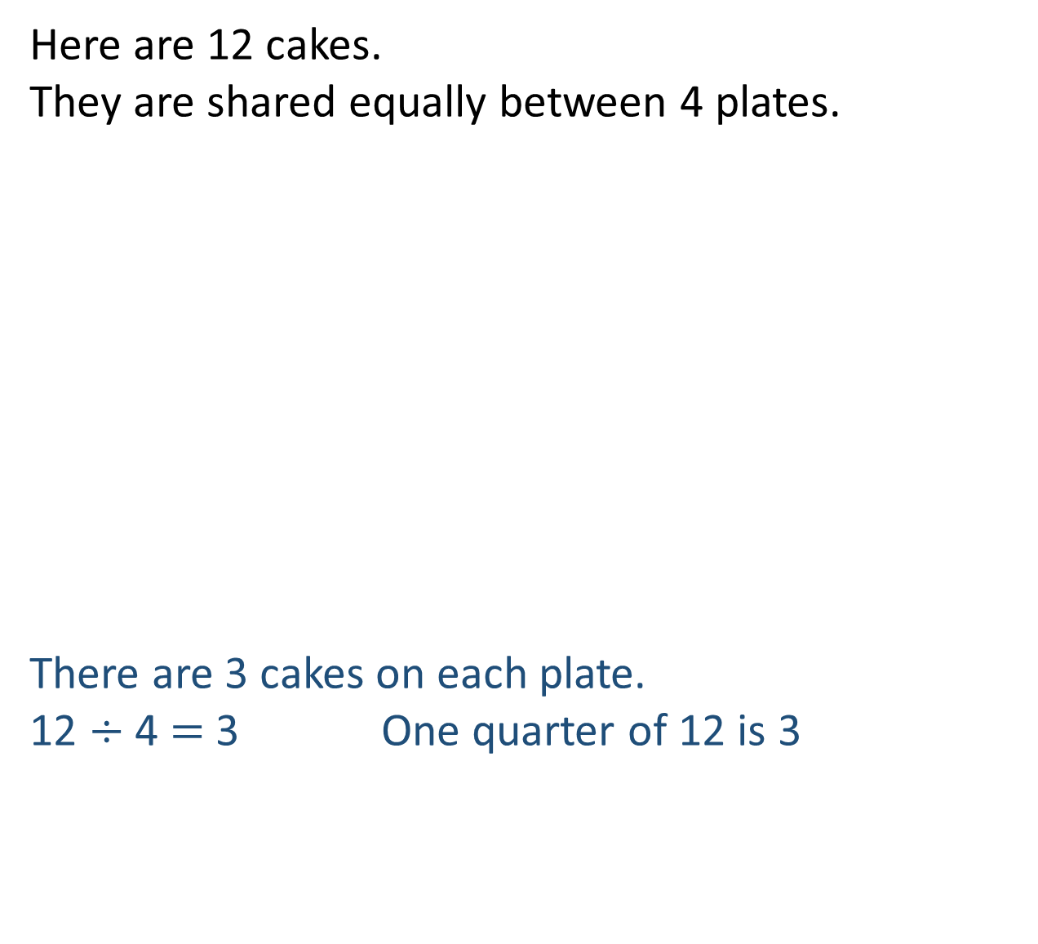
Here are 12 cakes.
They are shared equally between 4 plates.
There are 3 cakes on each plate.
12 $÷$ 4 $=$ 3 One quarter of 12 is 3

Slide 15


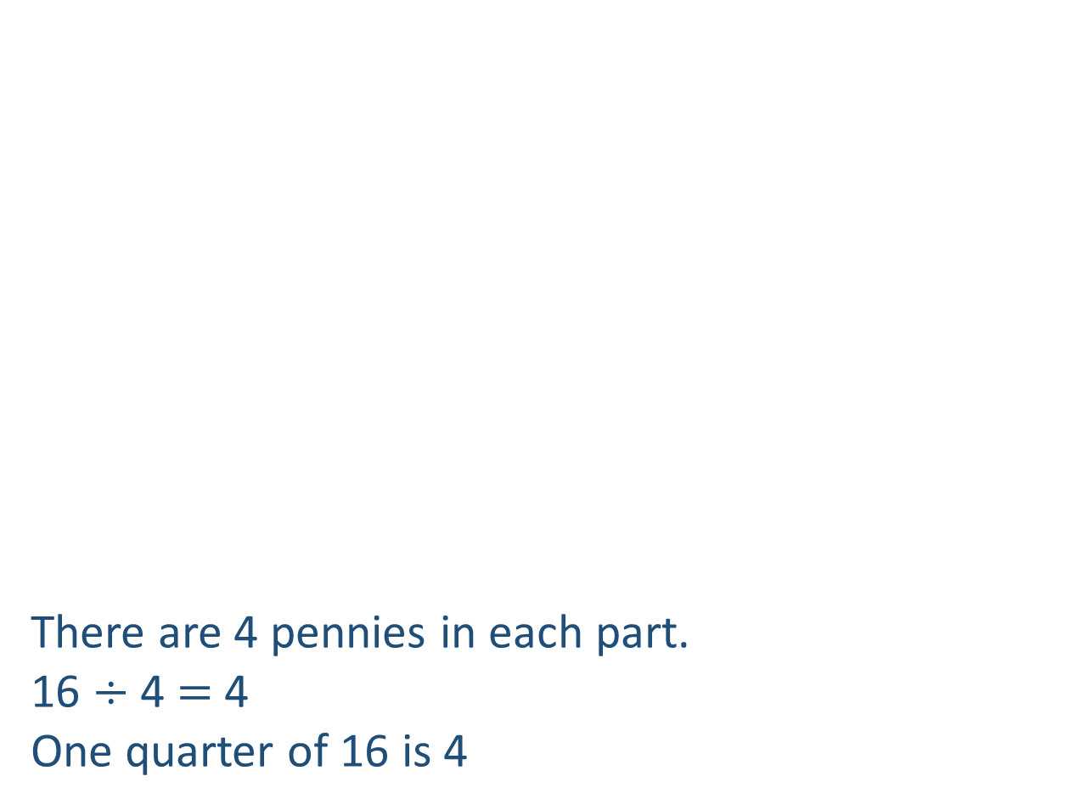
There are 4 pennies in each part.
16 $÷$ 4 $=$ 4
One quarter of 16 is 4
I can use a bar model to find a quarter.
16
4
4
4
4

Slide 16

I can halve and halve again to find a quarter.
One quarter of 16 is 4

Slide 17

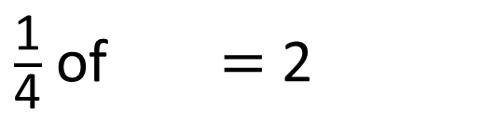
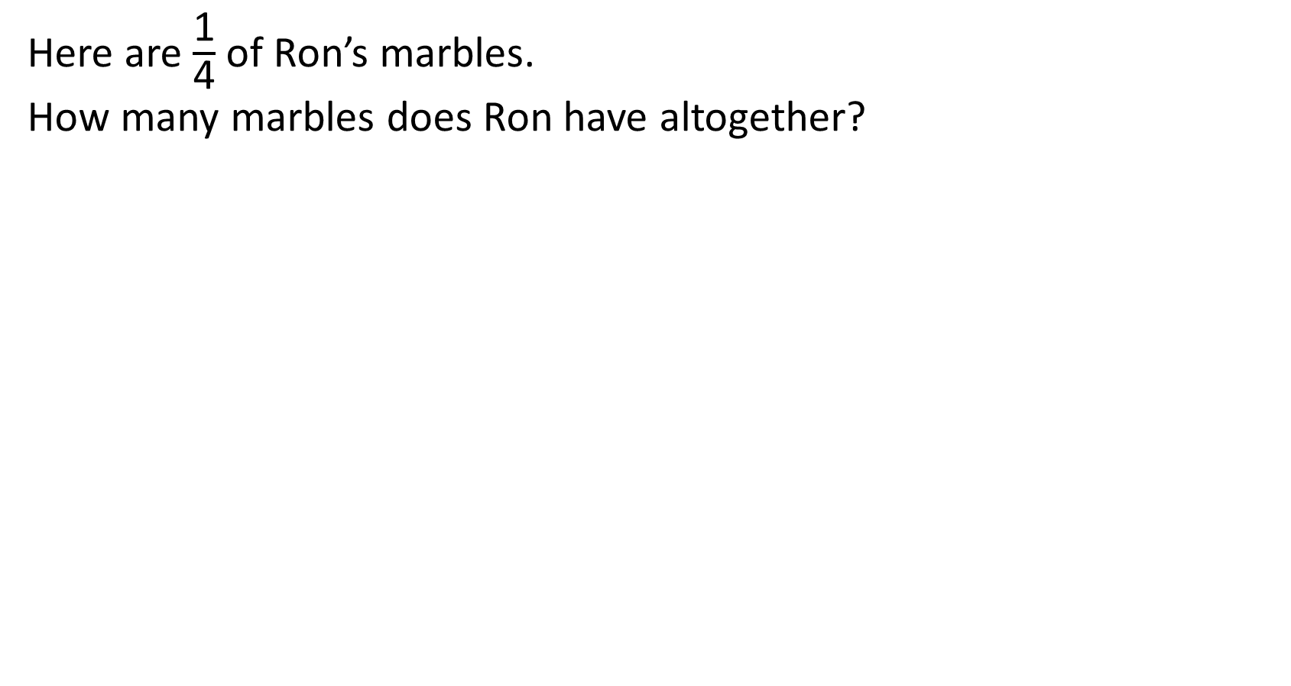
Here are $\frac{\text{1}}{\text{4}}$ of Ron’s marbles.
How many marbles does Ron have altogether?
8
?
$\frac{\text{1}}{\text{4}}$ of $=$ 2
8
Have a think

Slide 18
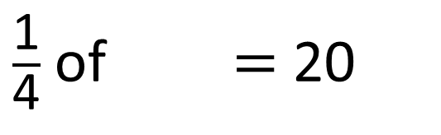
$\frac{\text{1}}{\text{4}}$ of $=$ 20
80
Have a think
80
?
20
20
20
20

