Slide 1
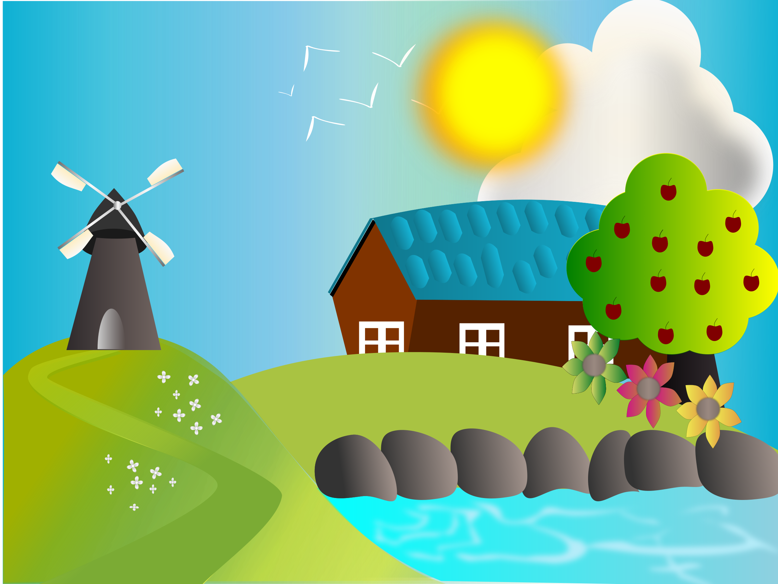

Little Red Hen
Narrative: Traditional Tales
Grammar Focus:
Expanded Noun Phrases
Subordinating Clauses

Slide 2
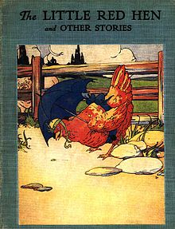
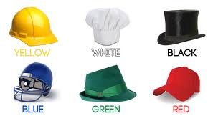
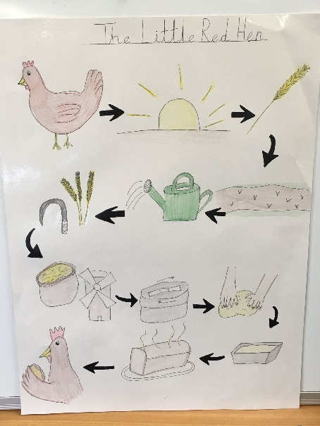
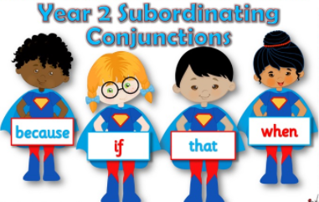

Last week…
Little Red Hen - Lesson 1
Monday
We read the Little Red Hen
Tuesday
We thought about the moral of the story and used our thinking hats.
Wednesday
We used photos and pictures to sequence the story or draw a story map.
Thursday
Grammar Lesson
We used when, if, that, because
Friday
Grammar Lesson
We learned about expanded noun phrases

Slide 3
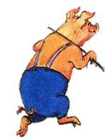
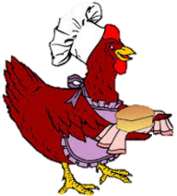
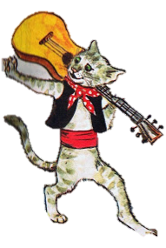
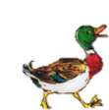
Little Red Hen - Lesson 1
How can we make this better?
“Who will help me eat this bread?” said the Little Red Hen
“Who will help me eat this delicious bread?” asked the Little Red Hen
“I will” shouted the pink pot bellied pig.
“I will” said the pig.
1
2
“I absolutely will” answered the black lazy cat.
“I will” said the cat.
“Of course!” exclaimed the small feathered duck.
“I will” said the duck.

Slide 4
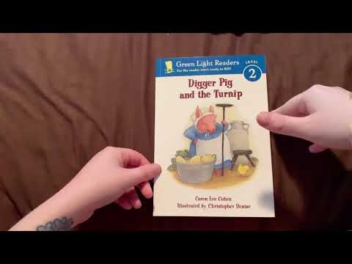
Little Red Hen - Lesson 1
Let’s listen to an alternative version of ‘The Little Red Hen’
How is this story similar or different to the original?

Slide 5
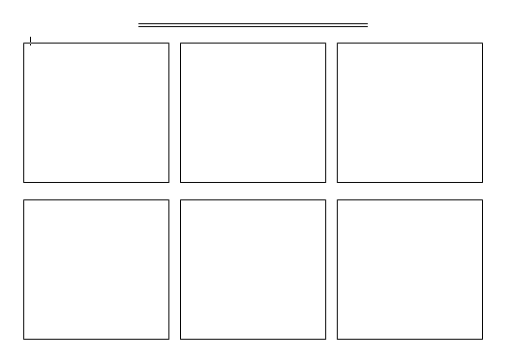
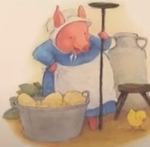

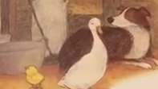
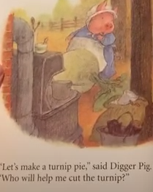
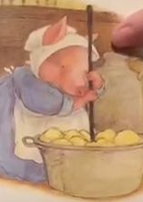
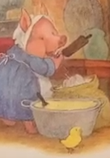
Little Red Hen - Lesson 1
Let’s listen to an alternative version of ‘The Little Red Hen’
Who’s the main character?
Wise Old Pink Pig
3 animals with expanded noun phrases
Who’s the main character going to make?
Turnip Pie
Feathered white duck
Lazy furry dog
Baby yellow chick
1st Step
Cut the turnip
2nd Step
Mash the turnip
3rd Step
Make the pie
How is this story similar or different to the original?

Slide 6

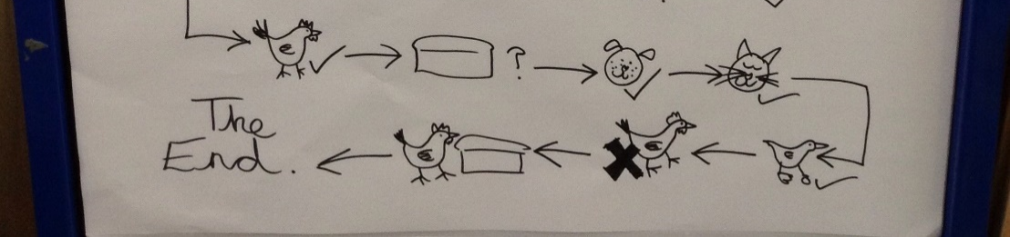

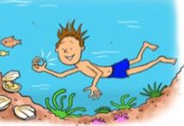
Little Red Hen - Lesson 1
Edit your story maps to include adjectives and expanded noun phrases
“Who will help me eat this delicious bread?” asked the Little Red Hen
“I will” shouted the happily barking dog.
“Of course!” exclaimed the small feathered duck.
“I absolutely will” answered the black lazy cat.
Use a comic strip to plan your story using the template of ‘The Little Red Hen’

Slide 7
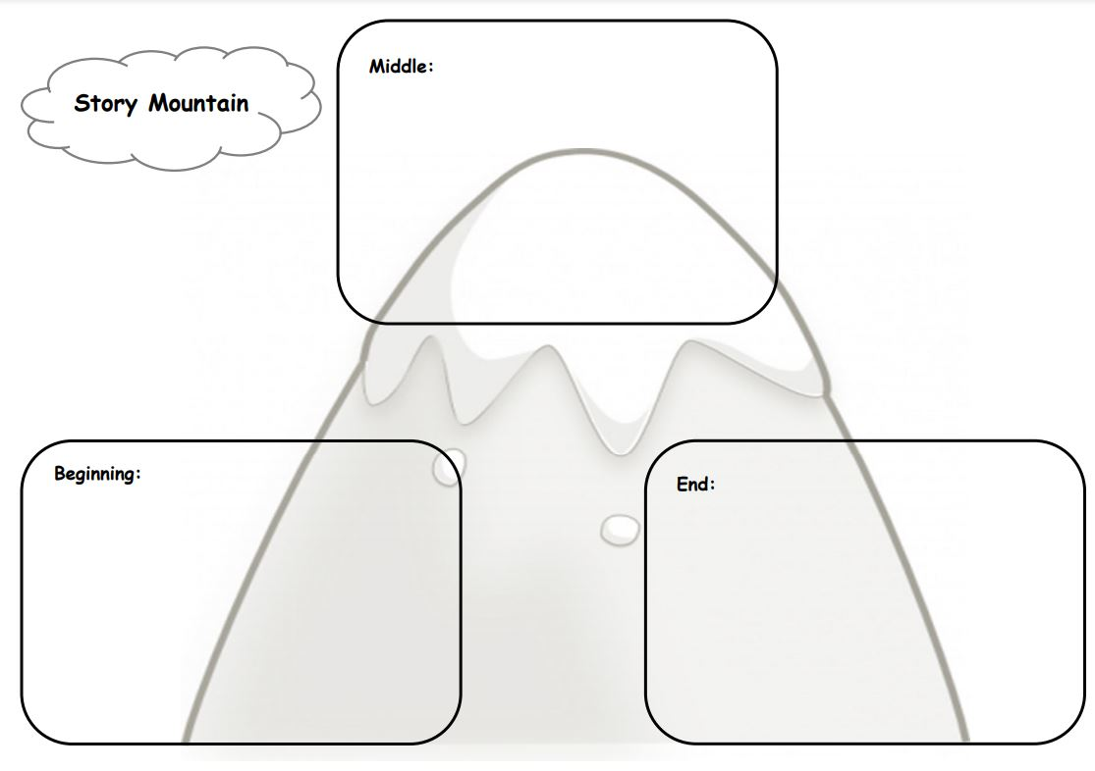
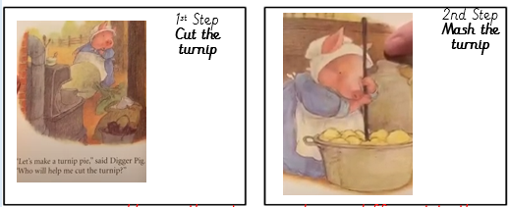
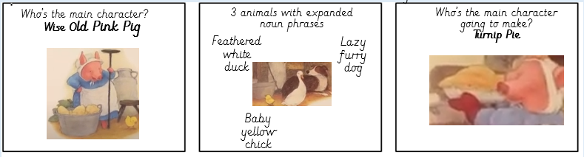
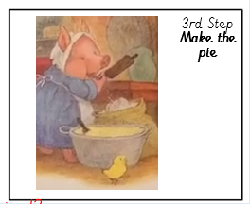
The Old Pink Pig
Middle
Beginning
Ending

Slide 8
Little Red Hen – Lesson 2
Let’s write our beginning
One day a Pig dug up a big turnip. “I can use this to make a good turnip pie” she said. The duck, the dog and the baby were napping in the corner of the barn.
“Let’s make a turnip pie” said the Old Pink Pig. “Who will help me cut the turnip?”
“ Not I” said the feathered white duck. “Not I” said the dog. “Not I” said the chick.
“All right then, I’ll cut it myself” said Pig and she did.
How can we make this better?

Slide 9
Little Red Hen – Lesson 2
Let’s listen to an alternative version of ‘The Little Red Hen’
One day Old Pink Pig dug up a huge turnip. “I can use this to make a good turnip pie” she thought. “I’m going to ask the others for help because this is going to take a lot of work!” The feathered white duck, the lazy furry dog and the baby yellow chick were napping in the corner of the barn.
“Let’s make a turnip pie” said the Old Pink Pig. “Who will help me cut the turnip?”
“Not I” said the feathered white duck when she opened her eyes. “Not I” yawned the lazy furry dog as he peered out from under the pile of hay. “Not I” clucked the baby yellow chick as she flapped her wings and stamped her feet.
“All right then, I’ll cut it myself!” exclaimed Old Pink Pig and she did.
Talk to the person next to you. How has Miss Tissot improved the story?

Slide 10
Little Red Hen – Lesson 2
Let’s listen to an alternative version of ‘The Little Red Hen’
Today you will write the beginning of the Little Red Hen story
Today you will write the beginning of the alternative story
One day Old Pink Pig dug up a huge turnip. “I can use this to make a good turnip pie” she thought. “I’m going to ask the others for help because this is going to take a lot of work!” The feathered white duck, the lazy furry dog and the baby yellow chick were napping in the corner of the barn.
“Let’s make a turnip pie” said the Old Pink Pig. “Who will help me cut the turnip?”
“Not I” quaked the feathered white duck when she opened her eyes. “Not I” yawned the lazy furry dog as he peered out from under the pile of hay. “Not I” clucked the baby yellow chick as she flapped her wings and stamped her feet.
“All right then, I’ll cut it myself!” exclaimed Old Pink Pig and she did.
One day the little red hen found some seeds on the ground. The little red hen had an idea. She would plant the seeds .
The little red hen asked her friends, "Who will help me plant the seeds ?"
"Not I," barked the lazy dog .
"Not I," purred the sleepy cat .
"Not I," quacked the noisy yellow duck
"Then I will," said the little red hen . So the little red hen planted the seeds all by herself.

Slide 11
Little Red Hen – Lesson 3
Let’s write the middle
When the turnip was cut the old pink pig asked her friends. “Who will help me mash the turnip for the filling for the pie”.
“Not I” said the feathered white duck when she opened her eyes. “Not I” yawned the lazy furry dog as he peered out from under the pile of hay. “Not I” clucked the baby yellow chick as she flapped her wings and stamped her feet.
“All right then, I’ll mash it myself!” exclaimed Old Pink Pig and she did.
What words have been repeated?

Slide 12
Little Red Hen – Lesson 3
Let’s write the middle
When the turnip was cut the old pink pig asked her friends. “Who will help me mash the turnip for the filling for the pie”.
“Not I” said the feathered white duck when she opened her eyes. “Not I” yawned the lazy furry dog as he peered out from under the pile of hay. “Not I” clucked the baby yellow chick as she flapped her wings and stamped her feet.
“All right then, I’ll mash it myself!” exclaimed Old Pink Pig and she did.

Slide 13
Little Red Hen – Lesson 3
Today you will write the middle of the Little Red Hen story
Today you will write the middle of the alternative story
When the seeds had grown, the little red hen asked her friends, "Who will help me cut the wheat ?"
"Not I," barked the lazy dog .
"Not I," purred the sleepy cat .
"Not I," quacked the noisy yellow duck
"Then I will," said the little red hen . So the little red hen cut the wheat all by herself.
When all the wheat was cut, the little red hen asked her friends, "Who will help me take the wheat to the mill to be ground into flour ?"
"Not I," barked the lazy dog .
"Not I," purred the sleepy cat .
"Not I," quacked the noisy yellow duck
"Then I will," said the little red hen . So the little red hen brought the wheat to the mill all by herself, ground the wheat into flour , and carried the heavy sack of flour back to the farm.
“Who will help me mash the turnip?” questioned the tired Old Pink Pig.
“Not I” quacked the feathered white duck when she opened her eyes. “Not I” yawned the lazy furry dog as he peered out from under the pile of hay. “Not I” clucked the baby yellow chick as she flapped her wings and stamped her feet.
“All right then, I’ll mash it myself!” exclaimed Old Pink Pig with exhaustion.
When all the turnip was mashed, the Old Pink Pig asked her friends once again for help with some trepidation.

Slide 14
Little Red Hen – Lesson 4
Let’s write the ending
When the turnip was chopped, mashed and cooked the old pink pig asked her friends. “Who will help me eat the turnip for the filling for the pie”.
“I will” quacked the feathered white duck as she flapped her wings with excitement. “I will” barked the lazy furry dog as he padded out from under the pile of hay. “I will” clucked the baby yellow chick as she bobbed her head and jumped up and down with glee.
“No I will!” chuckled the Old Pink Pig with delight and she did.
What words have been changed?

Slide 15
Little Red Hen – Lesson 4
Today you will write the ending of the Little Red Hen story
Today you will write the ending of the alternative story
When the bread was finished, the tired little red hen asked her friends, "Who will help me eat the bread ?"
"I will," barked the lazy dog .
"I will," purred the sleepy cat .
"I will," quacked the noisy yellow duck .
"No!" said the little red hen . "I will." And the little red hen ate the bread all by herself.
When the turnip was chopped, mashed and cooked the old pink pig asked her friends. “Who will help me eat the turnip for the filling for the pie”.
“I will” quacked the feathered white duck as she flapped her wings with excitement. “I will” barked the lazy furry dog as he padded out from under the pile of hay. “I will” clucked the baby yellow chick as she bobbed her head and jumped up and down with glee.
“No I will!” chuckled the Old Pink Pig with delight and she did.

Slide 16
Little Red Hen – Lesson 5
Today is editing day!
one day a pig dug up a big turnip. “i can use this to make a good turnip pie” she said. the duck, the dog and the baby were napping in the corner of the barn.
“let’s make a turnip pie” said the old pink pig. “who will help me cut the turnip?”
“ not i” said the feathered white duck. “not i” said the dog. “not i” said the chick.
“all right then, i’ll cut it myself” said pig and she did.
What has happened to the beginning of the story? Can you edit this text to make it correct?

Slide 17
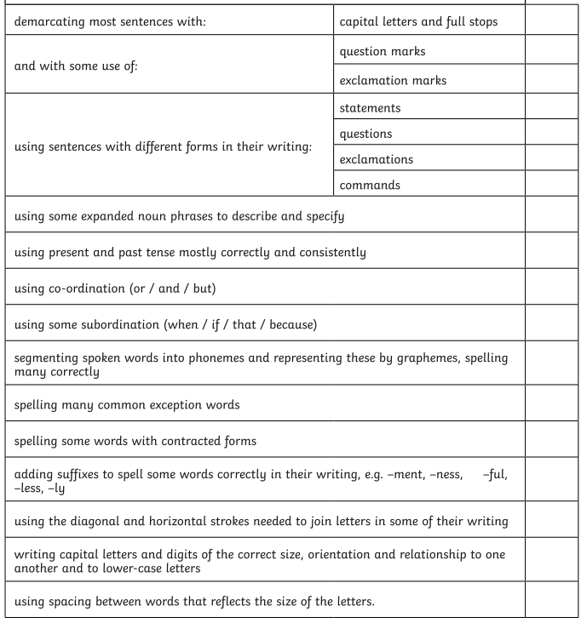
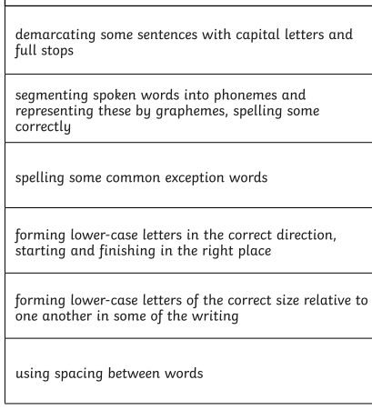
Little Red Hen – Lesson 5
Today is editing day! Use your red pen to edit your work following these checklists.

