Slide 1



Letter to Santa!
Click the icon to hear Miss Tissot’s voice.
Narrative: Letter Writing
Punctuation Focus:
To present neatly
To punctuate accurately

Slide 2
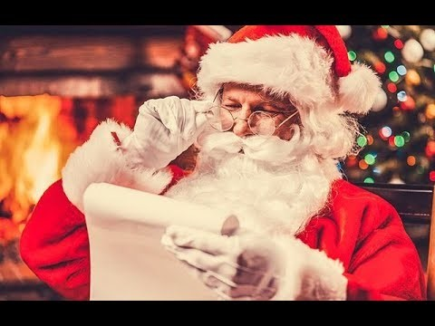
Lesson 1

Slide 3

Letters to Santa
Lesson 1
Has anyone ever written
to Santa?
What do we need to include in our letter?
Did you get
a reply?

Slide 4
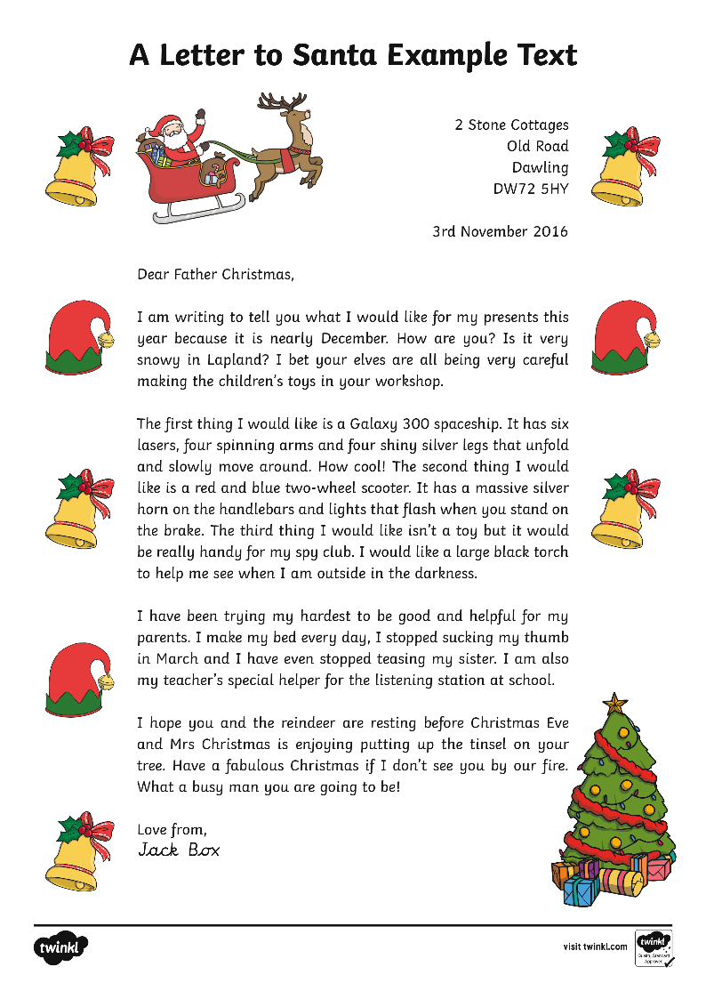
Lesson 1
Who Wrote This Letter to Santa?
What did they want for Christmas?
What did they include in their letter?

Slide 5

What Are the Features of an
Effective Letter to Santa?
Lesson 1
Sender’s address in the
top-right corner.
You need to write your school’s address so Santa knows where to reply.

Slide 6
What Are the Features of an
Effective Letter to Santa?
Lesson 1
Date the letter underneath the sender’s address.

Slide 7
What Are the Features of an
Effective Letter to Santa?
Lesson 1
An informal greeting
on the left.
You could write Dear Santa, Dear Father Christmas, or if you wanted to be a little more formal, Dear Mr Claus.

Slide 8
What Are the Features of an
Effective Letter to Santa?
Lesson 1
An introduction paragraph explains to the reader why you are writing.
You could also ask Santa some questions.

Slide 9
What Are the Features of an
Effective Letter to Santa?
Lesson 1
Add extra details in your next paragraph.

Slide 10
What Are the Features of an
Effective Letter to Santa?
Lesson 1
End with a conclusion.
Write a conclusion where you tell Santa what you hope might happen next.

Slide 11
What Are the Features of an
Effective Letter to Santa?
Lesson 1
Sign off in the bottom left hand corner.
You could use ‘love’, ‘best wishes’ or ‘from’, and then sign your signature.

Slide 12
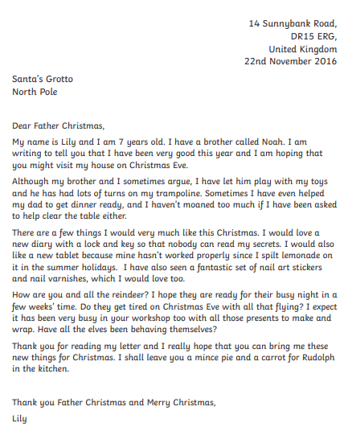
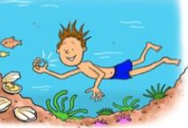


Task 1 - Let’s have a read!
Lesson 1

Slide 13
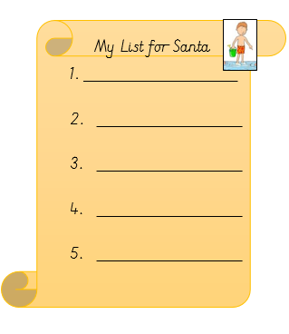
Task 2 - Let’s write a list!
Lesson 1
Write a numbered list in your books of items you wish for.
Can you add expanded noun phrases?

Slide 14

Planning our letter
Lesson 2
name: jane smith
i live with mummy
are you busy?
Dear Santa Claus
A new lunchbox, lego, build a bear, tablet
good list!
nice to my friends and i look after my cats
kind in school
Merry Christmas!
Jane Smith

Slide 15
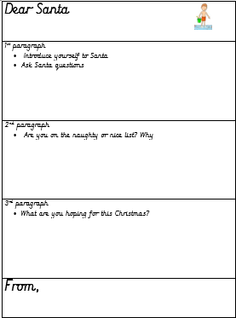

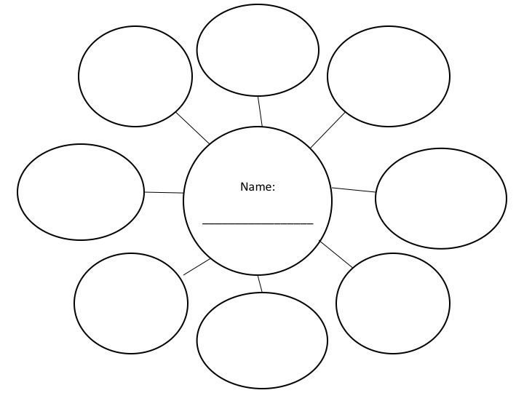
Planning a letter
Lesson 2
Can you draw your own plan in your book?
You may wish to use a bubble map to help you.

Slide 16
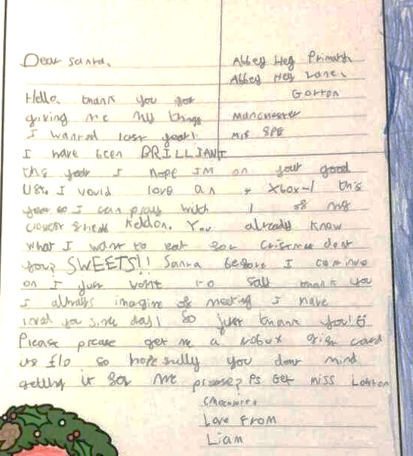
Writing our first draft
Lesson 3

Slide 17
Writing our first draft
Lesson 3 and 4
dear santa,
my name is miss tissot and i teach year 2 at binfield primary school. they’re a wonderful bunch of children! i live with my two cats in a small house. where do you live. are you very busy right now. i’m sure you are. i am just writing to tell you how i have been very good this year and my wishes for christmas.
Use your plans to write your introductory paragraph.
Use your target cards to help you!

Slide 18
Writing our first draft
Lesson 3 and 4
Dear Santa,
My name is Miss Tissot and I teach year 2 at Binfield Primary School. They’re a wonderful bunch of children! I live with my two cats in a small house. Where do you live? Are you very busy right now? I’m sure you are. I am just writing to tell you how I have been very good this year and my wishes for Christmas.
Use your plans to write your first draft
Use your target cards to help you!

Slide 19
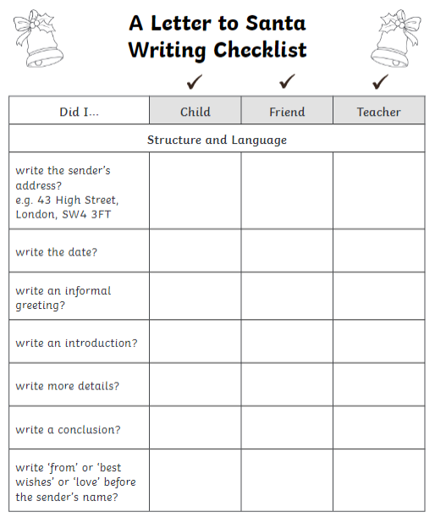
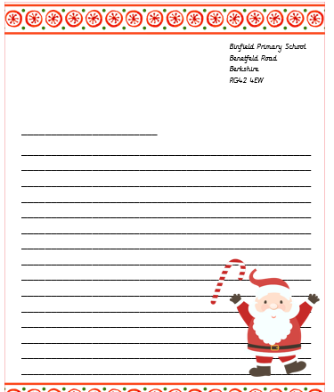
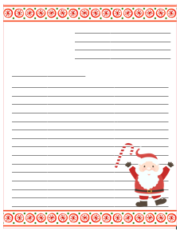
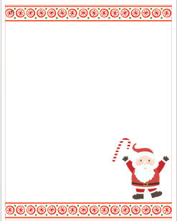
Writing our letter
Lesson 5

