Slide 1

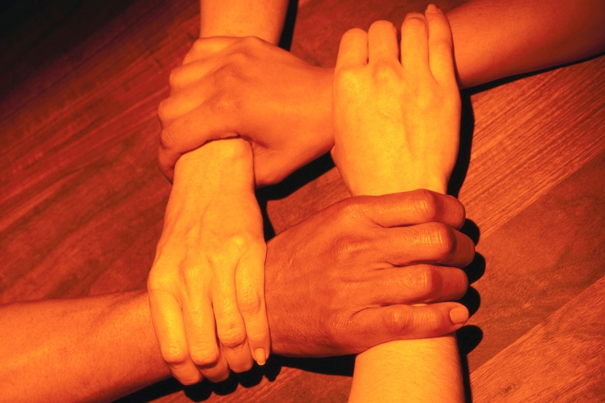
Hand Wake Ups

Slide 2
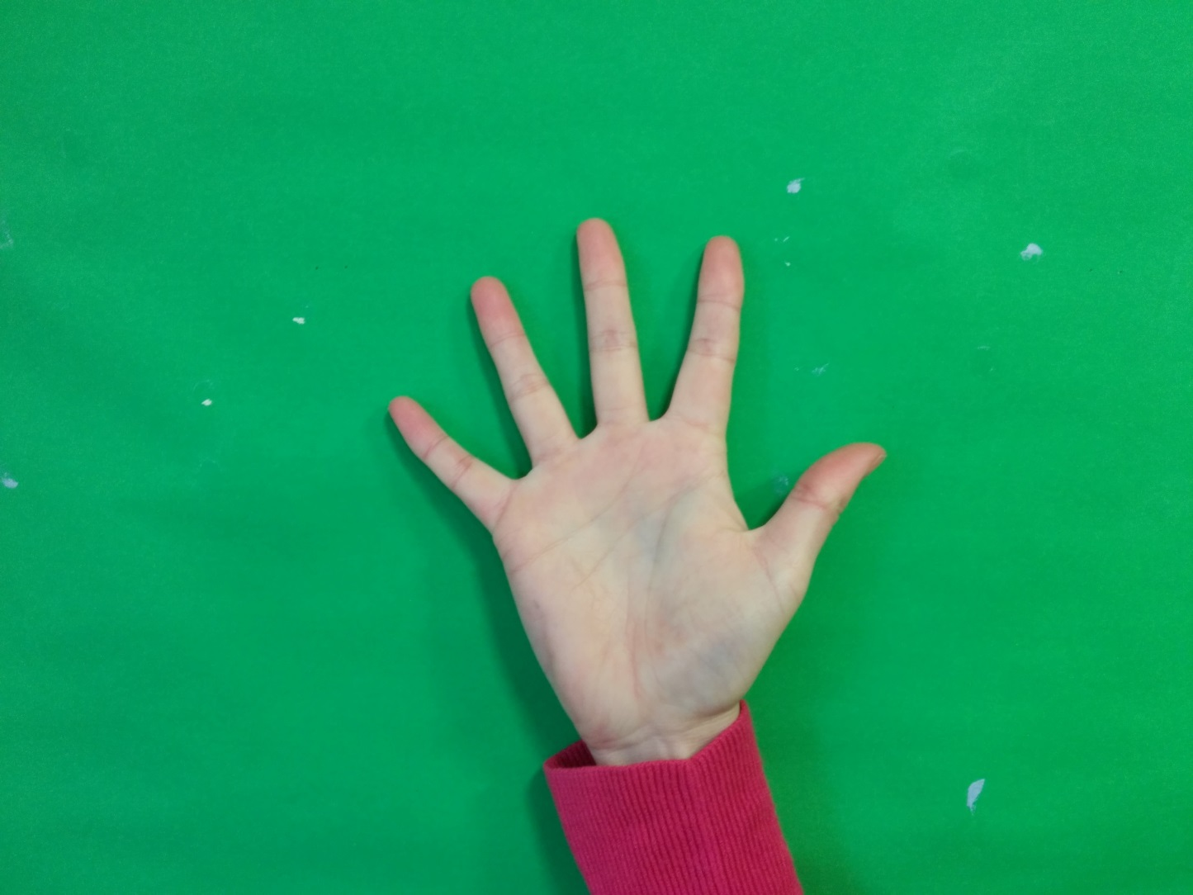
1. Make stars with both hands

Slide 3
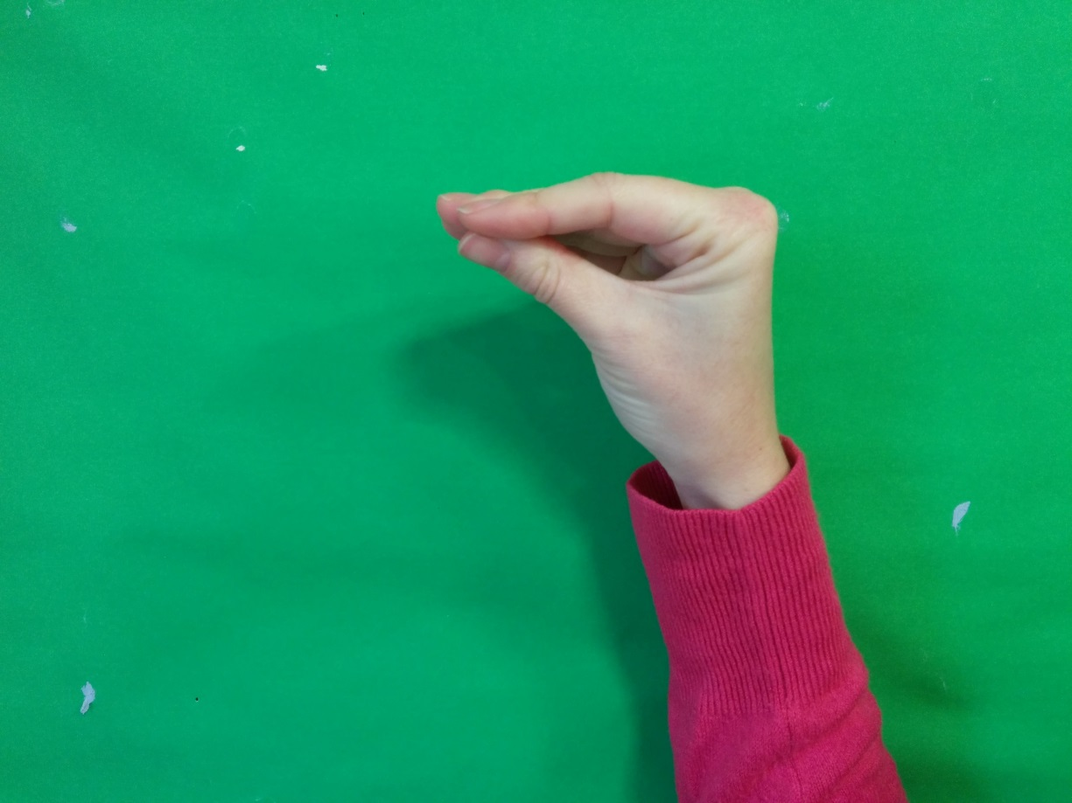
2. Make ‘duck beaks’ with both hands

Slide 4
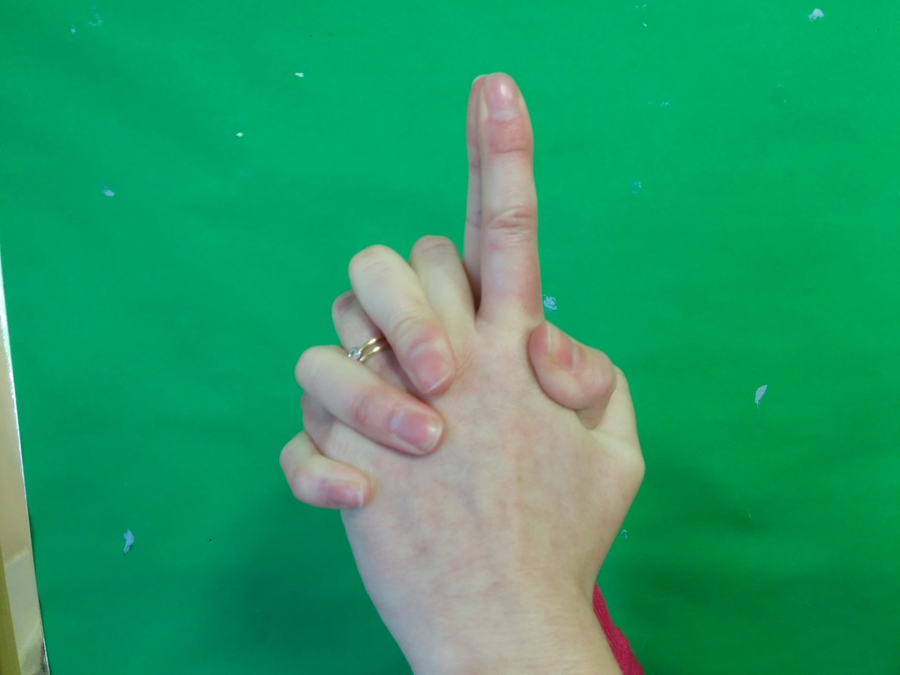
3. Weave fingers together and extend index fingers, pushing them together.

Slide 5
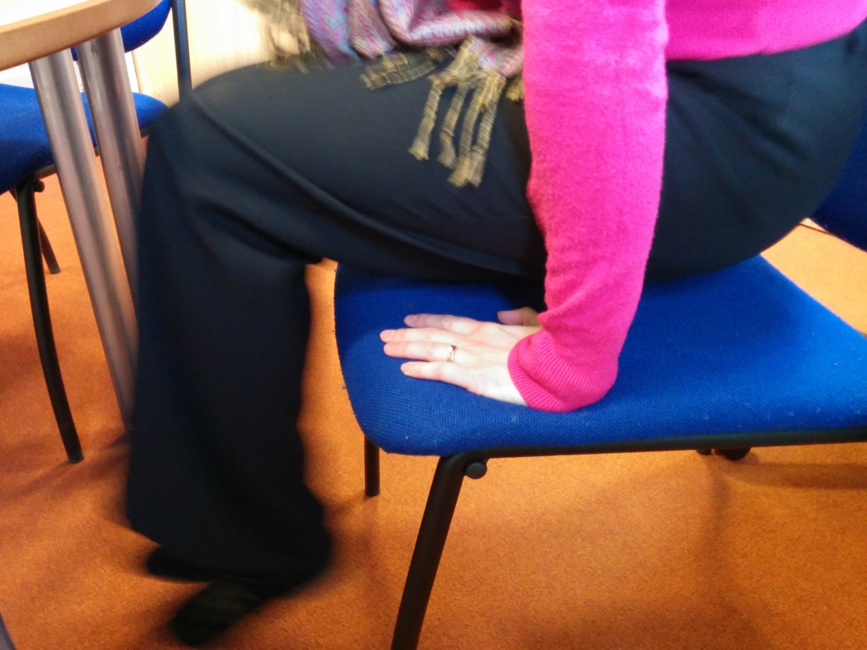
4. Sit on your hands, palms down and lift yourself off of the chair/floor. Repeat 10 times.

Slide 6
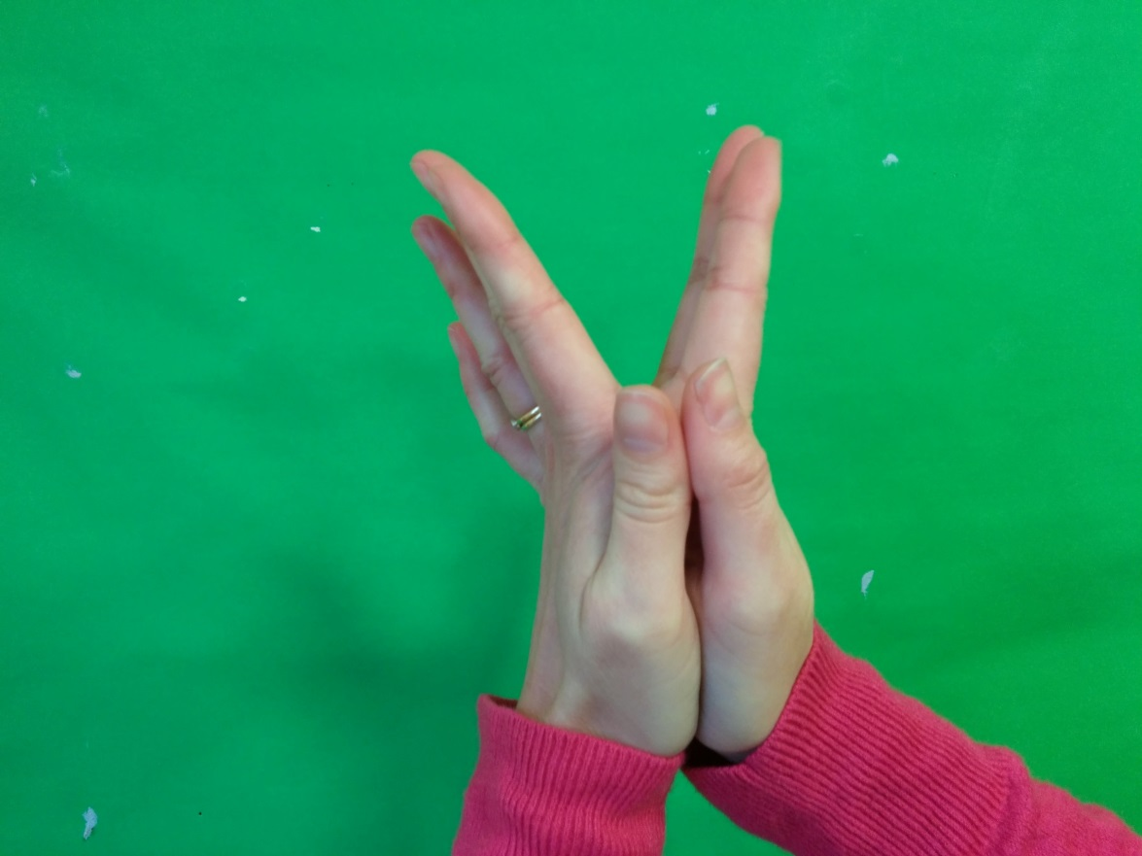
5. Put your palms together and open and close your fingers

Slide 7
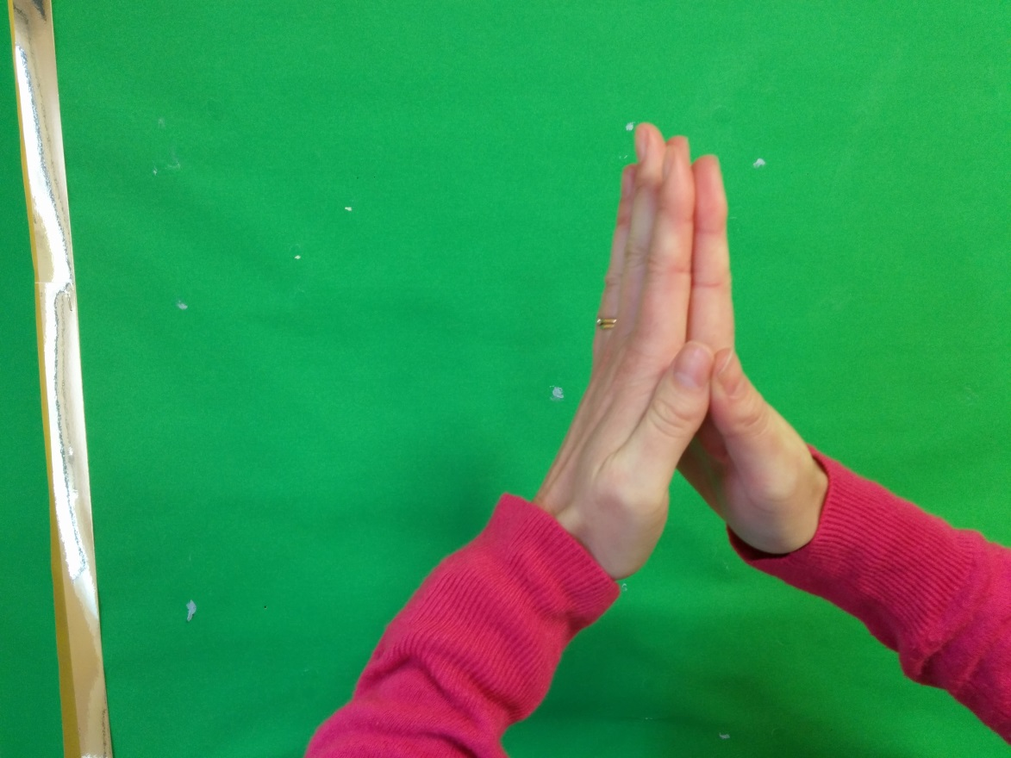
6. Put your palms together, push your fingers together and move your wrists apart.

Slide 8
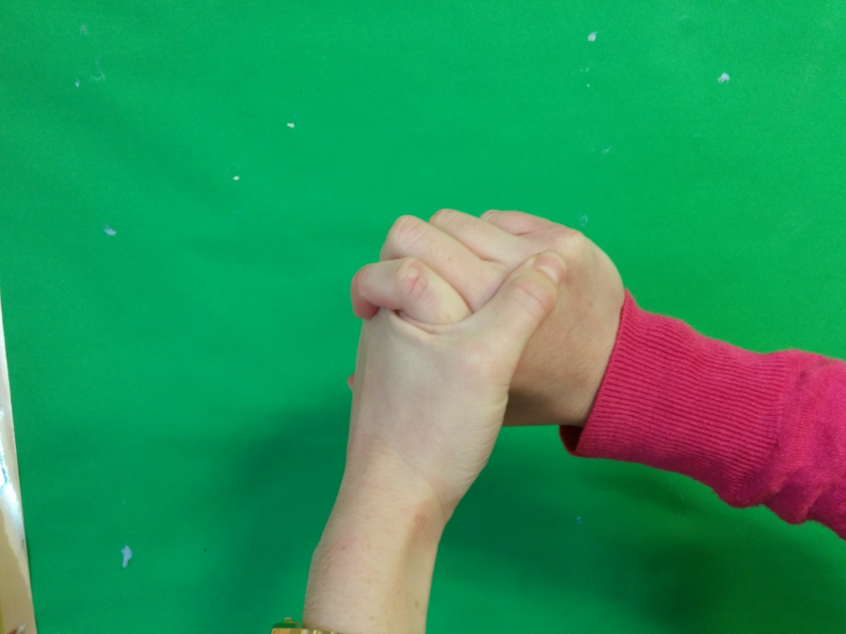
7. Wring your hands

Slide 9
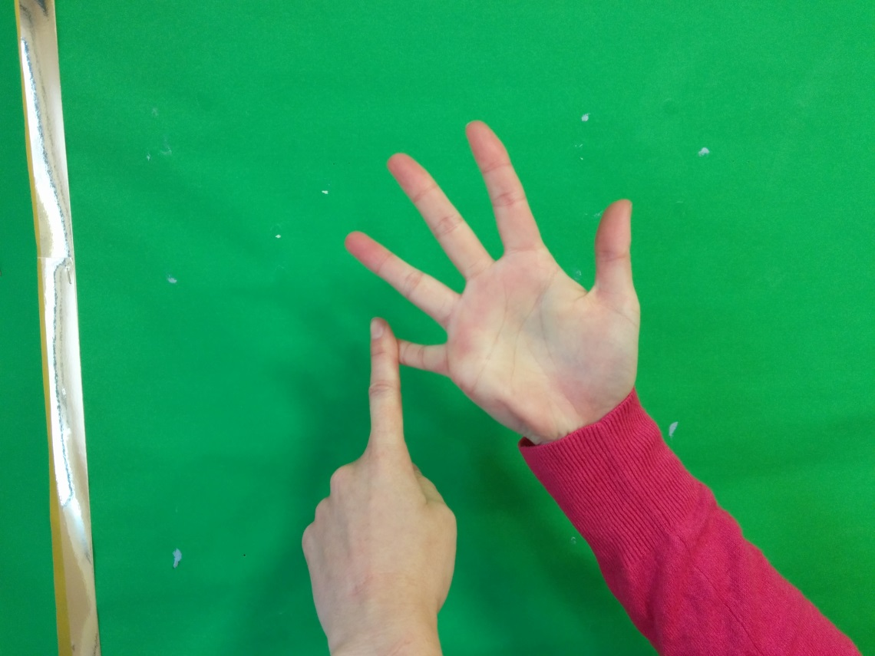
8. Count from 1-5 and point at your fingers using your index finger on the other hand.

Slide 10
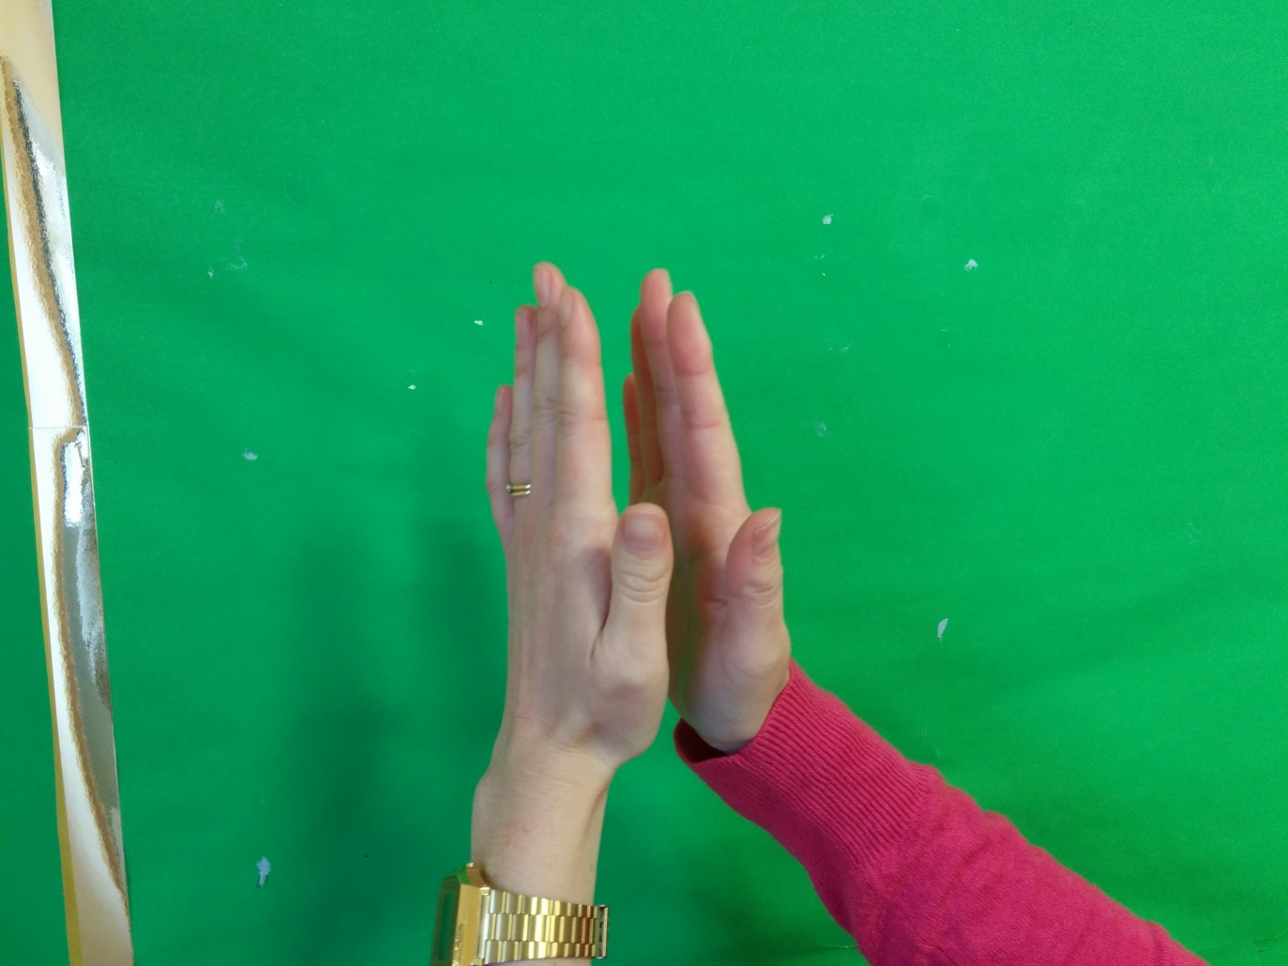
9. Clap quietly, getting louder and louder.

