Slide 1
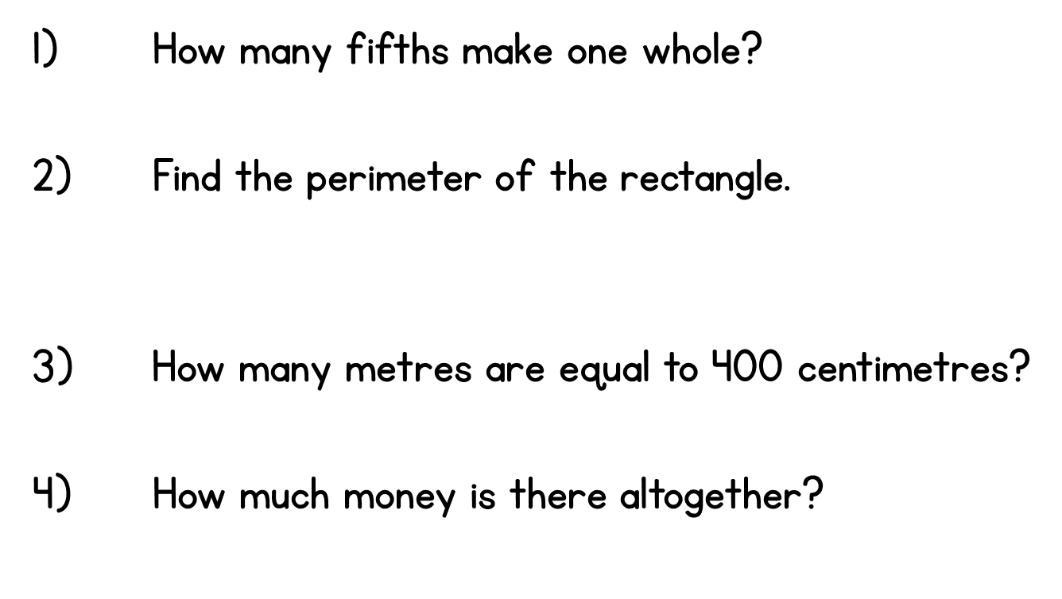

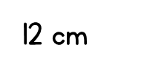
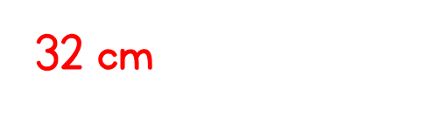

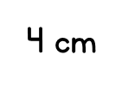

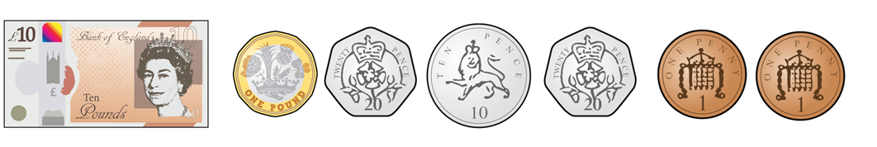

Year 3 | Week 10 | Day 4

Slide 3


Label each fraction in the shapes below.
The first one has been done for you.
Complete the statements below.
There are ____ equal halves in one whole.
There are ____ equal quarters in one whole.
$\frac{\text{1}}{\text{2}}$
$\frac{\text{1}}{\text{2}}$

Slide 4










Label each fraction in the shapes below.
The first one has been done for you.
Complete the statements below.
There are ____ equal halves in one whole.
There are ____ equal quarters in one whole.
$\frac{\text{1}}{\text{4}}$
$\frac{\text{1}}{\text{4}}$
$\frac{\text{1}}{\text{4}}$
$\frac{\text{1}}{\text{2}}$
$\frac{\text{1}}{\text{2}}$
$\frac{\text{1}}{\text{4}}$
$\frac{\text{1}}{\text{4}}$
$\frac{\text{1}}{\text{4}}$
$\frac{\text{1}}{\text{2}}$
$\frac{\text{1}}{\text{4}}$
$\frac{\text{1}}{\text{4}}$
$\frac{\text{1}}{\text{2}}$
2
4

Slide 6










$\frac{\text{1}}{\text{2}}$
$\frac{\text{1}}{\text{2}}$
There are 2 equal halves in one whole.
There are 3 equal thirds in one whole.
There are 4 equal quarters in one whole.
$\frac{\text{1}}{\text{3}}$
$\frac{\text{1}}{\text{3}}$
$\frac{\text{1}}{\text{3}}$
$\frac{\text{1}}{\text{4}}$
$\frac{\text{1}}{\text{4}}$
$\frac{\text{1}}{\text{4}}$
$\frac{\text{1}}{\text{4}}$
The bottom number tells you how many equal parts!
This shape has 3 equal halves!

Slide 7






$\frac{\text{1}}{\text{3}}$
$$\frac{\text{3}}{\text{3}}$$
$$\frac{\text{2}}{\text{3}}$$
$$\frac{\text{1}}{\text{3}}$$
numerator
$\frac{\text{1}}{\text{3}}$
denominator
$\frac{\text{1}}{\text{3}}$
The denominator tells us how many equal parts the whole is divided into.
The numerator tells us how many of those parts we are looking at.

Slide 8



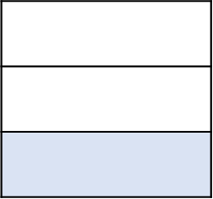

Which of these shapes have one third shaded?
Have a think

Slide 9


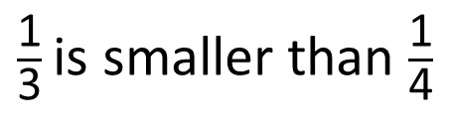






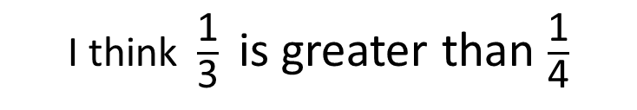

$\frac{\text{1}}{\text{3}}$ is smaller than $\frac{\text{1}}{\text{4}}$
I think $\frac{\text{1}}{\text{3}}$ is greater than $\frac{\text{1}}{\text{4}}$
$\frac{\text{1}}{\text{3}}$
$\frac{\text{1}}{\text{3}}$
$\frac{\text{1}}{\text{3}}$
$\frac{\text{1}}{\text{4}}$
$\frac{\text{1}}{\text{4}}$
$\frac{\text{1}}{\text{4}}$
$\frac{\text{1}}{\text{4}}$
Tiny is correct. $\frac{\text{1}}{\text{3}}$ is greater than $\frac{\text{1}}{\text{4}}$
Who is correct?
Have a think

Slide 10

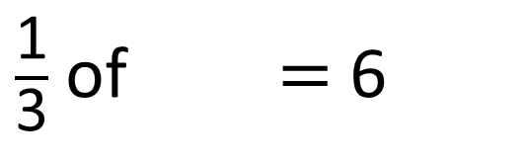
Annie built a tower of cubes.
Here is one third of her tower.
How many cubes are in the whole tower?
$\frac{\text{1}}{\text{3}}$ of $=$ 6
18
18
?
6
6
6
Have a think
There are 18 cubes in the whole tower.

Slide 11







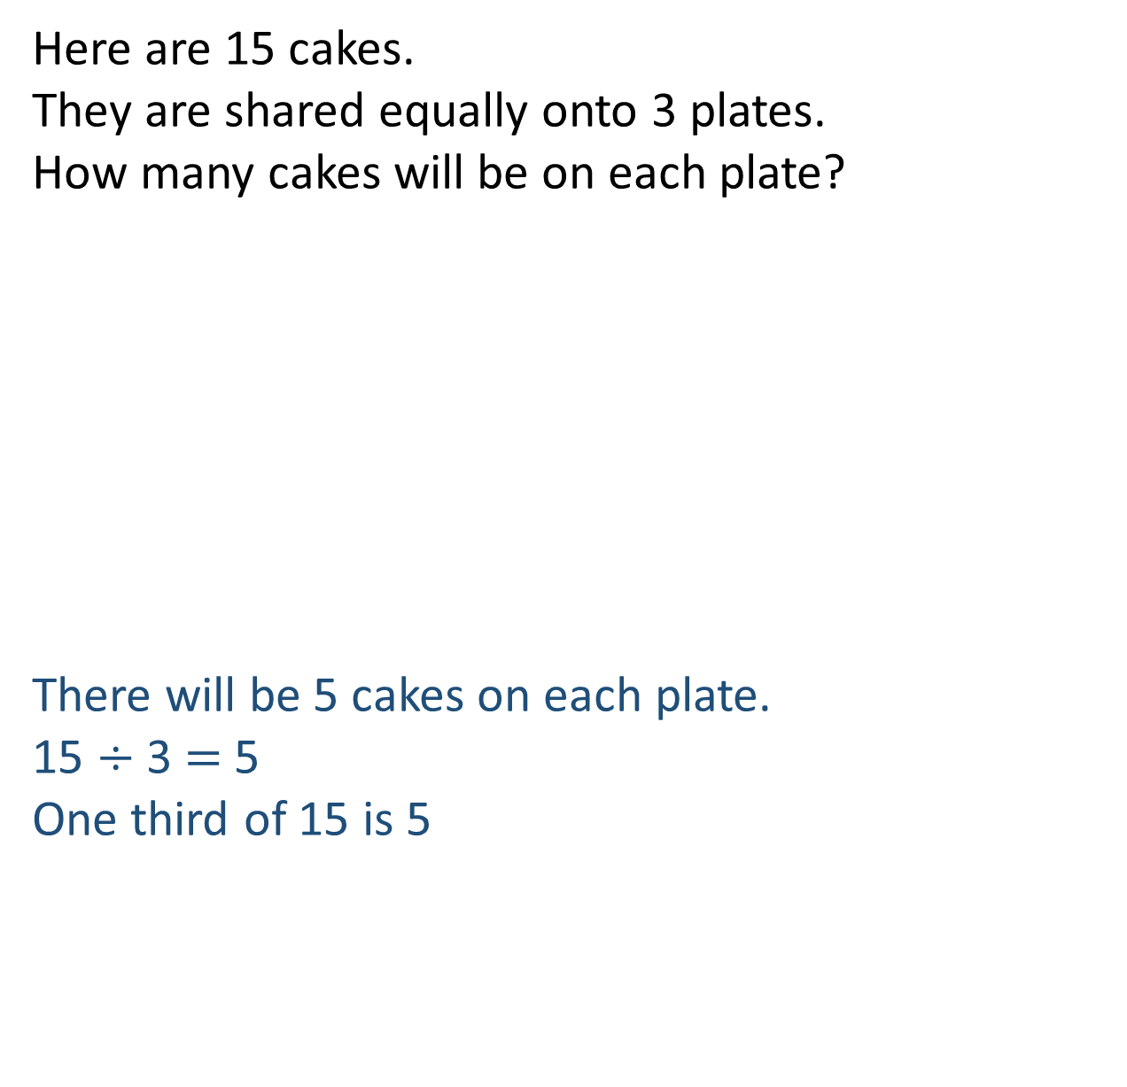
Here are 15 cakes.
They are shared equally onto 3 plates.
How many cakes will be on each plate?
There will be 5 cakes on each plate.
15 $÷$ 3 $=$ 5
One third of 15 is 5

Slide 12


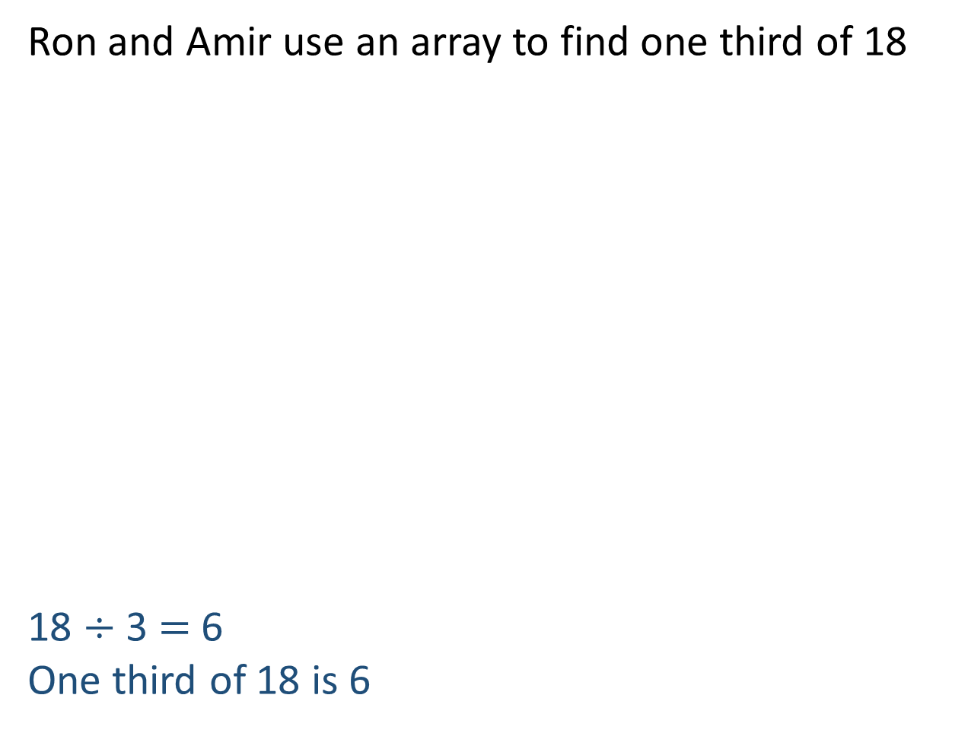
Ron and Amir use an array to find one third of 18
18 $÷$ 3 $=$ 6
One third of 18 is 6
I will draw lines to make 3 equal parts.
I can see a different way to make 3 parts.

Slide 13
Ron and Amir use an array to find one third of 18
18 $÷$ 3 $=$ 6
One third of 18 is 6
I will draw lines to make 3 equal parts.
I can see a different way to make 3 parts.

Slide 14

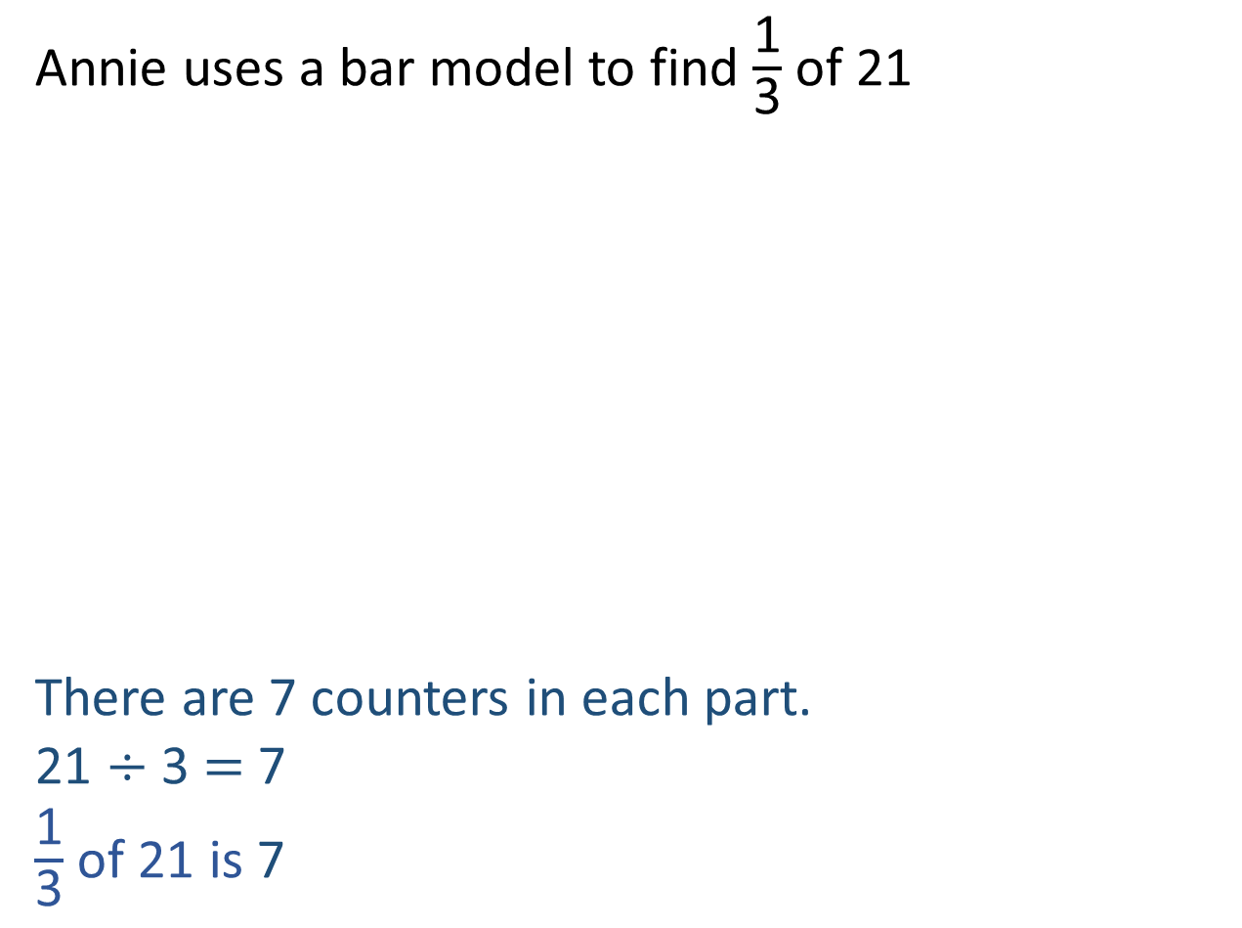
Annie uses a bar model to find $\frac{\text{1}}{\text{3}}$ of 21
There are 7 counters in each part.
21 $÷$ 3 $=$ 7
$\frac{\text{1}}{\text{3}}$ of 21 is 7
21
7
?
I’ve noticed a pattern.

Slide 15
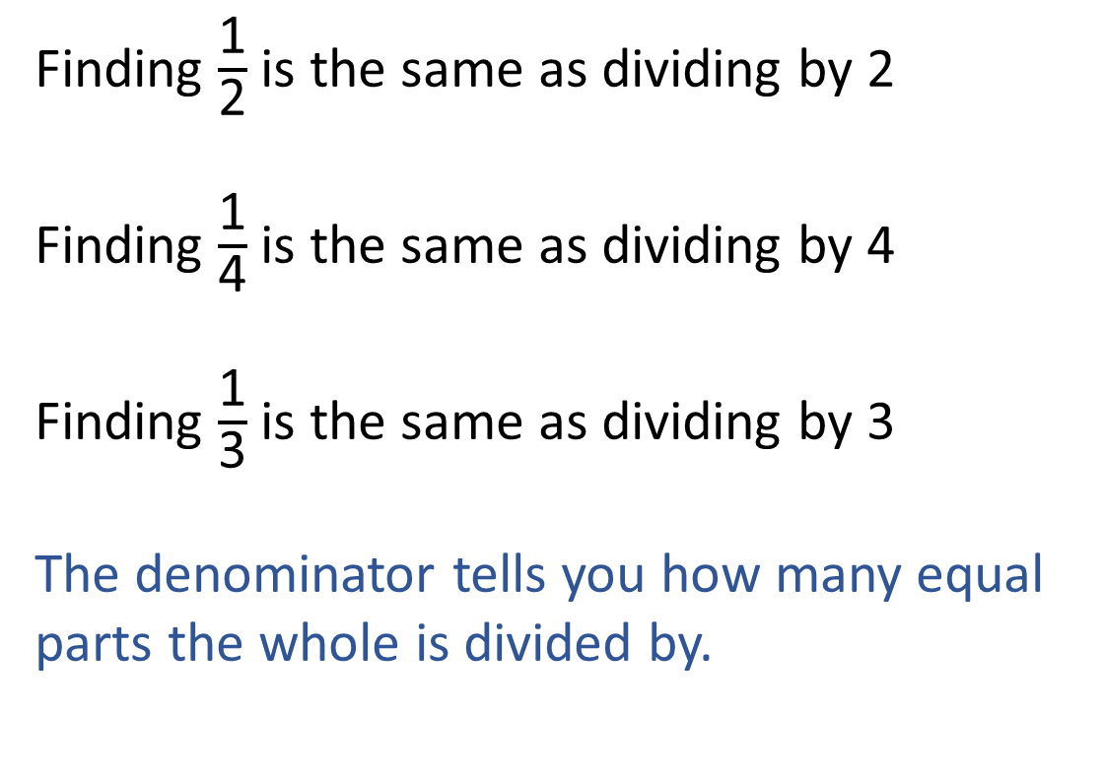
I’ve noticed a pattern.
Finding $\frac{\text{1}}{\text{2}}$ is the same as dividing by 2
Finding $\frac{\text{1}}{\text{4}}$ is the same as dividing by 4
Finding $\frac{\text{1}}{\text{3}}$ is the same as dividing by 3
The denominator tells you how many equal parts the whole is divided by.

Slide 16
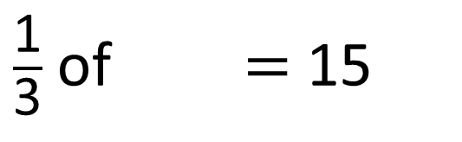
$\frac{\text{1}}{\text{3}}$ of $=$ 15
45
Have a think
45
?
15
15
15

Slide 17


Jack has one third of his birthday money left.
Dora has half of her birthday money left.
They both have £10 left.
What do you know? What can you find out?
£30
10
10
10
They received £50 altogether
left
spent
10
10
10
left
spent
£20
Jack had £30 altogether.
Dora had £20 altogether.
Jack spent £20
Dora spent £10
Have a think
Jack spent £10 more than Dora.

