Slide 1
Thursday 20th May 2021
L.O: To understand texts- comparison skills
C: Boy

Slide 2
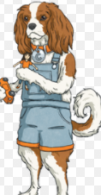
Today we are going to learn about some of Roald Dahl’s hobbies!
We are going to use our Cassie the Commentator skills to compare them!

Slide 3
Starter:
-What would you say is/are your best talent(s)?
-Why are they your talents?
-What makes you good at these things?

Slide 4
Class Read
Class Read p.198-204
Whilst we are reading, think about the differences between the two hobbies!

Slide 5
Our task
Which activity would you prefer to try?
A game of fives or some vintage photography?
https://www.youtube.com/watch?v=TMy6yRBEWrA

Slide 6
Our task
Can you write a paragraph explaining which hobby you would like to try and why?

Slide 7
Our task
Paddlers: Write a paragraph
Snorkellers: Write a paragraph with 3 clear reasons why.
Divers: Write a paragraph using evidence from the text.

Slide 8

Red Pen
Do you think you would be good at this new hobby? Why? Why not?

