Slide 1



Little Red Hen – Lesson 1
Click the icon to hear Miss Tissot’s voice.

Slide 2


Slide 3
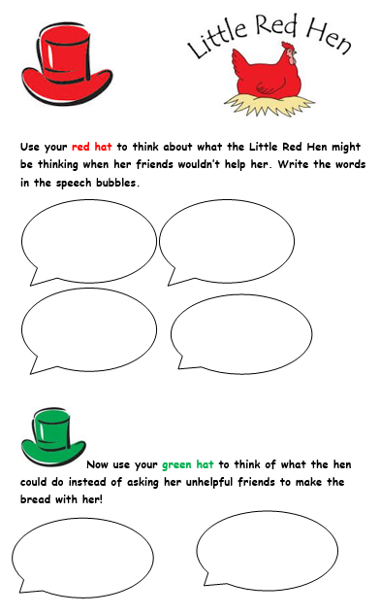
Little Red Hen – Lesson 2
Challenge!

Slide 4
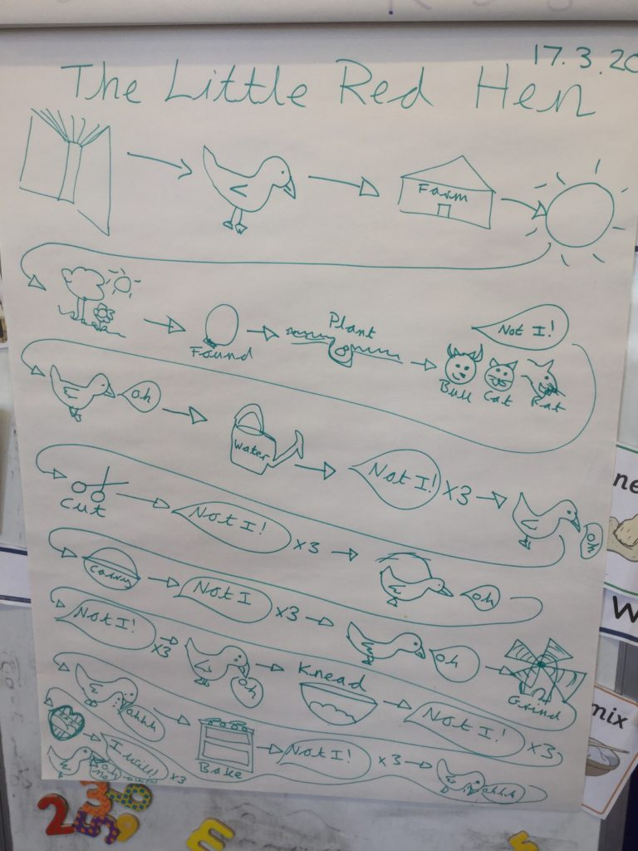
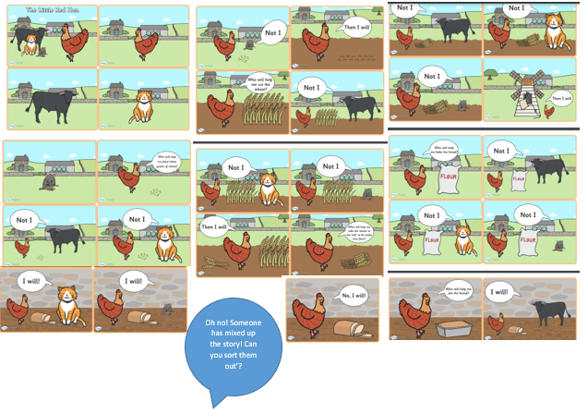
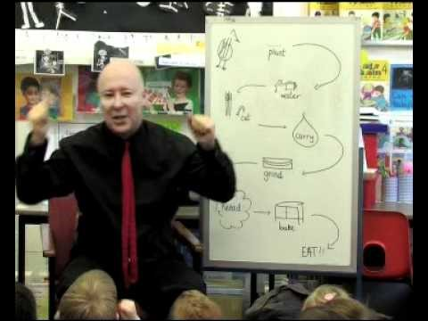
Little Red Hen – Lesson 3

Slide 5
Little Red Hen – Lesson 4
https://www.bbc.co.uk/bitesize/articles/z6rvbdm

Slide 6
Little Red Hen – Lesson 5
"Not I," barked the lazy dog .
"Not I," purred the sleepy cat .
"Not I," quacked the noisy yellow duck .

