Slide 1
Before we begin, let’s see
what we already know!

Slide 2
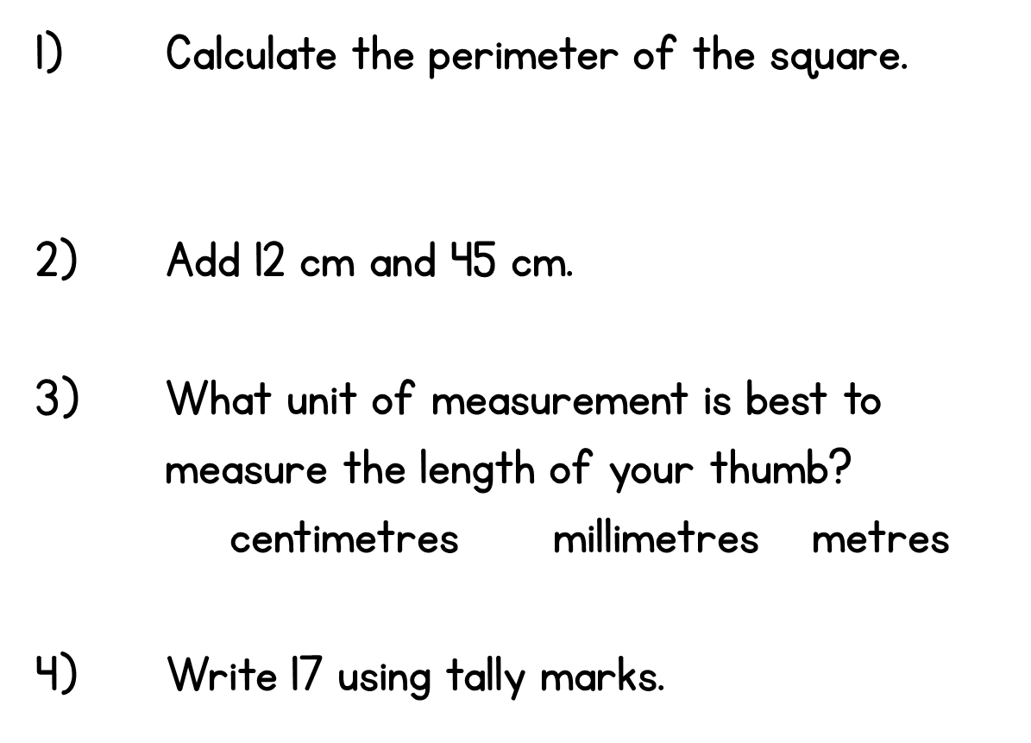
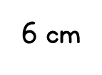

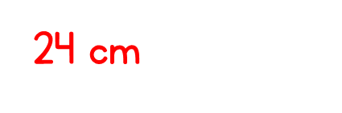
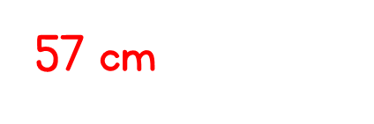


Year 3 | Week 10 | Day 1

Slide 4







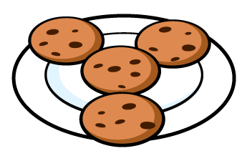

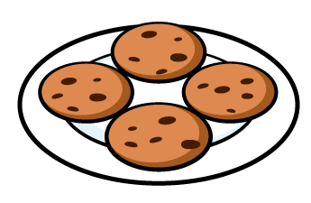
Are the groups equal or not equal?
2) Are the groups equal or not equal?
3) Are the groups equal or not equal?

Slide 5
Are the groups equal or not equal?
2) Are the groups equal or not equal?
3) Are the groups equal or not equal?
not equal
equal
equal

Slide 7


Part of these pictures have been hidden.
Can you identify the whole pictures from the parts you see?

Slide 8
Part of these red shapes have been hidden.
Can you identify the whole shapes from the parts you see?

Slide 9
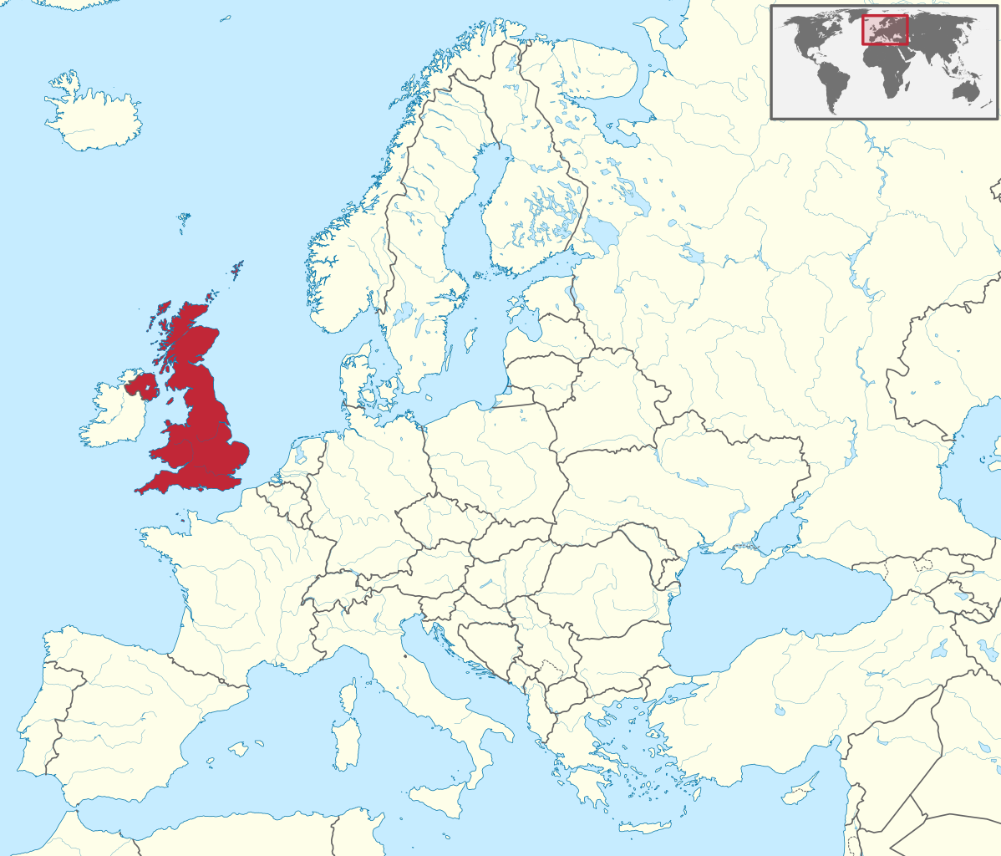
Europe
If _____ is a part, then _____
is the whole.
the UK

Slide 10
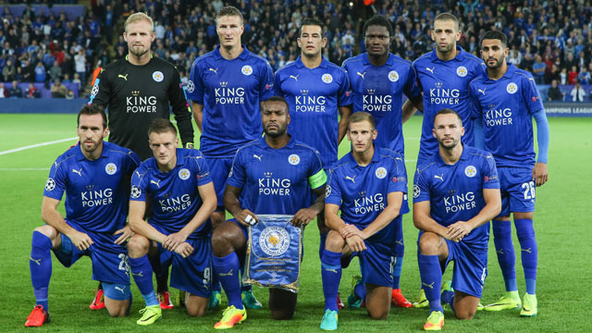
If ______________is a part, then ________is the whole.
the goalkeeper
the team

Slide 11
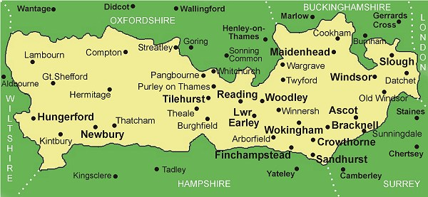
If ___________ is a part, then ___________ is the whole.
Bracknell
Berkshire
A fraction is part of a whole

Slide 12


Amir and Ron each build a tower of 4 cubes.
They break their towers into 2 parts
Amir has made equal parts.
Ron has made unequal parts.

Slide 13

Task 1: Build a tower of 8 cubes
How many ways can you break your tower into equal parts?
How many ways can you break your tower into unequal parts?
Have a think

Slide 14
Task 2: Equal parts
You will need some paper cut into squares.
How many different ways can you fold or cut the squares into 2 equal parts?
What about 4 equal parts?
Have a think

Slide 15
Task 2: Equal parts

Slide 16




Here is a number shape 6
Whitney builds 6 again using 2 parts.
Are the parts equal or unequal?

Slide 17



Task 3: How many ways can you build or draw 6?
Using 2 parts Using more than 2 parts
Using equal parts Using unequal parts
Have a think

Slide 18
Task 4: 20 counters
Count out 20 counters or other small objects.
How many different ways can you organise your counters into equal parts and unequal parts?
Have a think

Slide 19
Task 4: 20 counters
Count out 20 counters or other small objects.
How many different ways can you organise your counters into equal parts and unequal parts?

