Slide 1
Monday 17th May 2021
L.O: To understand texts- inference skills
C: Boy

Slide 2
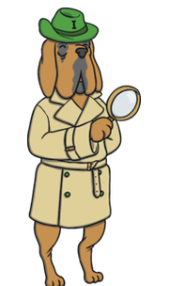
Today we are going to learn about something really exciting that happened at Repton!
We are going to use our Inference Iggy skills to infer how he was feeling.

Slide 3
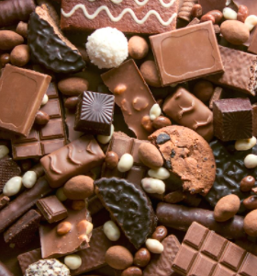
Starter:
Think about your favourite chocolate bar.
What do you like most about it?
What does it remind you of?
How does it make you feel?

Slide 4
Class Read
Class Read p.181-184
Whilst we are reading, think about how much Roald Dahl enjoyed this special opportunity.

Slide 5
Our task
We are going to pretend to be Roald Dahl and write a letter home to his family explaining the joy and excitement of the Cadbury testing parcels.

Slide 6
Our task
Paddlers:
Group write with the teacher
Snorkellers:
Write your letter whilst thinking about your tone and audience.
Divers:
Write your letter whilst thinking about your tone and audience. Try to use evidence from the text.

Slide 7

Red Pen
Can you add an exclaimation mark into your writing to show Roald Dahl’s enthusiasm and excitement?

