Slide 1
Let’s read the ending…
Carefully the Rainbow Fish pulled out the smallest scale and gave it to the little fish. “Thank you! Thank you very much!” The little blue fish bubbled playfully, as he tucked the shiny scale in among his blue ones. A rather peculiar feeling came over the Rainbow Fish. For a long time he watched the little blue fish swim back and forth with his new scale glittering in the water.
The little blue fish whizzed through the ocean with his scale flashing, so it didn’t take long before the Rainbow Fish was surrounded by the other fish. Everyone wanted a glittering scale. The Rainbow Fish shared his scales left and right. And the more he gave away, the more delighted he became. When the water around him filled with glimmering scales, he at last felt at home among the other fish.
Finally the Rainbow Fish had only one shining scale left. His most prized possessions had been given away, yet he was very happy. “Come on Rainbow Fish,” they called. “Come and play with us!” “Here I come,” said the Rainbow Fish and happy as a splash, he swam off to join his friends.

Slide 2
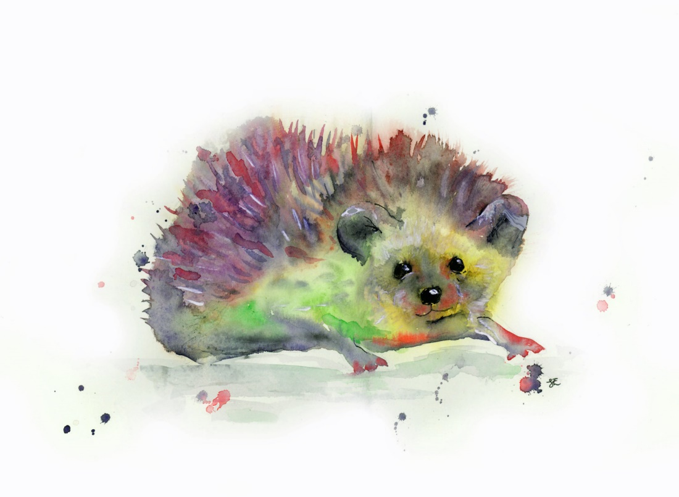
Carefully the Rainbow Hedgehog pulled out the smallest prickle and gave it to the little mouse. “Thank you! Thank you very much!” The little grey mouse squeaked playfully, as he wrapped his tail around the shiny prickle. A rather peculiar feeling came over the Rainbow Hedgehog. For a long time he watched as the little grey mouse happily ran back and forth with her prickle.

Slide 3
The little grey mouse scurried through the forest with his prickle flashing in the sunlight, so it didn’t take long before the Rainbow Hedgehog was surrounded by the other animals. Everyone wanted a glittering prickle. The Rainbow Hedgehog shared her prickles left and right. And the more she gave away, the more delighted she became. When the field around her filled with glimmering prickles, she at last felt at home among the other animals.

Slide 4
Finally the Rainbow Hedgehog had only one colourful prickle left. Her most prized possessions had been given away, yet she was very happy. “Come on Rainbow Hedgehog,” they called. “Come and play with us!” “Here I come,” said the Rainbow Hedgehog and with a happy little squeak, she joined her friends.

