Slide 1
Let’s read the middle paragraphs
What good were the dazzling, shimmering scales with no one to admire them? Now he was the loneliest fish in the entire ocean. One day he poured out his troubles to the starfish. “I really am beautiful. Why doesn’t anybody like me?” “I can’t answer that for you,” said the starfish. “But if you go beyond the coral reef to a deep cave you will find the wise octopus. Maybe she can help you.”
The Rainbow Fish found the cave. It was very dark inside and he couldn’t see anything. Then suddenly two eyes caught him in their glare and the octopus emerged from the darkness. “I have been waiting for you,” said the octopus with a deep voice. “The waves have told me your story. This is my advice. Give a glittering scale to each of the other fish. You will no longer be the most beautiful fish in the sea, but you will discover how to be happy.”
“I can’t...” the Rainbow Fish started to say, but the octopus had already disappeared into a dark cloud of ink. Give away my scales? My beautiful shining scales? Never. How could I ever be happy without them? Suddenly he felt the light touch of a fin. The little blue fish was back! “Rainbow Fish, please, don’t be angry. I just want one little scale.” The Rainbow Fish wavered. Only one very very small shimmery scale, he thought. Well maybe I wouldn’t miss just one.

Slide 2
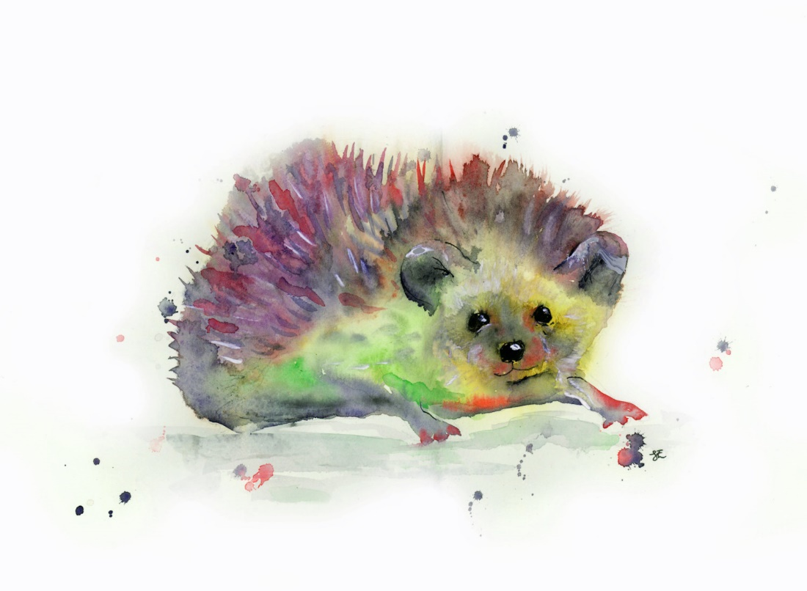
What good were the dazzling, shimmering prickles with no one to admire them? Now she was the loneliest hedgehog in the entire forest. One day was walking along the path talking to herself, “I really am beautiful. Why doesn’t anybody like me?” A head with long ears popped up out of a hole. "I can’t answer that for you,” said the rabbit. “But if you go up the tallest tree, on the highest branch, lives the wise owl. Maybe she can help you.”

Slide 3
The Rainbow Hedgehog found the owl. “I have been waiting for you,” said the owl with a soft voice. “The birds have told me your story. This is my advice. Give a glittering prickle to each of the other animals. You will no longer be the most beautiful hedgehog in the forest, but you will discover how to be happy.”

Slide 4
The wise owl spread her wings before the Rainbow Hedgehog could speak. Give away my prickles? My beautiful prickles? Never. Suddenly he felt the light touch of a soft tail. The little grey mouse was back! “Rainbow Hedgehog, please, don’t be angry. I just want one little prickle.” The Rainbow Hedgehog wavered. Only one very very small shimmery prickle, she thought. Well maybe I wouldn’t miss just one.

