Slide 1

Let’s read the opening paragraph
A long way out in the deep blue sea there lived a fish. Not just an ordinary fish, but the most beautiful fish in the entire ocean. His scales were every shade of blue and green and purple, with sparkling silver scales among them. The other fish were amazed at his beauty. The called him Rainbow Fish. “Come on, Rainbow Fish,” they would call. “Come and play with us!” But the Rainbow Fish would just glide past, proud and silent, letting his scales shimmer.
One day, a little blue fish followed after him. “Rainbow Fish,” he called, “wait for me! Please give me one of you shiny scales. They are so wonderful, and you have so many. ”You want me to give you one of special scales? Who do you think you are?” cried the Rainbow Fish. “Get away from me!” Shocked, the little blue fish swam away. He was so upset; he told all his friends what had happened. From then on, no one would have anything to do with the Rainbow Fish. They turned away when he swam by.

Slide 2
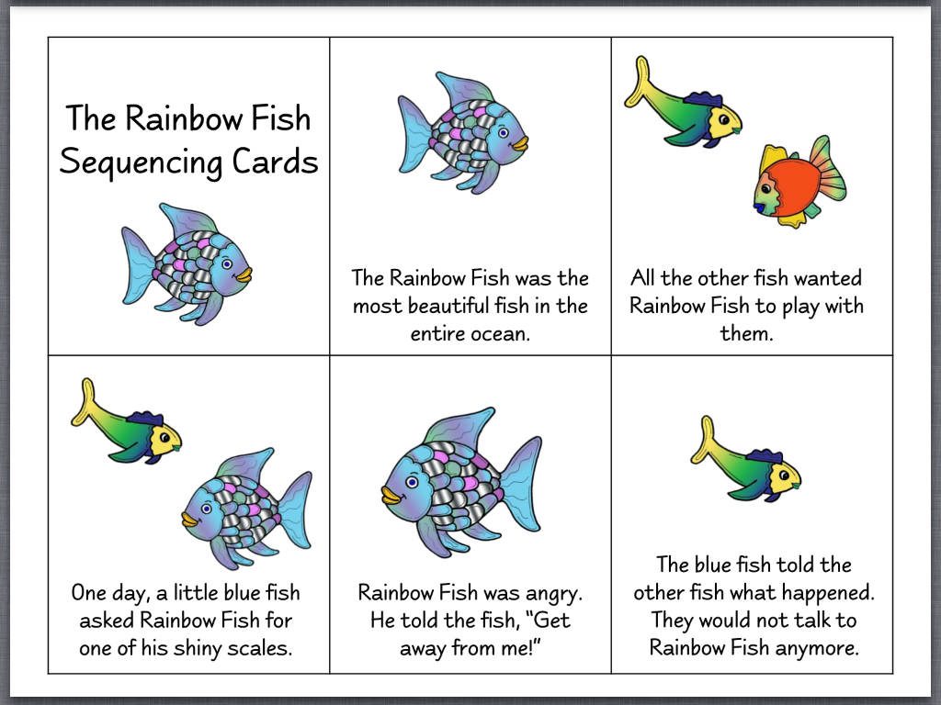
The Rainbow Hedgehog | The Rainbow Hedgehog was the most beautiful Hedgehog in the entire forest. | All the other animals wanted the Rainbow Hedgehog to play with them. | One day, a little grey mouse asked the Rainbow Hedgehog for one of her shiny prickles. | Rainbow Hedgehog was angry. ‘Get away from me!’ | The grey mouse told the other animals what had happened. They would not talk to the Rainbow Hedgehog anymore.

Slide 3
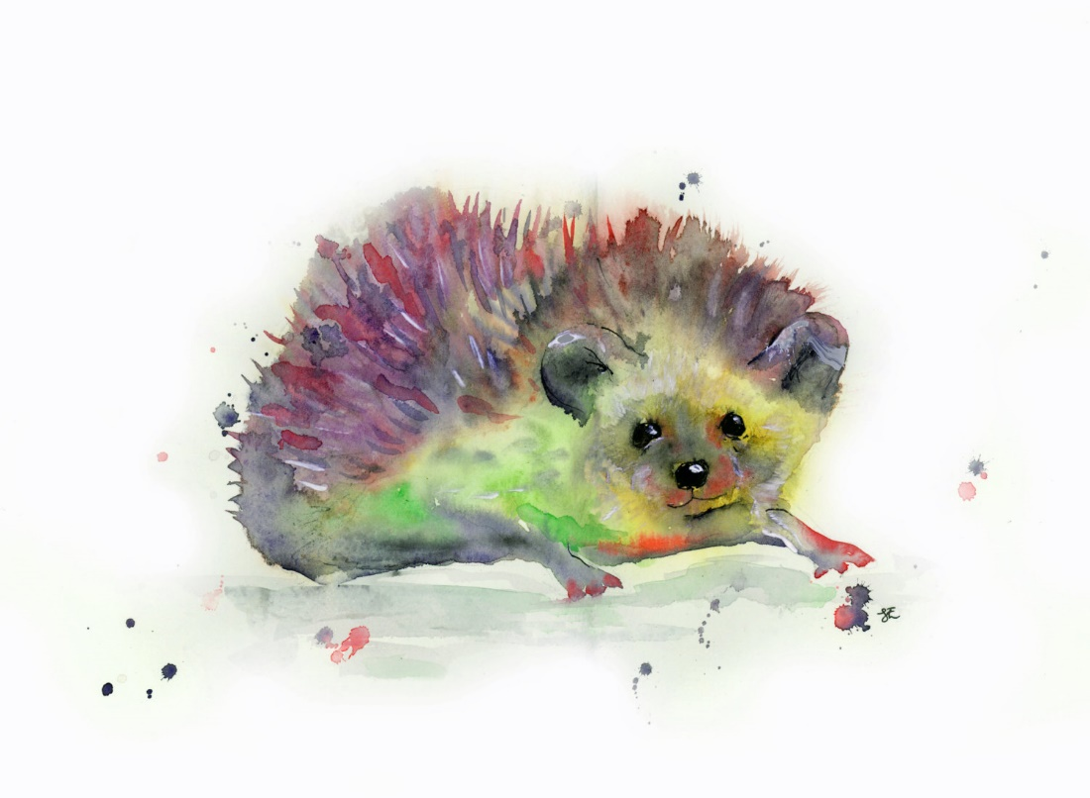
A long way out in the deep dark forest lived a hedgehog. Not just an ordinary hedgehog, but the most beautiful hedgehog in the entire forest. Her prickles were every shade of the rainbow, with sparkling silver prickles among them.
The other animals were amazed at the hedgehog’s beauty. They called Rainbow Hedgehog. “Come on Rainbow Hedgehog” they would call “come and play with us!”. But the Rainbow Hedgehog would just shuffle past, proud and silent and let her prickles shine in the sunlight.

Slide 4
One day, a little grey mouse followed after her. “Rainbow Hedgehog,” he called, “wait for me! Please give me one of you shiny prickles. They are so wonderful, and you have so many. ”You want me to give you one of special prickles? Who do you think you are?” cried the Rainbow Hedgehog. “Get away from me!” Shocked, the little grey mouse scurried away. He was so upset. He told all his friends what had happened. From then on, no one would have anything to do with the Rainbow Hedgehog. They turned away when she came by.

