Slide 1
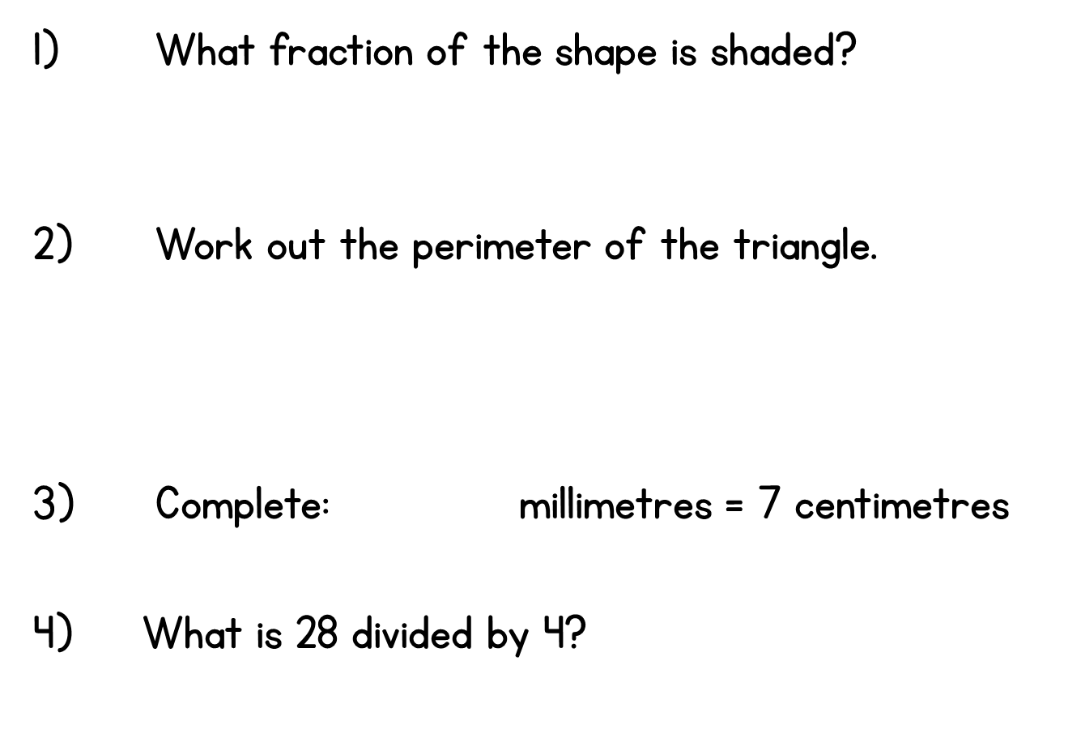
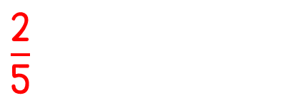

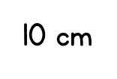
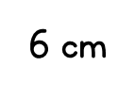

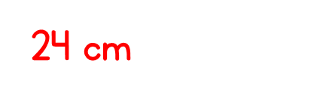
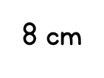
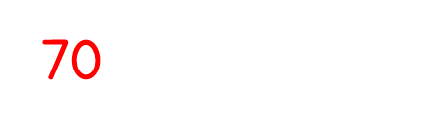
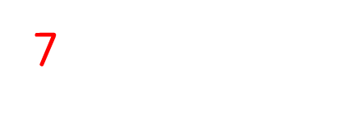
Year 3 | Week 10 | Day 2

Slide 3

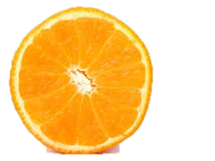
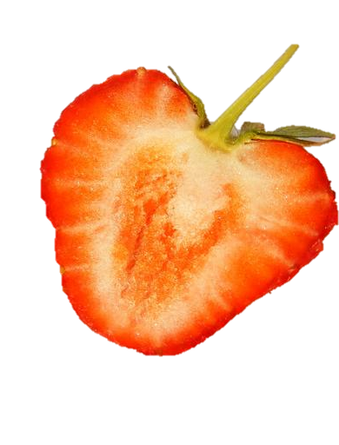
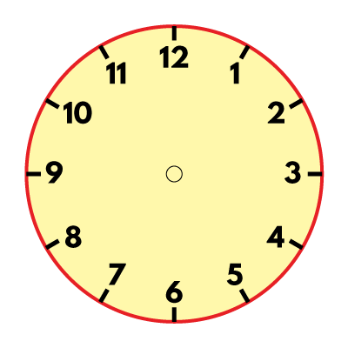

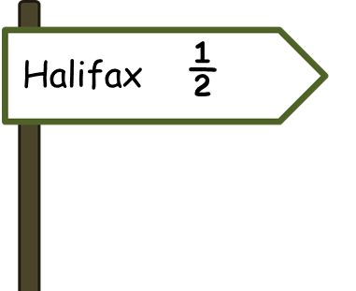
What do you notice?
Have a think

Slide 5




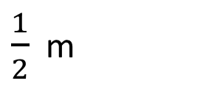
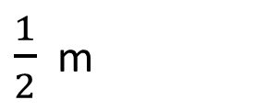
Here are some more halves.
$$\frac{1}{2}$$
$$\frac{1}{2}$$
$$\frac{1}{2}$$
$$\frac{1}{2}$$
$\frac{1}{2}$ m
$\frac{1}{2}$ m
One half means one part out of 2 equal parts.
Two halves are equal to one whole.

Slide 6

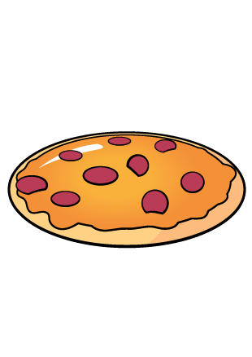
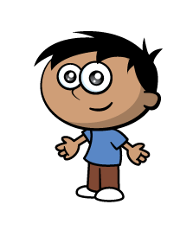
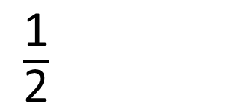
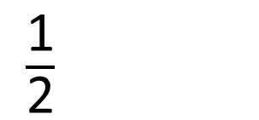
Ron and Amir are going to share the pizza.
They cut it into 2 equal parts.
They each have one half of the whole pizza.
Here is a pizza.
$\frac{\text{1}}{\text{2}}$
$\frac{\text{1}}{\text{2}}$

Slide 7

Which of these shapes have one half shaded?
v
v

Slide 8

Eva wants to colour half of each set of shapes.
a)
b)
c)
How many should she colour each time?
Have a think

Slide 9


Which shapes have exactly one half shaded?
Have a think

Slide 10



Here are 12 flowers.
There are 6 flowers in each pot.
12 $÷$ 2 $=$ 6
Half of 12 $=$6
The flowers are shared equally between 2 pots.
How many flowers will be in each pot?

Slide 11
Here are 14 flowers.
There are 7 flowers in each pot.
14 $÷$ 2 $=$ 7
Half of 14 $=7$
The flowers are shared equally between 2 pots.
How many flowers will be in each pot?
Have a think

Slide 12


Here are 10 marbles.
They will each get 5 marbles.
10 $÷$ 2 $=$ 5
Half of 10 $=$5
Ron and Amir need half each to start their game.
How many marbles will they each get?

Slide 13
They have lost a marble. Now there are 9
Can Ron and Amir halve 9 marbles?

Slide 14

Jack is using this array to help him find $\frac{\text{1}}{\text{2}}$ of 12

Slide 15


Ron bought some sweets.
He has eaten half of them.
Here are the sweets he has left.
How many sweets did Ron have to begin with?
8
?
$\frac{\text{1}}{\text{2}}$ of $=$ 4
Have a think
8

Slide 16
$\frac{\text{1}}{\text{2}}$ of $=$ 20
40
Have a think
40
?
20
20

