Slide 2
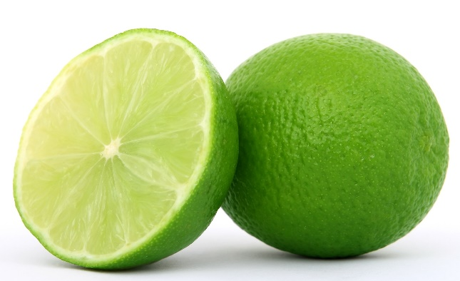
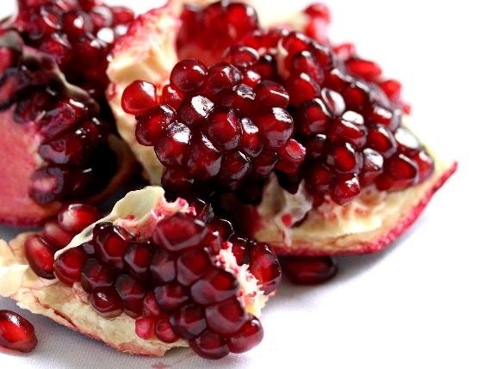
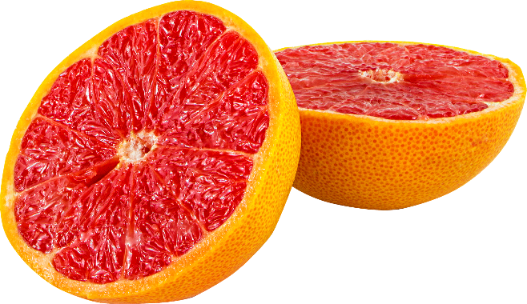
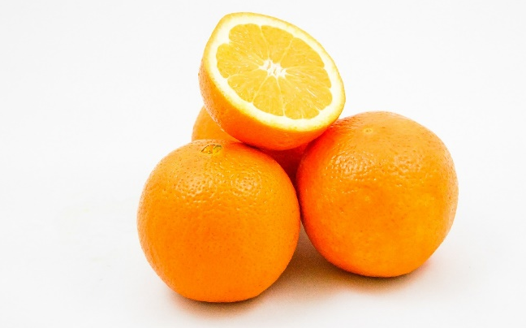
1. Which is the odd one out?
Answer
Next

Slide 3
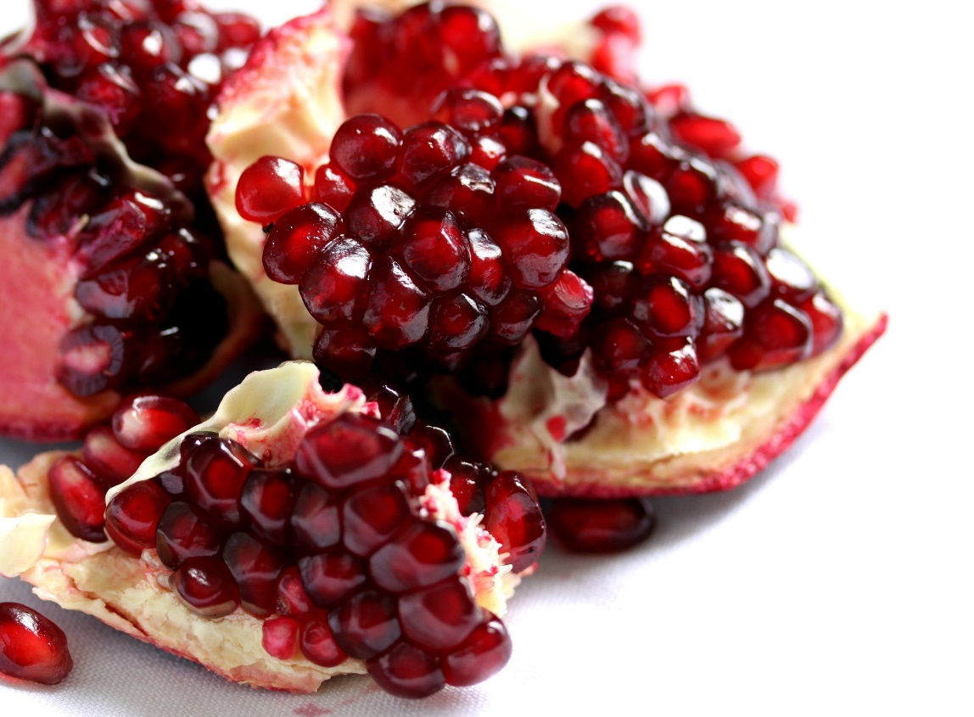
The Pomegranate is the odd one out.
The rest are all citrus fruits (lime, blood orange and kumquat)
Back
Next

Slide 4
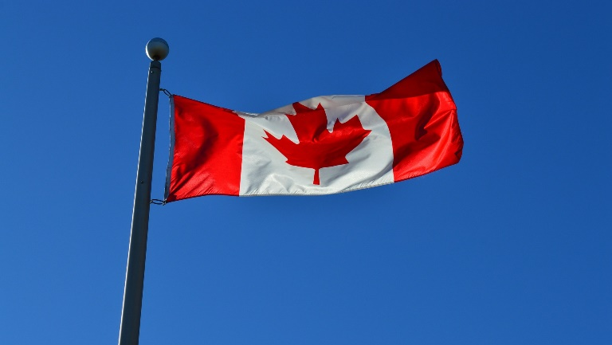
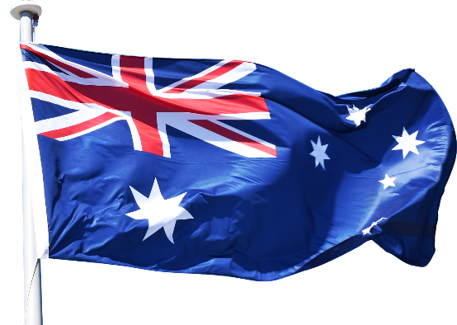
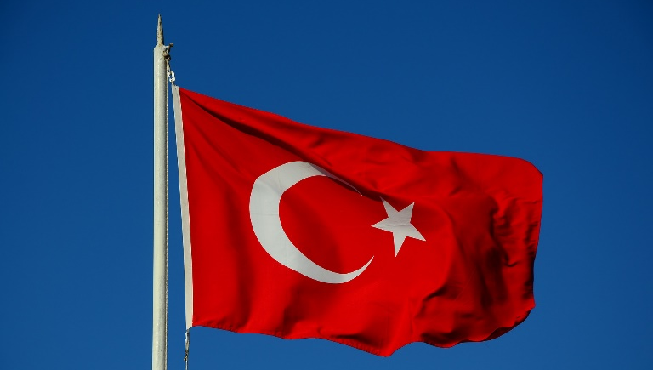
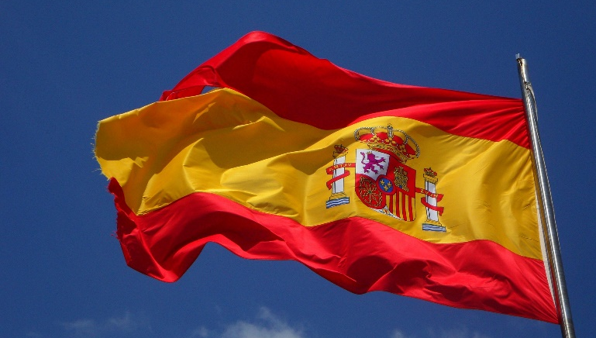
2. Which country is the odd one out?
Answer
Next

Slide 5

Australia is the odd one out.
The rest are all in the northern hemisphere (Canada, Turkey and Spain).
Back
Next

Slide 6
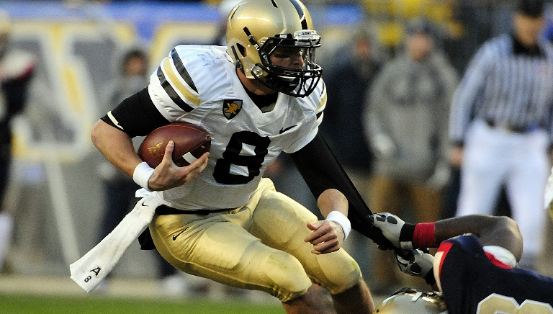

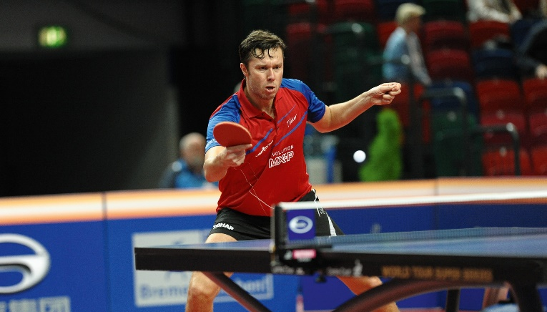
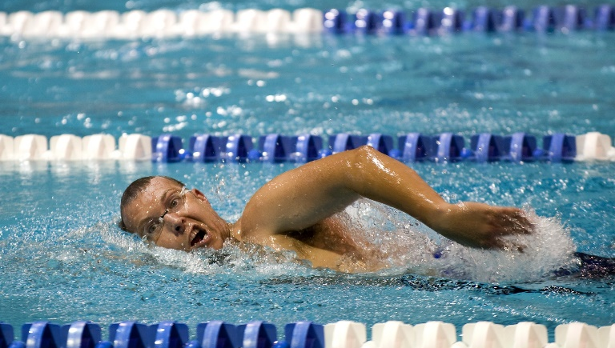
3. Which is the odd one out?
Answer
Next

Slide 7

Swimming is the odd one out.
The rest are all sports you play with a ball (American football, golf and table tennis.)
Back
Next

Slide 8
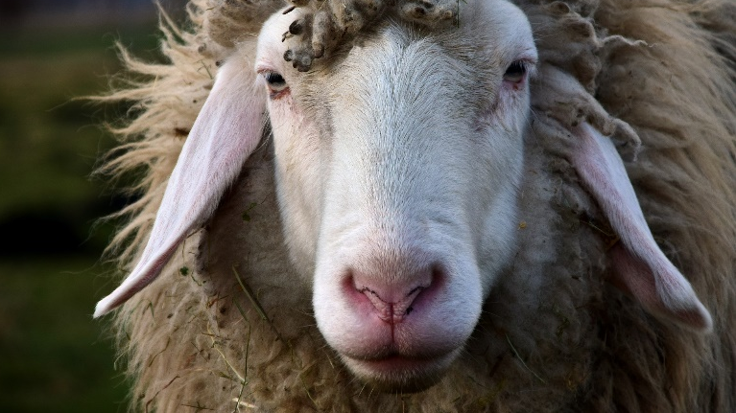
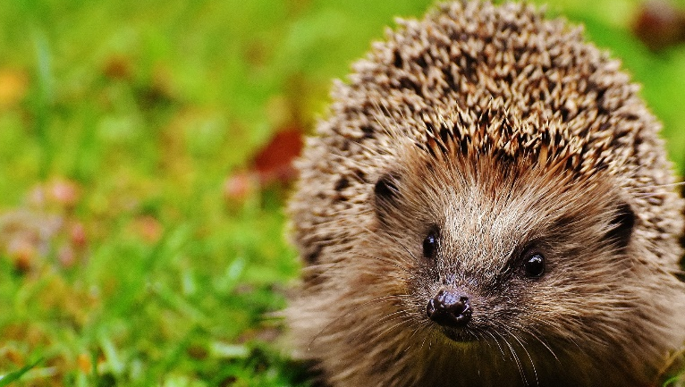
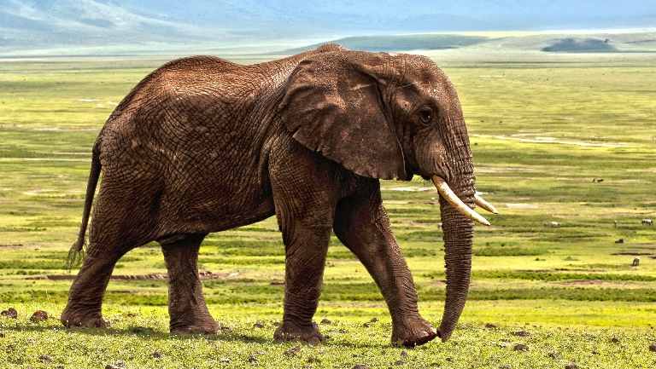
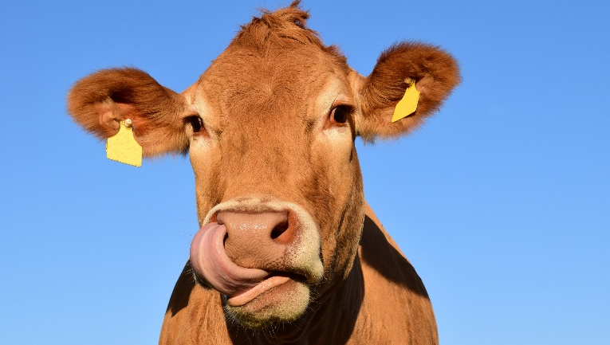
4. Which is the odd one out?
Answer
Next

Slide 9

Hedgehog is the odd one out.
The rest are all herbivores (sheep, cow and elephant).
Back
Next

Slide 10
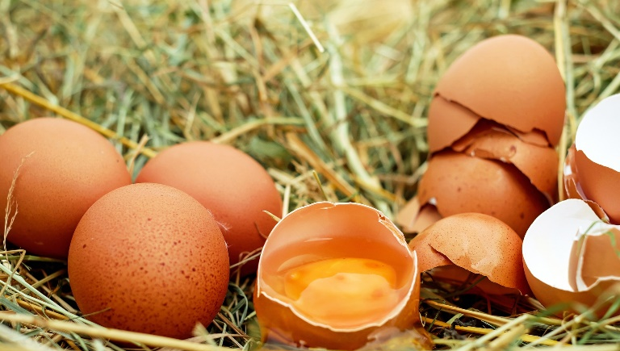
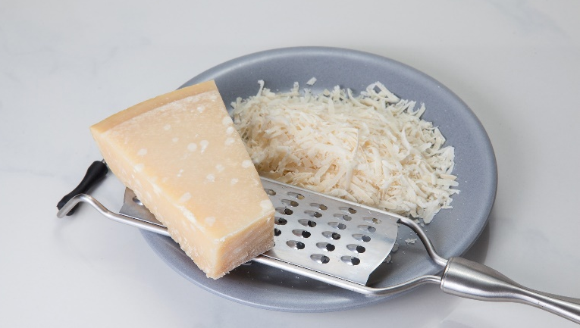
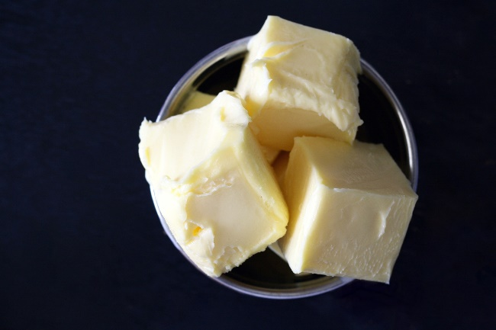
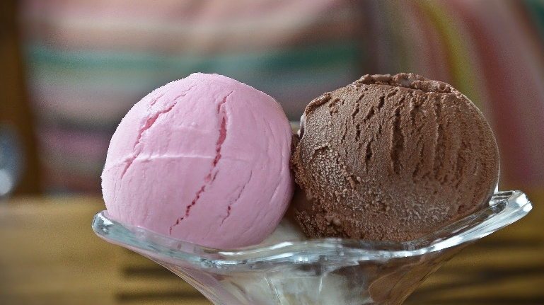
5. Which is the odd one out?
Answer
Next

Slide 11

Eggs are the odd one out.
The rest are all milk products (cheese, butter and ice cream).
Back
Next

Slide 12
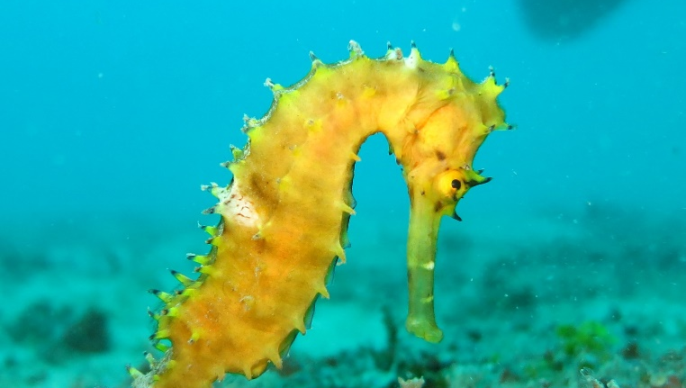
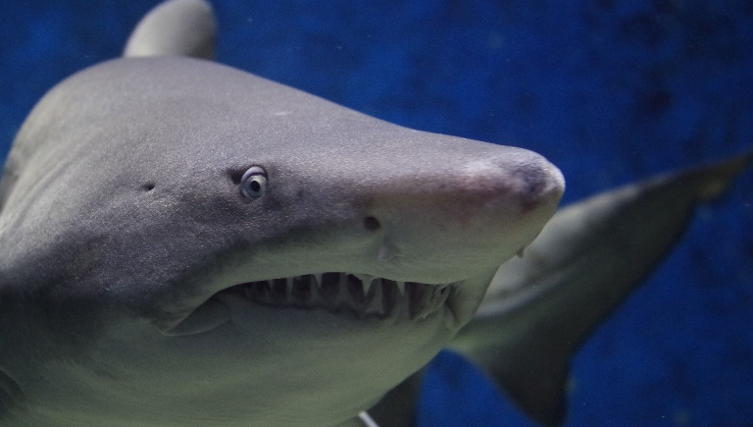
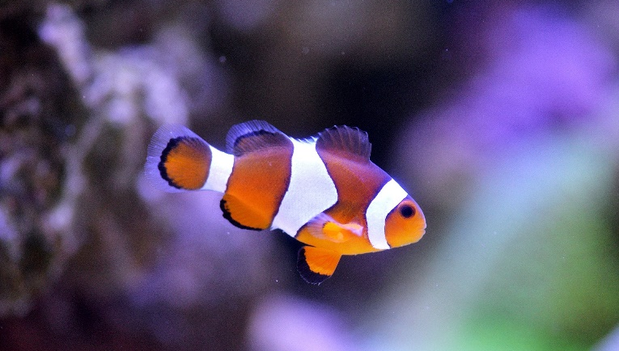
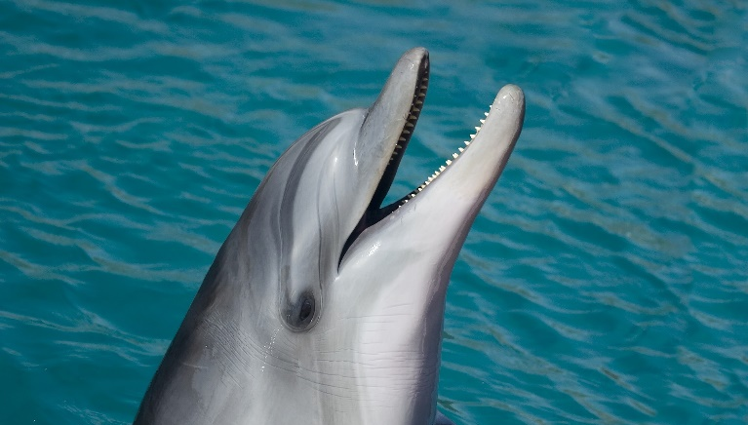
6. Which is the odd one out?
Answer
Next

Slide 13

The dolphin is the odd one out.
A dolphin is a mammal and the rest are all fish (seahorse, shark and clownfish).
Back
Next

Slide 14
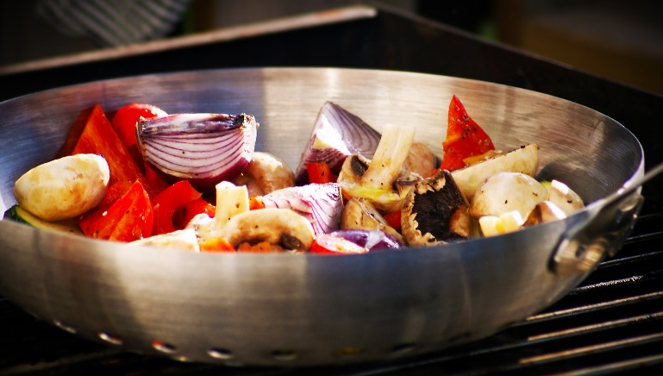

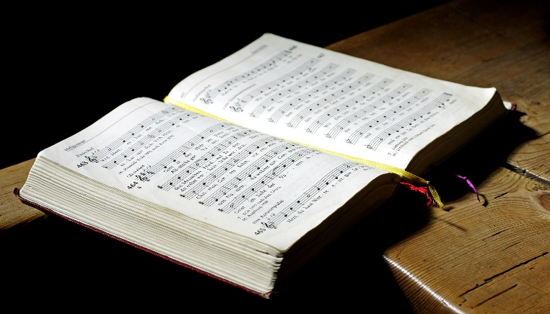
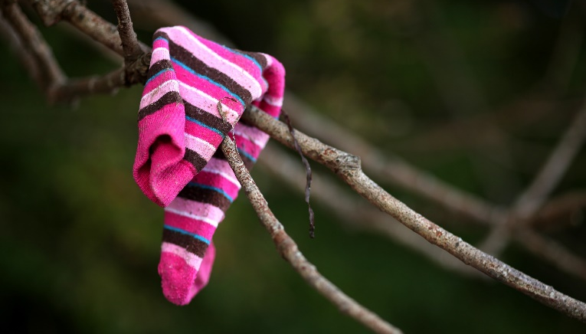
7. Which is the odd one out?
Answer
Next

Slide 15

The book is the odd one out.
All the others rhyme! (wok, lock and sock)
Back
Next

Slide 16
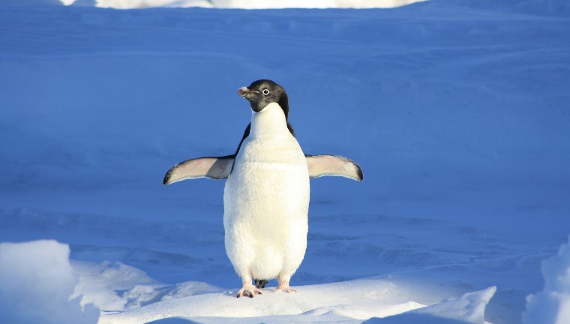
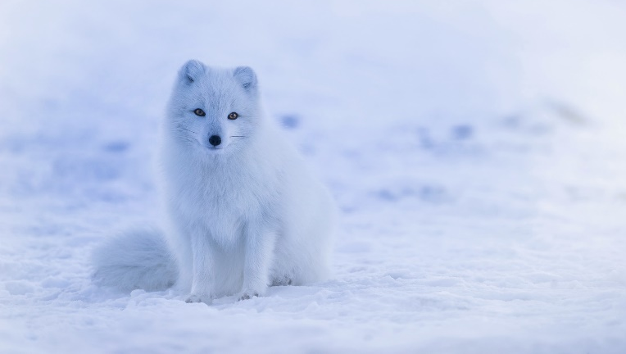
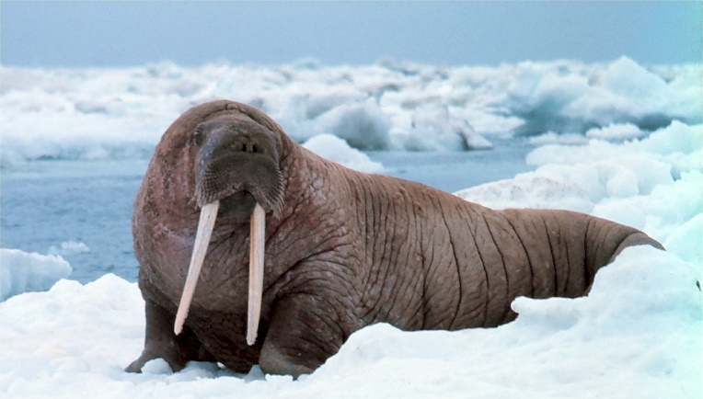
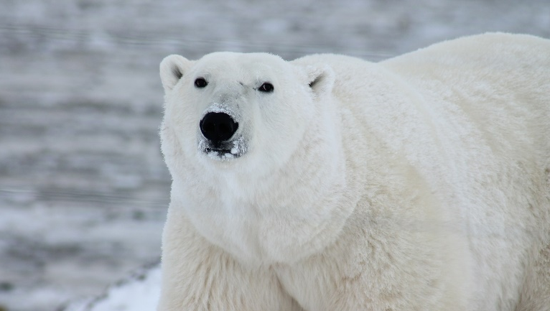
8. Which is the odd one out?
Answer
Next

Slide 17

The penguin is the odd one out.
The penguin is found at the South Pole and the rest are found at the North Pole
(polar bear, arctic fox and walrus).
Back
Next

Slide 18
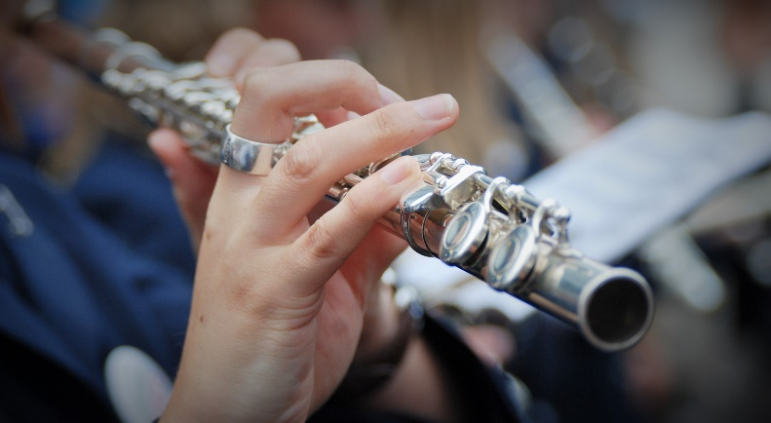
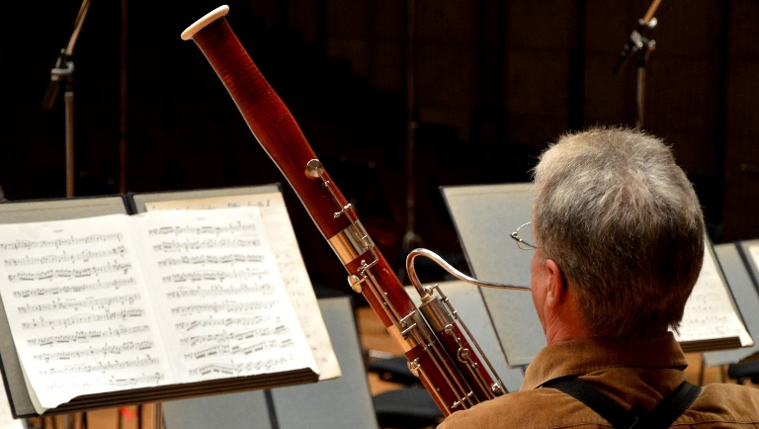
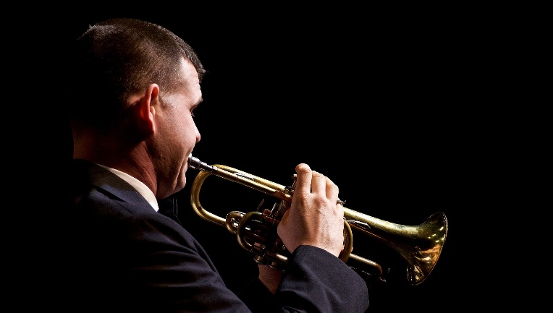

9. Which is the odd one out?
Answer
Next

Slide 19

The trumpet is the odd one out.
The trumpet is a brass instrument and the rest are woodwind instruments
(flute, bassoon and oboe).
Back
Next

Slide 20
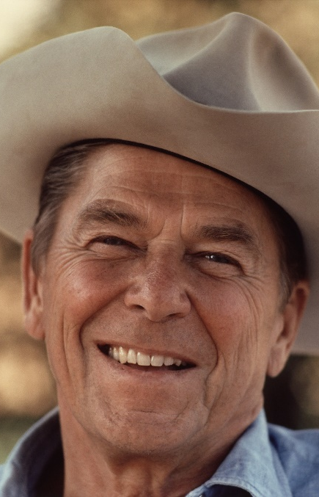
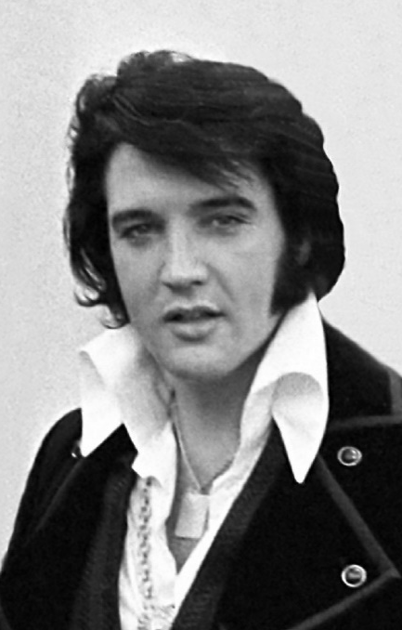
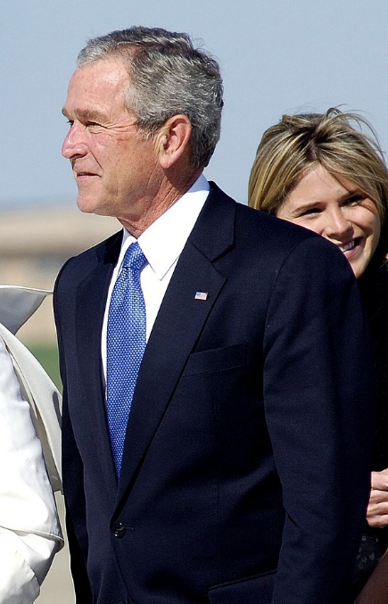
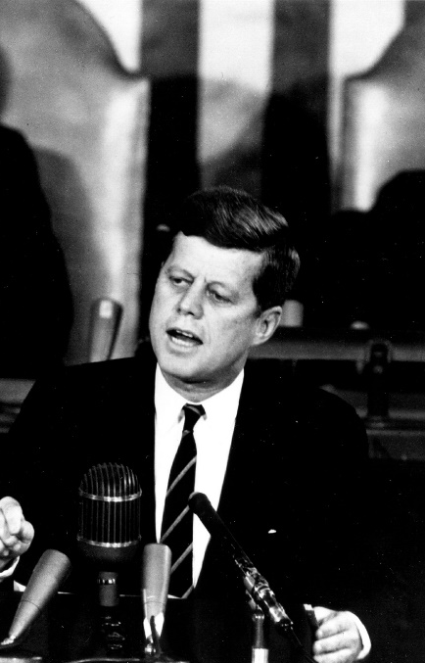
10. Which is the odd one out?
Answer
Next

Slide 21

Elvis Presley is the odd one out.
Elvis was a global superstar, all the others are US Presidents
(Ronald Reagan, John F. Kennedy and George W. Bush).
Back
Next

