Slide 1


Slide 2
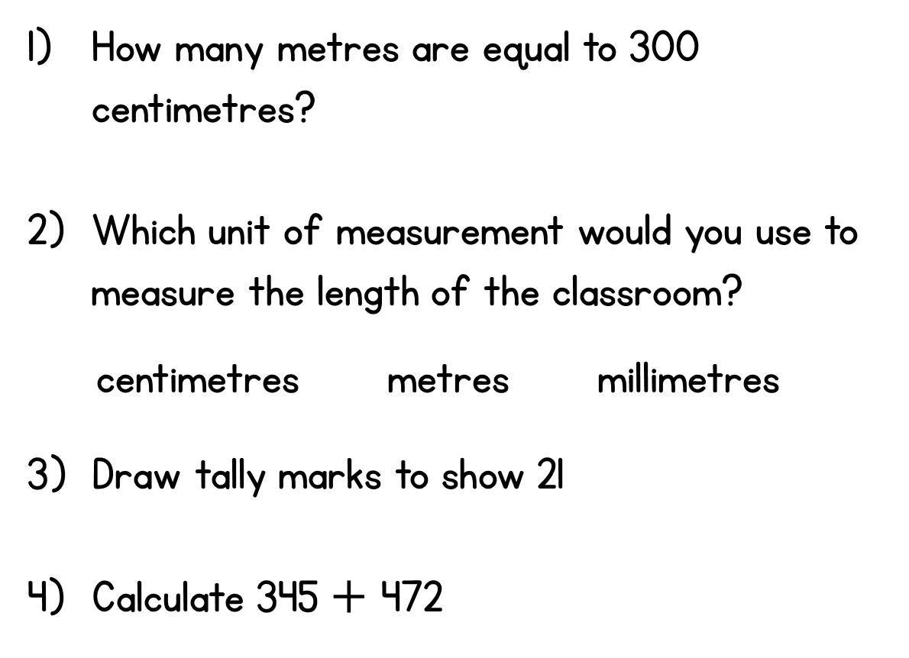



Year 3 | Week 8 | Day 1

Slide 3
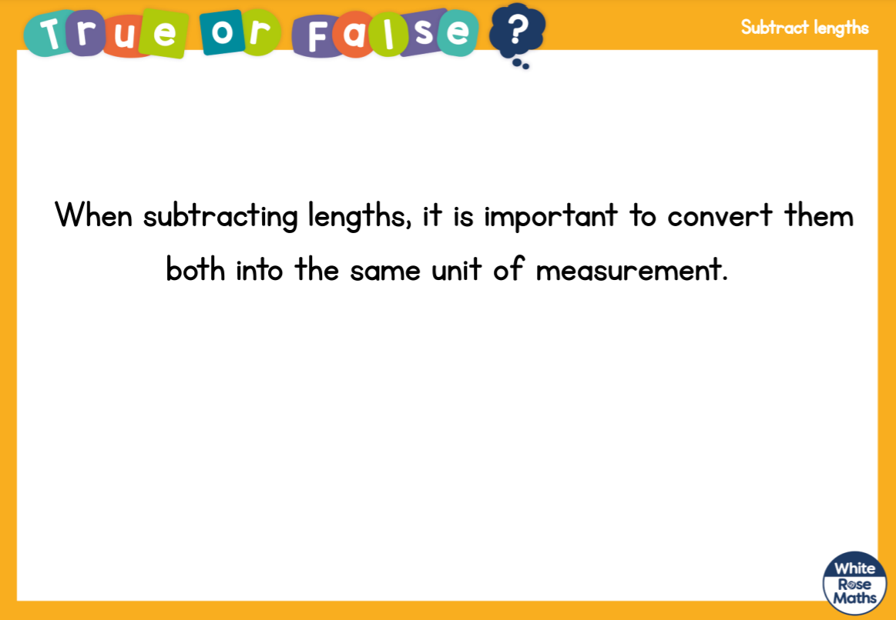

Slide 4
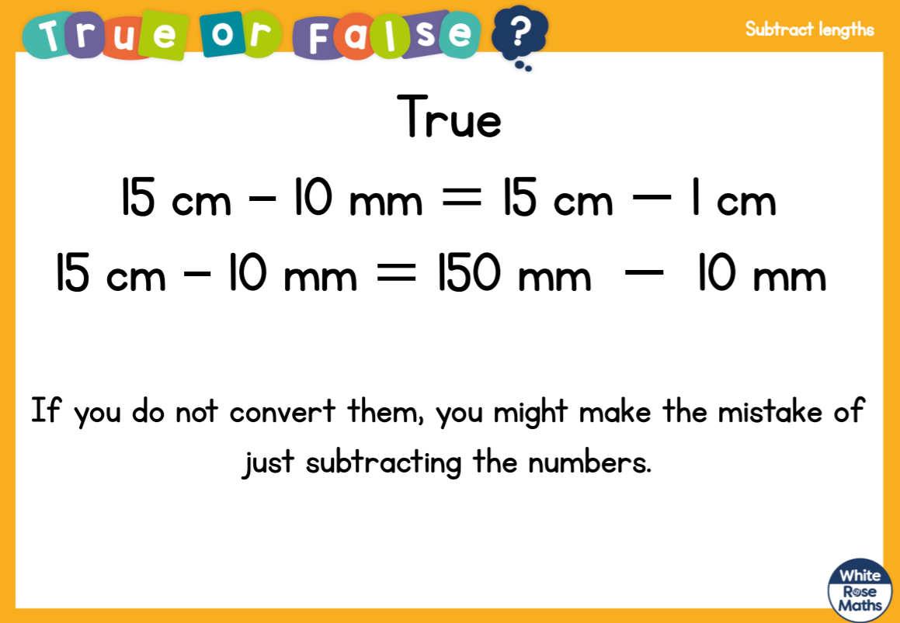

Slide 6


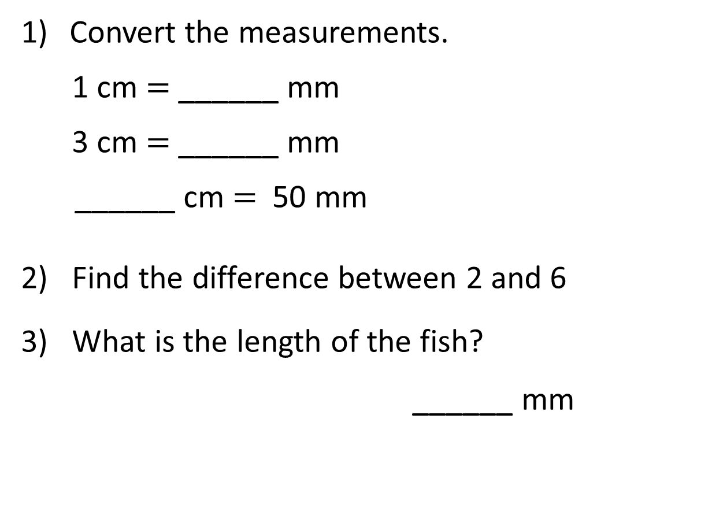
Convert the measurements.
1 cm $=$ ______ mm
3 cm $=$ ______ mm
______ cm $=$ 50 mm
2) Find the difference between 2 and 6
3) What is the length of the fish?
______ mm

Slide 7
Convert the measurements.
1 cm $=$ ______ mm
3 cm $=$ ______ mm
______ cm $=$ 50 mm
2) Find the difference between 2 and 6
3) What is the length of the fish?
______ mm
10
30
5
4
40

Slide 8
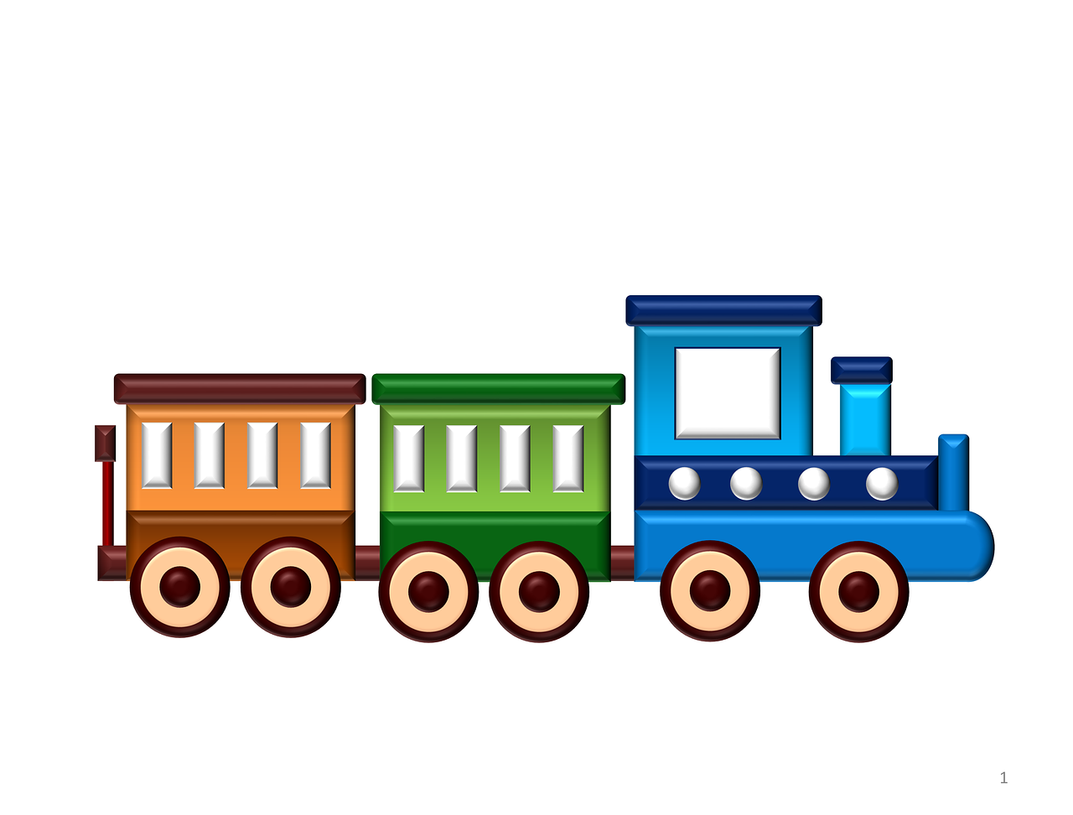


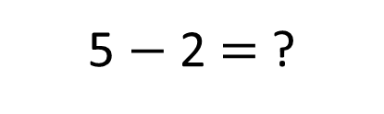
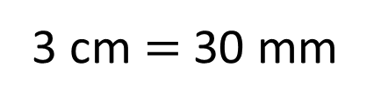
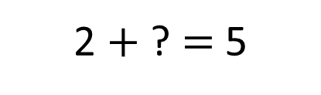
6
The train is ____ cm long.
30
The van is ____ mm long.
2 $+$ ? $=$ 5
3 cm $=$ 30 mm
How much longer is the train than the van?
The train is 3 cm/30 mm longer than the van.
5 $−$ 2 $=$ ?

Slide 9
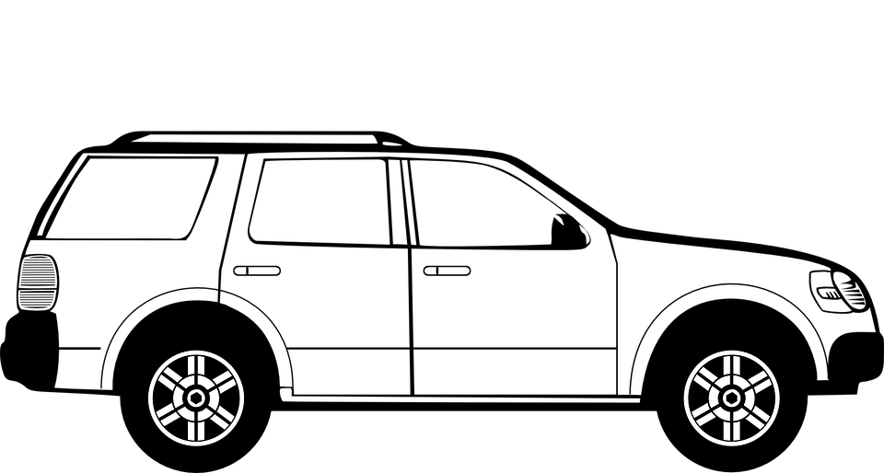
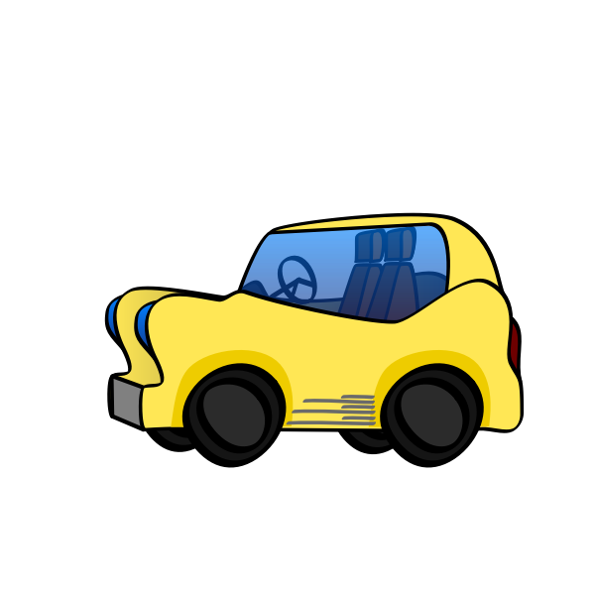

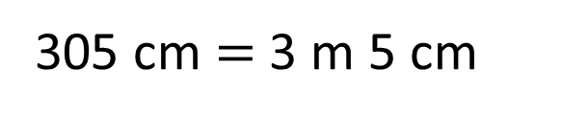
The large car is 145 cm longer than the small car.
The large car is 4 m 50 cm long.
How long is the small car?
____ m ___ cm
3
5
H | T | O
4 | 5 | 0
1 | 4 | 5
4 m 50 cm
Large
450 cm
4
1
145 cm
$$−$$
?
Small
305 cm $=$ 3 m 5 cm
3
0
5

Slide 10




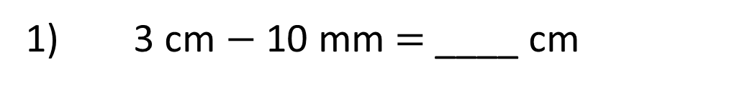
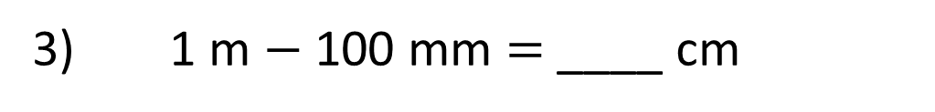

Have a think
2
1) 3 cm $−$ 10 mm $=$ ____ cm
3 cm $−$ 1 cm $=$ 2 cm
10
2) 9 cm $−$ 80 mm $=$ ____ mm
90 mm $−$ 80 mm $=$ 10 mm
90
3) 1 m $−$ 100 mm $=$ ____ cm
100 cm $−$ 10 cm $=$ 90 cm

