Slide 1
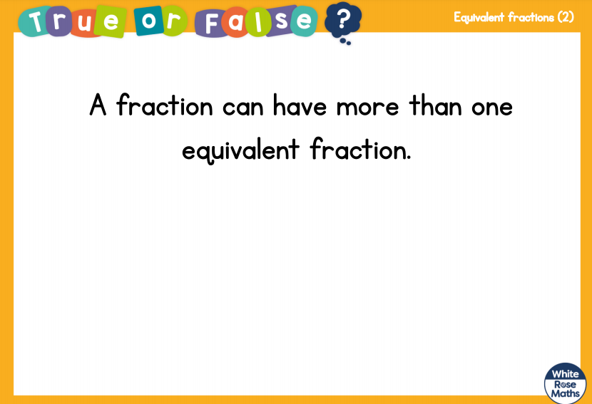

Slide 2
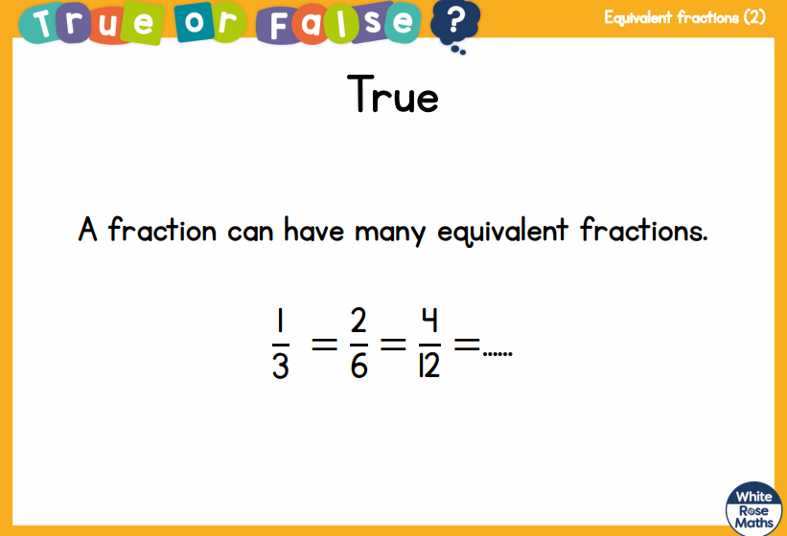

Slide 3
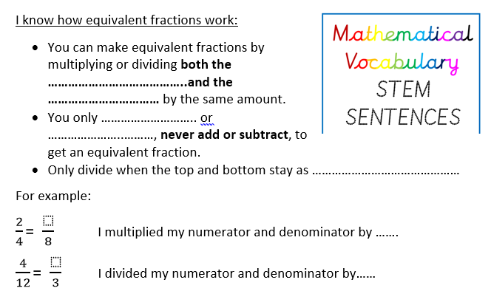

Slide 4
https://www.bbc.co.uk/bitesize/articles/zbqkvwx

