Slide 1
Wednesday 23rd June 2021
LO: To organise writing appropriately
C: Recount

Slide 2

Think about a day or moment this year that has made you smile or made you feel happy.

Slide 3

Tell your partner about this event in
as much detail as possible.
Did your partner use any great descriptive phrases?

Slide 4
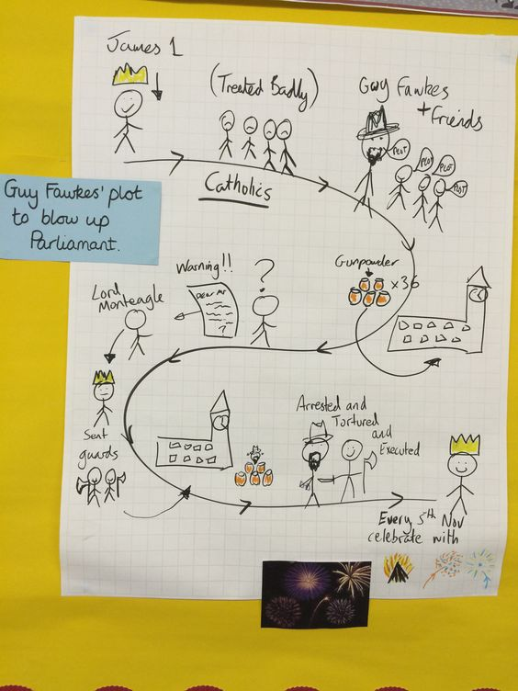
Let’s create a map of our memorable
day!
Can you add time conjunctions?

