Slide 1
Orff
Carmina Burana – ‘O fortuna’
Primary classroom lesson plan
Written by
Rachel Leach
Notes:
For:
Key Stage 2 in England and Wales
Second Level, P5-P7 in Scotland
Key Stage 1/Key Stage 2 in Northern Ireland

Slide 2
Lesson outcomes
After this lesson, pupils will be able to:
listen and reflect on a piece of orchestral music
create their own pieces of music using instruments and voice
perform as an ensemble
learn musical language appropriate to the task
Notes:
Resources required
A large, open space
Classroom percussion instruments and any other instruments your children might be learning
Card, pens, sharp pencils!
This scheme of work is plotted out over six lessons. Feel free to adapt it to suit your children and the resources you have available.
The six lessons at a glance
Lesson 1:
Activities: Watch the film and discuss
Listen and create gestures in response to the music
Draw characters in response to the music
Curriculum link: Listen with attention to detail and recall sounds with increasing aural memory
Appreciate and understand a wide range of high-quality live and recorded music drawn from different traditions and from great composers and musicians
Develop an understanding of the history of music
Lesson 2:
Activities: Learn and perform a pulse
Select appropriate instruments and begin to follow music notation
Curriculum link: Listen with attention to detail and recall sounds with increasing aural memory
Play and perform in solo and ensemble contexts, using their voices and playing musical instruments with increasing accuracy, fluency, control and expression
Lesson 3:
Activities: Invent repeating rhythmic patterns (ostinatos)
Select instruments to play these patterns
Learn about and perform a crescendo
Curriculum link: Listen with attention to detail and recall sounds with increasing aural memory
Play and perform in solo and ensemble contexts, using their voices and playing musical instruments with increasing accuracy, fluency, control and expression
Improvise and compose music for a range of purposes using the interrelated dimensions of music
Lesson 4:
Activities: Create a spinning wheel
Create words for this wheel which will be used later as lyrics
Curriculum link: N/A This session is not a musical one but may cover curriculum links to literacy and general creativity and/or art
Lesson 5:
Activities: Invent lyrics and melody
Sing to a pulse
Structure ideas into a bigger piece
Curriculum link: Listen with attention to detail and recall sounds with increasing aural memory
Play and perform in solo and ensemble contexts, using their voices and playing musical instruments with increasing accuracy, fluency, control and expression
Improvise and compose music for a range of purposes using the interrelated dimensions of music
Lesson 6:
Activities: Structure all ideas into a piece
Perform on pitched and unpitched instruments and voice
Perform the piece to an audience
Use technical terminology where appropriate
Curriculum link: Play and perform in solo and ensemble contexts, using their voices and playing musical instruments with increasing accuracy, fluency, control and expression
Improvise and compose music for a range of purposes using the interrelated dimensions of music

Slide 3
Curriculum checklist
Learners will:
play and perform in ensemble contexts, using their voices and playing musical instruments
improvise and compose music for a range of purposes using the interrelated dimensions of music
listen with attention to detail and recall sounds with increasing aural memory

Slide 4
Glossary of music terms
Term | Definition
Crescendo | gradually getting louder (opposite: decrescendo or diminuendo)
Melody | another word for ‘tune’: a sequence of notes that makes a satisfying shape
Ostinato | a repeating (often rhythmic) pattern
Pitched percussion | percussion instruments that can play different pitches (or ‘notes’) – xylophones, glockenspiels, chime bars etc.
Pulse | the steady ‘beat’ under much music made up of notes of the same length (like a ticking clock)
Unpitched percussion | Percussion instruments that make sounds that don’t have a specific pitch (or ‘note’) – drums, shakers, woodblocks, tambourine.

Slide 5
Orff – Lesson 1
Watching and listening
Copyright Rachel Leach & BBC
Notes:
Lesson 1:
Activities: Watch the film and discuss
Listen and create gestures in response to the music
Draw characters in response to the music
Curriculum link: Listen with attention to detail and recall sounds with increasing aural memory
Appreciate and understand a wide range of high-quality live and recorded music drawn from different traditions and from great composers and musicians
Develop an understanding of the history of music

Slide 6
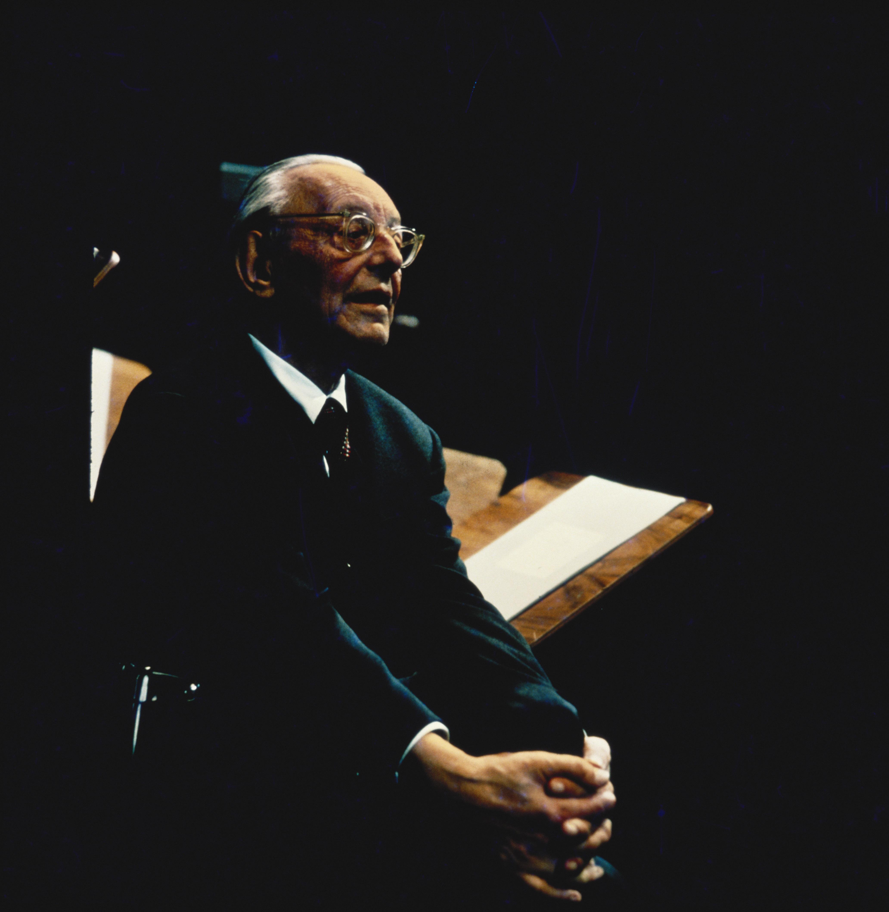
Background – the composer
Carl ORFF (1895 - 1982)
German composer
Invented a new approach to music education which is still followed in many parts of Europe

Slide 7
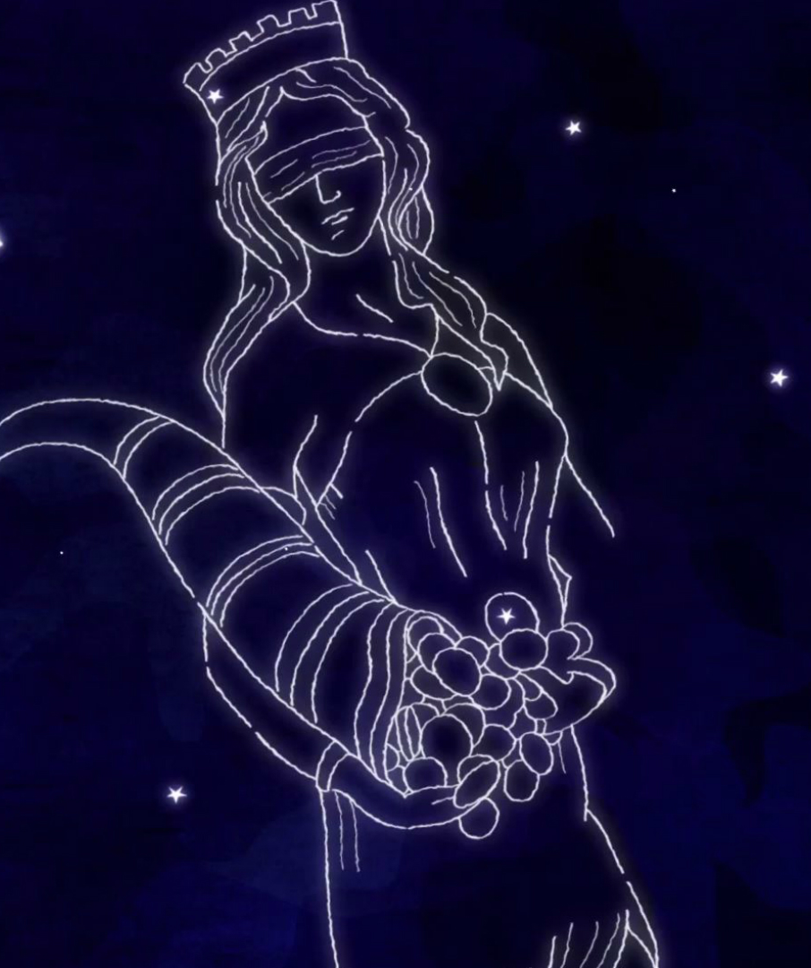
Background – the music
‘Largo’ from Symphony No. 9, ‘From the New World’
• Written in 1893 whilst in America
• Dvořák had secured the opportunity of a lifetime to head a music school in New York City but he was terribly homesick
• This extract is an extremely famous solo for cor anglais (the bigger, deeper sounding oboe)
Carmina Burana – ‘O fortuna’
Written in 1937
‘Carmina Burana’ is a huge piece for orchestra, three choirs and about nine soloists based on 24 medieval poems and sung in a mixture of German and Latin text.
The full piece takes over an hour to perform. ‘O fortuna’ is its very famous opening section
PRONUNCIATION:
KAR-min-uh boor-AA-nuh
Notes:
LESSON 1:Watching and listening
Prepare your class
Explain to your class that you are going to begin a 6-week music project focusing on an important piece of music by a composer called Carl Orff.
Explain further that Orff was a German composer whose life spanned the 20th century. His most famous piece is ‘O fortuna’. Warn your children that it might already be strangely familiar to them!
Pronunciation: KAR-min-uh boor-AA-nuh
-oor as in poor (not pour)
-aa as in father
-note stress

Slide 8

Get to know Orff’s
‘O fortuna’ from Carmina Burana
http://www.bbc.co.uk/programmes/articles/3Cj3llLqxGNB2jpd241vHwK
Notes:
Watch the film & discuss
Watch the Orff Ten Pieces film and afterwards have a class discussion about what you have just seen. Ask the following questions –
Did you like the film?
What was your favourite part?
Did you find any of it scary?
You might like to have a further little discussion about the concept of ‘fate’. This might be something your children haven’t encountered before. Explain that fate is the idea that your life is already mapped out ahead of you no matter what you do and that you can’t change it. Ask them: ‘do you believe in fate?’
Pick up also on the idea of a ‘Goddess of Fate and Fortune’ called “Fortuna” who has the power to decide everyone’s fate and her ‘wheel of fortune’ constantly spinning out good and bad luck

Slide 9


Listen/Watch the piece
Watch/listen to the opening of the full orchestral performance of
‘O fortuna’ from Carmina Burana
As you listen, you’ll hear three short sections of powerful music. This is a call to the goddess of fate. The words are:
O fortuna O fortuna
Velut luna Like the moon
Statu variabilis You are changeable
Draw Fortuna and/or create a powerful pose to recreate her stance
Listen to ‘O fortuna’
Notes:
Listening task
Listen to the very opening of ‘O fortuna’ – just the first 25 seconds or so. You can either watch the video clip of the full performance of the piece or listen to the audio by downloading the mp3. You’ll hear three short sections of very powerful music. This is a call to the goddess of fate. The words here are:
O fortuna O fortune
Velut luna Like the moon
Statu variabilis You are changeable
Ask your children to stand up. They can do this next to their tables or better still make some space in the centre of the classroom. Play the beginning again and ask them to pretend to be the ‘Goddess of Fate and Fortune’ and make three powerful statues with their bodies to fit with the opening lines of Orff’s piece.
Give out paper and pens and ask them to draw Fortuna. Remind them that she is all powerful so she probably has a very powerful look. Ask them to think about her clothing, her size, her facial expression and her stance. You might even get some children to come out and model their powerful poses again for the rest of the class to copy.
As your children work, keep Orff’s music playing in the background for extra inspiration.
FINALLY – remind your class about the ‘wheel of fortune’. Ask them to add it to their picture.

