Slide 1


Slide 3
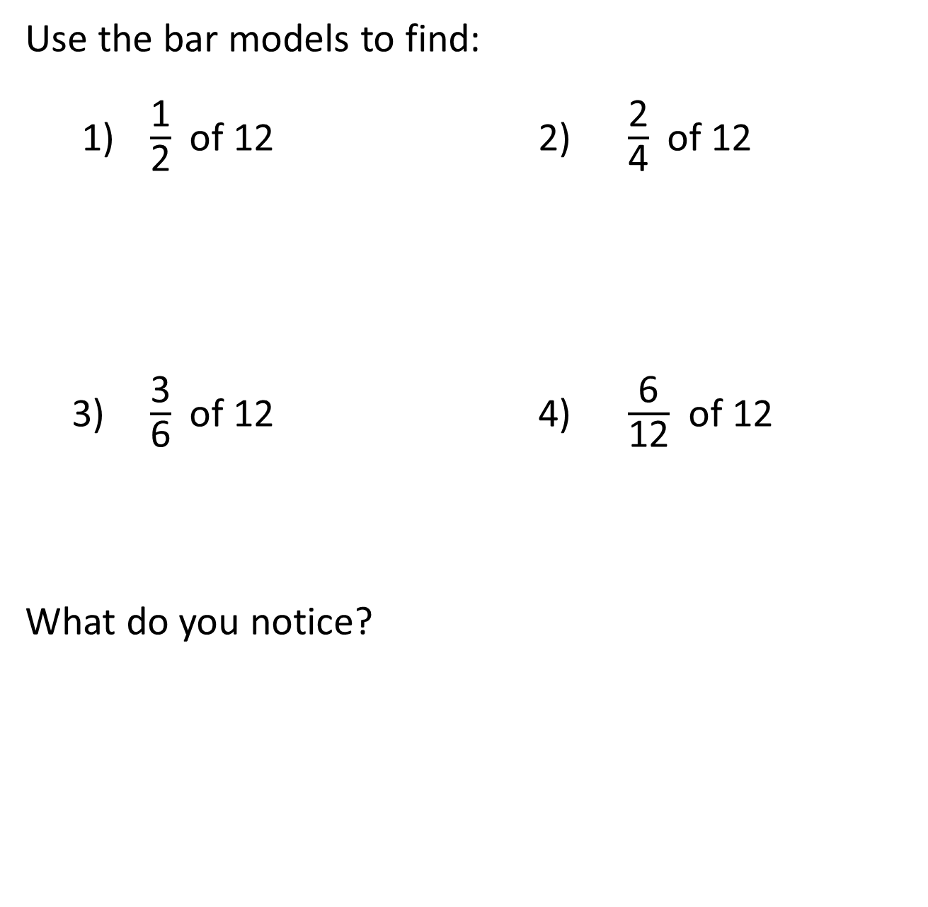
Use the bar models to find:
1) $\frac{\text{1}}{\text{2}}$ of 12 2) $\frac{\text{2}}{\text{4}}$ of 12
3) $\frac{\text{3}}{\text{6}}$ of 12 4) $\frac{\text{6}}{\text{12}}$ of 12
What do you notice?

Slide 4
Use the bar models to find:
1) $\frac{\text{1}}{\text{2}}$ of 12 2) $\frac{\text{2}}{\text{4}}$ of 12
3) $\frac{\text{3}}{\text{6}}$ of 12 4) $\frac{\text{6}}{\text{12}}$ of 12
What do you notice?
6
6
6
6

Slide 6



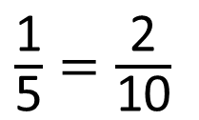
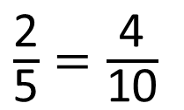
Whitney and Dora are shading shapes to show equivalent fractions.
Which equivalent fractions have they shaded?
Have a think
$\frac{\text{1}}{\text{5}}=\frac{\text{2}}{\text{10}}$
$\frac{\text{2}}{\text{5}}=\frac{\text{4}}{\text{10}}$

Slide 7
























Label the fractions on each bar model.
Which equivalent fractions can you see?
Have a think
$\frac{\text{1}}{\text{4}}$
$\frac{\text{1}}{\text{4}}$
$\frac{\text{1}}{\text{4}}$
$\frac{\text{1}}{\text{4}}$
$\frac{\text{1}}{\text{8}}$
$\frac{\text{1}}{\text{8}}$
$\frac{\text{1}}{\text{8}}$
$\frac{\text{1}}{\text{8}}$
$\frac{\text{1}}{\text{8}}$
$\frac{\text{1}}{\text{8}}$
$\frac{\text{1}}{\text{8}}$
$\frac{\text{1}}{\text{8}}$
$\frac{\text{1}}{\text{12}}$
$\frac{\text{1}}{\text{12}}$
$\frac{\text{1}}{\text{12}}$
$\frac{\text{1}}{\text{12}}$
$\frac{\text{1}}{\text{12}}$
$\frac{\text{1}}{\text{12}}$
$\frac{\text{1}}{\text{12}}$
$\frac{\text{1}}{\text{12}}$
$\frac{\text{1}}{\text{12}}$
$\frac{\text{1}}{\text{12}}$
$\frac{\text{1}}{\text{12}}$
$\frac{\text{1}}{\text{12}}$

Slide 8
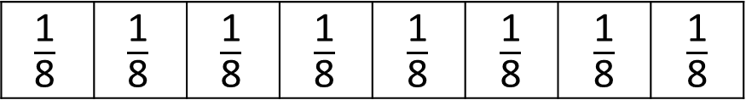
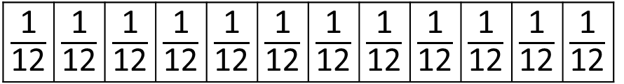

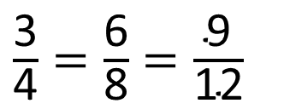

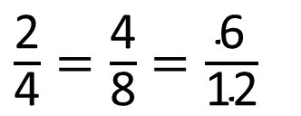

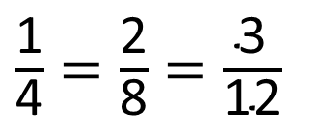

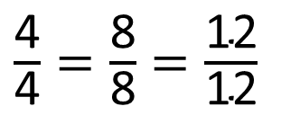
What equivalent fractions can you see?
$\frac{\text{1}}{\text{4}}$
$\frac{\text{1}}{\text{4}}$
$\frac{\text{1}}{\text{4}}$
$\frac{\text{1}}{\text{4}}$
$\frac{\text{1}}{\text{4}}=\frac{\text{2}}{\text{8}}=\frac{\text{3}}{\text{12}}$
$\frac{\text{3}}{\text{4}}=\frac{\text{6}}{\text{8}}=\frac{\text{9}}{\text{12}}$
$\frac{\text{2}}{\text{4}}=\frac{\text{4}}{\text{8}}=\frac{\text{6}}{\text{12}}$
$\frac{\text{4}}{\text{4}}=\frac{\text{8}}{\text{8}}=\frac{\text{12}}{\text{12}}$

Slide 9


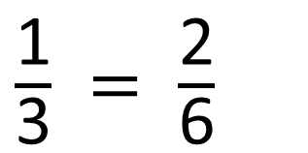









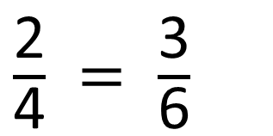


Here is another fraction wall.
Use the wall to complete the equivalent fractions.
Have a think
$\frac{\text{1}}{\text{3}}$
$\frac{\text{1}}{\text{3}}$
$\frac{\text{1}}{\text{3}}$
$\frac{\text{1}}{\text{4}}$
$\frac{\text{1}}{\text{4}}$
$\frac{\text{1}}{\text{4}}$
$\frac{\text{1}}{\text{4}}$
$\frac{\text{1}}{\text{6}}$
$\frac{\text{1}}{\text{6}}$
$\frac{\text{1}}{\text{6}}$
$\frac{\text{1}}{\text{6}}$
$\frac{\text{1}}{\text{6}}$
$\frac{\text{1}}{\text{6}}$
$\frac{\text{1}}{\text{3}} = \frac{\text{2}}{\text{6}}$
$\frac{\text{2}}{\text{4}} = \frac{\text{3}}{\text{6}}$

Slide 10
Here is another fraction wall.
Use the wall to complete the equivalent fractions.
$\frac{\text{1}}{\text{3}}$
$\frac{\text{1}}{\text{3}}$
$\frac{\text{1}}{\text{3}}$
$\frac{\text{1}}{\text{4}}$
$\frac{\text{1}}{\text{4}}$
$\frac{\text{1}}{\text{4}}$
$\frac{\text{1}}{\text{4}}$
$\frac{\text{1}}{\text{6}}$
$\frac{\text{1}}{\text{6}}$
$\frac{\text{1}}{\text{6}}$
$\frac{\text{1}}{\text{6}}$
$\frac{\text{1}}{\text{6}}$
$\frac{\text{1}}{\text{6}}$
$\frac{\text{1}}{\text{3}} = \frac{\text{2}}{\text{6}}$
$\frac{\text{2}}{\text{4}} = \frac{\text{3}}{\text{6}}$

Slide 11
Have a go at questions
1 - 3 on the worksheet

Slide 12
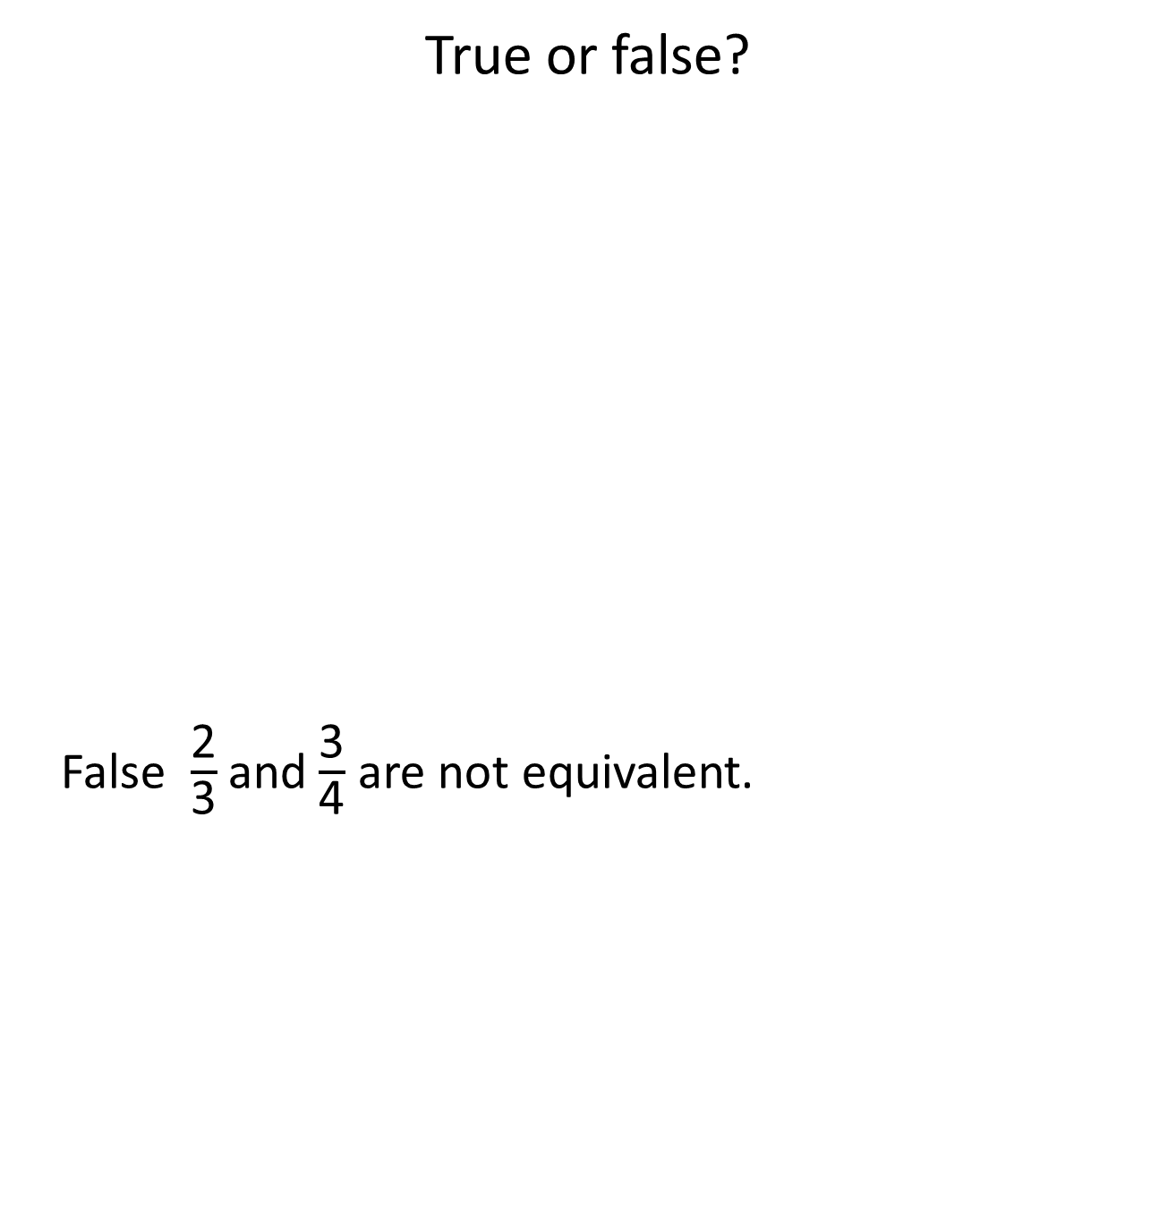
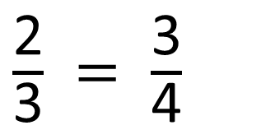
True or false?
False $\frac{\text{2}}{\text{3}}$and$\frac{\text{3}}{\text{4}}$ are not equivalent.
$\frac{\text{1}}{\text{3}}$
$\frac{\text{1}}{\text{3}}$
$\frac{\text{1}}{\text{3}}$
$\frac{\text{1}}{\text{4}}$
$\frac{\text{1}}{\text{4}}$
$\frac{\text{1}}{\text{4}}$
$\frac{\text{1}}{\text{4}}$
$\frac{\text{1}}{\text{6}}$
$\frac{\text{1}}{\text{6}}$
$\frac{\text{1}}{\text{6}}$
$\frac{\text{1}}{\text{6}}$
$\frac{\text{1}}{\text{6}}$
$\frac{\text{1}}{\text{6}}$
$\frac{\text{2}}{\text{3}} = \frac{\text{3}}{\text{4}}$
Have a think

Slide 13
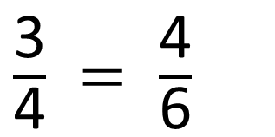

True or false?
$\frac{\text{1}}{\text{3}}$
$\frac{\text{1}}{\text{3}}$
$\frac{\text{1}}{\text{3}}$
$\frac{\text{1}}{\text{4}}$
$\frac{\text{1}}{\text{4}}$
$\frac{\text{1}}{\text{4}}$
$\frac{\text{1}}{\text{4}}$
$\frac{\text{1}}{\text{6}}$
$\frac{\text{1}}{\text{6}}$
$\frac{\text{1}}{\text{6}}$
$\frac{\text{1}}{\text{6}}$
$\frac{\text{1}}{\text{6}}$
$\frac{\text{1}}{\text{6}}$
$\frac{\text{3}}{\text{4}} = \frac{\text{4}}{\text{6}}$
Have a think
False $\frac{\text{3}}{\text{4}}$and$\frac{\text{4}}{\text{6}}$ are not equivalent.

Slide 14
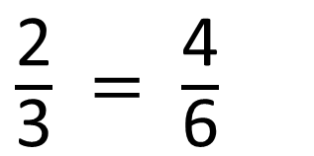

True or false?
$\frac{\text{1}}{\text{3}}$
$\frac{\text{1}}{\text{3}}$
$\frac{\text{1}}{\text{3}}$
$\frac{\text{1}}{\text{4}}$
$\frac{\text{1}}{\text{4}}$
$\frac{\text{1}}{\text{4}}$
$\frac{\text{1}}{\text{4}}$
$\frac{\text{1}}{\text{6}}$
$\frac{\text{1}}{\text{6}}$
$\frac{\text{1}}{\text{6}}$
$\frac{\text{1}}{\text{6}}$
$\frac{\text{1}}{\text{6}}$
$\frac{\text{1}}{\text{6}}$
$\frac{\text{2}}{\text{3}} = \frac{\text{4}}{\text{6}}$
Have a think
True $\frac{\text{2}}{\text{3}}$and$\frac{\text{4}}{\text{6}}$ are equivalent.

Slide 15
Have a go at the rest of the worksheet

