Slide 1
Friday 25th June 2021
LO: To use sentences appropriately
C: Recount

Slide 2
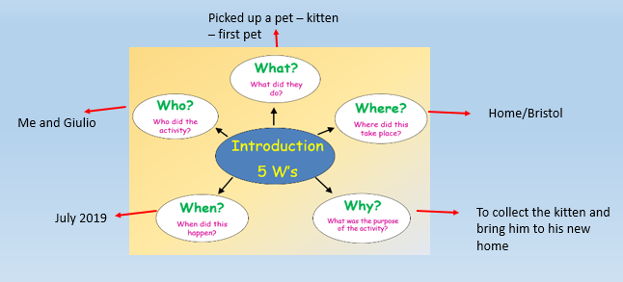
Look at your bubble map from yesterday

Slide 3

To check you are confident with the 5Ws, see if you can talk through what you may write in your introduction.

Slide 4
How do we write in the past tense?
Work through the tenses video on the class pages.

Slide 5
when
what
where
A few years ago, I went on the most amazing adventure to Bristol. I had been to Bristol before, but this trip was an extra special one. Giulio and I were off to collect a cute, fluffy and playful kitten and bring him to his new home – our flat!
why
where

Slide 6
Now write your own introduction.
You need to include the 5Ws!

