Slide 1
Thursday 6th May 2021
L.O: To understand texts- inference skills
C: Boy

Slide 2

Today we are continuing to learn about his new school!
We are going to use our inference skills to help us to understand how he is feeling!

Slide 3
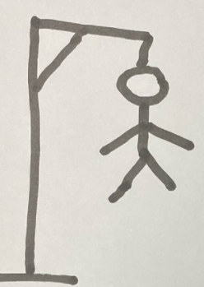
Starter: Word of the day!
Let’s play hangman!

Slide 4
Class Read
Class Read p.173-175
Whilst we are reading, think about how the younger boys are feeling.

Slide 5
Our task
Complete a thought bubble.
Think about how you would they feel if you had to stand in the middle of the room while everyone else examined your injuries.

Slide 6
Our task
Paddlers:
Write a thought bubble
Snorkellers:
Write a thought bubble using evidence from the text.
Divers:
Write a thought bubble using evidence from the text. Around the edge, add in some emotion words he may be feeling.

Slide 7

Red Pen
Would you rather go to St Peter’s or Repton?

