Slide 1
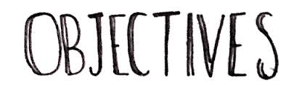
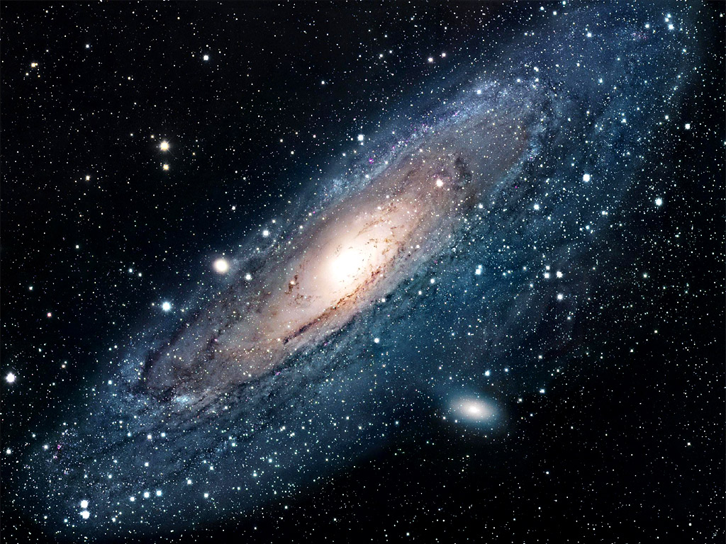
Predestination
Understand Muslim beliefs about predestination and human freedom.
Know how these beliefs relate to the Day of Judgement.

Slide 2
AQA
Islam: Predestination

Slide 3

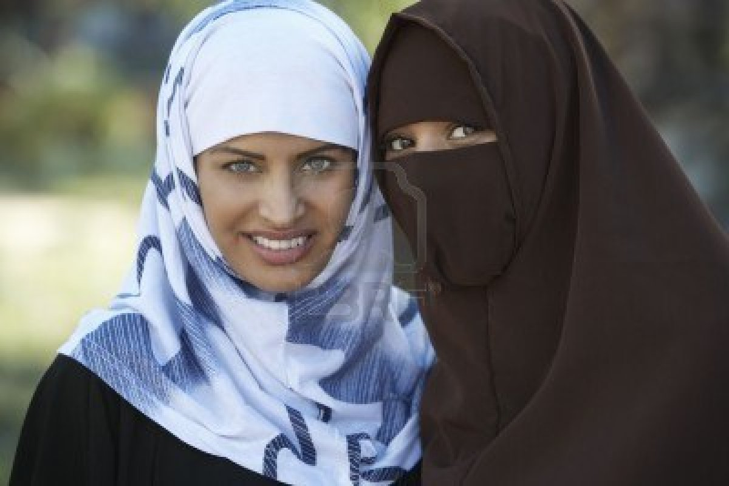
Muslim: one who has submitted to the will of God and has accepted Islam.
Predestination

Slide 4
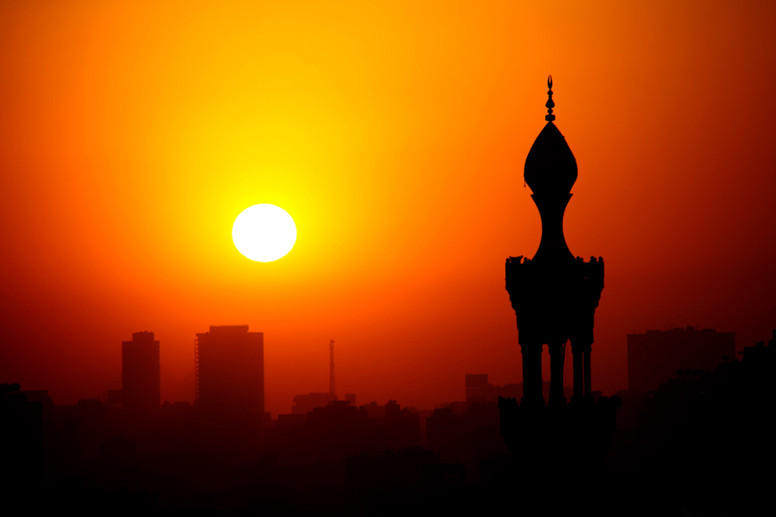
Islam: the name of the religion followed by Muslims; to surrender to the will of God; peace.
Predestination

Slide 5
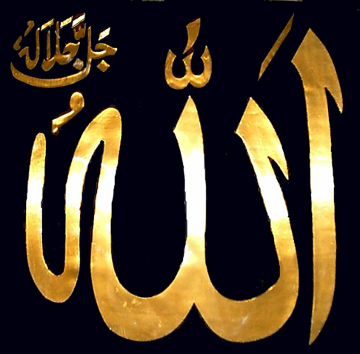
Allah: the Arabic name for God.
Predestination

Slide 6
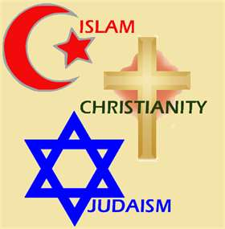
Monotheistic: a religion that believes there is only one God.
Predestination

Slide 7
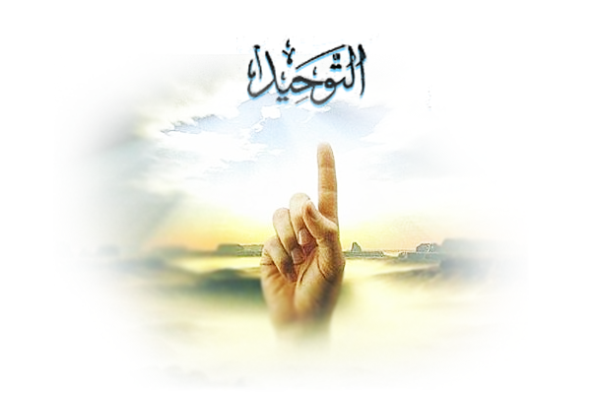
Tawhid: the Oneness and unity of God.
Predestination

Slide 8
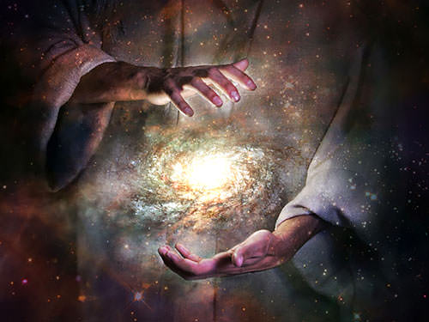
Supremacy: supreme power or authority; a quality of God.
Predestination

Slide 9
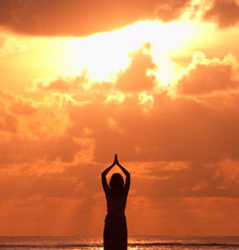
Immanent: the idea that God is present in and involved with life on earth and in the universe; a quality of God.
Predestination

Slide 10
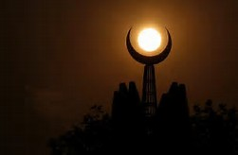
Transcendent : the idea that God is beyond and outside life on earth and the universe, a quality of God.
Predestination

Slide 11
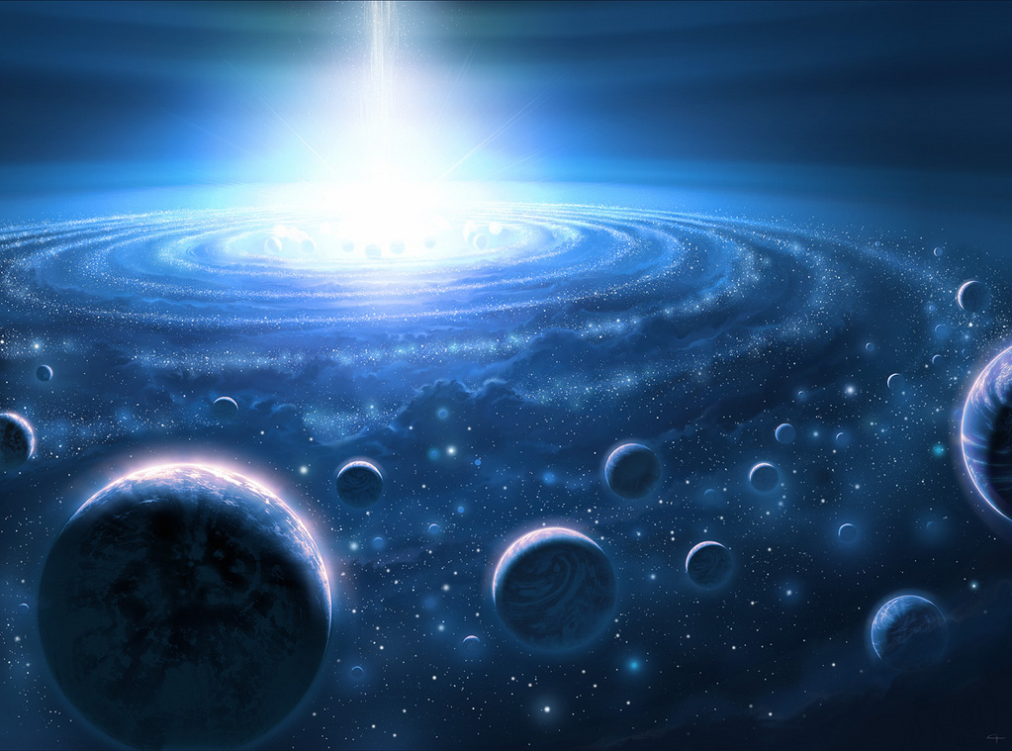
Omnipotent: almighty, having unlimited power; a quality of God.
Predestination

Slide 12
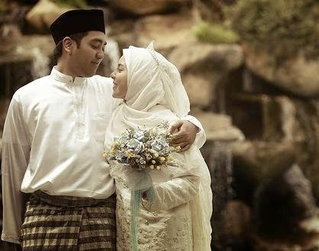
Beneficent: benevolent, all-loving, all-good; a quality of God.
Predestination

Slide 13
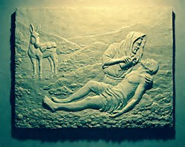
Merciful: the quality of God that shows compassion or forgiveness to humans, even though he has the power to punish them.
Predestination

Slide 14
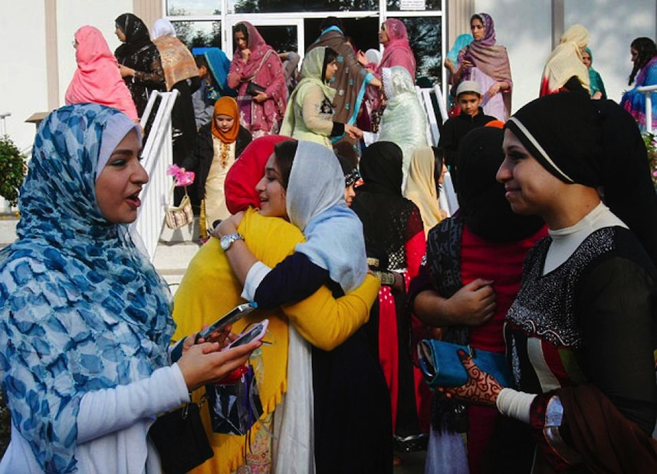
Fairness: the idea that God treats people fairly and impartially without favour or discrimination.
Predestination

Slide 15
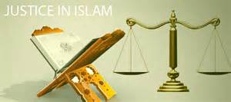
Justice: the idea that God is just and fair and judges human actions, rewarding the good and punishing the bad.
Predestination

Slide 16
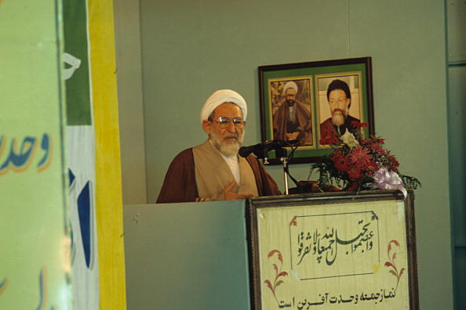
Adalat: the concept of justice in Shi’a Islam.
Predestination

Slide 17
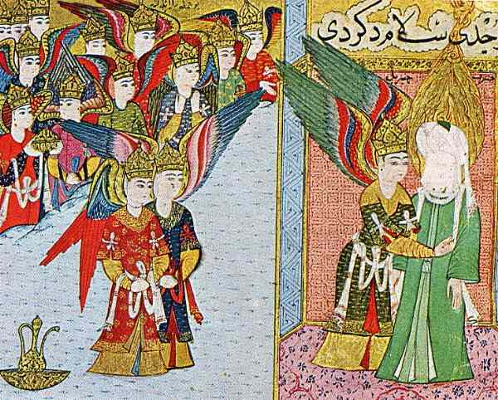
Angels: spiritual beings believed to act as messengers of God.
Predestination

Slide 18
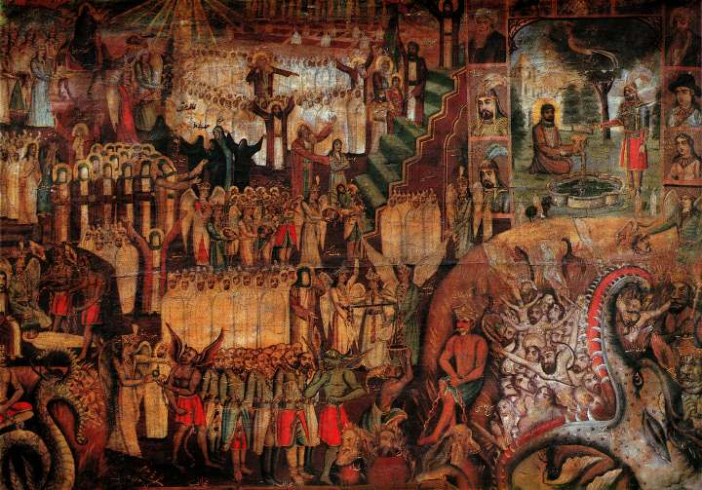
Day of judgement: a time when the world will end and every soul will be judged by God, and either rewarded or punished.
Predestination

Slide 19
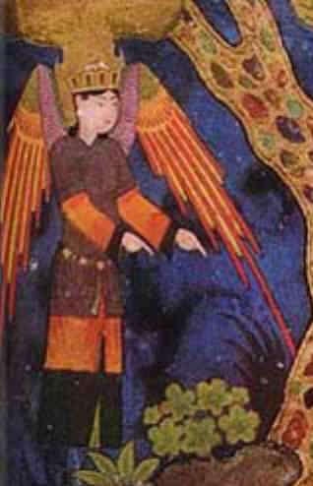
Jibril: the Arabic name for Gabriel, the archangel who brought God’s message to the prophets, particularly to Muhammad.
Predestination

Slide 20
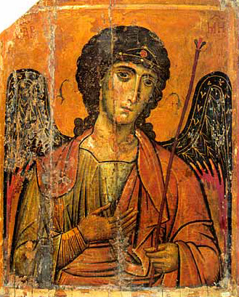
Mika’il: the Arabic name for Michael, the archangel of mercy who rewards good deeds and provides nourishments.
Predestination

Slide 21
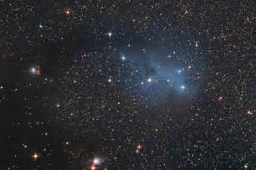
Predestination: the idea that God knows or determines everything that will happen in the universe.
Predestination

Slide 22
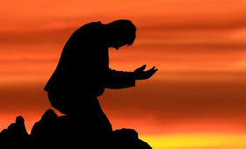
Predestination in Islam
There are different ideas about predestination in Islam. Some Sunni Muslims believe that God has already determined everything that will happen in the universe. He has written down everything in a ‘book of decrees.’ God creates all things, including the actions of his creatures, so they must act accordingly to his will.

Slide 23
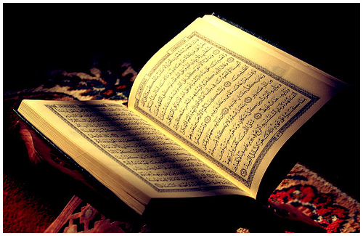
“ Say, “ Never will we be struck except by what Allah has decreed for us; He is our protector”. And upon Allah let the believers rely.
Qur’an 9: 51

Slide 24
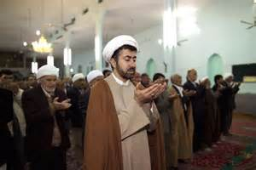
Predestination in Islam
This is linked to the belief in the supremacy of God’s will. Muslims believe that because God’s will is so powerful, he can determine everything that is going to happen. This view places greater emphasis on God’s omniscient and less emphasis on human freedom, but it does not mean that people have no choice about how they behave.

Slide 25
Human freedom
Here is one way to think about it: a mother of a little boy knows her child very well, and knows in advance what he is going to do. If he is given a choice between a bowl of peas and ice cream, she is very sure he will choose the ice cream. That’s not to say the boy was forced to eat the ice cream – it was his choice. Another time he might be offered peas or spinach, and he might choose the peas then if he likes them better. Just because a mother might be able to predict what will happen does not mean the boy is not being given a real choice.

Slide 26
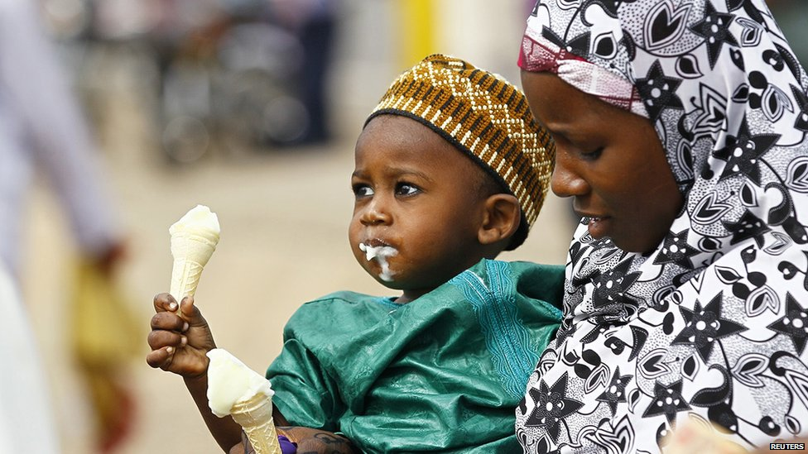
A mother knows what her child will choose

Slide 27
Human freedom
Or imagine you have travelled in time 100 years into the future. You spend time observing what people are doing and writing down their actions. You take this written record back with you to the present year. Does this mean that the people you observed 100 years in the future suddenly have no free choice? No; those people are still deciding for themselves what they want to do – you just happen to have been able to see in advance what they are going to decide.

Slide 28
Human freedom
Another way to think about it is this: God is the creator of time so is not bound by it. For God there is no past, present and future – for him it is as everything has happened. Human events happen in time due to cause and effect or human free will, but God is outside time. Therefore many Muslims do not see conflict between the supremacy of God’s will, and human freedom to act freely and make choices.

Slide 29

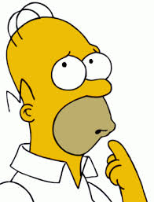
Take care not to confuse the belief in predestination with the idea that people have already been chosen to go to heaven or hell regardless of their behaviour.

Slide 30
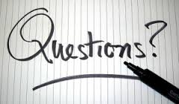
Give the correct definitions for: predestination, angels, Day of Judgement, Jibril and Mika’il.
Explain the Muslim idea of predestination.
’Predestination means that humans have no freedom.’ Evaluate this statement. Be sure to include more than one point of view and refer to Muslim teachings in your answer.

