Slide 1


Slide 2
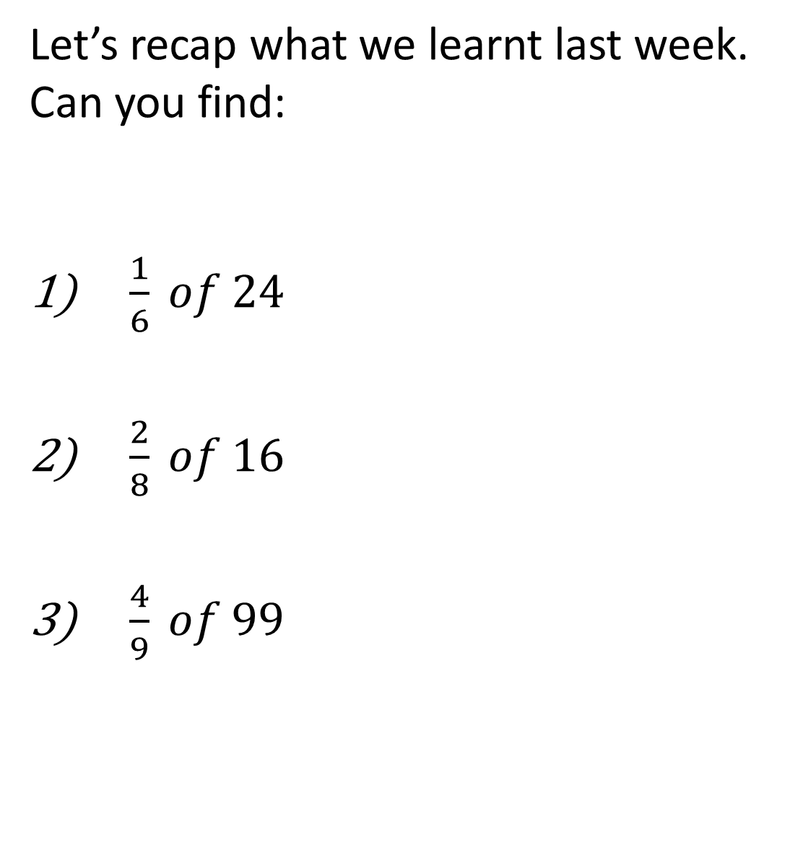
Let’s recap what we learnt last week.
Can you find:
$\frac{1}{6} of 24$
$\frac{2}{8} of 16$
$\frac{4}{9} of 99$

Slide 4



1) Complete the bar models.
Complete the part-whole models.
3) What is half of 70?
100
50
100
1
$\frac{\text{3}}{\text{7}}$
$\frac{\text{3}}{\text{8}}$
1

Slide 5


1) Complete the bar models.
Complete the part-whole models.
3) What is half of 70?
100
50
100
50
50
25
25
25
25
25
25
1
$\frac{\text{4}}{\text{7}}$
$\frac{\text{3}}{\text{7}}$
$\frac{\text{3}}{\text{8}}$
$\frac{\text{5}}{\text{8}}$
1
35

Slide 7



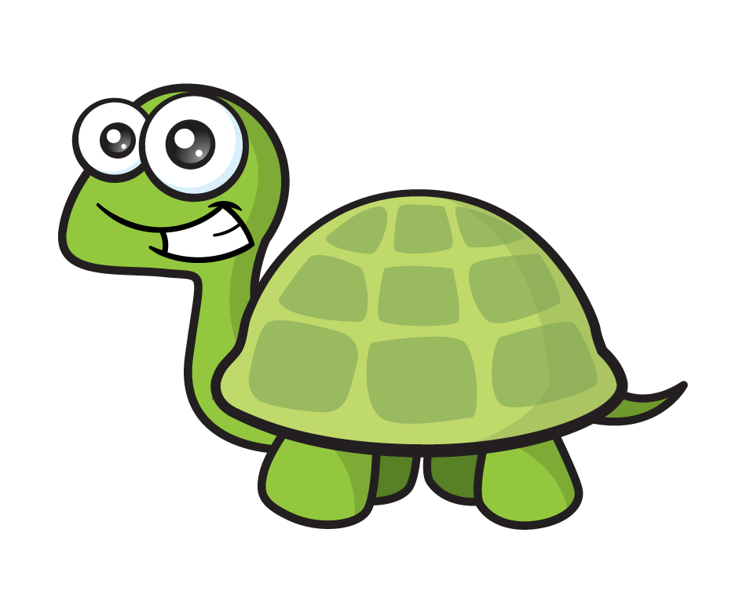
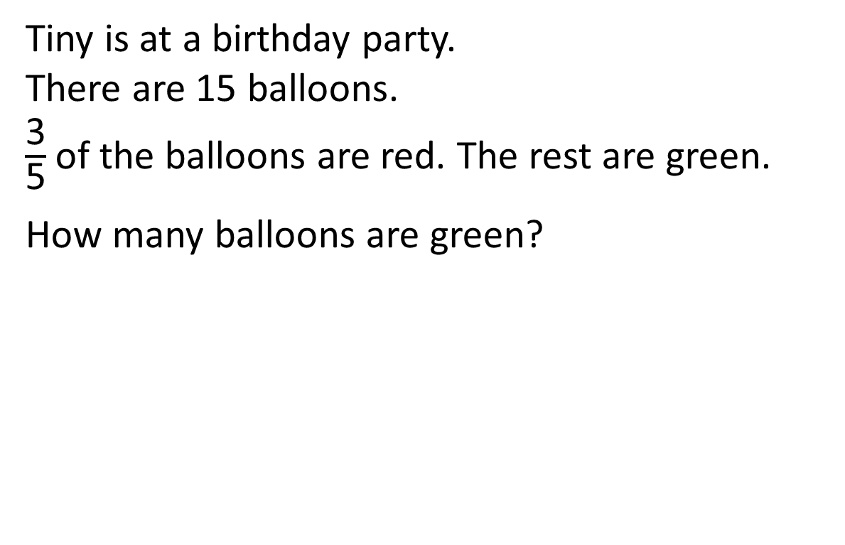
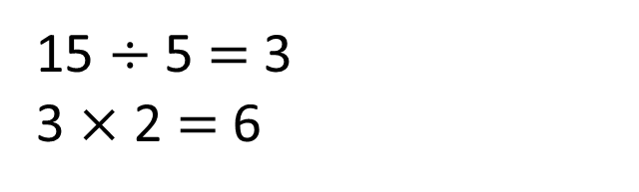
Tiny is at a birthday party.
There are 15 balloons.
$\frac{\text{3}}{\text{5}}$of the balloons are red. The rest are green.
How many balloons are green?
Have a think
15
3
3
3
3
3
?
15 $÷$ 5 $=$ 3
3 $×$ 2 $=$ 6
6 balloons are green.

Slide 8

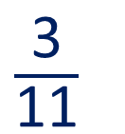
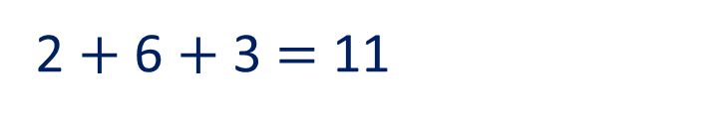
Tiny asked the children which drink they would like.
What fraction of the children chose lemonade?
What else can you find out?
Drink | Tally
Orange juice
Blackcurrant juice
Lemonade
$\frac{\text{3}}{\text{11}}$
3 children chose lemonade.
?
2 $+$ 6 $+$ 3 $=$ 11
Have a think

Slide 9





Ron and Mo have £1 and 70p to spend at the shop.
They decide to split it equally.
How much do they each have to spend?
Have a think
I know that £1 and 70p is 170p so I will halve 170
I will halve the value of each coin then find the total.

Slide 10
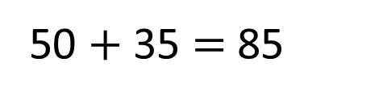
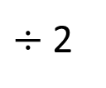
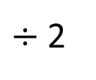
Ron and Mo have £1 and 70p to spend at the shop.
They decide to split it equally.
How much do they each have to spend?
I know that £1 and 70p is 170p so I will halve 170
170
50 $+$ 35 $=$ 85
100
We will each have 85p
70
$÷$ 2
$÷$ 2
50
35

Slide 11
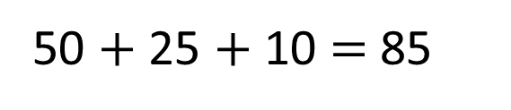
Ron and Mo have £1 and 70p to spend at the shop.
They decide to split it equally.
How much do they each have to spend?
I will halve the value of each coin then find the total.
25p
25p
10p
50p
10p
50p
50 $+$ 25 $+$ 10 $=$ 85
We will each have 85p

Slide 12
Have a go at questions
1 – 6 on the worksheet

Slide 13

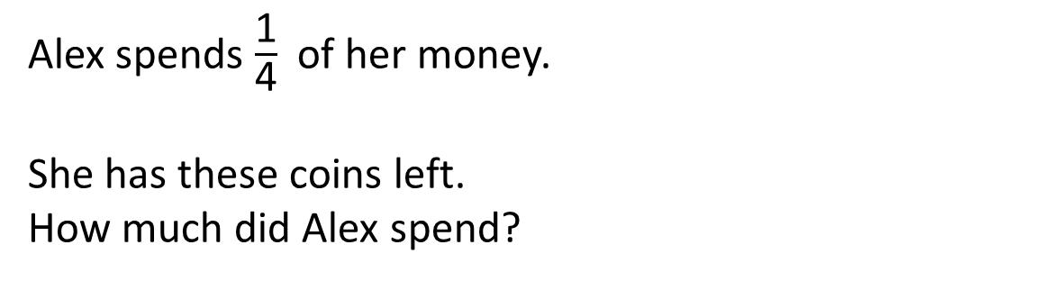
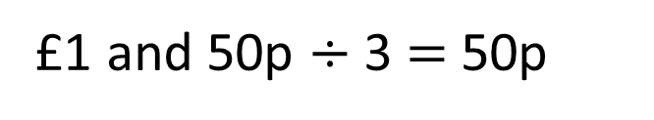
Alex spends $\frac{\text{1}}{\text{4}}$ of her money.
She has these coins left.
How much did Alex spend?
Have a think
50p
50p
50p
50p
left
£1 and 50p
spent
?
£1 and 50p $÷$ 3 $=$ 50p
Alex spent 50p

Slide 14

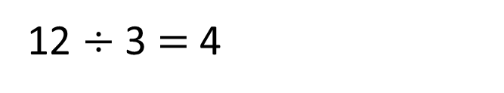
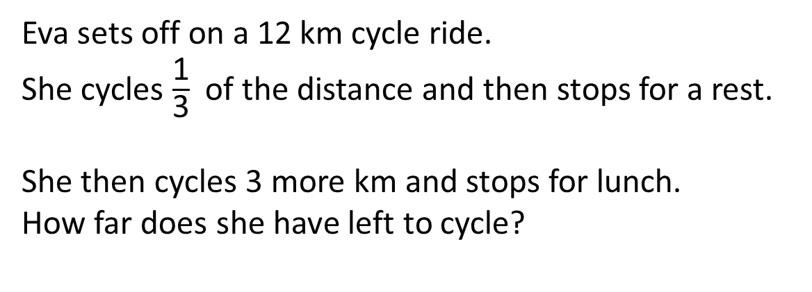
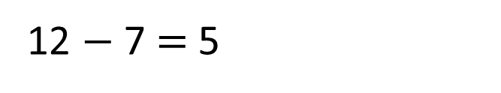
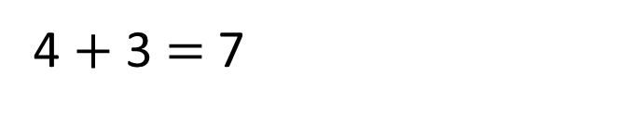
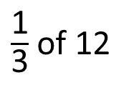
Eva sets off on a 12 km cycle ride.
She cycles $\frac{\text{1}}{\text{3}}$ of the distance and then stops for a rest.
She then cycles 3 more km and stops for lunch.
How far does she have left to cycle?
rest
lunch
$\frac{\text{1}}{\text{3}}$ of 12
3 km
? km
4 km
12 km
12 $÷$ 3 $=$ 4
12 $−$ 7 $=$ 5
4 $+$ 3 $=$ 7
Have a think
Eva still has 5 km to cycle.

Slide 15
Have a go at the rest of the questions on the worksheet

