Slide 1
Thursday 24th June 2021
LO: To organise writing appropriately
C: Recount

Slide 2
Starter: Time conjunctions video – see link on class pages

Slide 3
Look over your story board from yesterday, can you use it to answer the following questions.
What are you recounting?
What are the 5Ws for this event?
What order did the events happen?
What conjunctions could we use to show the time order?

Slide 4
Now you have answered the questions and watched the video, try and add some time conjunctions to your story map in order to help link the events!

Slide 5
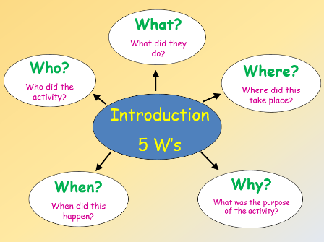
Today, we are going to bubble map to plan the introduction to our recount. My story is about the day I collected my cat, Jasper.
Picked up a pet – kitten – first pet
Home/Bristol
Me and Giulio
July 2019
To collect the kitten and bring him to his new home

Slide 6
Can you create your own bubble map with the information you need to include in your introduction?

