Slide 1


Slide 3



equivalent
“of equal value, amount or meaning”
are equivalent to
3 $+$ 3
is equivalent to
5 $+$ 1
1 cm
is equivalent to
10 mm

Slide 4




Slide 5
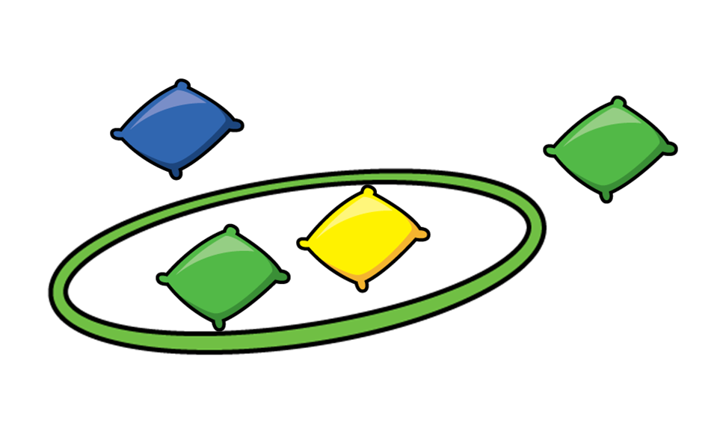



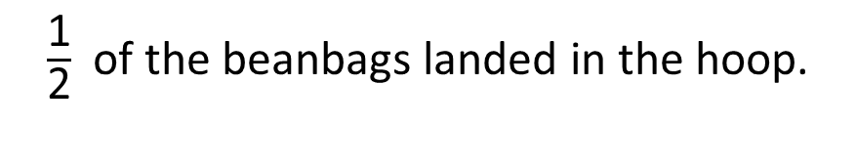
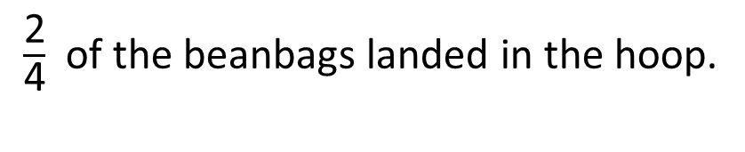
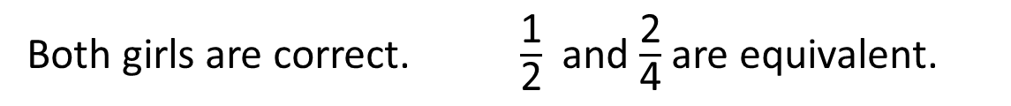
$\frac{\text{2}}{\text{4}}$ of the beanbags landed in the hoop.
$\frac{\text{1}}{\text{2}}$ of the beanbags landed in the hoop.
Both girls are correct. $\frac{\text{1}}{\text{2}}$ and $\frac{\text{2}}{\text{4}}$ are equivalent.
Have a think
Who do you think is correct?

Slide 6

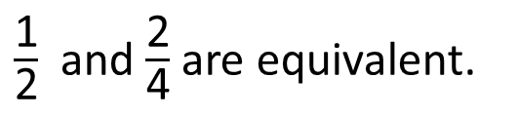


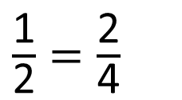



$\frac{\text{1}}{\text{2}}$ and $\frac{\text{2}}{\text{4}}$ are equivalent.
$\frac{\text{1}}{\text{2}}$
$\frac{\text{1}}{\text{2}}$
$\frac{\text{1}}{\text{4}}$
$\frac{\text{1}}{\text{4}}$
$\frac{\text{1}}{\text{4}}$
$\frac{\text{1}}{\text{4}}$
$\frac{\text{1}}{\text{2}}=\frac{\text{2}}{\text{4}}$

Slide 7





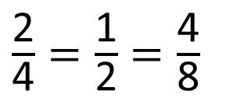








$\frac{\text{1}}{\text{4}}$
$\frac{\text{1}}{\text{4}}$
$\frac{\text{1}}{\text{4}}$
$\frac{\text{1}}{\text{4}}$
$\frac{\text{1}}{\text{8}}$
$\frac{\text{1}}{\text{8}}$
$\frac{\text{1}}{\text{8}}$
$\frac{\text{1}}{\text{8}}$
$\frac{\text{1}}{\text{8}}$
$\frac{\text{1}}{\text{8}}$
$\frac{\text{1}}{\text{8}}$
$\frac{\text{1}}{\text{8}}$
How many eighths are equivalent to a half?
$\frac{\text{2}}{\text{4}}=\frac{\text{1}}{\text{2}}=\frac{\text{4}}{\text{8}}$
Have a think

Slide 8
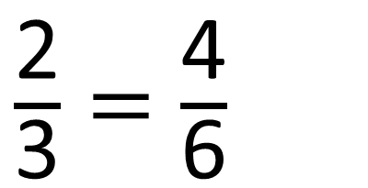
Have a think
$\frac{\text{2}}{\text{3}}=\frac{\text{4}}{\text{6}}$

Slide 9
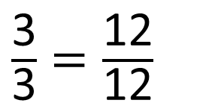
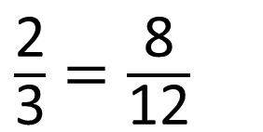
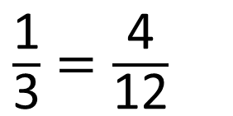
Have a think
$\frac{\text{1}}{\text{3}}=\frac{\text{4}}{\text{12}}$
$\frac{\text{2}}{\text{3}}=\frac{\text{8}}{\text{12}}$
$\frac{\text{3}}{\text{3}}=\frac{\text{12}}{\text{12}}$

Slide 10
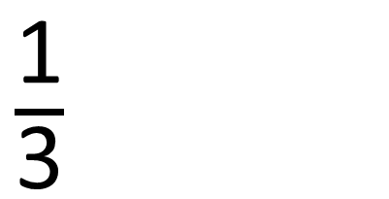
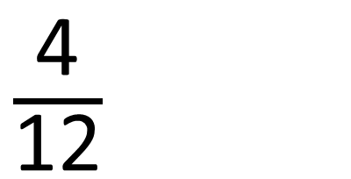
$\frac{\text{4}}{\text{12}}$
$\frac{\text{1}}{\text{3}}$
Have a think

Slide 11
Have a go at questions
1 – 4 on the worksheet

Slide 12
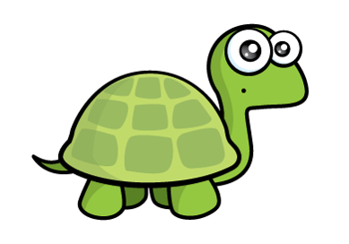

Have a think
I could use any of these bar models to show $\frac{\text{1}}{\text{2}}$

Slide 14
Have a go at the rest of the worksheet

